Slide 1
DIURETICS
M.MUDASSIR NAWAZ

Slide 13
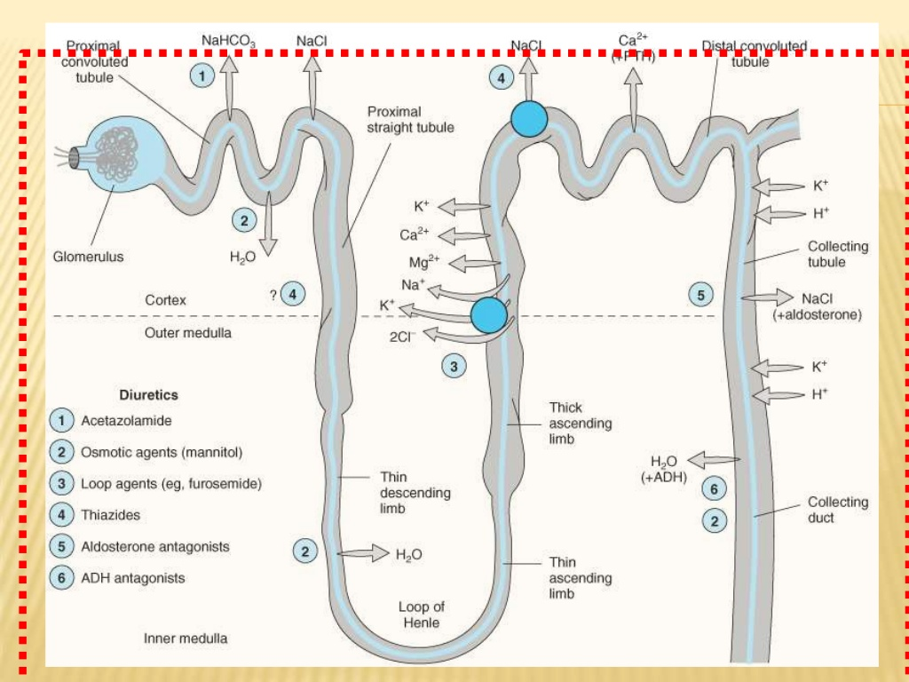

Slide 14
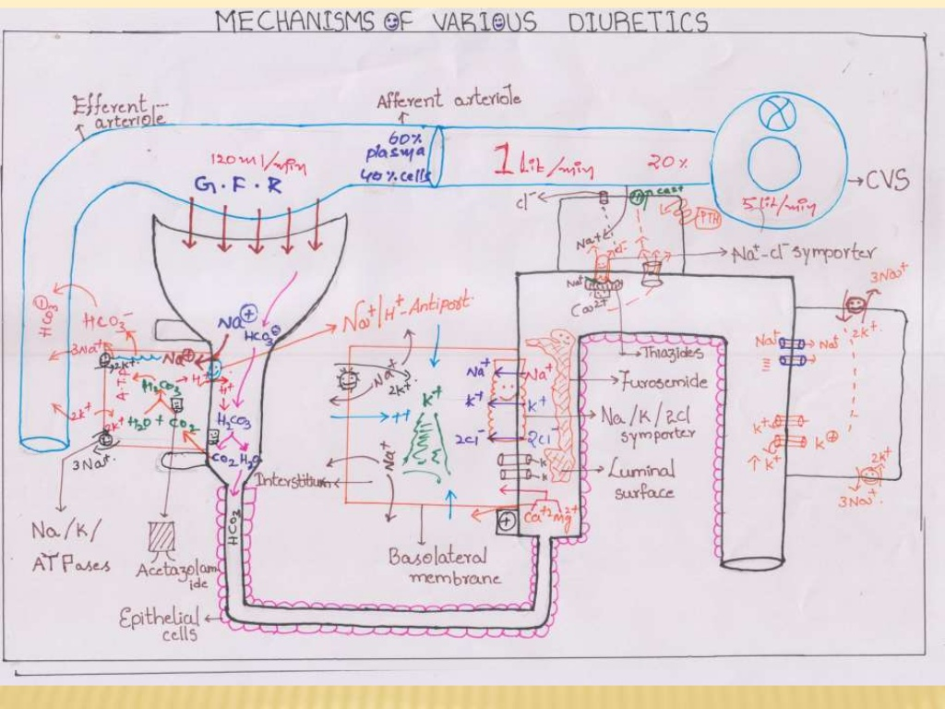

Slide 15
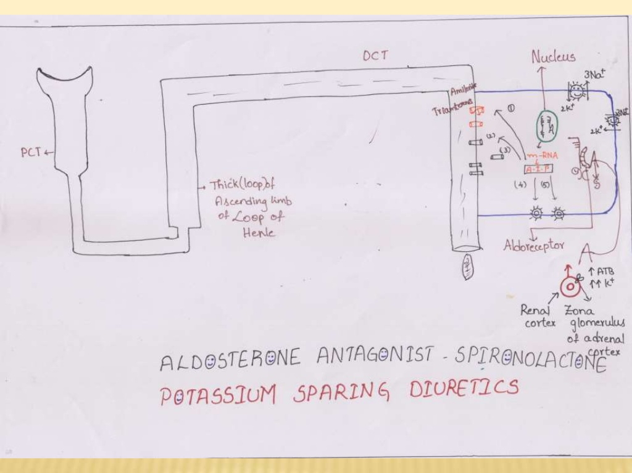

Slide 30
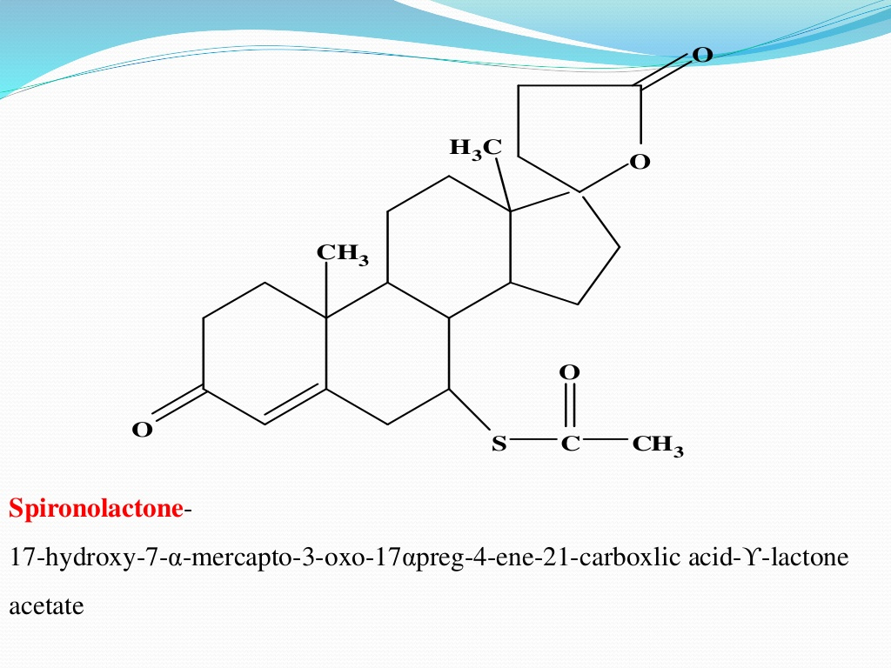

Slide 33
MODELS FOR TESTING ACTIVITY OF DIURETIES

Slide 36
