Slide 1
Topic: Pediatric Pharmacy Practice

Slide 2
Introduction:
Paedetrics consists of 20 to 25% of total world population [1].
Poorly developed organ functions and highest risk of toxicity and poor clinical response are major challenges in paedetric care.
Sulphanilamide elixir- death:

Slide 3
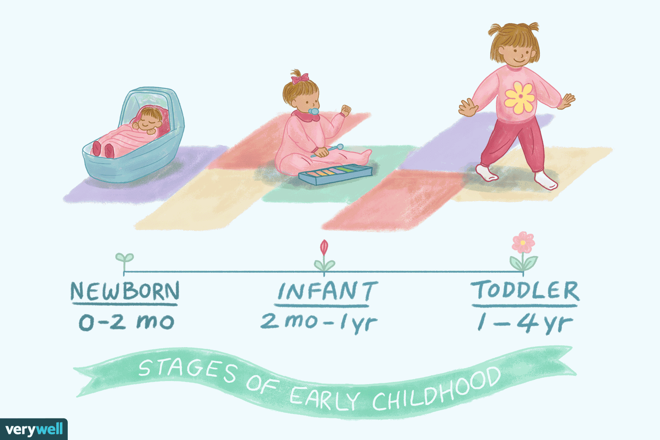
Child Age 3-11.
Adolescent Age 12 onwards.

Slide 4
Why Do We Need Paediatric Pharmacists?
Children are at increased risk of adverse drug events (ADE’s).
Age-based variability in absorption, distribution, metabolism, and excretion of drugs.
Weight and/or body surface area (BSA) need to be considered for each drug for each patient [2].
Paediatric medication orders are more prone to errors than adult orders.
Doses are not standard.
Math errors can occur when calculating the dose [2].
Suspensions often have to be compounded.
Tablets may have to be cut.
Dilutions need to be made to make amounts that are measurable.

Slide 5
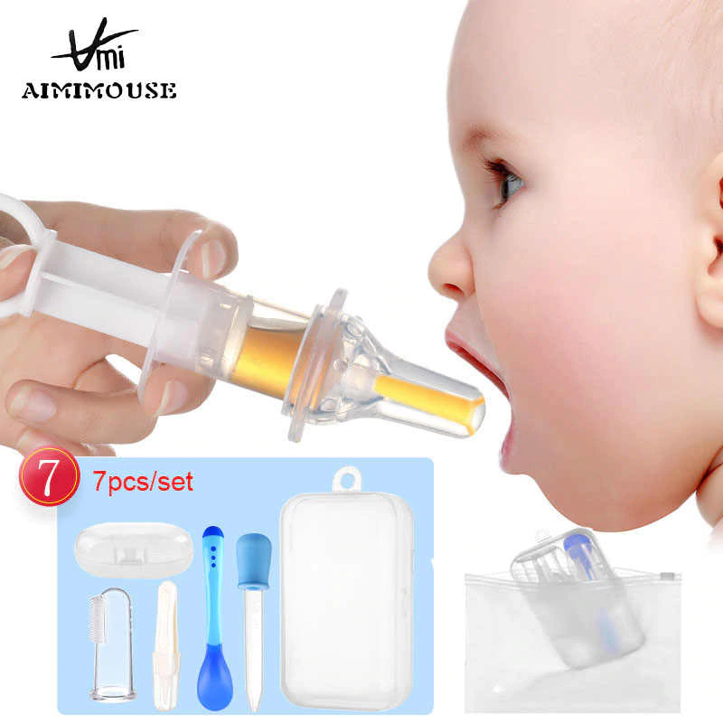
Skills Necessary:
Dosage calculations
Dosage-form selection
Specialized drug preparation and administration techniques [3].
Understanding of PK/PD changes occurring with age
Understanding of disease-specific conditions affecting drug choice or dose [3].
Understanding nature of medication errors in pediatric patients

Slide 6
Special Challenges of Practicing in Pediatrics:
Lack of published information on therapeutic uses and monitoring of drugs [4].
Lack of FDA approval for many drugs used in pediatrics. e.g: The most commonly off‐ label prescribed drugs are ceftriaxone , followed by cloxacillin, gentamycin, and paracetamol.
Lack of appropriate commercially available dosage forms and concentrations of commonly used medications [5].
Inability of patients to communicate with caregivers
Interacting with parents.

Slide 7
Pharmacokinetic considerations:
Absorption – Gastrointestinal:
pH- gastric acid output maturity is related to postnatal age and approaches adult values by 3 months of age
GI motility- neonates have a delay in gastric emptying time, adult values are reached at 6-8 months of age [8].
GI contents- develops rapidly within the first year of life, underdeveloped flora can increase absorption of drugs (digoxin)
Percutaneous Absorption:
Absorption is increased in the newborn due to immature epidermal barrier and increased skin hydration during the first 2 weeks of life [8].
Increased surface area to weight ratio increases percutaneous absorption.

Slide 8
Distribution:
Body Water:
Neonates are 80% body water compared to 55% in adults
Vd is increased for drugs that distribute to aqueous parts of the body (aminoglycosides).
Total body fat is 1% in a 29 wk neonate
Total body fat is 15% in a full term baby
Fat content tends to increase between 5-10 years followed by a decrease through age 17 [9].
Vd is increased for drugs that are highly lipid soluble
Plasma Protein Binding:
Neonates have decreased plasma protein which increases unbound concentrations (ex: Phenytoin may only be 70% bound in a neonate compared to 90% in an adult)

Slide 9
Blood Brain Barrier:
An immature BBB due to incomplete CNS myelination results in increased CNS drug penetration.
Metabolism:
Neonates have decreased activity of many enzyme pathways, that is why drug dosages are decreased for neonates
P450 activity is 50% of adult levels.
Decreased hydroxylation activity leads to decreased metabolism of phenobarbital, phenytoin, lidocaine.
Children have increased hepatic enzyme activity between 2-4 years of age.

Slide 10
Excretion:
At birth, kidney function is decreased, GFR matures first, then tubular secretion, and lastly tubular reabsorption
GFR at birth is 2-4 ml/min, which is 0.5% of an adult level.
After the first week of life, a significant increase in GFR is seen, this explains why recommended doses change after 7 days of life.
At 1 year, GFR reaches 70 ml/min.
At this time period GFR and tubular secretion are more mature than tubular reabsorption and cause an increased renal clearance of drugs (digoxin).

Slide 11
Drug therapy related problems:
Compliance:
PEDIATRIC Drug formulations should be adapted to suit children’s age, size, physiologic condition & treatment requirements [4].
Issues:
1. Difficulty in swallowing conventionally sized tablets.
2. Safety issues with excipients present in adult formulations esp. OTC.
3. Adherence problems with unpalatable medicines.
Patient & Parent education:
dose, timing, route of administration, duration of treatment, storage, desired responses, adverse responses.
To promote compliance:
use convenient drug forms, select dosing forms to fit lifestyle of patients, mix drugs with foods when allowed, returned demonstrations [3].

Slide 12
TOXICITY AND POISONING:
Younger children are at especially high risk of accidental poisoning when they discover and take caregivers’ vitamins or drugs [6].
Infants are also at risk of toxicity from drugs used by adults: -
toxicity can occur prenatally when they are exposed via placental transfer or postnatally when exposed through breast milk.
ABSTINENCE SYNDROME- maternal opiate use.
HYPERSEROTONERGIC STATE- maternal SSRI use.
OPIATE TOXICITY- maternal codeine use for pain management.
Drug-Drug interactions:
Ceftriaxone should be avoided in infants younger than 28 days of age if they are receiving or are expected to receive intravenous calcium-containing products because of reports of neonatal deaths resulting from crystalline deposits in the lungs and kidneys [6].

Slide 13
What is Polypharmacy?
Multiple drugs to treat a single condition, with the same mechanism of action [7].
Polypharmacy is different from medication overuse, which can be defined as, the inappropriate overprescribing of a medication or therapy for treatment of a disease state. Examples of medication overuse include overprescribing asthma medication in children with persistent cough or overprescribing the use of short-acting beta-2 agonists for asthma exacerbations.
For example: Some conscious parents often when their baby suffers from a mild cough or a sore throat they use nebulizer.
Pharmacists have a unique opportunity to improve health care for pediatric patients by participating in the detection of polypharmacy through clinical pharmacy practice (making interventions, completing medication histories, discharge counseling) in the inpatient setting, and activities like medication reconciliation in the outpatient setting [7].

Slide 14
Paedetric dose calculation:

Slide 18
Conclusion:
Children are often called “therapeutic orphans”.
Inadequate research data for prescribers to ensure safe dosing d/t inability to get consent, impact of ontogeny on drug disposition [6].
Special methods of drug administration are needed for infants and young children.
Many medicines needed for pediatric patients are not available in appropriate dosage forms; thus, the dosage forms of drugs marketed for adults may require modification for use in infants and children, necessitating assurance of potency and safety of drug use [5].
The pediatric medication-use process is complex and error-prone because of the multiple steps required in calculating, verifying, preparing, and administering doses.

Slide 19
References:
1- Nelson’s textbook of Pediatrics (1ST SOUTH ASIA EDN.)
2- Vernacchio L, Kely J, Kaufman DW, Mitchell AA. Medication use among children <12 years of age in the United States: results from the Slone Survey. Pediatrics. 2008;124:446–454
3- PHARMACOTHERAPY(A PATHOPHYSIOLOGIC APPROACH) 8TH EDN:Chap. 10: Pediatrics Milap C. Nahata; Carol Taketomo
4- Pediatric Drug Formulations: A Review of Challenges and Progress. pediatrics/aappublications.org Verica Ivanovska, Carin M.A. Rademaker, Liset van Dijk, Aukje K. Mantel-Teeuwisse
5- FDA: Development of Drug Therapies for Newborns and Children The Scientific and Regulatory Imperatives Yeruk (Lily) Mulugeta, PharmDa, *, Anne Zajicek, PharmD, MDb , Jeff Barrett, PhDc , Hari Cheryl Sachs, MDa , Susan McCune, MDa , Vikram Sinha, PhDd , Lynne Yao, Mda
6- The STEP (safety and toxicity of excipients for paediatrics) database: part 2–the pilot version

Slide 20
7- Choosing medications wisely: Is it time to address paediatric polypharmacy?
8- JointCommission.org Hospital: 2015 National Patient Safety Goals. [Accessed March 1, 2015]. Available from: http://www.jointcommission.org/hap_2015_npsgs/
9- JCS JOINT WORKING GROUP: 2012 GUIDELINES ON PEDIATRIC DRUG THERAPY IN CARDIOVASCULAR DISEASES.
10- Oswald DP, Soneklar NA. Medication use among children with autism-spectrum disorders. J Child Adolesc Psychopharmacol. 2007;17:348–355

