Slide 2
FISH AND SHELL FISH
INTRODUCTION
COMMERCAIL IMPORTANCE
NUTRITIONAL IMPORTANCE
PROCESSING
PRODUCTS
PRESERVATION
QUALITY CONTROL

Slide 3
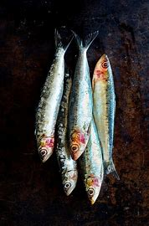
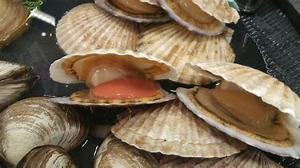
FISH AND SHELL FISH
Fish are aquatic vertebrates with gills for breathing and fins for swimming
Shell fish are aquatic invertebrates with shells and carapaces

Slide 4
FISH
Fish that are found in fresh water are round in shape and white in color
Fish that are found in salt water are flat fish and are oily fish
Both types of fish have eyes on both sides, on the top of head
Top of their bodies is darker while bottom is lighter in color
41% of fish species are found in fresh water

Slide 5
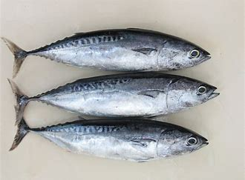
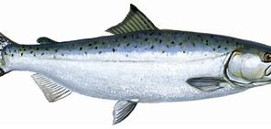
FISH
There are 531 species of Fish in Pakistan, 233 of them are of fresh water

Slide 6
COMMERCIAL IMPOTANCE OF FISH
Fish provides more than one billion poor people with most of their daily animal protein
Fish provides nutrients and micronutrients that are essential to cognitive and physical development, especially in children, and are an important part of a healthy diet
Globally, more than 250 million people depend directly on fisheries and aquaculture for their livelihoods and millions are employed in fisheries

Slide 7
NUTRITIONAL IMPOTANCE OF FISH
Fish is packed with many nutrients that includes high-quality protein, iodine, and various vitamins like Vit D and minerals
It provides omega-3 fatty acids which is essential for brain and eye development
Heart attacks and strokes are the two most common causes of premature death in the world, Fish is considered one of the most heart-healthy food
Autoimmune diseases like type 1 diabetes occur when immune system mistakenly attacks and destroys healthy body tissues, fish helps in preventing it
Consuming fish can prevent chronic illness such as asthma
It also improve sleep quality and prevents sleep disorders

Slide 8
FISH PROCESSING
Fish processing involves following steps
1.WASHING
After the harvesting of fish, it is washed with water to remove any form of contamination and slime from the fish body
2.GRADING
Manually grading and sorting is done to separate different groups of fish
3.SCALING
Using sharp ends, scales are removed from head to toe

Slide 9
FISH PROCESSING
4.TRIMMING
To remove all the fins, trimming of fish is done
5.GUTTING
Removal of gills by cutting the throat connection, knife is run along the belly and all viscera are removed
6.DEHEADING AND WASHING
Head is removed and fish is thoroughly washed
7.SIZE REDUCTION
There are numerous market forms in which size of fish is removed

Slide 10
SEA FOOD PROCESSED PRODUCTS
1)Fish mince
Flesh separated from bones is fish mince
2)Surimi
It is a concentrate of fish proteins obtained from fish muscles
3)Fish oil
Oil derived from the tissues of fish
4) Fish meal
After removal of oil, remaining portion is fish meal

Slide 11
FISH MICROBIOLOGY
The microorganisms associated with fish are
Yersinia enterocolitica
Clostridium botulinum
Listeria monocytogenes
Hepatitis A
Norwalk virus

Slide 12
FISH BIOCHEMISTRY
Scombroid food poisoning, also known as simple scombroid, is a foodborne illness that typically results from eating spoiled fish
Symptoms may include flushed skin, headache, itchiness, blurred vision, abdominal cramps, and diarrhea
Scombroid occurs from eating fish high in histamine due to inappropriate storage or processing
Onset of symptoms is typically 10 to 60 minutes after eating and can last for up to two days

Slide 13
FISH BIOCHEMISTRY
Ciguatera fish poisoning (CFP)is a foodborne illness caused by eating reef fish whose flesh is contaminated with toxins
Symptoms may include diarrhea, vomiting, numbness, itchiness, sensitivity to hot and cold, dizziness, and weakness
The onset of symptoms varies with the amount of toxin eaten from half an hour to up to two days
Some symptoms typically remain for a few weeks to months
Heart difficulties such as slow heart rate and low blood pressure may also occur

Slide 14
FISH PRESERVATION
1.CHILLING
Just after catching, fish is stored at 0C which slows down the microbial growth, chemical and biochemical reactions
2.FREEZING
Fish stored at -18C which inactivates all the microbial growth and extend the shelf life of fish
3.FISH CURING
Salt is a primary ingredient used to cure fish and other foods
Removal of water and addition of salt to fish creates a solute rich environment where osmotic pressure draws water out of microorganisms, retarding their growth

Slide 15
FISH PRESERVATION
4.FISH SMOKING
Fish can also be preserved by smoking, which is drying the fish with smoke from burning or smoldering plant materials, usually wood Smoking helps seal the outer layer of the food being cured, making it more difficult for bacteria to enter
5.FISH CANNING
Canned fish are fish which have been processed. sealed in an airtight container such as a sealed tin can, and subjected to heat. Canning is a method of preserving food, and provides a typical shelf life ranging from one to five years

Slide 16
FISH QUALITY CONTROL
Degree of acceptability by consumer
1.Sensory evaluation
Sensory evaluation is defined as “a scientific discipline used to invoke, measure, analyze, and interpret reactions to characteristics of foods and materials as they are perceived by the senses of sight, smell, taste, touch, and hearing”
Rheometer: used for texture analysis
Microscopic analysis for structural change
Artificilance for odor profile

Slide 17
FISH QUALITY CONTROL
Quality Index Method (QIM)
The Quality Index Method (QIM) is based upon objective evaluation of certain attributes of raw fish (skin, eyes, gills etc) using a points scoring system (from 0 to 3).
The scores for all the attributes are then added to give an overall sensory score, the so-called quality index. The quality index increases linearly with keeping time in ice. Therefore the total demerit score can also be used to predict the remaining shelf life

Slide 18
FISH QUALITY CONTROL
2.Chemical and Biochemical methods
Total volatile basic amines like ammonia, dimethyl amine etc are measured using Conway method
Biogenic amines are measured by using HPLC and GC chromatographic techniques
Oxidative rancidity is also measured by GC

Slide 19
FISH QUALITY CONTROL
3.Physical methods
GR Terrymeter is used to measure the properties of skin and tissue after death
The pH meter is used to access the fish quality
4.Microbiological methods
Total count is also known as total plate count, all live bacteria in sample appears through it
Direct Epiflouresecence filter technique used to access live and dead sample both

