Slide 1
Citrus Withertip
Dr. Salman Ahmad
April 10, 2020

Slide 2
Etiology:
Causal organism: Colletotrichum gloeosporides

Slide 3
Symptoms:
Shedding of leaves and die back of twigs.
Dead twigs give silvery appearance.
Reddish brown stain (color) on fruit rind*(outer skin of fruit).

Slide 4
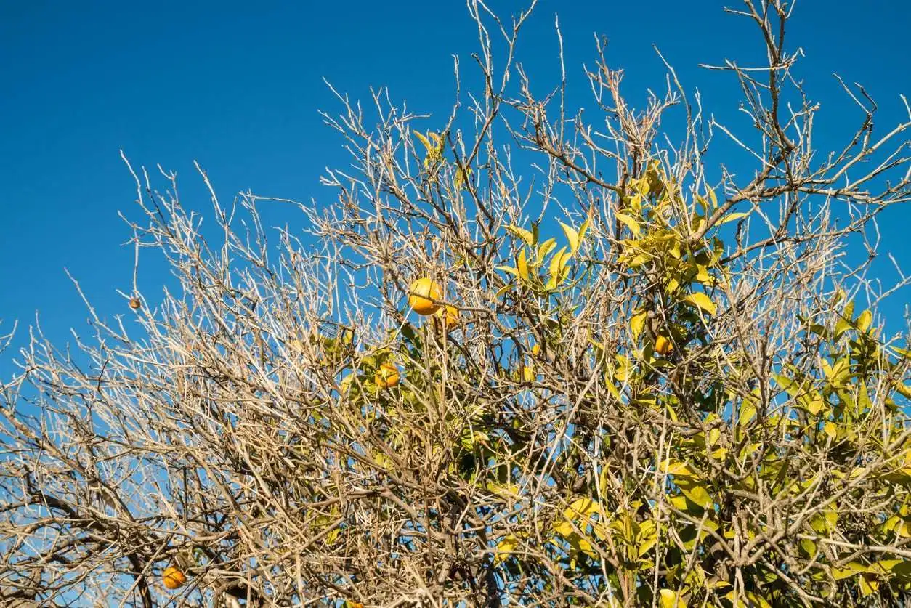
Symptoms:

Slide 5
Disease cycle:
Infected twigs and branches are source of infection.
Spores spread through air to new plantation.
Wounds provide the entry points for the pathogen.

Slide 6
Epidemiology:
Temperature 22-26°C
High relative humidity

Slide 7
Management:
Pruning of infected twigs and branches followed by spray of fungicides.
Bordeaux paste at 1:2:12, i.e. 1 kg of copper sulphate and 2 kg of lime mixed in 12 litres of water.
Spray of 0.33% prenox.
Spray copper based fungicides e.g. copper oxychloride 3 ml per litre of water starting in July and repeat twice with an interval of 21 days. Difenoconazole 3ml per litre of water also show good results.
Avoid overhead irrigation

