Slide 1
Histology Of Thyroid Gland and Parathyroid Gland
Dr Muhammad Aaqib Riaz
Anatomy Department
Sargodha Medical College

Slide 2
Thyroid Gland
Thyroid is a bilobed organ which is located in anterior aspect of neck
Two lobes of thyroid are connected with each other by the isthmus in front of trachea.

Slide 3
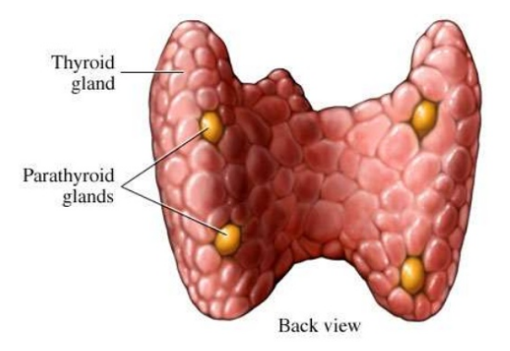

Slide 4
Microscopic Features of Thyroid Gland
Capsule:
It is covered by a thin connective tissue capsule.
Many septa arise from capsule which convey blood vessels, nerves and lymphatics into the gland.
Parenchyma:
The parenchyma consist of hollow, spheroidal structures called thyroid follicles and parafollicular cells.

Slide 5
Thyroid Follicles
Consist of single layer of cells called follicular cells. These cells rest on basement membrane
The CT between thyroid follicles contains
Capillaries
Nerves
Lymphatics

Slide 6
Thyroid Follicles
Lumen of follicles is filled with colloid material
In resting state, follicular cells are cuboidal
In actively secreting state, follicular cells are tall and amount of colloid decreases
In less active state, amount of colloid is more and follicular cells become flat

Slide 7
Thyroid Follicles
Colloid is formed by follicular cells
Main component of colloid is thyroglobulin which is inactive form of thyroid hormone

Slide 8
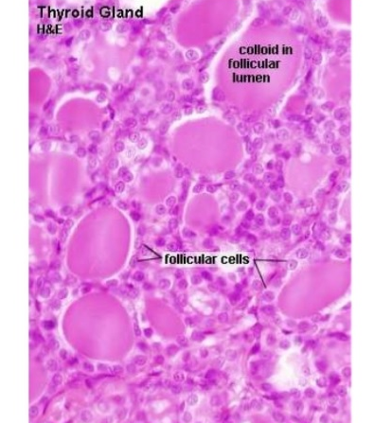

Slide 9
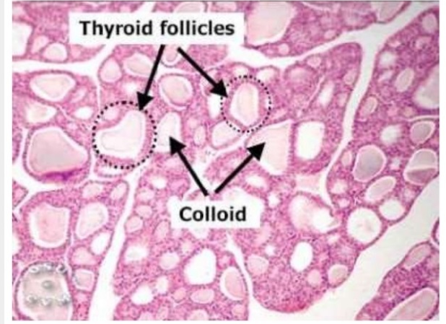

Slide 10
Thyroid Follicles
Follicular cells have spherical nucleus containing one or two nucleoli
Luminal surface of follicular cells have microvilli
Basal cytoplasm have numerous RER, SER, Golgi complex and colloid resorption droplets

Slide 11
Parafollicular cells
Parafollicular cells are also called C cells
These are present in cluster of connective tissue in between the follicles
These are also present as single cell within the follicle
Within the follicle they are located away from the colloid adjacent to the basement membrane
These cells secrete calcitonin hormone which reduces the blood calcium level by reducing bone resorption by osteoclats

Slide 12
Hormones Of Thyroid Gland
Thyroid hormone
Increases the basal metabolic rate
Essential for body growth
Essential for development of CNS
Calcitonin
is secreted by parafollicular cells
Antagonises the action of parathyroid hormone
Reduced the blood calcium level, thus helps to maintain blood calcium level

Slide 13
SYNTHESIS & STORAGE OF THYROID HORMONE
Thyroglobulin is synthesized by RER and then carried to Golgi complex
Where it is packed into vesicles
These vesicles are then transported to apical surface of follicular cells
Where thyroglobulin is discharged into lumen of follicles by exocytosis

Slide 14
Iodide uptake
under the influence of TSH
Follicular cells take iodide from blood
Iodide is oxidized to iodine by enzyme thyroid peroxidase
Iodination of thyroglobulin
occurs at luminal surface of follicular cells which forms Triiodothyronine (T₃) and Tetraiodothyronine (T₄).
Also known as Thyroxine

Slide 15
RELEASE OF THYROID HORMONE
Occurs due to stimulation of follicular cells by TSH which results in release of T₃ and T₄

Slide 16
CONTROL OF THYROID HORMONE
Hypothalamus
Adenohypophysis
Thyroid gland
T₃ and T₄
TRH
TSH

Slide 17
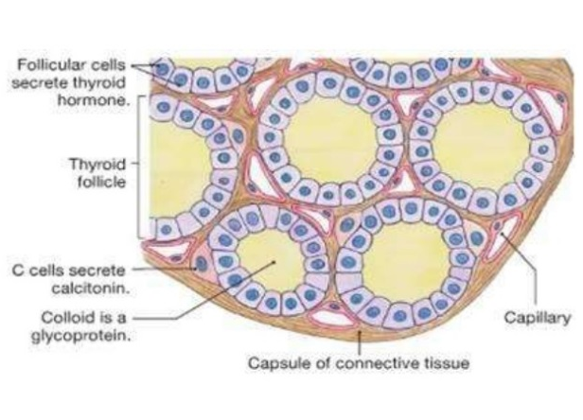

Slide 18
Parathyroid Gland
Two pairs of parathyroid glands
Embedded in capsule of thyroid on its posterior aspect

Slide 19
Microscopic Features
Parathyroid contains two types of cells
Principal or Chief cells
Oxyphil cells
Chief cells
Secrete parathyroid hormone
Most numerous cells
Polygonal in shape
Arranged in clumps or cords
Cytoplasm of cells shows numerous secretery granules

Slide 20
Each cell has centrally located spherical nucleus
Large capilliries are present in between the cords and clumps of cells

Slide 21
Oxyphil Cells
Large in size but fewer in number than chief cells
Arranged in clumps
Function is not clear

Slide 22
PARATHYROID HORMONE (PTH)
Secreted by chief cells
Raises blood calcium level
Acts on three different sites to increase blood calcium level i.e., bone, kidney and intestine
In bone, PTH acts on osteoclasts and increases the bone resorption

Slide 23
In kidney, PTH decreases the phosphate resorption in proximal tubules and increases calcium resorption in distal tubules
In small intestine, PTH increases absorption of calcium

Slide 24
CONTROL OF PARATHYROID SECRETION
Secretion of parathyroid is regulated by blood calcium level by negative feedback mechanism
The low blood calcium level stimulates gland to produce and secrete PTH
Increase in blood calcium level inhibits parathyroid gland

Slide 25
