Slide 1
Earn from development
In-app purchases

Slide 2
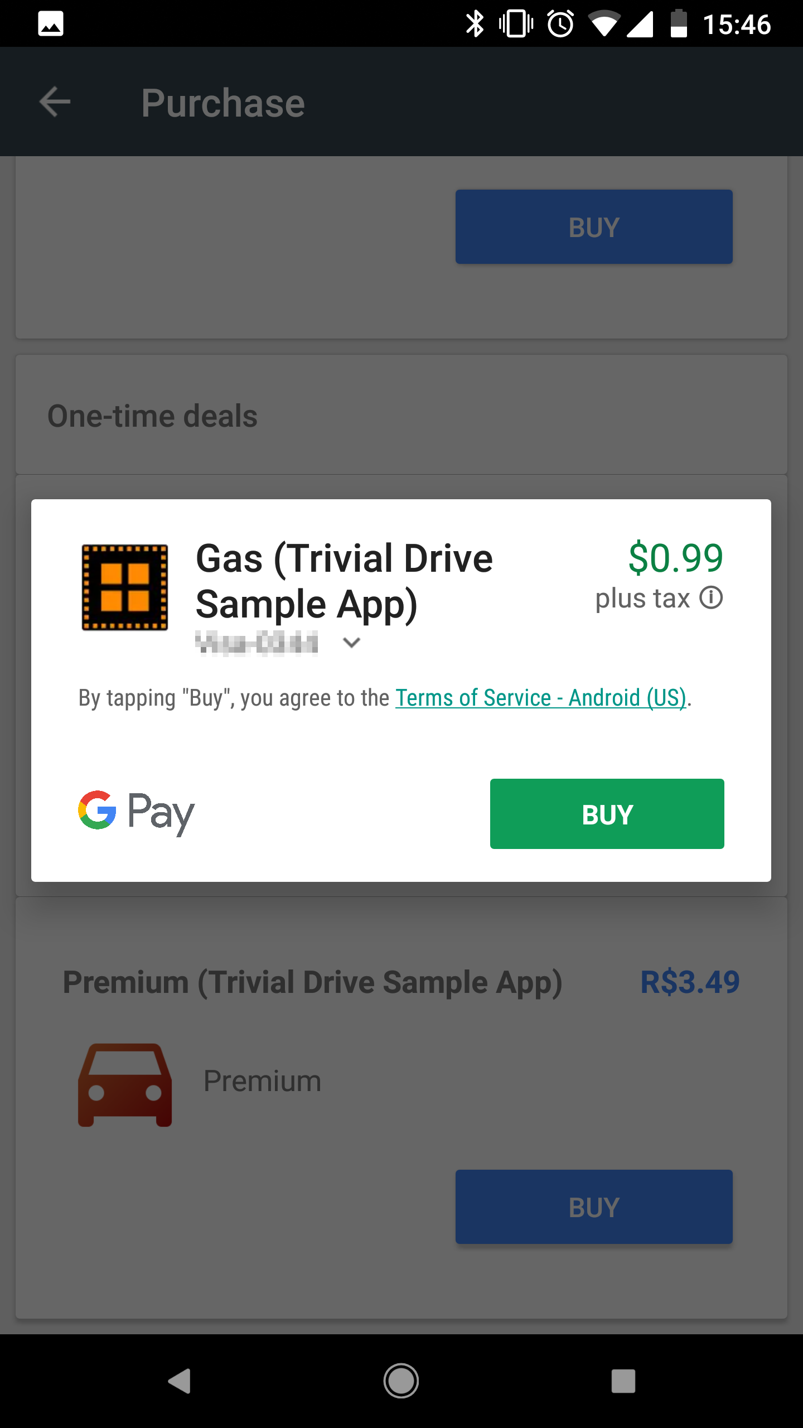
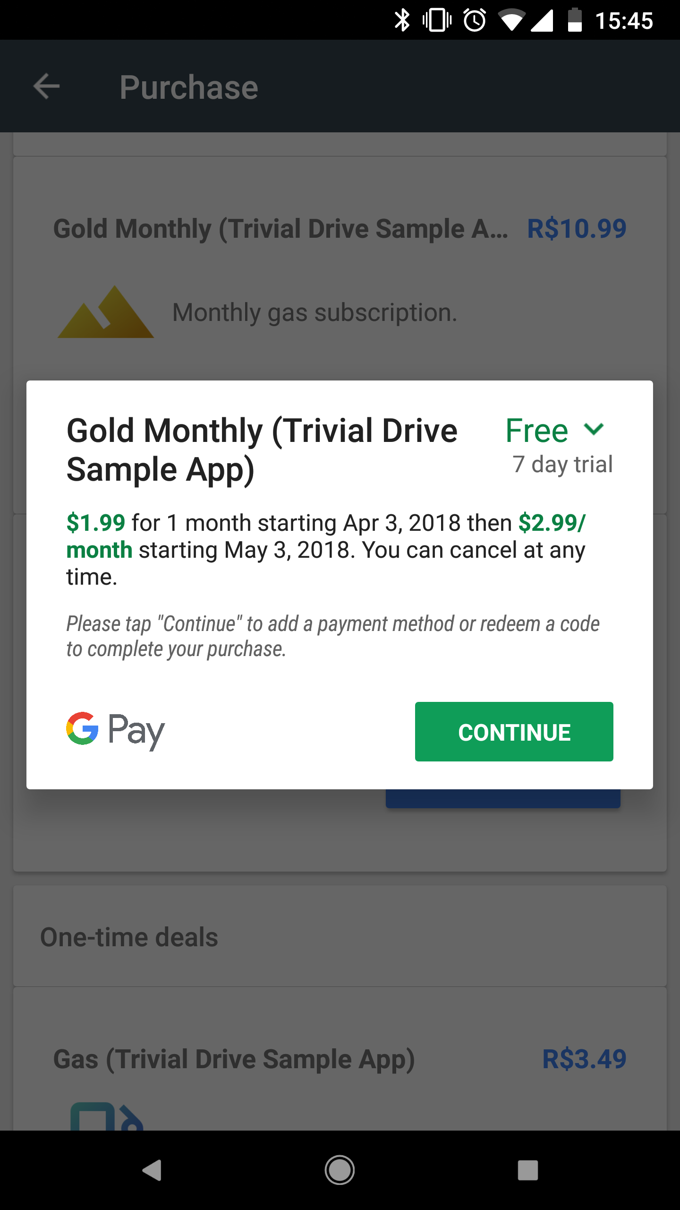

Slide 3
Overview: Choosing monetization model
To maximize your revenue, consider multiple monetization models for your app. Different audiences have different preferences for paid apps, in-app purchases, subscriptions, ads, and e-commerce.
Monetization options:
In-app purchases: Use Google Play Billing to sell items and additional features, or to remove ads. Take advantage of automatic conversion to local prices, with options to round for local pricing patterns or set local prices yourself, pricing templates, promotion codes, and the ability to sell both durable and consumable virtual goods.

Slide 4
Overview: Choosing monetization model
Subscriptions: Use Google Play Billing to offer users ongoing access to content or services for a recurring fee. Use features such as flexible billing frequencies, free trials, introductory and local pricing, payment grace periods, upgrades and downgrades, price changes, conversion analytics, and billing reports and dashboards.
Advertising: Get paid for showing Google AdMob ads, including features such as native ads that allow you to match ads to your app’s look and feel.

Slide 5
Overview: Choosing monetization model
Rewarded Products: Using Google technology and advertiser demand, provide your users with rewarded videos. You use the same integration used for in-app purchases on Google Play and the products are managed in the Play Console.
Paid apps: Set a price for your app that the user must pay before they can download and install it. Here, you can also take advantage of automatic local pricing (or set prices yourself), promo codes, and pricing templates.
E-commerce: Use Google Pay to sell physical goods and services from your app. Take advantage of user familiarity with their payment methods and a simplified checkout while continuing to use your clearance provider and processes.

Slide 6
Best Practices for setting your initial monetization strategy
Research other apps in your category. Learn how other developers charge for their apps and content. Consider whether there are benefits in breaking from the norm and offering users alternative ways to pay.
Think about how your app will be used. Your app’s use patterns can guide the best monetization choices. The more casual the use is likely to be, the more appropriate advertising or in-app purchases are for monetization. However, always consider offering an in-app purchase that removes ads.
Make use of natural extensions. If your app can be extended or expanded, such as adding levels in a game, consider making the core app available for free and offering extended features through in-app purchases or subscriptions.

Slide 7
Best Practices for setting your initial monetization strategy
Consider your cost structures. If you have significant recurring content costs, consider using subscriptions. Use a free trial period to encourage uptake.
Take your audience into account. For some audiences, the scope for using advertising, subscriptions, or in-app purchases is limited. For example, users are more likely to pay for an ad-free, kid-friendly app than a casual use app. In these cases, premium (paid) apps are more appropriate.
Consider local factors when setting prices. When setting prices for apps, in-app purchases, or subscriptions in specific markets consider cost of living differences, local pricing patterns, the pricing of competitive apps, and other market factors.

Slide 8
Sell digital purchases with Play In-app Billing
When you use Google Play In-app Billing to sell items, Google Play handles the checkout details so your app never has to process financial transactions. Your app will use the same checkout flow which is used for content purchases on Google Play, so users will get a familiar, reliable, and secure experience.
How to do it:
Determine what content or features you want to sell as digital goods.
Set-up a Google Wallet Merchant Account in the Google Play Console.
Define your in-app products in the Play Console, choosing between durables (once purchased, always available to the user) and consumables (items used a limited number of times or for a set period of time).
Integrate the In-app Billing API into your app.
Add mechanisms to unlock features or deliver content to your app.

Slide 9
Problems with in-app purchases
With some apps, you can buy additional content or services within the app. We call these "in-app purchases." Examples include a powerful sword in a game, a key that unlocks more features of a free app, or virtual currency used for purchases.
If your in-app purchase is not showing up, is not working, or won’t download, you can:
Troubleshoot the issue on your own.
Contact the developer for support.
Request a refund

Slide 10
In-app product -types
Google Play Billing can be used to sell the following types of in-app products:
One-time products: An in-app product requiring a single, non-recurring charge to the user's form of payment. Additional game levels, premium loot boxes, and media files are examples of one-time products. The Google Play Console refers to one-time products as managed products, and the Google Play Billing library calls them "INAPP".
Subscriptions: An in-app product requiring a recurring charge to the user's form of payment. Online magazines and music streaming services are examples of subscriptions. The Google Play Billing Library calls these "SUBS"

Slide 11
Purchase tokens and order IDs
Google Play Billing tracks products and transactions using purchase tokens and order IDs.
A purchase token is a string that represents a buyer's entitlement to a product on Google Play. It indicates that a Google user has paid for a specific product, represented by a SKU.
An order ID is a string that represents a financial transaction on Google Play. This string is included in a receipt that is emailed to the buyer, and third-party developers use the order ID to manage refunds in the Order Management section of the Google Play Console. Order IDs are also used in sales and payout reports.

Slide 12
Purchase tokens and order IDs
For one-time products, every purchase creates a new token and a new order ID.
For subscriptions, an initial purchase creates a purchase token and an order ID. For each continuous billing period, the purchase token stays the same and a new order ID is issued. Upgrades, downgrades, and re-signups all create new purchase tokens and order IDs.

Slide 13
In-app product configuration
One-time products and subscriptions have several common configurable options within the Google Play Console. Following are the most important common configurable options:
Title - A short description of the in-app product, such as “loot box.”
Description - A longer description of the in-app product, such as “A special in-game treasure chest containing useful stuff for your character.” This field may be used in your app's store listings page to describe your in-app product.
Product ID - A unique, human readable ID for your product. Product IDs are also called SKUs in the Google Play Billing Library.

Slide 14
In-app product configuration
Price / Default Price - The amount the user will pay for the in-app product. Default price has a slightly different meaning depending on the type of in-app product:
The default price for a one-time product reflects the amount (in that user’s preferred currency) the user will be charged for the product. The default price is charged to the customer once for each one-time product purchase.
The default price for a subscription is the price the user will be charged in that user’s preferred currency after they enter a regular billing cycle (subscriptions can have free trial and introductory pricing too). The default price is charged to the customer on a recurring basis for each subscription that a user has purchased.
A single app can have multiple in-app products available for purchase, each with a different Product ID and price. The Google Play Console provides pricing templates which are used to easily configure several in-app products that share the same price.

Slide 15
Unique subscription product configuration
The Google Play Console offers a lot of flexibility when creating subscription products. Following is a list of the options available for your subscription products:
Billing period: The frequency at which a user is charged while their subscription is active. You can choose between weekly, 1 month, 3 months, 6 months, and annual billing periods in the Google Play Console.Billing continues indefinitely at the interval and price specified for the subscription. At each subscription renewal, Google Play charges the user account automatically, then notifies the user of the charges afterward by email.
Free trial period: An amount of time during which a user may access a subscription without being billed. A free trial period is a way to entice users to try your subscription before committing to purchase it. You can set a free trial period of 3 or more days.

Slide 16
Unique subscription product configuration
Introductory price: The price of the subscription over a certain number of initial, “introductory” billing periods. Introductory price is a way to entice users to try your subscription while simultaneously gaining some revenue. The Introductory price must be less than the subscription's normal price.
Grace period: The amount of time a user’s subscription will remain active, giving the user additional time to fix their payment issue. A grace period starts when a user's form of payment, such as a credit card, is declined.
Account hold: The state a subscription can enter when a user does not update their form of payment during the grace period. Account hold lasts 30 days during which time the subscription content is not available to the user.

Slide 17
Coding Practice
https://developer.android.com/google/play/billing/billing_library_overview
https://github.com/anjlab/android-inapp-billing-v3

