Slide 1
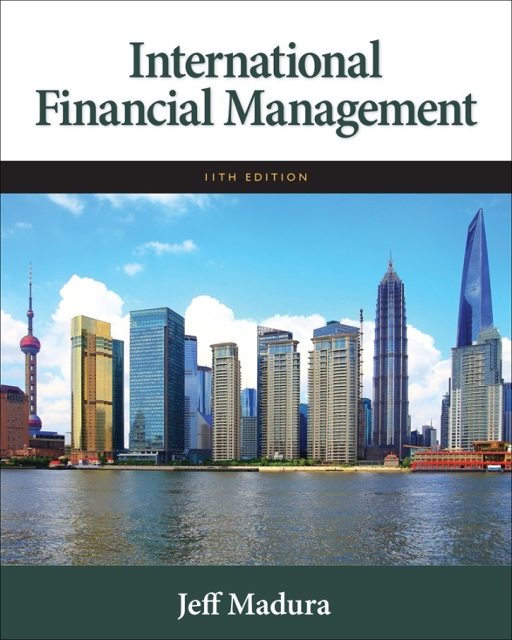

Slide 2
12
Managing Economic Exposure and Translation Exposure
Chapter Objectives
Explain how an MNC’s economic exposure can be hedged
Explain how an MNC’s translation exposure can be hedged
2

Slide 3
Managing Economic Exposure
Economic exposure represents the impact of exchange rate fluctuations on a firm’s future cash flows. (Exhibit 12.1)
Assessing economic exposure
An MNC must measure its exposure to each currency in terms of its cash inflows and cash outflows. (Exhibit 12.2)

Slide 4
Managing Economic Exposure
Restructuring to reduce economic exposure, e.g.:
Increase sensitivity of revenues to exchange rate movements.
Decrease sensitivity of expenses to exchange rate movements. (Exhibit 12.3 & 12.4)
Expediting the Analysis with Computer Spreadsheets
Determining the sensitivity of cash flows (ignoring tax effects) to alternative exchange rate scenarios can be expedited by using a computer to create a spreadsheet similar to Exhibit 12.3.

Slide 5
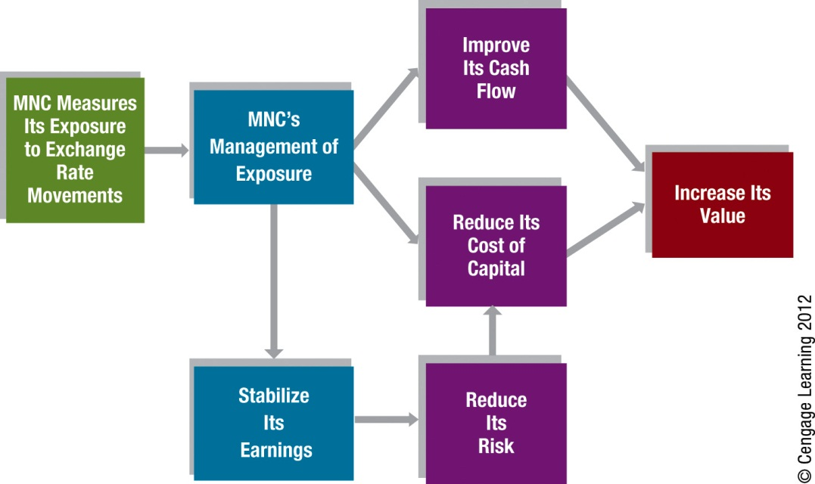
Exhibit 12.1 How Managing Exposure Can Increase an MNC’s Value

Slide 6
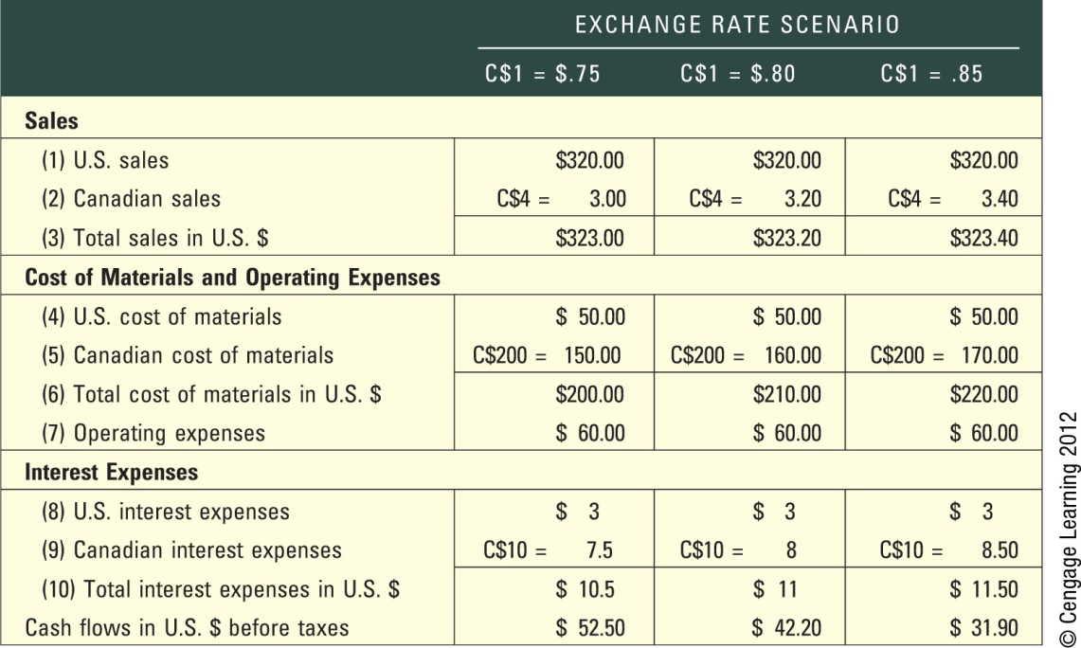
Exhibit 12.2 Original Impact of Possible Exchange Rates on Cash Flows of Madison Co. (in Millions)

Slide 7
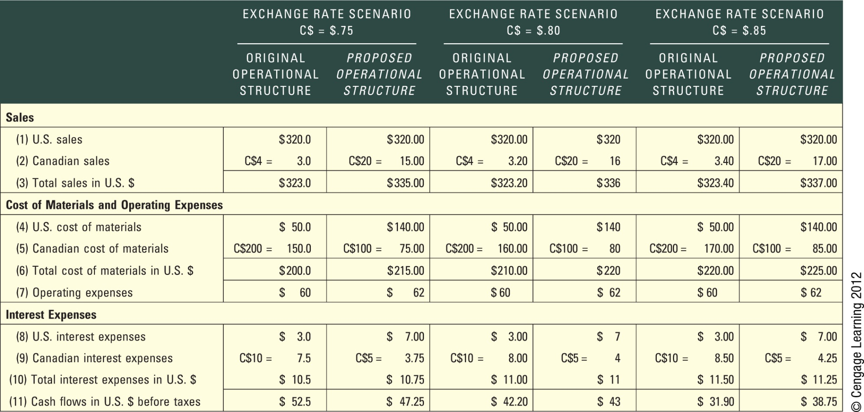
Exhibit 12.3 Impact of Possible Exchange Rate Movements on Earnings under Two Alternative Operational Structures (in Millions)

Slide 8
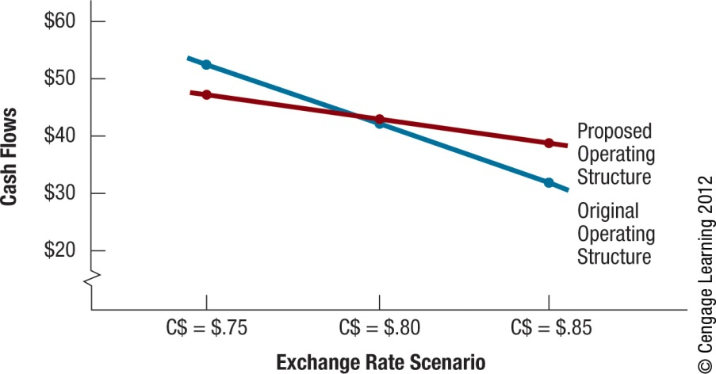
Exhibit 12.4 Economic Exposure Based on the Original and Proposed Operating Structures

Slide 9
Issues Involved in the Restructuring Decision
Should the firm attempt to increase or reduce sales in new or existing foreign markets?
Should the firm increase or reduce its dependency on foreign suppliers?
Should the firm establish or eliminate production facilities in foreign markets?
Should the firm increase or reduce its level of debt denominated in foreign currencies?

Slide 10
Exhibit 12.5 How to Restructure Operations to Balance the Impact of Currency Movements on Cash Inflows and Outflows

Slide 11
A Case on Hedging Economic Exposure: Savor Co., a U.S. firm with exposure to the Euro
Assessment of economic exposure: assess the relationship between the euro’s movement and each unit’s cash flows over last 9 quarters.
Assessment of each unit’s exposure using regression analysis
Identifying the source of each unit’s exposure
See Exhibit 12.6

Slide 12
A Case on Hedging Economic Exposure: Savor Co., a U.S. firm with exposure to the Euro
Possible strategies to hedge economic exposure:
Pricing policy
Hedging with forward contracts
Purchasing foreign supplies
Financing with foreign funds
Revising operations of other units

Slide 13
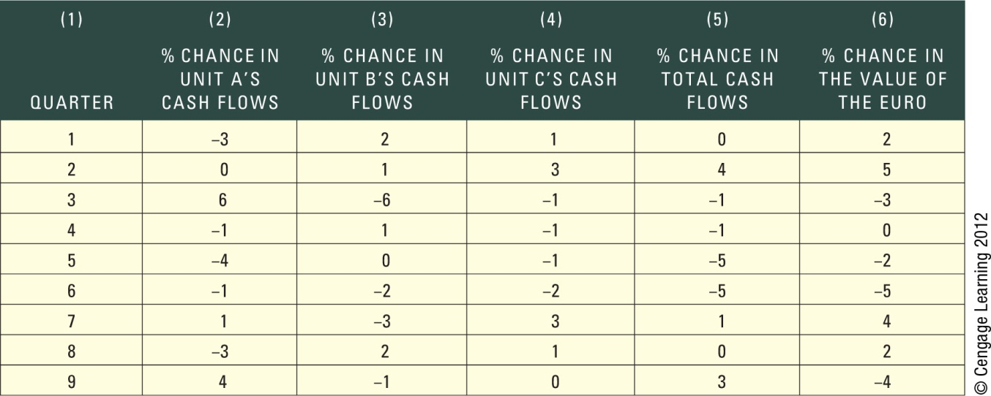
Exhibit 12.6 Assessment of Savor Co.’s Cash Flows and the Euro’s Movements

Slide 14
A Case on Hedging Economic Exposure: Savor Co., a U.S. firm with exposure to the Euro
Savor’s Hedging Strategy: instruct other units to do their financing in Euros as well
Limitations of Savor’s Optimal Hedging Strategy: impact of Euro’s movements on Savor’s cash outflows is known with certainty but impact on cash inflows is uncertain.

Slide 15
Hedging Exposure to Fixed Assets
Hedging the sale of fixed assets by:
Selling the currency forward in long-term forward contract
Creating a liability in that currency that matches the expected value of the assets in the future.
Limitations of hedging the sale of fixed assets:
MNC may not know the date when it will sell the assets
MNC may not know the price in the local currency at which it will sell them.

Slide 16
Managing Translation Exposure
Translation exposure occurs when each subsidiary’s financial data is translated to its home currency for consolidated financial statements.
Translation exposure can be hedged with forward or futures contracts.

Slide 17
Managing Translation Exposure
Limitations of hedging translation exposure:
Inaccurate earnings forecasts - earnings in a future period are uncertain.
Inadequate forward contracts for some currencies - forward contracts are not available for all currencies.
Accounting distortions - the forward rate gain or loss reflects the difference between the forward rate and the future spot rate, whereas the translation gain or loss is caused by the change in the average exchange rate over the period in which the earnings are generated.
Increased transaction exposure – the MNC may be increasing its transaction exposure

Slide 18
SUMMARY
Economic exposure can be managed by balancing the sensitivity of revenue and expenses to exchange rate fluctuations. The firm must first recognize how its revenue and expenses are affected by exchange rate fluctuations. For some firms, revenue is more susceptible. These firms are most concerned that their home currency will appreciate against foreign currencies since the unfavorable effects on revenue will more than offset the favorable effects on expenses. Conversely, firms whose expenses are more sensitive to exchange rates than their revenue are most concerned that their home currency will depreciate against foreign currencies. When firms reduce their economic exposure, they reduce not only these unfavorable effects but also the favorable effects if the home currency value moves in the opposite direction.

Slide 19
SUMMARY (Cont.)
Translation exposure can be reduced by selling forward the foreign currency used to measure a subsidiary’s income. If the foreign currency depreciates against the home currency, the adverse impact on the consolidated income statement can be offset by the gain on the forward sale in that currency. If the foreign currency appreciates over the time period of concern, there will be a loss on the forward sale that is offset by a favorable effect on the reported consolidated earnings. However, many MNCs would not be satisfied with a “paper gain” that offsets a “cash loss.”

