Slide 1
ENTO-306
Agricultural pests and their management
Identification of important agricultural pests
Their mode of damages
Control measures
By: Dr. Muhammad Zeeshan Majeed

Slide 2
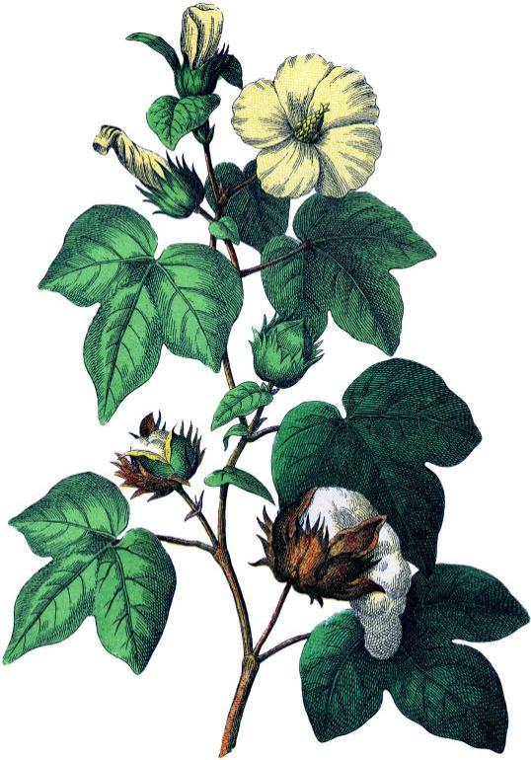
Major Insect Pests of Cotton (Gossypium hirsutum)
Crop in Pakistan
Sucking pest complex
Bollworms complex
Notes:
Single crop country facing threat again by 3 million shortfall (30% less than targeted) of cotton lint (phutti) mainly due to cotton mealy bug and CLCV (12 March 2015).
Target 2018-19= target sowing Punjab 2.31 (overall 2.95) M hec, sown = 2.29 (2.68) M hec. (in 2015 was 3.23 M hec)
Estimated proudction = 8.8 M bales
In major cotton areas, Vehari, Multan, DG Khan, RY Khan, Rajanpur, cotton crop fails due to cotton mealybug.
Cotton growers from Mailsi, Sahiweal, Pakpattan, and Gojra complained bearing Rs 1500 additional expenses on each acre on purchasing pesticides on double rates due to severe Mealy Bug attack.
1300 insect species on globe / 93 species attack in Pakistan.

Slide 3
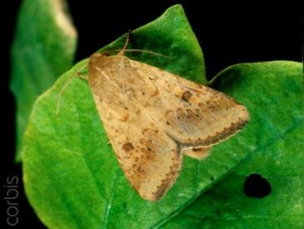
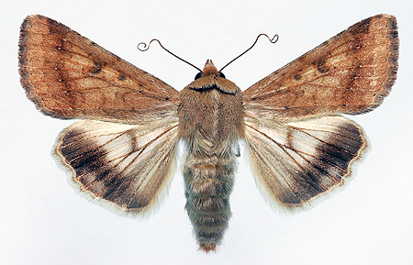
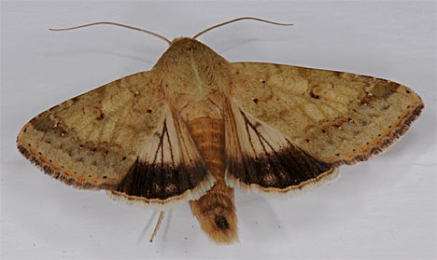
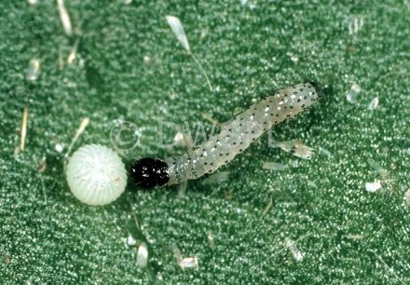
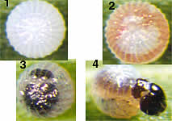
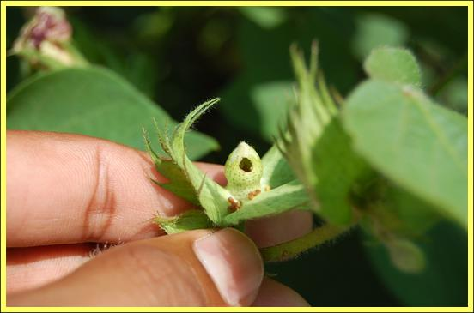
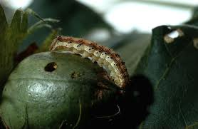
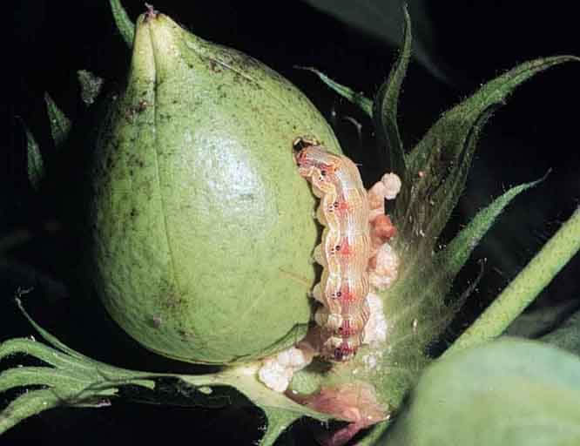
ENTO-306 Agricultural pests and their management 4(3-1)
Insect pests of Cotton American bollworm (Helicoverpa armigera ; Noctuidae, Lepid.)
Notes:
Helicoverpa armigera
Voracious feeders of all fruiting bodies
Prominent hole on boll or square
5th and 6th instar more damaging and difficult to control

Slide 4
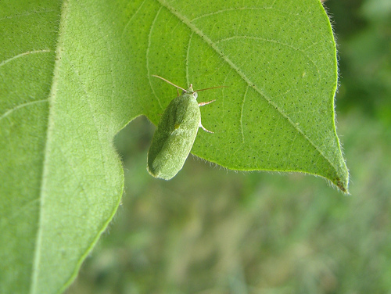
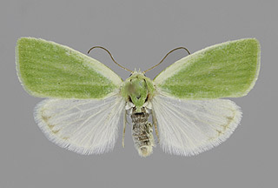
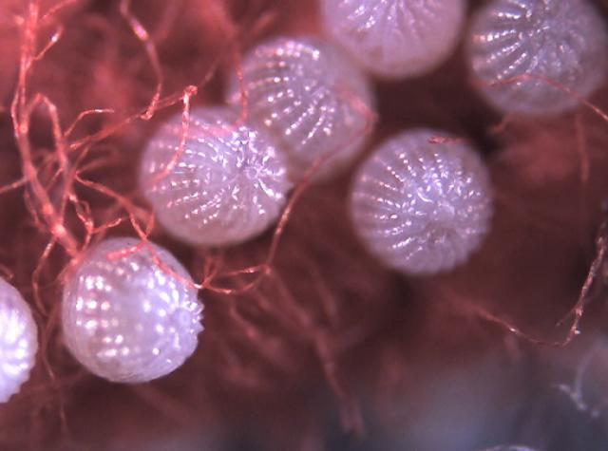
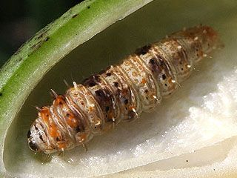
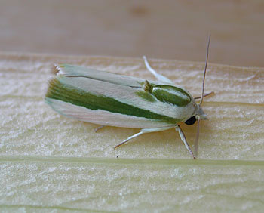
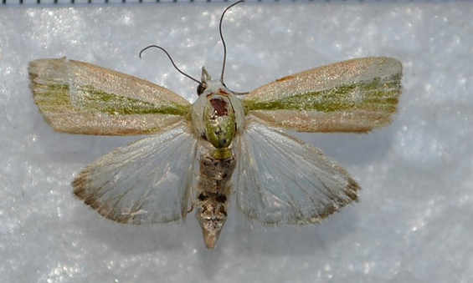
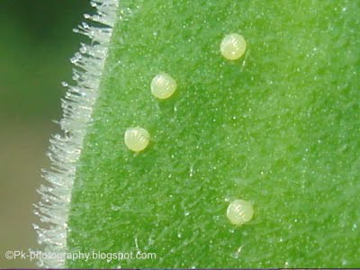
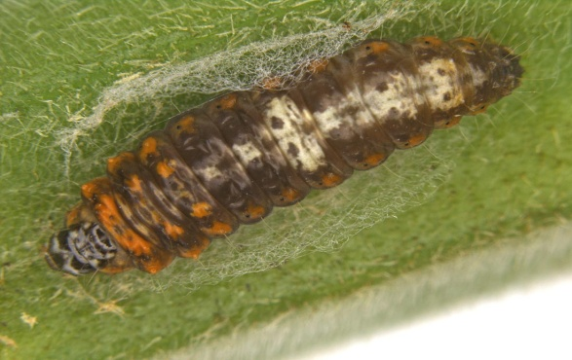
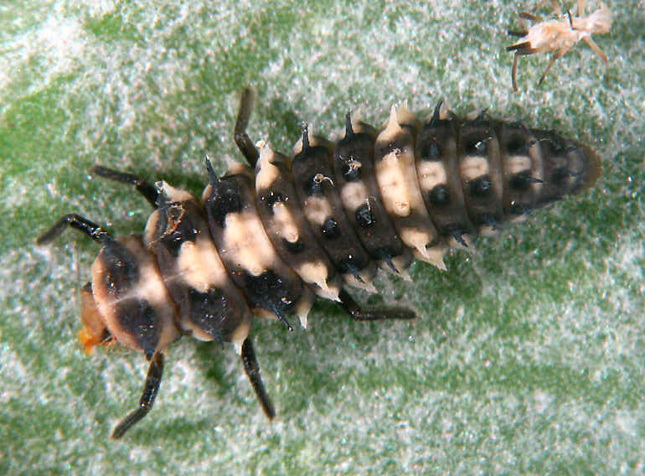
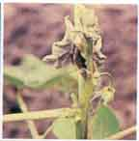
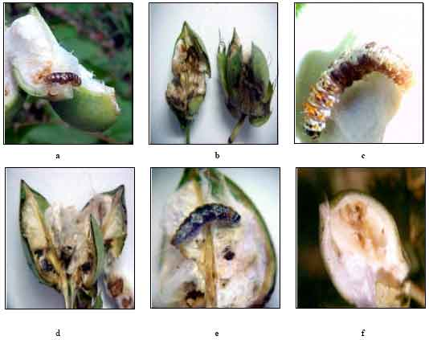
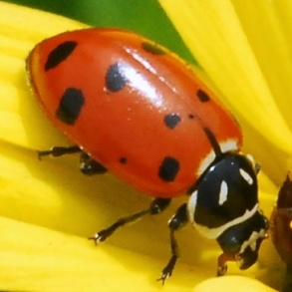
ENTO-306 Agricultural pests and their management 4(3-1)
Insect pests of Cotton Spotted bollworm (Noctuidae, Lepidoptera)
Earias insulana
Earias vittella
Notes:
Moth (25mm wingspan) dull white or greenish color (hind wings whitish and front wings either entirely pale green (E. insulana) or dirty white with median longitudinal green strip (E. vittella) in middle of forewing.
Eggs with sculptures 200/female laid in night on flowers, buds, young foliage etc in March April. 4-5 generations per year.
Hibernates (overwinters) in form of pupae in crop stubbles and in infested shoots and bolls.
E. insulana larvae (20mm long) is dull greenish white with black spots on body and orange dots on prothoracic segment.
E. vittella larva is brownish with a median longitudinal streak on dorsal side and ventral side usually pale yellow or greenish
Boring into terminal portions of young growing shoots, flower buds, flowers and fruits. Killing of young plants or growing shoots and boring of fruits and buds causing heavy fruit and flower shedding (up to 30-40%). Lint becomes spoiled in attacked boll. In okra, fruits become inedible and unfit due to its damage.
Clean cultivation, destruction of crop stubbles and remnants

Slide 5
Earias insulana
Earias vittella

Slide 6
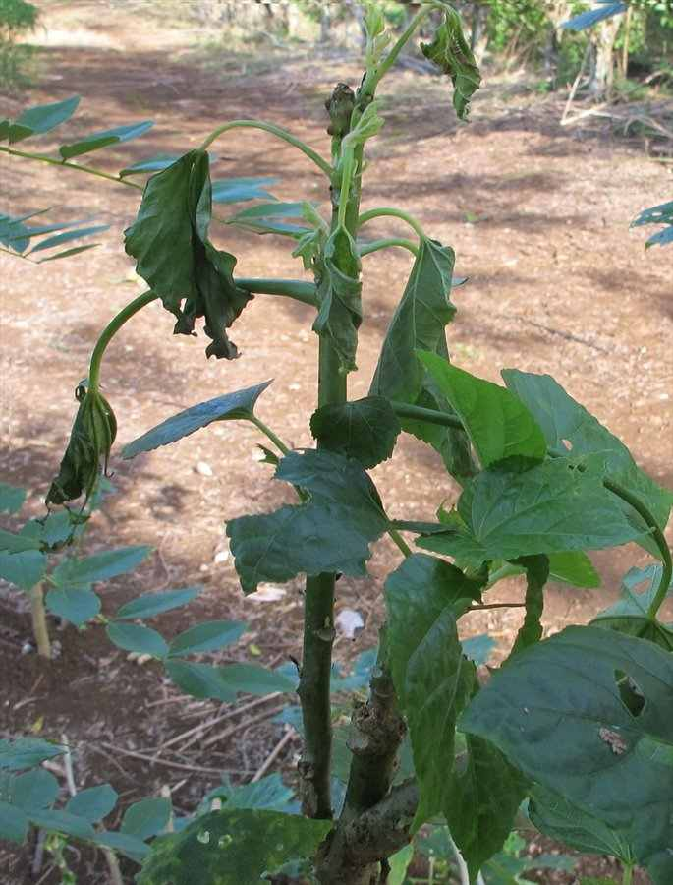
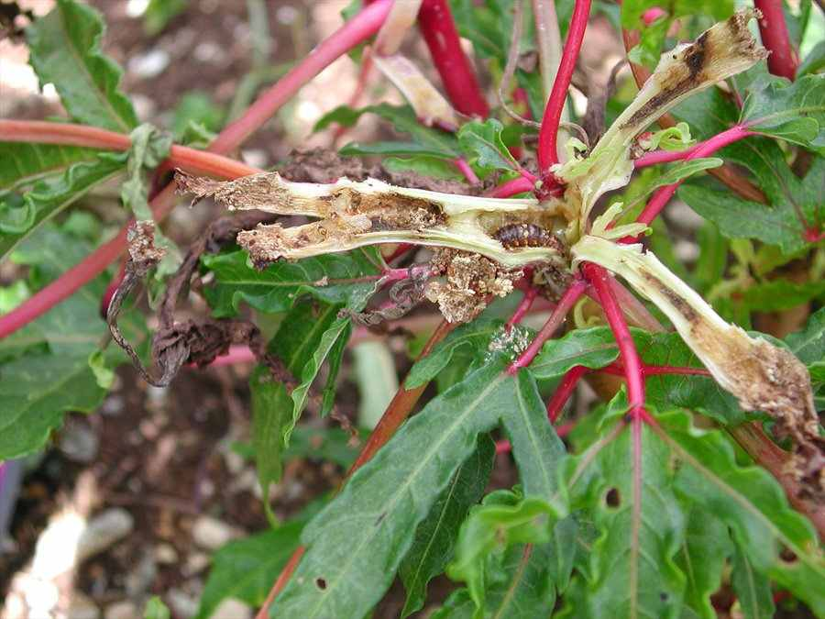

Slide 7
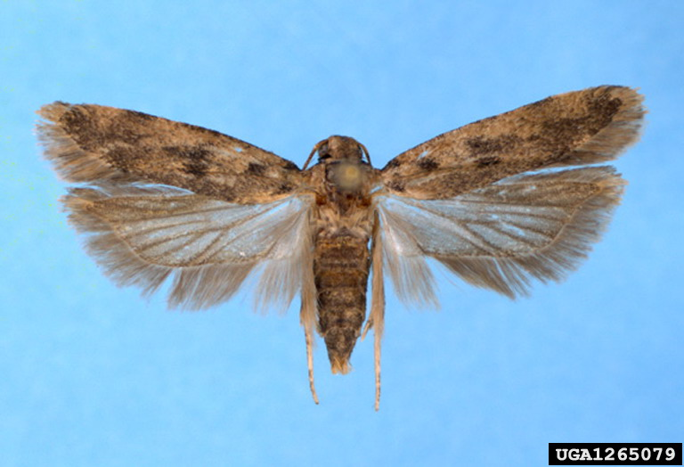
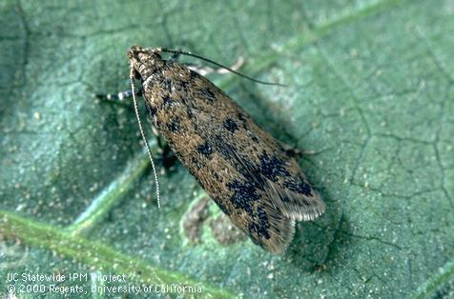
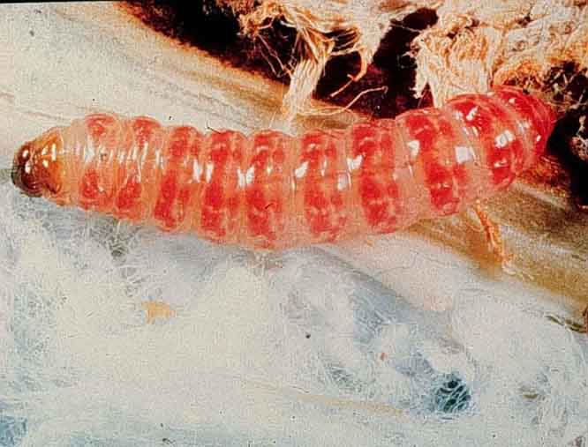
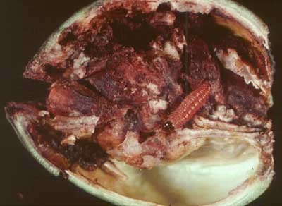
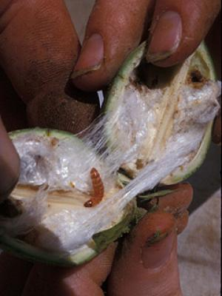
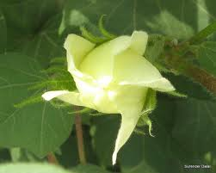
ENTO-306 Agricultural pests and their management 4(3-1)
Insect pests of Cotton Pink bollworm (Pectinophora gossypiella ; Gelechiidae, Lepidoptera)
Notes:
Pectinophora gossypiella
Global pest of cotton found in Africa, Asia, Australia and America
Adults are dark brown 8-9 mm long (wingspan) with blackish spots on fore wings and hind wing margins fringed with hairs.
Attack on squares and cause rossette flower
No sing of entry on boll while damaging lint inside boll on seed kernels. Pupation occurs in soil or under leaf-debris etc. 4-6 generations per annum.
50% shedding of fruits bodies by all bollworms and more than half may be due to Pinkbollworm.

