Slide 1
Storage Devices

Slide 2
Storage Device:
A storage device is a piece of hardware that is primarily used for storing data. Every desktop computer, laptop, tablet, and smartphone will have some kind of storage device within it, and you can also get standalone, external storage drives that can be used across multiple devices.
Storage is necessary not just for saving files, but also for running tasks and applications. Any file you create or save on your computer is saved to your computer’s storage device, as are any applications you use, as well as the operating system your computer runs on.
As technology has advanced over time, data storage devices have also evolved in a major way. Nowadays, storage devices come in many shapes and sizes, and there are a few different types of storage device that cater to different devices and functions.
A storage device is also known as a storage medium or storage media, and digital storage is measured in megabytes (MB), gigabytes (GB), and, these days, terabytes (TB).
Some computer storage devices are able to hold information permanently, while others can only hold information temporarily. Every computer has both primary and secondary storage, with primary storage acting as a computer’s short-term memory, and secondary as a computer’s long-term memory.

Slide 3
Primary Storage: Random Access Memory (RAM):
Random Access Memory, or RAM, is the primary storage of a computer.
When you’re working on a file on your computer, it will temporarily store data in your RAM. RAM allows you to perform everyday tasks like opening applications, loading webpages, editing a document or playing games, and allows you to quickly jump from one task to another without losing your progress. In essence, the larger the RAM of your computer, the smoother and quicker it is for you to multitask.
RAM is a volatile memory, meaning it cannot hold onto information once the system is turned off. For example, if you copy a block of text, restart your computer, and then attempt to paste that block of text into a document, you’ll find that your computer has forgotten the copied text. This is because it was stored only temporarily in your RAM.
RAM makes it possible for a computer to access data in a random order, and therefore reads and writes much faster than a computer’s secondary storage

Slide 4
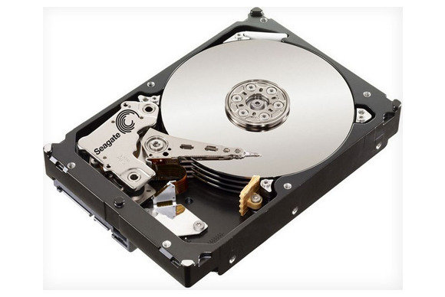
Secondary Storage: Hard Disk Drives (HDD) & Solid-State Drives (SSD):
In addition to RAM, every computer also has another storage drive that’s used for storing information on a long-term basis, and this is known as secondary storage. Any file you create or download is saved to the computer’s secondary storage. There are two types of storage device used as secondary storage in computers: HDD and SSD. While HDDs are the more traditional of the two, SSDs are fast overtaking HDD as the preferred tech for secondary storage.
Secondary storage devices are often removable, so you can replace or upgrade your computer’s storage, or move your storage drive to a different computer. There are notable exceptions however, like MacBooks, which don’t offer removable storage.
Hard Disk Drives (HDD):
The hard disk drive (HDD) is the original hard drive. These are magnetic storage devices that have been around since the 1950s, though they’ve evolved greatly over time.
A hard disk drive is comprised of a stack of spinning metal disks known as platters. Each spinning disk has trillions of tiny fragments that can be magnetized in order to represent bits (1s and 0s in binary code). An actuator arm with a read/write head scans the spinning platters and magnetizes fragments in order to write digital information onto the HDD, or detects magnetic charges to read information from it.

Slide 5
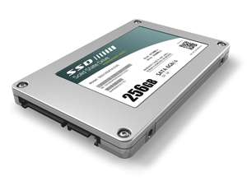
Solid-State Drives (SSD):
Solid-state drives emerged far more recently, in the ‘90s. SSDs don’t rely on magnets and disks, instead they use a type of flash memory called NAND. In an SSD, semiconductors store information by changing the electrical current of circuits contained within the drive. This means that unlike HDDs, SSDs don’t require moving parts to operate.
Because of this, SSDs not only work faster and smoother than HDDs (HDDs take longer to gather information due to the mechanical nature of their platters and heads), they also generally last longer than HDDs (with so many intricate moving parts, HDDs are vulnerable to damage and wear).
Outside of newer PCs and high-end laptops, you can find SSDs in smartphones, tablets, and sometimes video cameras.
External storage devices:
In addition to storage media contained
within a computer, there are also digital storage devices that are external from computers. These are commonly used to expand storage capacity when a computer runs low on space, to allow more portability, and to allow easy file transfers from one device to another.

Slide 6
External HDDs and SSDs
You can get both HDD and SSD devices as external drives. These generally offer the largest storage capacity among external options, with external HDDs offering up to 20 TB of storage and (reasonably-priced) external SSDs offering up to 8 TB of storage.
External HDDs and SSDs work in the exact same way that their internal counterparts do. Most external drives can be connected to any computer; they’re not tied to one device, so they’re a decent solution for transferring files across devices.
Flash memory devices:
We mentioned flash memory earlier when discussing SSDs. A flash memory device contains trillions of interconnected flash memory cells that store data. These cells hold millions of transistors that when switched on or off represent 1s and 0s in binary code, allowing a computer to read and write information based on the electrical current of the transistors.
Perhaps the most recognizable type of flash memory device is the USB flash drive. Also known as a thumb drive or simply a ”USB," these small, portable storage devices have long been a popular choice for extra computer storage. Before it was quick and easy to share files online, USB-flash drives were basically essential for easily moving files from one device to another.
These days, a USB flash drive can hold up to 2 TB of storage. They’re more expensive per gigabyte than an external hard drive, so while it’s unlikely that anyone is using thumb drives to store all of their personal data, they have prevailed as a simple, convenient solution for temporarily storing and transferring smaller files.
Aside from USB drives, flash memory devices also include SD and memory cards, which you’ll recognize as the storage medium used in digital cameras.

Slide 7
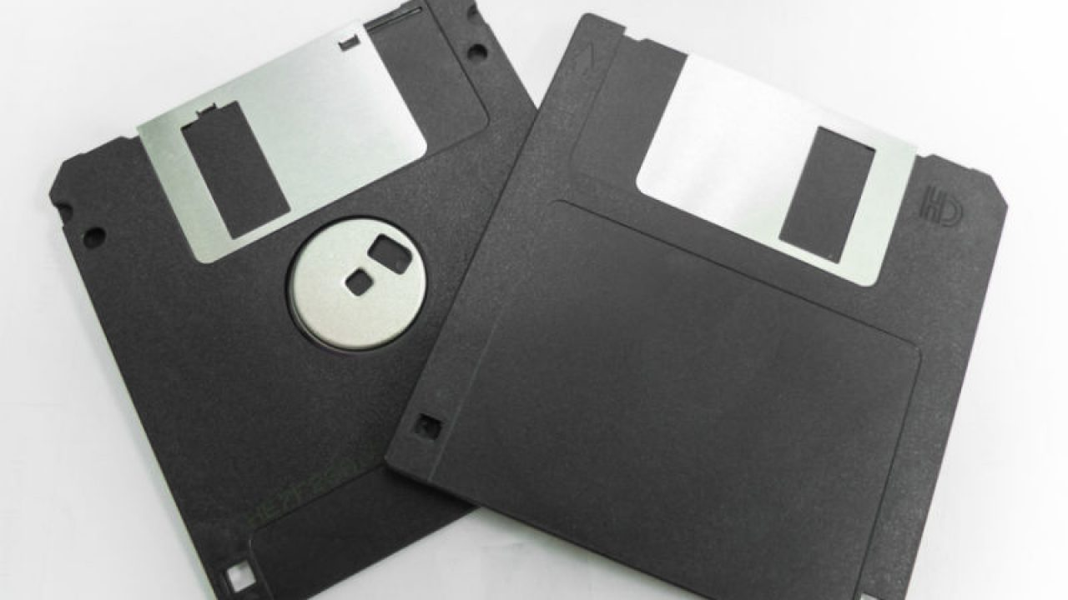
Optical Storage Devices:
CDs, DVDs, and Blu-Ray disks are used for a lot more than just playing music and videos—they also act as storage devices, and collectively they’re known as optical storage devices or optical disk media.
Binary code is stored on these disks in the form of minuscule bumps along a track that spirals outwards from the center of the disk. When the disk is in operation it spins at a constant speed, while a laser contained within the disk drive scans the bumps on the disk. The way the laser reflects or bounces off a bump determines whether it represents a 0 or 1 in binary.
Floppy Disks:
While they may mostly obsolete at this point, we can’t discuss storage devices without at least mentioning the humble floppy disk. Floppy disks were the first widely-available portable, removable storage devices. They work in the same way as hard disk drives, although at a much smaller scale.
The storage capacity of floppy disks never exceeded 200 MB before CD-RW and flash drives became the favored storage media. The iMac was the first personal computer released without a floppy disk drive, in 1998, and from here the over 30-year reign of the floppy disk very quickly declined.

Slide 8
Cloud storage:
While not exactly a device per se, cloud storage is the newest and most versatile type of storage for computers. “The cloud” is not one place or object, but rather a huge collection of servers housed in data centers around the world. When you save a document to the cloud, you’re storing it on these servers.
Because everything is stored online, cloud storage doesn’t use any of your computer’s secondary storage, allowing you to save space.
Cloud storage offers significantly higher storage capacities than USB flash drives and other physical options, saving you from having to sift through each device to get to the file you’re looking for.
While external HDDs and SSDs were once favored for their portability, they, too, fall short compared to cloud storage. There aren’t many pocket-friendly external hard drives, and while they’re of course smaller and lighter than a computer’s internal storage drive, they are still tangible devices that you need to take care of. The cloud, on the other hand, can go with you anywhere you go without taking any physical space at all, and without the physical vulnerabilities of an external drive.
External storage devices were also popular as a quick solution for transferring files, but of course, they’re only useful if you can physically access each device. Cloud computing is striving at a time where many businesses now operate remotely. You probably wouldn’t post a USB drive overseas just to send a large file to a colleague, so cloud storage acts as a bridge between remote workers, making collaboration from afar a breeze.

Slide 9
If you forget to bring a hard drive containing important documents to a meeting, there’s not much you can do other than go back and grab it. If you break or lose a hard drive altogether, it’s unlikely you’ll ever get that data back. These risks don’t exist for cloud storage—your data is backed up and accessible whenever and wherever you are so long as you have access to the internet.

