Slide 1
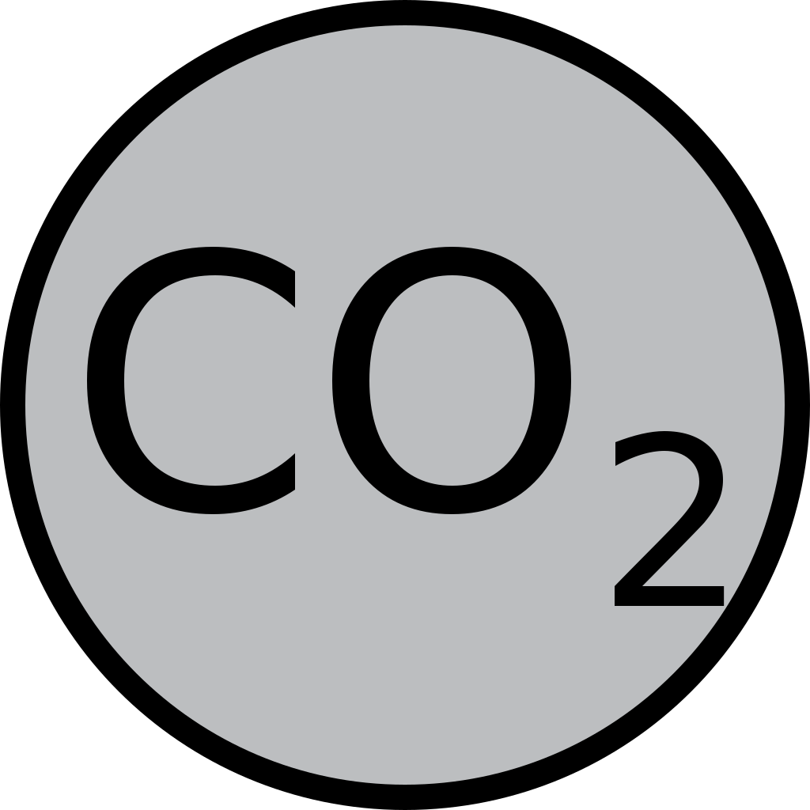
Carbon Dioxide
Processing of Carbon Dioxide

Slide 2
Contents
Carbon Dioxide
Properties
Dry Ice
Sources of CO₂
Introduction to Carbon Capture and Storage(CCS)
CO₂ Transportation
CO₂ Capturing Technologies
CO₂ Storing
Advantages
Disadvantages

Slide 3
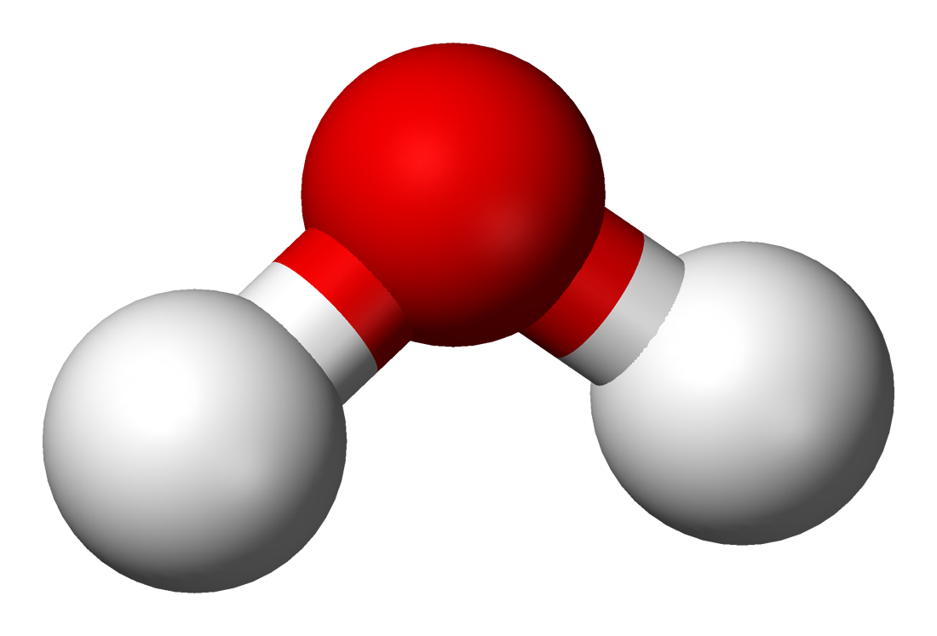
Carbon Dioxide
Carbon Dioxide is natural gas
It is present in air at very low level 0.03% by volume
It vital substance to plant kingdom for the process of photosynthesis
Carbon Dioxide can exist in three forms:
Gas
Solid (dry ice)
Liquid (under certain pressure level)
C
O
O

Slide 4
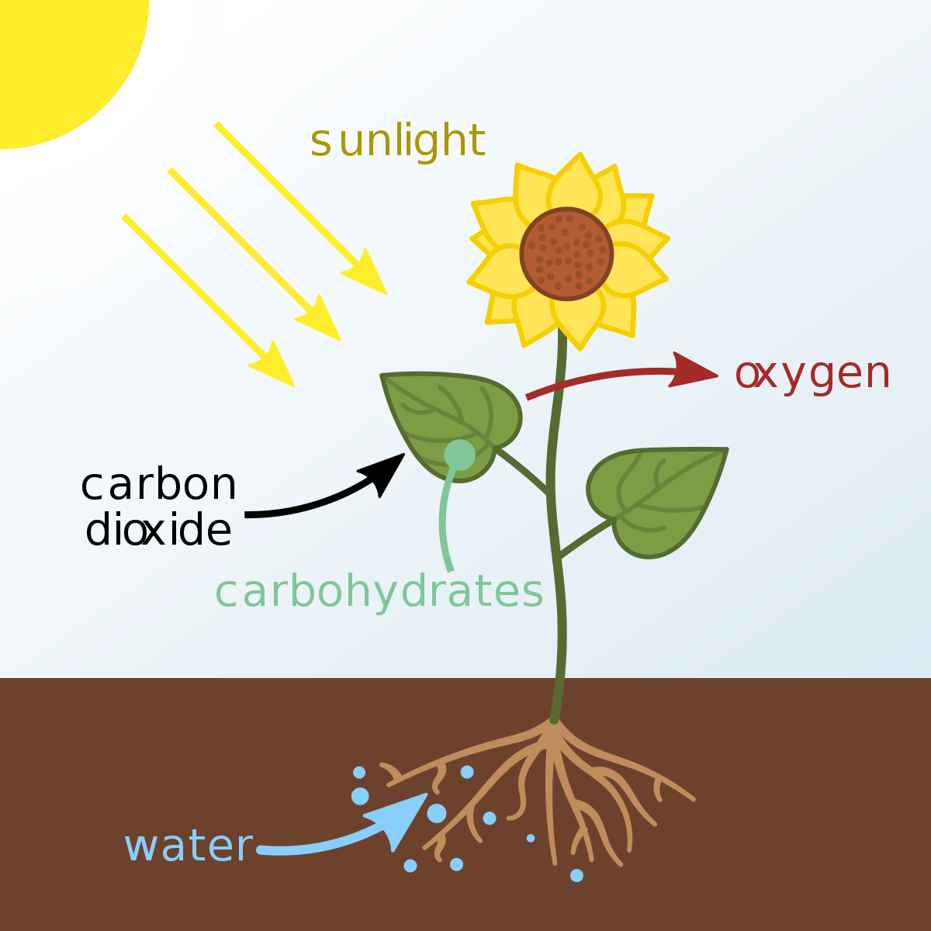

Slide 5
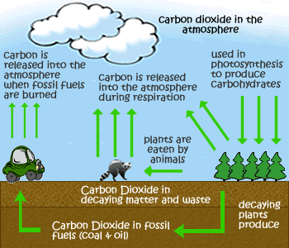

Slide 6
Properties
Non-toxic, colorless and odorless gas that does not impart any flavor to the beverage
Nonflammable and no fire hazards when handling
Soluble in water and dissolves easily in the beverages
Its solubility can be controlled by regulating the temperature and pressure
In water , it forms a weak acid(carbonic acid)
The carbonic acid can retard the growth of microorganisms
Carbonic acid easily releases Co₂ gas to create effervescence

Slide 7
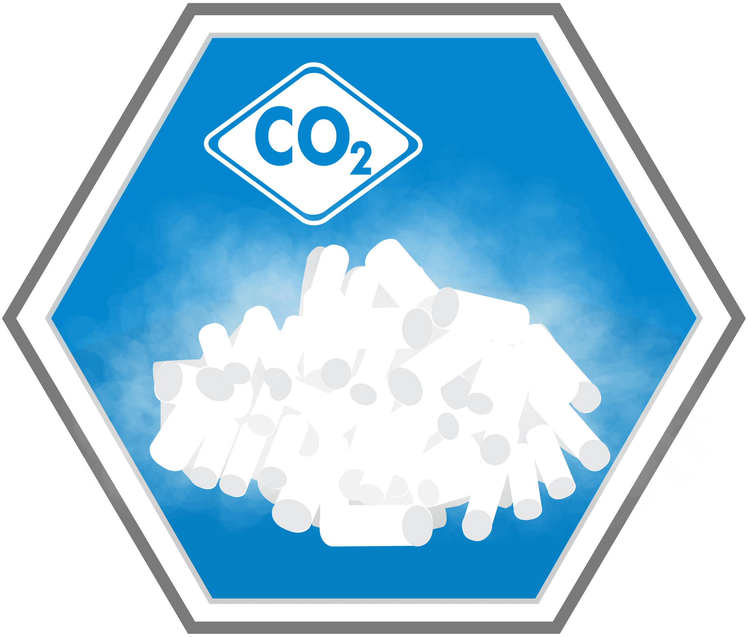
Dry Ice
Dry ice is the solid form of carbon dioxide
It is used primarily as a cooling agent
Its temperature is lower than water ice
It is useful for preserving frozen foods where mechanical cooling is unavailable

Slide 8
Sources of CO₂
By burning of carbonaceous materials
C + O₂ CO₂
In the production of H2 by steam reforming of methane or other hydrocarbons, 16% pure Co₂ is obtain
CH₄ + 2H₂O CO₂ + 4H₂
In manufacture of alcohol (ethanol) by the fermentation process 99.9 % pure CO2 is obtained
C₆H₁₂O₆ C₂H₅OH + CO₂
In calcinations of CaCo₃ at 1000°C ,40% Co₂ is obtained
CaCo₃ CaO + Co₂

Slide 9
CO₂ Capturing & Storing process

Slide 10
Carbon Capture & Storage Technology
“A Technology that can capture 90% of the Carbon Dioxide Emission and Prevent Co₂ from entering the Atmosphere”
The CCS chain consist of three parts
Capturing
Transportation
Storage

Slide 11
Capturing Carbon Dioxide
Capturing of Co₂ by
Pre Combustion Technology
Post Combustion Technology
Oxy Fuel Process

Slide 12
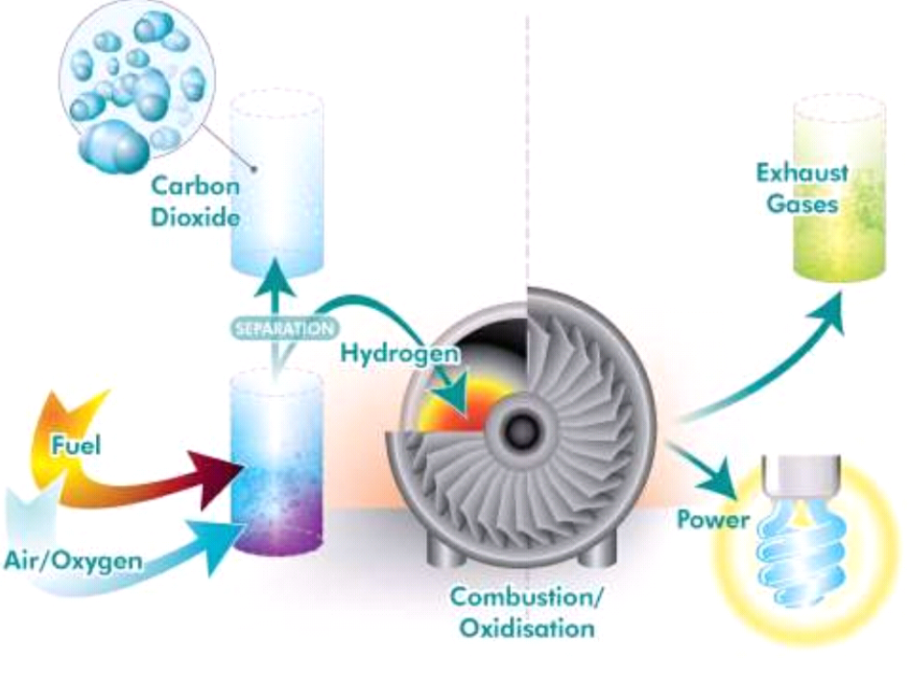
Pre Combustion Technology
Removing CO₂ before combustion
By Gasifying the coal through the reaction with oxygen(O₂)
It is possible to obtain a mixture of mostly CO₂ & H₂
CO₂ is captured and H₂ is use as fuel

Slide 13
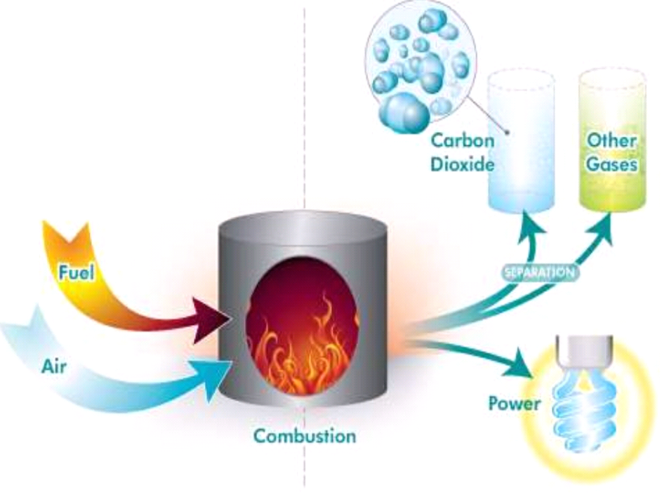
Post Combustion Technology
Removing CO₂ after combustion
Applicable to fossil fuel burning power plants that release fuel gas
Reacting the fuel gas with chemicals that absorb CO₂ and then heat the chemicals to release CO₂
Fuel Gas “Mixture of Nitrogen , water vapor , 15% CO₂

Slide 14
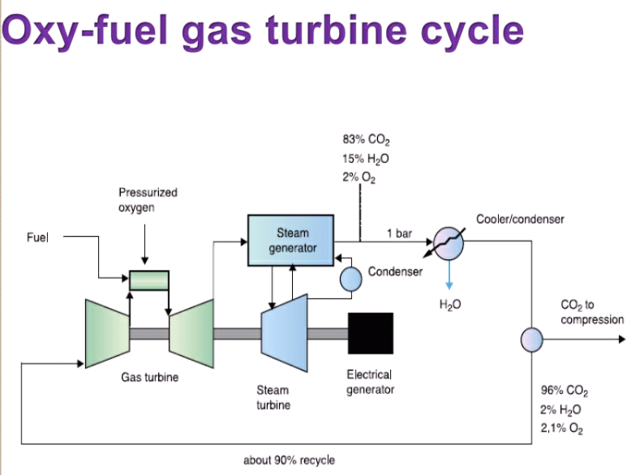
Oxy Fuel Process
The Fuel is burnt in oxygen(O₂) instead of air
The resultant flue gas is condensed through cooling
Resultant is an pure CO₂ stream

Slide 15
Overview of CO₂ Capture

Slide 16
Transport of CO₂
CO₂ is transported in three states:
Gas
Liquid
Solid
Transportation system used:
Pipeline Transportation system
Marine Transportation system

Slide 17
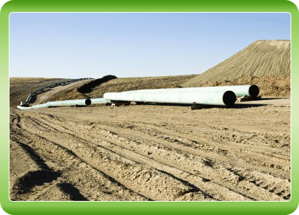
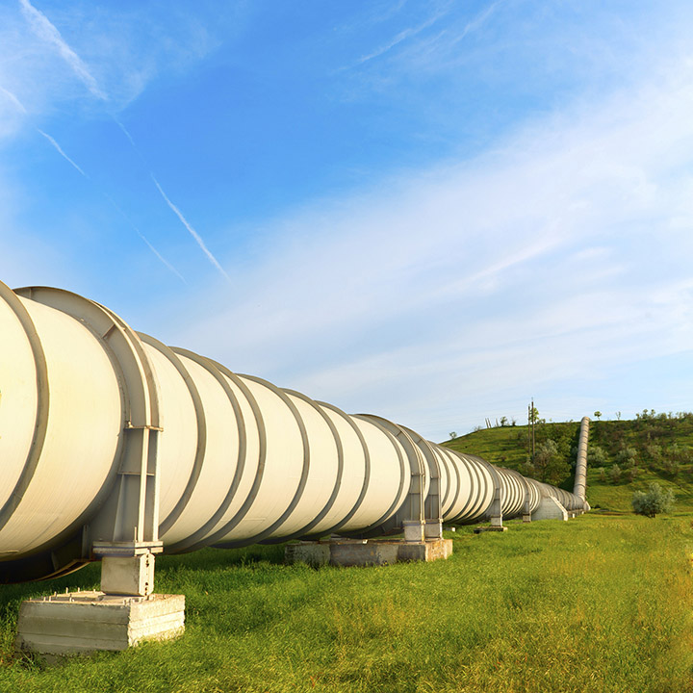
Pipeline Transportation system

Slide 18
Marine Transportation system

Slide 19
Storage options
Geological storage
Oceanic storage
Mineral storage

Slide 20
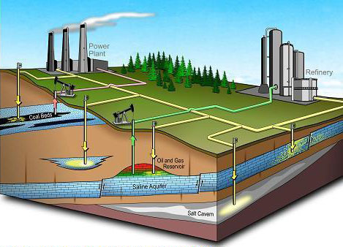
Geological storage
Storing carbon dioxide under earth's surface is called geo-sequestration
Injecting CO₂ into:
Underground geological formations
Oil fields
Saline formations

Slide 21
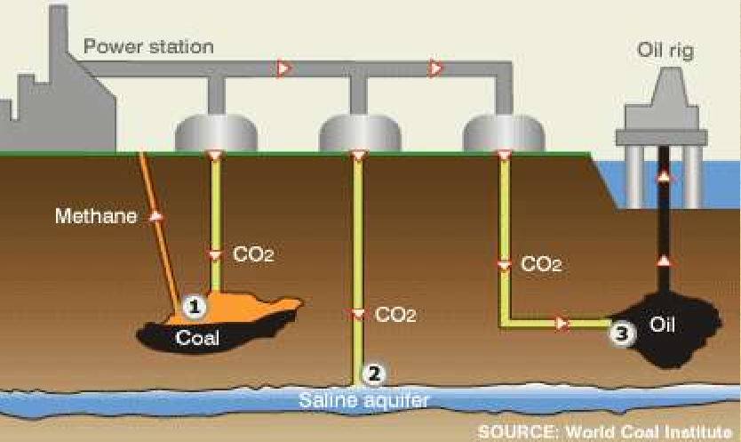

Slide 22
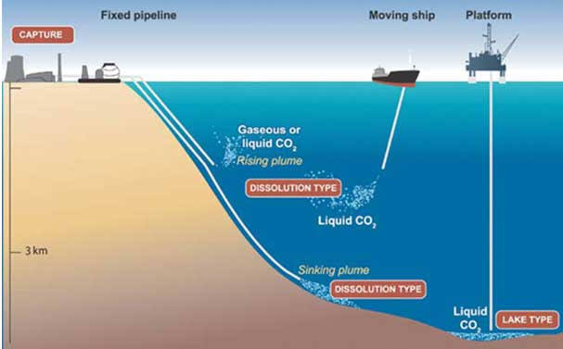
Oceanic storage
Dissolving CO₂ at mid depths
Injecting CO₂ at depths exceeding 3km where it would form lakes of liquid CO₂
Below 3km where depth
Liquid CO₂ will be denser than sea water and will sink to the ocean floor

Slide 23
Mineral Storage
CO₂ is reacted with mineral to form Carbonates

Slide 24
Purification of CO₂
The purification CO₂ consist on two methods:
Cryogenic separation
Distillation

Slide 25
Cryogenic separation
Cryogenic separation method, the liquefaction temperature increases by improving the initial pressure of the mixed gases
The separation ratio could also be maintained at a high level by multi-stage separation and compression

Slide 26
Distillation
In the distillation subsystem, crude product is distillated under high pressure and near ambient temperature conditions

Slide 27
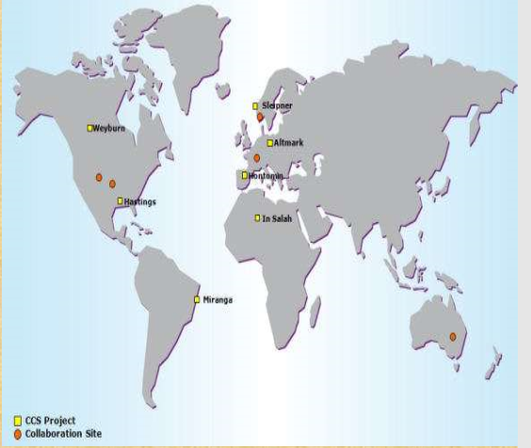
MAJOR STORAGE SITES IN THE WORLD
Sleipner, Norwegian North Sea
Altmark, Germany
Weyburn, Canada
In Salah, Algeria
Miranga, Brazil
Hontomin, Spain
Hastings, Texas, USA

Slide 28
Advantages
Reduces pollution
Reduces changes in atmospheric temperature
Enhanced oil recovery

Slide 29
Disadvantages
Leakage problems may occur
Costly process
Damage pipelines
Oceanic Acidification

Slide 30
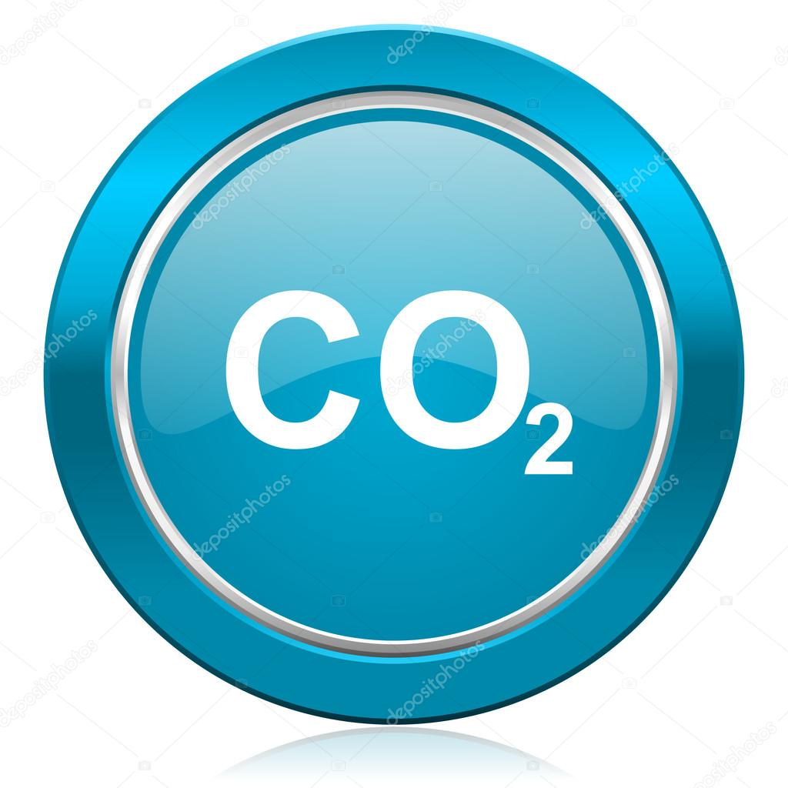
Conclusion
CCS involves capturing millions of tones of CO₂ a year from gas or coal
Valuable tool in the fight against climatic change

Slide 31
Uses of CO₂
Food
Carbon dioxide is a food additive used as a propellant and acidity regulator in the food industry
It is approved for usage in the EU, USA, Australia and New Zealand

Slide 32
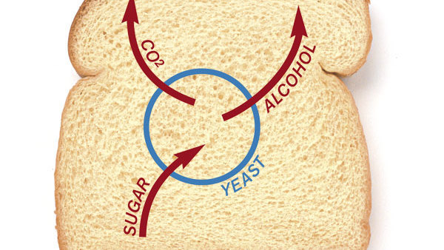
Baking
Leavening agents cause dough to rise by producing carbon dioxide
yeast produces carbon dioxide by fermentation of sugars within the dough, while chemical leaveners such as baking powder and baking soda release carbon dioxide when heated or if exposed to acids

Slide 33
Beverages Carbonation
Carbon dioxide is used to produce carbonated soft drinks and soda water
Traditionally, the carbonation in beer and sparkling wine came about through natural fermentation, but many manufacturers carbonate these drinks with carbon dioxide recovered from the fermentation process
In the case of bottled and kegged beer, the most common method used is carbonation with recycled carbon dioxide

Slide 34
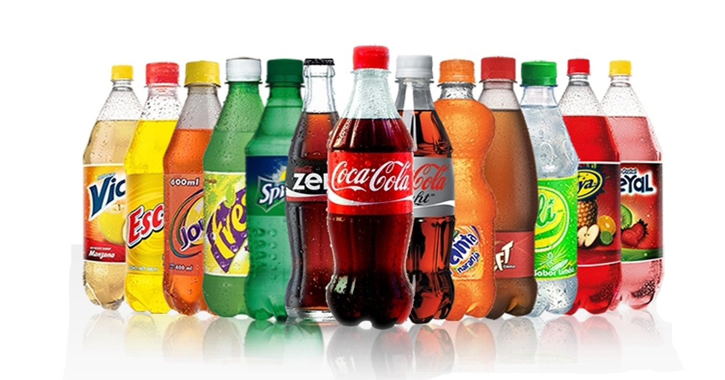
Carbonated Beverages

Slide 35
Wine Making
CO₂ is used as a seal gas to prevent oxidation of the wine during maturation
The main advantage of using dry ice over regular water ice is that,
It cools the grapes without adding any additional water that may decrease the sugar concentration in the grape
Therefore also decrease the alcohol concentration in the finished wine.

Slide 36
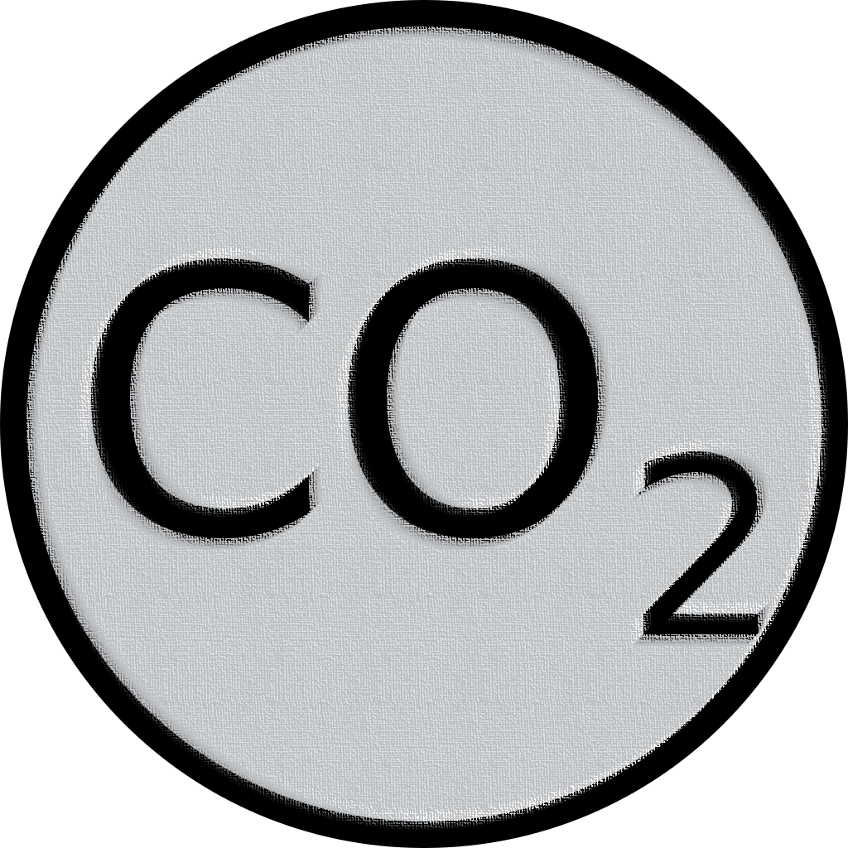
Cont...
CO₂ is also produced during the fermentation process
It is already captured on-site for reuse for its inert gas properties

Slide 37
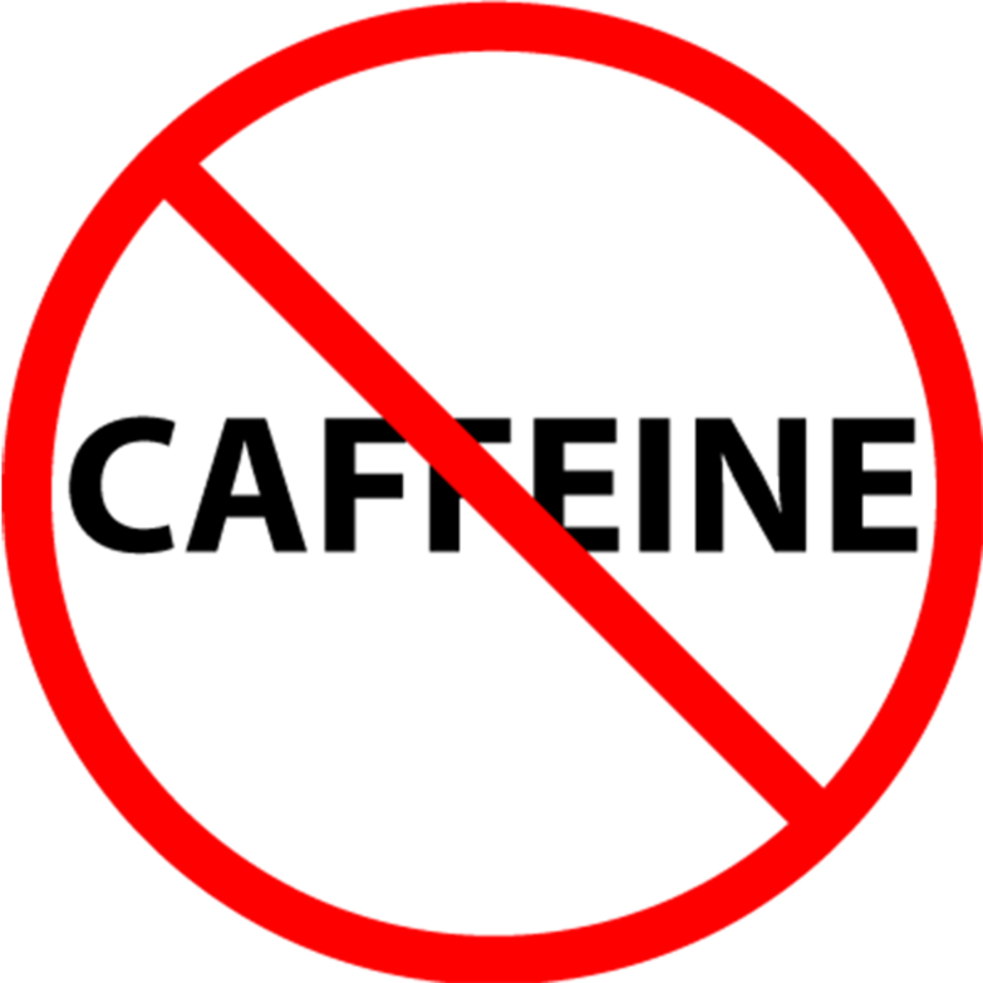
Coffee Decaffeination
Supercritical CO₂ is used as the solvent for decaffeinating coffee
It is preferred due to its inert and non-toxic properties.

Slide 38
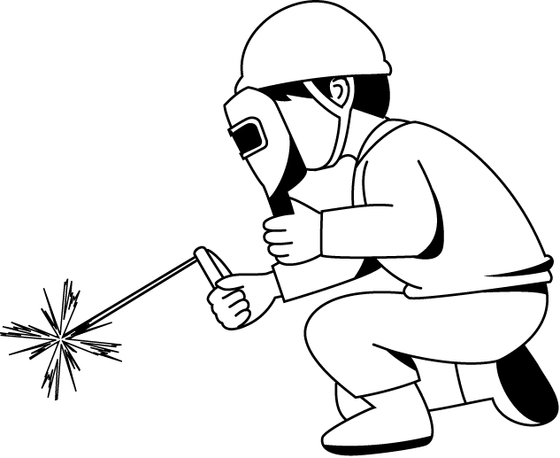
Welding & Metal Fabrication
Carbon dioxide is most often mixed with argon as a shielding gas
Used to prevent atmospheric contamination of molten metal in electric arc welding processes

Slide 39
Fire Extinguisher
Carbon dioxide extinguishes flame
Some fire extinguishers, especially those designed for electrical fires, contain liquid carbon dioxide under pressure

Slide 40
Food processing, preservation and packaging
CO₂ is used for various applications in the food industry
Carbon dioxide is commonly used in MAP and CAP because of its ability to inhibit growth of bacteria that cause spoilage
In packaging applications, CO₂ is used in MAP&CAP with products such as cheese, poultry, snacks, produce and red meat etc.
Including cooling while grinding powders such as spices and as an inert atmosphere to prevent food spoilage

Slide 41
Supercritical CO₂ as solvent
Liquid carbon dioxide is a good solvent for many lipophilic organic compounds
It is used to remove caffeine from coffee
Other chemical processing industries as a less toxic alternative to more traditional solvents such as oraganochlorides

Slide 42
Pulp and paper processing
CO₂ is used to reduce pH during pulp washing operations.

Slide 43
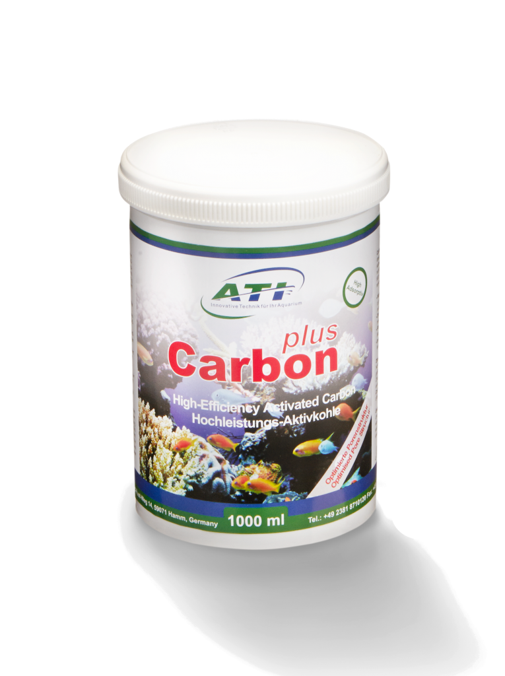
Pharmaceutical
Use of CO₂ in the pharmaceutical industry typically includes
Inerting
Chemical synthesis
Supercritical fluid extraction
Product transportation at low temperature
Acidification of wastewater

Slide 44
Enhanced oil recovery (EOR)
Co₂ is injected into depleted oil fields
The CO₂ acts as a solvent that reduces the viscosity of the oil, enabling it to flow to the production well
Once production is complete, the CO₂ can potentially be permanently stored in the reservoir

Slide 45
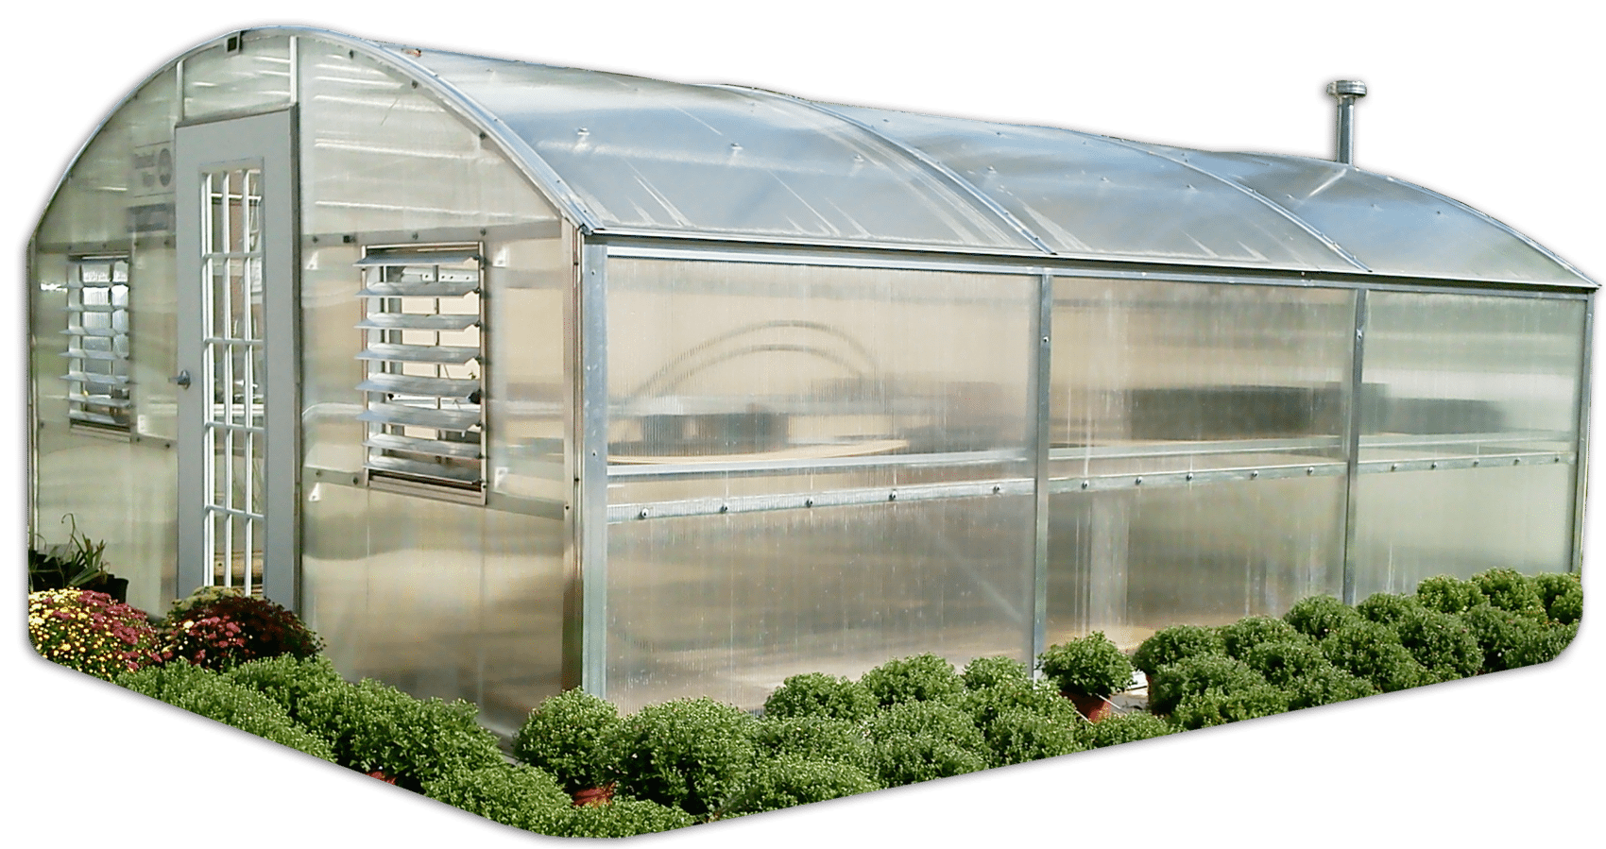
Horticulture
CO₂ is provided to greenhouses to maintain optimal Co₂ concentration and maximize plant growth rate
Sources include on-site cogeneration schemes as well as off-site industrial sources connected via pipeline networks

