Slide 1
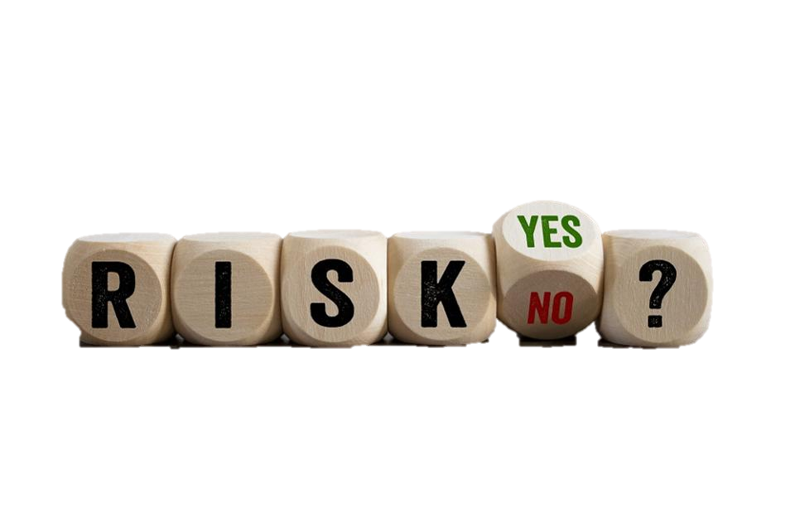
managing risks and constraints
By: Saba Ashraf
Noon business school, university of Sargodha

Slide 2
outline
How risks involve uncertainty and loss?
Three common types of risks
Risk areas
Risk breakdown structure
Being creative with the solutions
Risk tolerance
Steps in the risk management process
The Delphi technique
Tracking risks
Constraint vs. risks

Slide 3
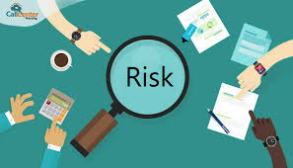
How risks involve uncertainly and loss?
A project that moves beyond the initiation stage without taking risks and constraints into account will be more likely to fail.
How?
Uncertainty is always there.
If something went wrong and you didn’t have any available solution to the problem, the project would definitely fall apart.
What is needed to be done?
Risk and constraint analysis
The goal of the risk and constraint analysis is to establish the feasibility study of the project within the budget, schedule, politics, laws, and organizational structure that limit your project.
RISK is an uncertain event or condition that, if occurs, has an effect on at least on of the objectives such as scope, schedule, cost, and quality. And risk always lurks in future.

Slide 4
Three common types of risk
The kind of risks you'll encounter vary with projects. The most common are;
THE KNOWN RISKS
The risks you can identify after reviewing the project scope within the context of business or technical environment.
THE PREDICTABLE RISKS
They are anticipated risks based on work with similar projects. They have to do with things such as staff turnover or economic changes, that can have an anticipated impact.
THE UNPREDICTABLE RISKS
Happening of something that is beyond the control of project manager or team. “The stuff that just happens”

Slide 5
Risk areas
Risks can be broken down into areas that may impact delivery of the defined product and services. The primary among these are following;
BUDGET: You may fall short of funding that your project needs.
SCHEDULE: You might find things are taking longer than you originally planned.
STAFFING: As the project starts, you might find that you cannot find the right staff in the marketplace.
STAKEHOLDERS: They might not have time to work with the project team and assist in developing the solution to project problems.
PROJECT SIZE AND/OR COMPLEXITY: The project is so large and complex that there are just too many factors to attempt to control them all.

Slide 6
Risk areas
CORPORATE POLITICS: Because of political decisions, competing work groups share responsibilities for certain activities, potentially creating a situation where n one is assuming accountability for decision you require.
ORGANIZATIONAL RESISTANCE: The project makes business sense, but key stakeholder groups are resisting the changes the project deliverables require.
EXTERNAL FACTORS: External risk factors hover outside your control, such as new government regulations, or shifting technologies.

Slide 7
Don’t forget business risks
MARKET ACCEPTACE: The product is good one but customer won’t buy.
TIME-TO-MARKET: It will be a good product, and the customers will want it, but only if you can deliver it within specific time fame
COST OF PRODUCTION: It will be a good product, and the customers will want it, but due to the cost of producing it, customers wont be able to afford it.
DIFFICULT TO SUPPORT: It is a great product, but who’s going to support it? The operations group doesn’t have the people and skills to support the product once it is in marketplace.
LOSS OF POLITICAL SUPPORT: A project loses support from executive management.

Slide 8
The ultimate risk: acts of god
As humans we can do a little to prevent to prevent the acts of god
However, we can combat any situation when we are prepared beforehand.
You can insure project safety by keeping all this in mind at a very early stage.

Slide 9
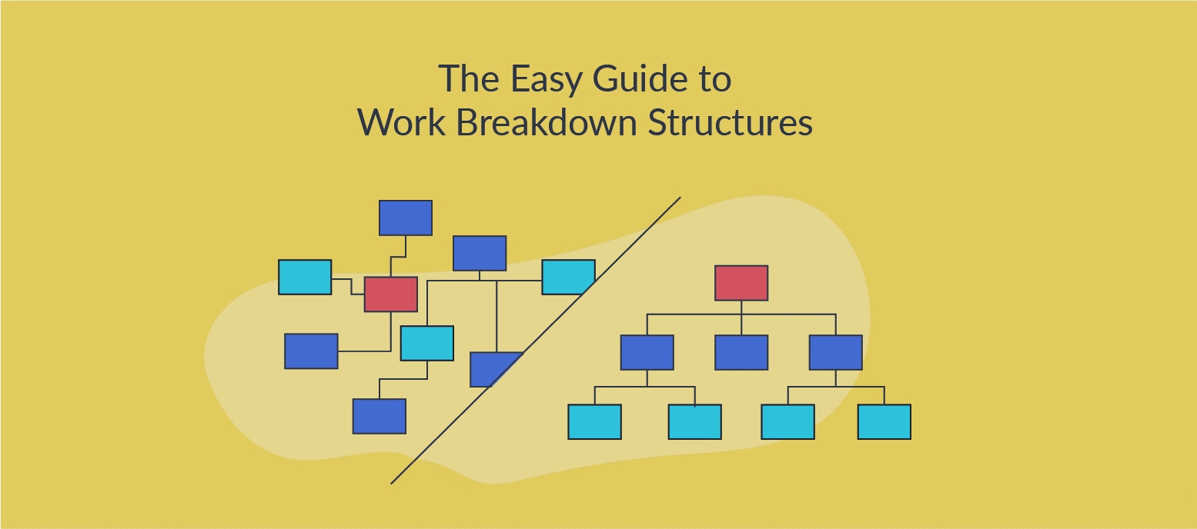
risk breakdown structure
A risk break down structure is a systematic way to put risks in the form of a hierarchy so you can identify the risks by category and subcategory. It provides the pictorial causes.

Slide 11
Being creative with the solutions
Identify potential problems early in the planning cycle (using proactive approach) and provide input into management decisions regarding resource allocation.
Involve team members at all levels of the project; focus their attention on how to identify risks and prevent them from happening.
Avoid the problem by eliminating the cause of threat.
Use the mitigation strategy to reduce the impact of the risk by reducing the probability of the risk occurring
Use a retention strategy: This means that you accept the risk as possible and you will develop a plan if it occurs.

Slide 12
Risk tolerance
Before you begin to make decision about how to plan risks, consider the amount of risk (risk appetite) you and your project sponsors are ready to tolerate.
For example; for the management team, the project schedule may be very important. Thus, the project manager and the steering committee might be less tolerant of the risk.

Slide 13
The basics of risk management
In the basic risk management, you plan the possibility that a problem will occur by estimating the probability of the problem arising during the project, evaluating the impact if the problem does arise, and preparing solutions in advance to keep the risk at an acceptable level.

Slide 14
Steps in risk management process
Identify the risks by listing them and describing their potential impact on the project.
Learn from the past projects.
Anticipate problems by looking at critical relationship or resources in the project and anticipating what could occur if these change.
Interview the staff, subcontractors, vendors, suppliers, service providers, management, and customer to look at deliverables from different point of view,
Evaluate the environment, labour practices, and availability of raw materials or technologies.

Slide 15
Analyse the probability that the risk will occur and the potential impact of the risk.
When you consider the impact, also consider whether the risk will impact your schedule, budget, quality, or people.
Assign a number on the scale 1 (lowest impact) to 5 (highest impact) to quantify the potential impact of the risk to your project.
Determine how likely you think this event will occur using the same 1 to 5 scale.
Determine the overall severity of the risk.
You do this by multiplying the probability number by the impact number to come up with severity level.
Determine which risks are most important for further action
You usually establish a ‘risk threshold’ that determines all those that are high in both impact and likelihood get the most attention.
Risks with less severity are considered for further analysis.
Come up with risk threshold that establishes the risk that require further actions.

Slide 16
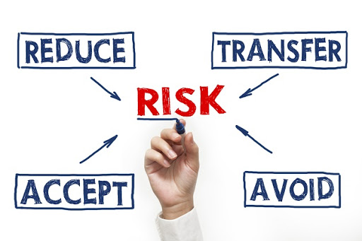
5. Document a response plan for the risks.
You have four basic options for dealing with risks on your list:
Accept the risk: it means you intend to do nothing special at this point.
This is an appropriate option if the consequences for the risk are cheaper than a program to eliminate or reduce the risk.
Avoid the risk: it means you’ll delete the part of the project that contains the risk or break the project into smaller subprojects that reduces the risk overall.
Be aware that reducing or avoiding the risk in this way may change the business case for the project.
Monitor the risk and develop a contingency plan in case the risk becomes imminent.
Developing a contingency plan for the key risks is one of the most important aspect of risk management.
The contingencies are alternative plans and strategies to be put into place when necessary.
You need to be proactive rather than reactive.
Transfer the risk:
Insurance is an obvious option to transfer the risks like theft, fire, and flood.
Another way is to hire someone to implement the part of the project.

Slide 17
The Delphi technique
Start
Identify risks
Evaluate risks
Develop mitigation plan
Communicate mitigation plan
Monitor risks
You first summarize risks after speaking to experts individually and then circulate the summery. Next, ask the experts for comments and have them return the document to you. After a few iteration, you can often get the consensus you were hoping for. Plus, it reduces the bias and keeps one person from having to much influence on your risk analysis.
Risk Analysis
Risk Management

Slide 18
Tracking risk with risk register
Maintaining a risk register allows you to track information about the risk to the project, their analysis, their status and the plans to deal with them.
You could track risks in a spreadsheet, use a database, depending on the size of the project. Some project management software programs also have register as part of their feature.
Always review and update your risk register regularly.
Some risks will disappear as the project progresses, and other will appear.
Identify who owns the risk, both from monitoring and tracking.
Risk register can be a key tool as you develop your lesson learned at the end of the project.

Slide 19
Managing risks is a balancing act between the cost associated with planning and managing risks and the likelihood and impact of risk occurring
Cost of Action
impacts and likelihood

Slide 20
Constraints vs. risks
A risk is an event that may or may not happen, resulting in unwanted consequences.
A constraint is a real-world limit on the possibilities for your project.
Six main constraints are;
Budget
Risks
Schedule
Quality
Resources
Scope

Slide 21
The people
How should you deal with people issues as you build project team?
People’s skills as well as their conflicts is project manager’s most pressing concern.
Who makes the project? The people
Availability and affordability is the key factor.
Availability of right people is both a risk to anticipate and constraint you must deal with.

Slide 22
The real world
Sometimes, reality hits you hard.
One of the reasons projects fail is that you underestimate the amount of time and effort it takes to complete all the work.

Slide 23
important
The constraints of your project should be well documented in your charter as a part of scope statement.
That we-can-do-anything attitude is good for team spirit BUT when the things get ugly and you will have to face reality, your team members will get frustrated and management will complain.
What will you do in such times?

