Slide 1
Heart Valves and Circulation of Blood
Atrioventricular valves
Tricuspid and bicuspid valves
Atria contracts/ ventricle relaxed
AV valve opens, cusps project into ventricle
In ventricle, papillary muscles are relaxed and chordae tendinae slack
Atria relaxed/ ventricle contracts
Pressure drives cusps upward until edges meet and close opening
Papillary muscles contract tightening chordae tendinae
Prevents everting
Notes:
Slacks evert: turn (a structure or organ) outwards or inside out.
1.
loosen (something, especially a rope).
"slacking the outhaul allows you to adjust the sail"
2.decrease or reduce in intensity, quantity, or speed.
"the flow of blood slacked off"

Slide 2
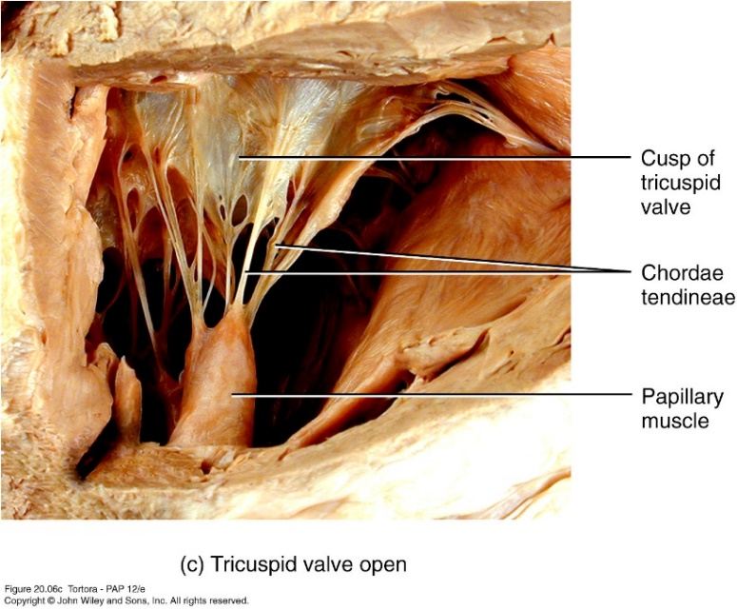
Notes:
chorda ten·​din·​ea | \ -ˌten-ˈdin-ē-ə \
plural chordae tendineae

Slide 3
Semilunar valves
Aortic and pulmonary valves
Valves open when pressure in ventricle exceeds pressure in arteries
As ventricles relax, some backflow permitted but blood fills valve cusps closing them tightly
No valves guarding entrance to atria
As atria contracts, compresses and closes opening

Slide 4
Systemic and pulmonary circulation - 2 circuits in series
Systemic circuit
Left side of heart
Receives blood from lungs
Ejects blood into aorta
Systemic arteries, arterioles
Gas and nutrient exchange in systemic capillaries
Systemic venules and veins lead back to right atrium
Pulmonary circuit
Right side of heart
Receives blood from systemic circulation
Ejects blood into pulmonary trunk then pulmonary arteries
Gas exchange in pulmonary capillaries
Pulmonary veins takes blood to left atrium

Slide 5
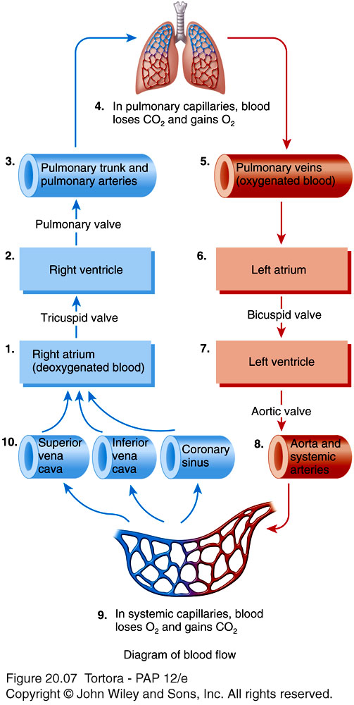
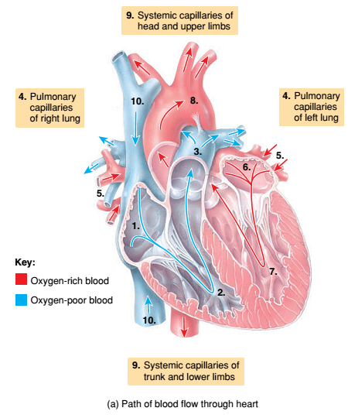

Slide 6
Coronary circulation
Myocardium has its own network of blood vessels
Coronary arteries branch from ascending aorta
Anastomoses provide alternate routes or collateral circuits
Allows heart muscle to receive sufficient oxygen even if an artery is partially blocked
Coronary capillaries
Coronary veins
Collects in coronary sinus
Empties into right atrium
Notes:
An anastomosis is a connection or opening between two things that are normally diverging or branching, such as between blood vessels, leaf veins, or streams

