Slide 1
Growth and development

Slide 2
Growth
It is the change in size resulting from invrease in the number or size of cell in body
It’s a quantitative increase in the size of body and can be measured in cm and kgz
Serial measurements are taken to asses growth and then ploted to determine pattern of growth

Slide 3
Growth( continued)
WEIGHT
Weight is best index of nutrition and growth
Chages in weight occur before change in any aspect
Average weight is 3.2 kg,new born loses upto 10%weight due to passage of meconium,urine,physiological edema and less intake.
Increase in weight is 30g/day(200g/week) during first 3 month and 150 g/ week upto 1yr of age
Birth weight is doubled at 5_6 months of age,trpled at 1yr and 4 times at 2 yrs of age then annual increase of 5 lbs per yr till puberty

Slide 6
HEIGHT
Average length at birth is 50 cm ,inc by 25cm in first yr
At 4 yr average height is 100cm and then increases by 5cm/year till puberty when growth spurt occurs increases by 9-10 cm / year for 2-3 years

Slide 9
HEAD CIRCUMFERENCE
Shows estimate of brain growth,it increase rapidly during infancy
If head size is small then should be compared to size of body

Slide 11
DENTITION
On average deciduous teeth erupts at 6months of age and eruption is complete by 2.5 yrs
Shedding of deciduous teeth starts at 6yrs and is complete by 12 yrs

Slide 13
DEVELOPMENT
It is quantitative ,functional maturation of organ systems
It takes place in cephalocaudal directiom i.e control of head precedes control of arm and b9th precedes control of arm .It is assesed under four headings
1)Gross motor
2)Fine motor and vision
3)Hearing and speech
4) social behaviour

Slide 14
DEVELOPMENT(NEONATE)
GROSS MOTOR
Turns head to one side buttocks high with hip flexed,knees under abdomen,elbow flexed
Tonic neck reflexe present when head turned to one side,limbs on other side are extendef,and opposite side flexed
Marked head lag,placing and walking reflex present
Head and hips or flexef

Slide 15
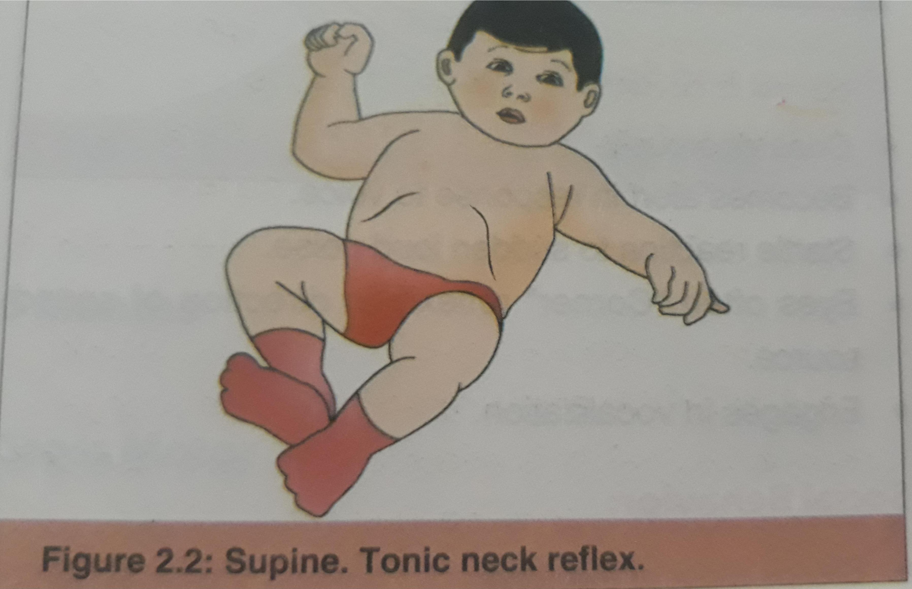

Slide 16
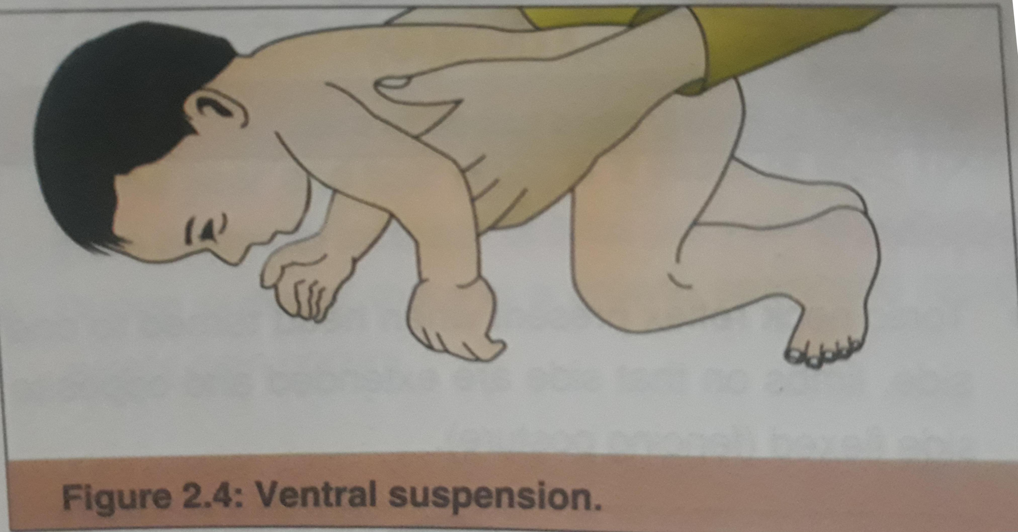

Slide 17
FINE MOTOR AND VISION
Pupils react to light
Optical closure from sudden bright light
Doll’s eye reflex present
Eyes and head turn to diffuse light

Slide 18
HEARING AND SPEECH
Cries vigrously
Becomes alert in response to light
Startle reaction to sound
Engages in vocalization

Slide 19
SOCIAL BEHAVIOUR
sleeps most of time
Moro ,rooting,sucking,and swallowing reflex are present
Hands normally closed
Social smile recognize parents
Drops toys

Slide 20
3 MONTH
GROSS MOTOR
Head is midline,limbs move symetrically,
Lifts head and chest above couch using fore arm as support
Little or no head lag
Back is straight except in lumbar region

Slide 21
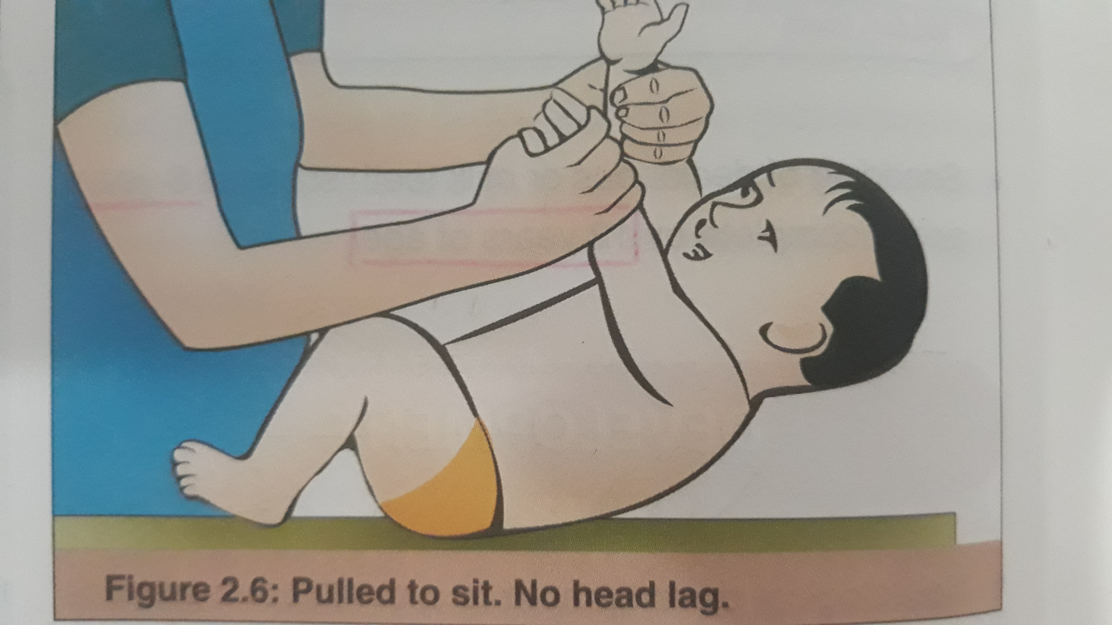

Slide 22
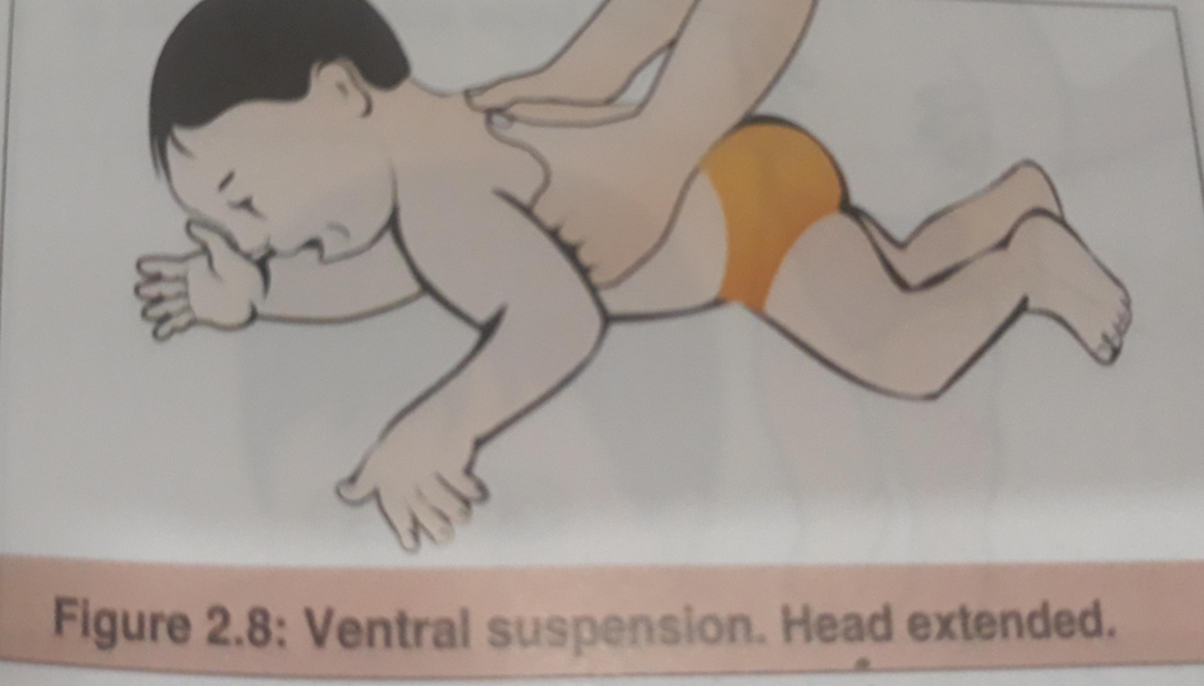

Slide 23
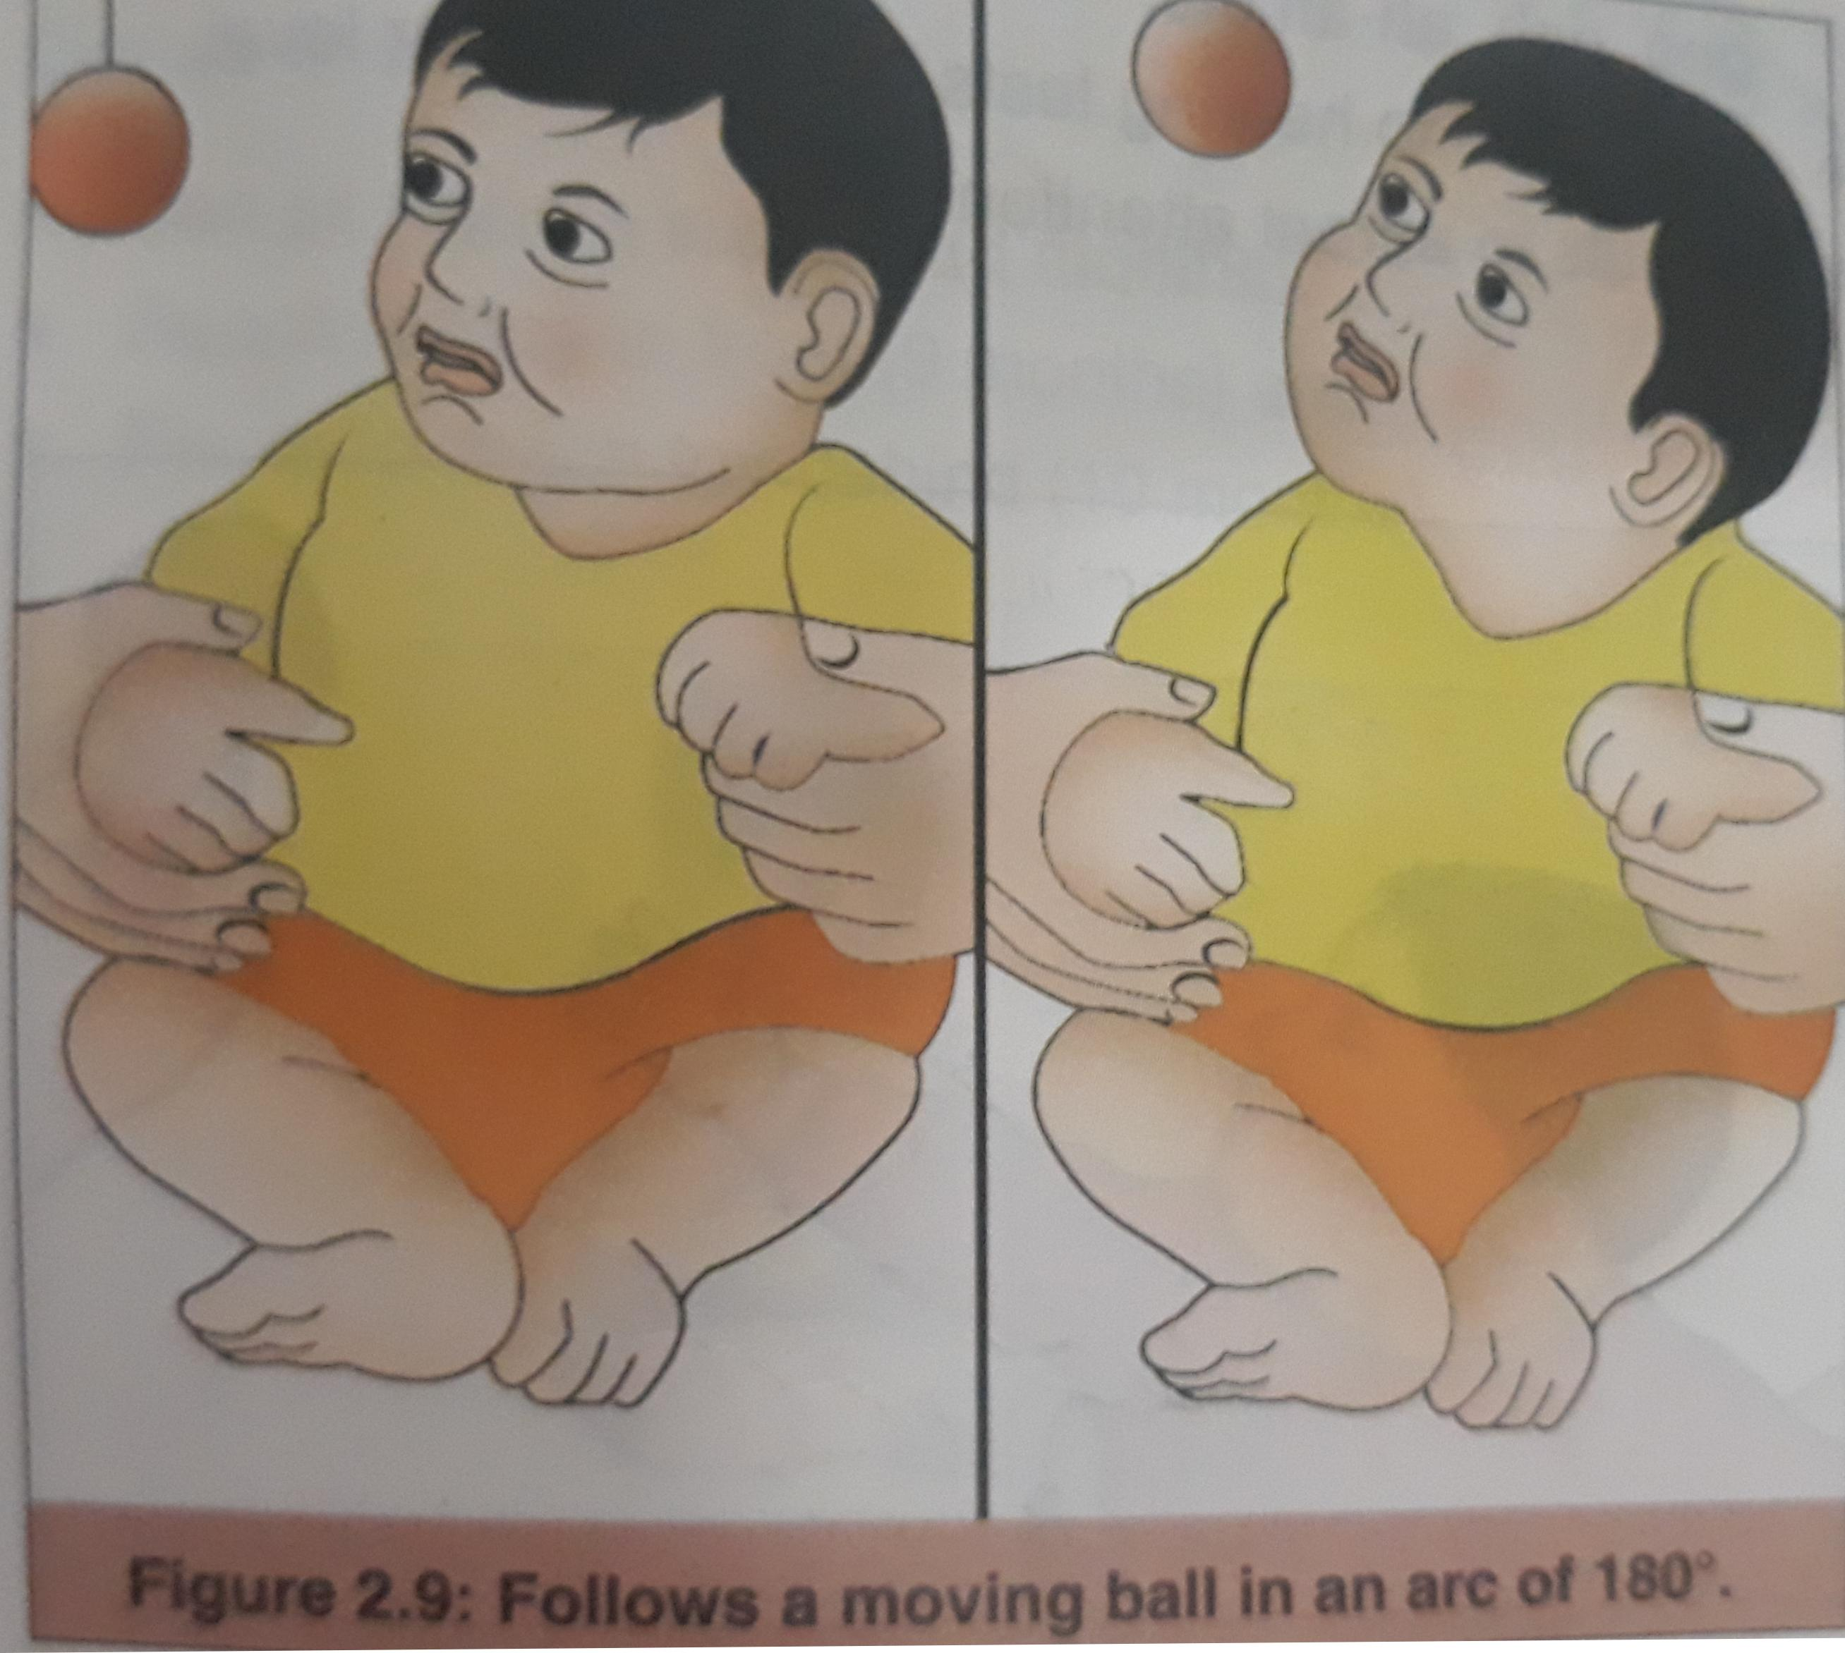
FINE MOTOR AND VISION
Follows light through arc of 180 degree
Defensive blink is present
Regards mother face
Holds rattle
Grasp cube_ first ulnar then later thumb opposition

Slide 24
HEARING AND SPEECH
Vocalizes,delighted when spoken to or pleased
Quiets to sound of rattle
Turns to nearby voice

Slide 25
SOCIAL BEHAVIOR
Happy response to mothers face when feeding
Hands largely open
Actine grasp anticipate food

Slide 26
DEVELOPMENT (6MONTHS)
GROSS MOTOR
Lifts head from pillows
Lifts leg to vertical
Grasp feet
Lifts head chest wall up supporting weight on extended arms
SITS WITH SUPPORT,stretches out arm and raises head in anticipation
Takes weight on extended legs
Downward parachute reflex present

Slide 27
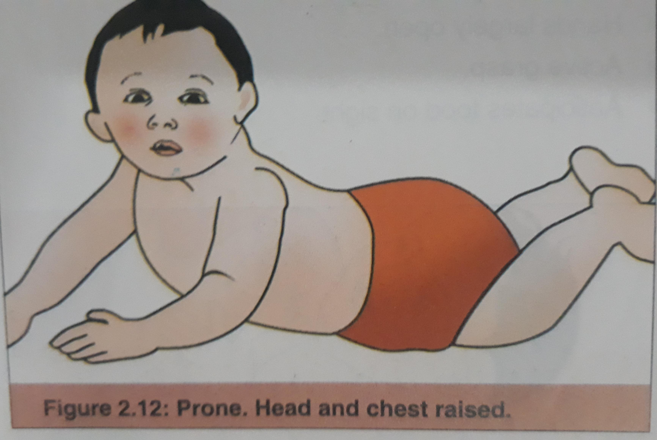

Slide 28
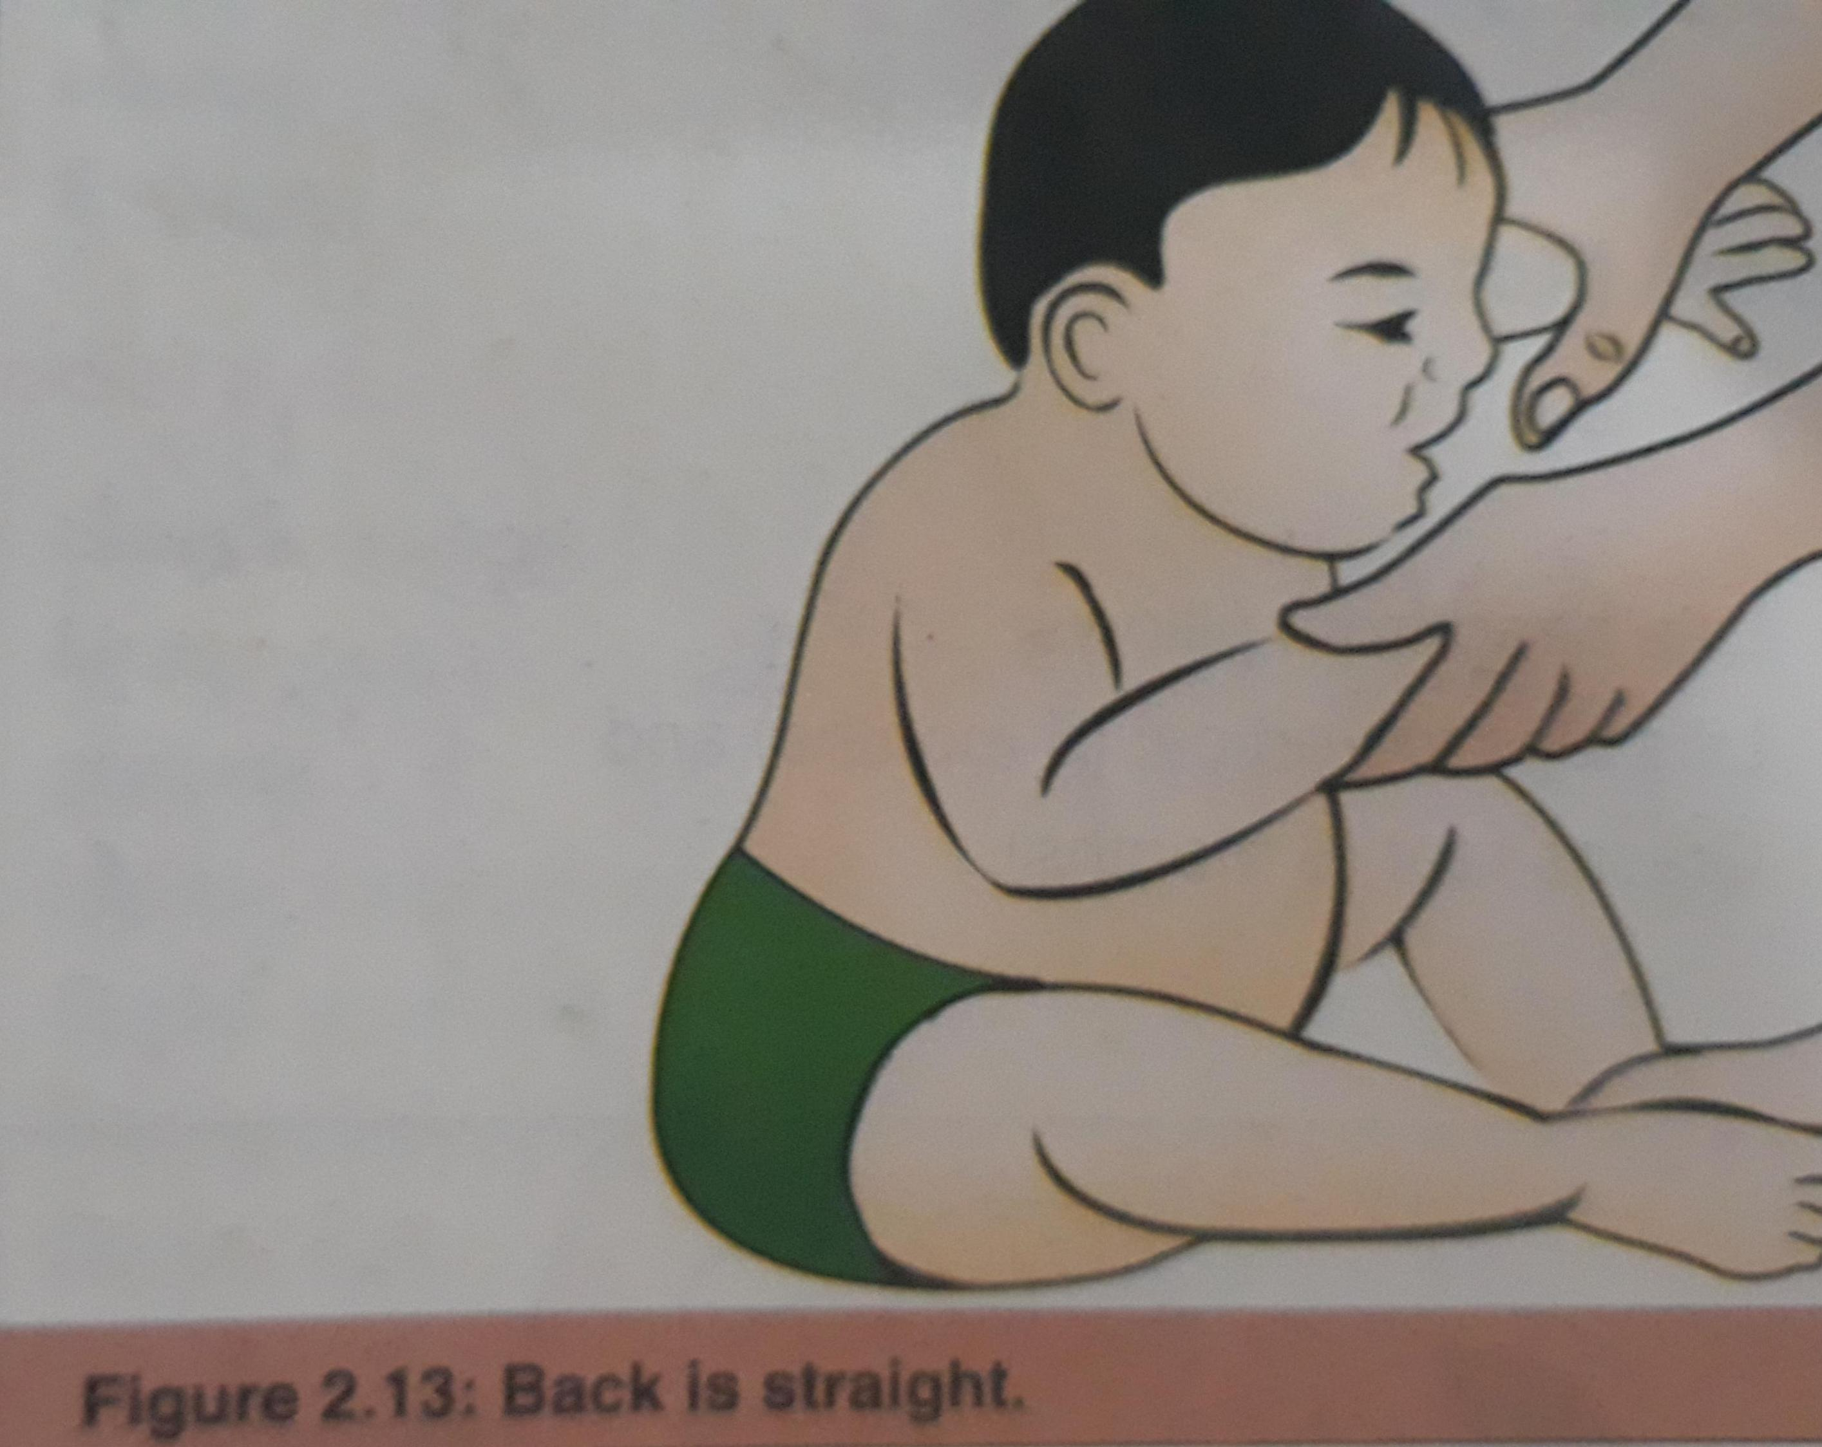
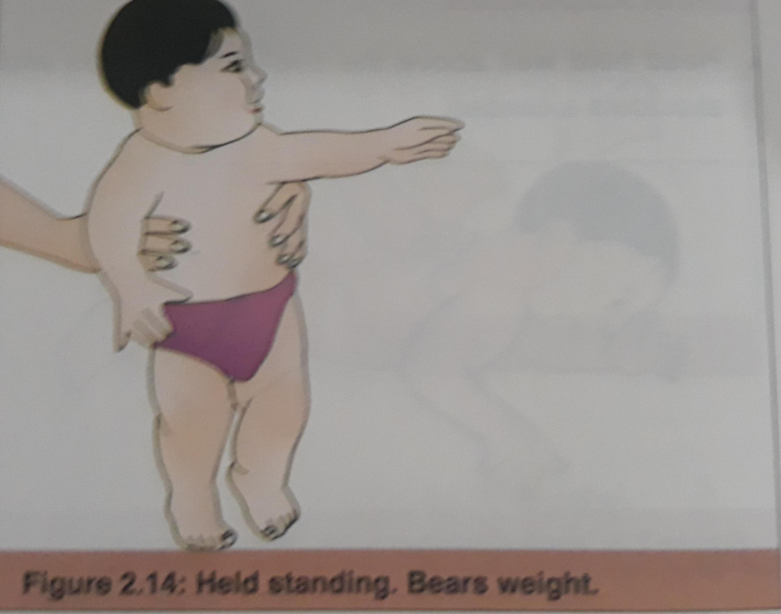

Slide 29
FINE MOTOR AND VISION
Reaches with one hand
Follows dangling ball in all direction
Both eyes in unison
PALMER GRASP present

Slide 30
HEARING AND SPEECH
Vocalizes in single or double Syllables
Response to hearing test at 1 foot interval

Slide 31
SOCIAL BEHAVIOUR
Takes every thing to mouth
Sits alone ,friendly with stranger
Imitiates bye_bye

Slide 32
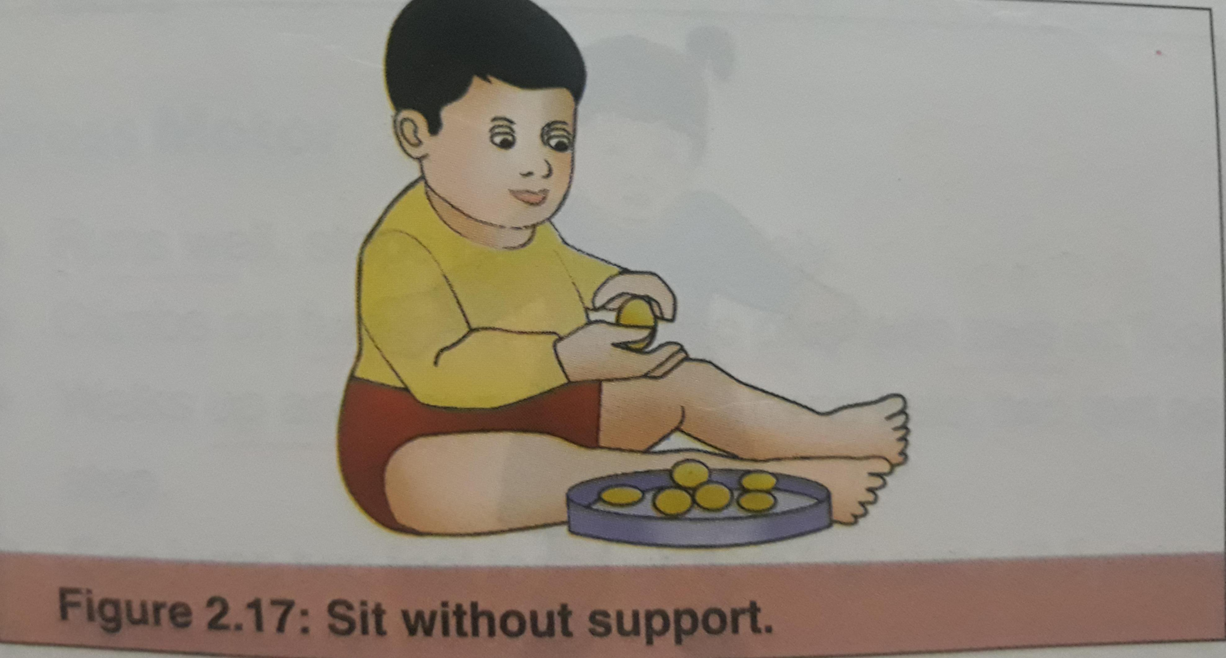
DEVELOPMENT(9MONTH)
GROSS MOTOR
Sits without support 8 month
Reach for toy in front 9month
Pivots to reach toy behind 10 month
Can crawl
Pulls to stand

Slide 33
FINE MOTOR AND VISION
Alert to peripheral vision
Drops an object and looks at fallen object
Uncovers the toy
Grasps string between infex finger and thumb

Slide 34
HEARING AND SPEECH
Localizes sound
Babbles long syllables(baba,dad-dad,agaga)
SOCIAL BEHAVIOUR
Holds bites and chews biscuit
Fear of stranger present
Plaus peek –a-boo and imitates hand clapping

Slide 35
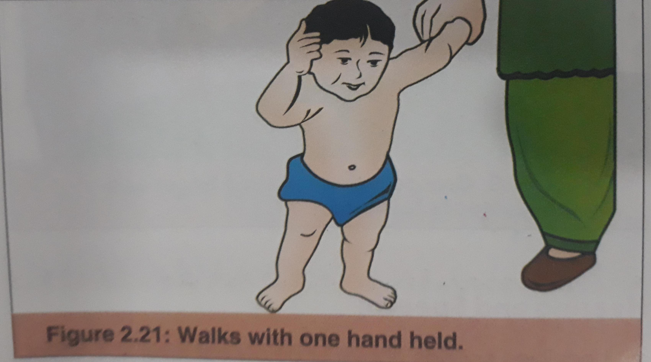
DEVELOPMENT(12MONTH)
GROSS MOTOR
Can walk holding furniture
Walks with one hand held
FINE MOTOR
Pincer grasp
Turns pages of book
Tries to build tower of 2 cubes

Slide 36
HEARING AND SPEECH
Turns to own name says 2_3 words,speaks one real word
Says amma baba,,knows 5_6 words
SOCIAL BEHAVIOR
Helps while dresding while holding out arm
Gives toys on request
Drinks from cup with little assistance

Slide 37
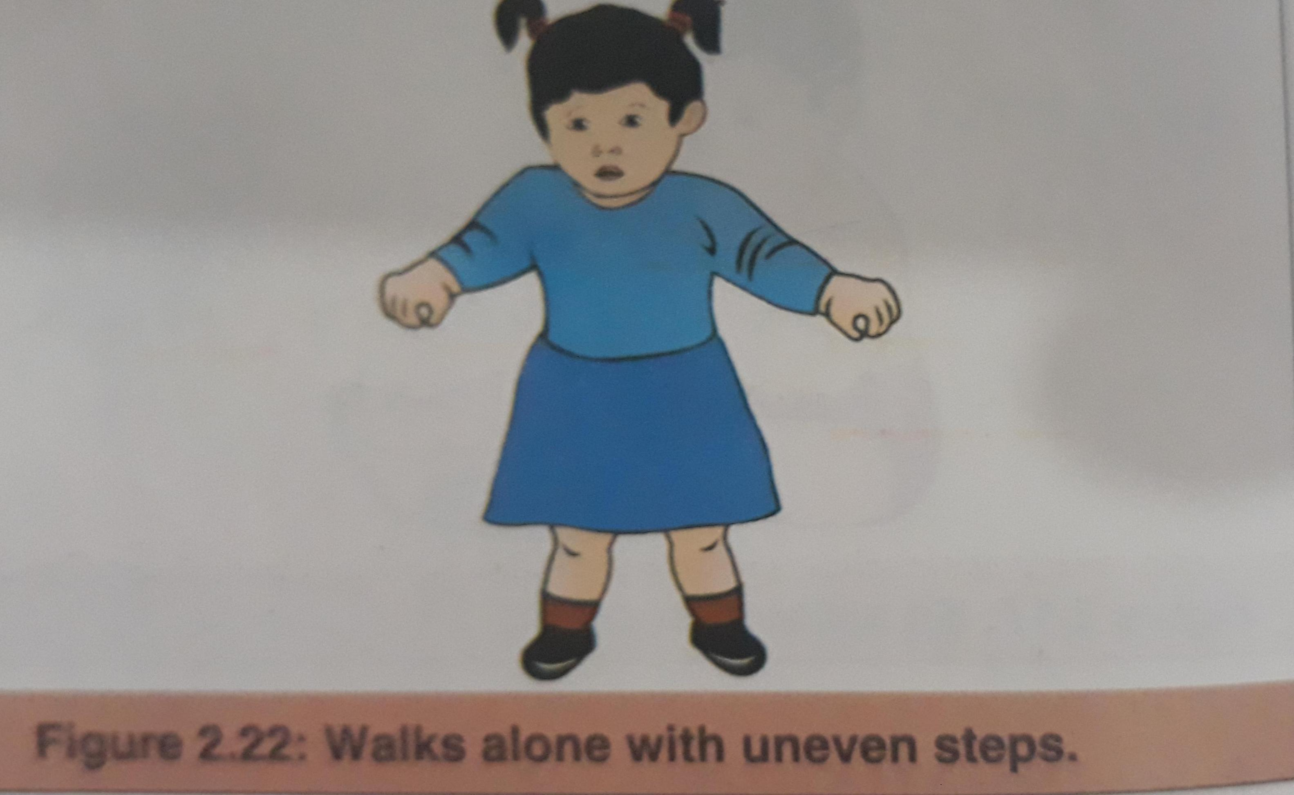
DEVELOPMENT (18 MONTHS)
GROSS MOTOR
Walks alone with uneven steps and feet apart
Throws ball, walks upstairs with one hand held
FINE MOTOR
Tripod grasp
Build tower of 3 cubes
Turns several pages of book at time

Slide 38
HEARING AND SPEECH
Uses 6-20 recognizable words
Obeys simple instructios
Names pi ctures
SOCIAL BEHAVIOUR
Feed self with spoon
Still wets paint
Takes off shoes and socks

Slide 39
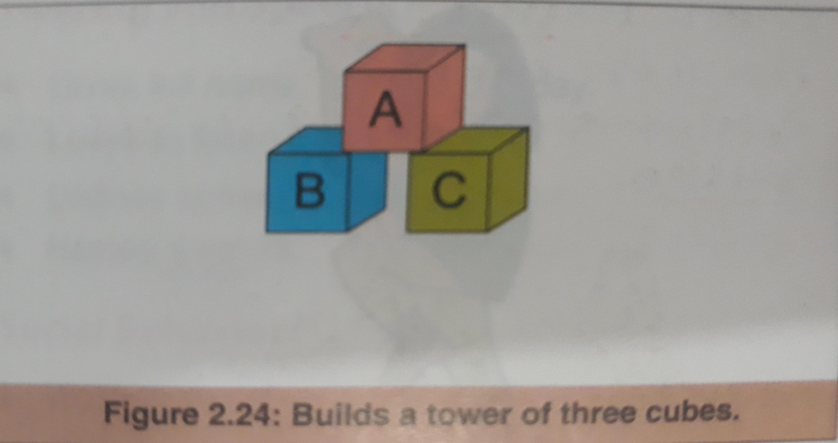
DEVELOPMENT(2YEARS)
GROSS MOTOR
Runs well,stops and start safely
Opens door,can jump 2 feet together
Kicks ball on request
FINE MOTOR AND VISION
Picks up pins ,thread.
Builds tower of six cubes
Hold pencil and scrible
Makes bridge with 3 cubes

Slide 40
HEARING AND SPEECH
Joins 2-3 words to form sentence
Refers to self by name
Uses 50 or more words
SOCIAL BEHAVIOR
Verbalizes toilet needs ,handles spoon well
Enjoy pictures book and stories
Usually dry by day
Pulls down pants or knickers at toilet

Slide 41
DEVELOPMENT(3YEARS)
GROSS MOTOR
Walks upstairs with alternating feet
Rides tricycle
Can walk tip toe
FINE MOTOR AND VISION
Builds tower of 9_10 cubes
Copies a circle

Slide 42
SPEECH AND HEARING
Gives full name and knows age and sex
Knows several nursery rhymes
Counts upto 10 or more
Counts 3 objects correctly
SOCIAL BEHAVIOR
Washes and dries hand under supervisiom
Dry by night,can pull paints down or up
Enjoys floor play

Slide 43
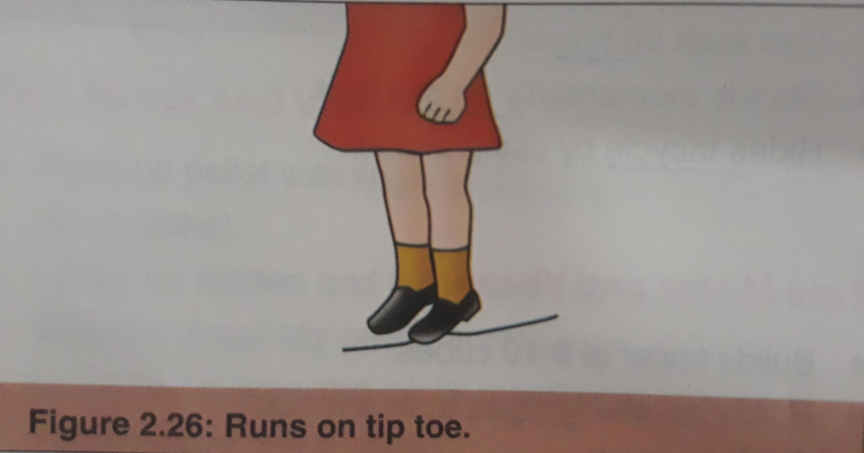
DEVELOPMENT (4YEARS)
GROSS MOTOR
Walks downstairs with alternating feet
Runs on tiptoe,climbs well
Runs and turns without losing balance
FINE MOTOR AND VISION
Draws a man with head,leg,trunk
Uses scissor to cut paper
Can copy a cross

Slide 44
HEARING AND SPEECH
Gives full name and home address
Counts upto 20 or more
SOCIAL BEHAVIOR
Washes and dries hand
Brushes teeth
Can dress and undress except shoe laces
Knows days of week,self care at toilet,tells a story

Slide 45
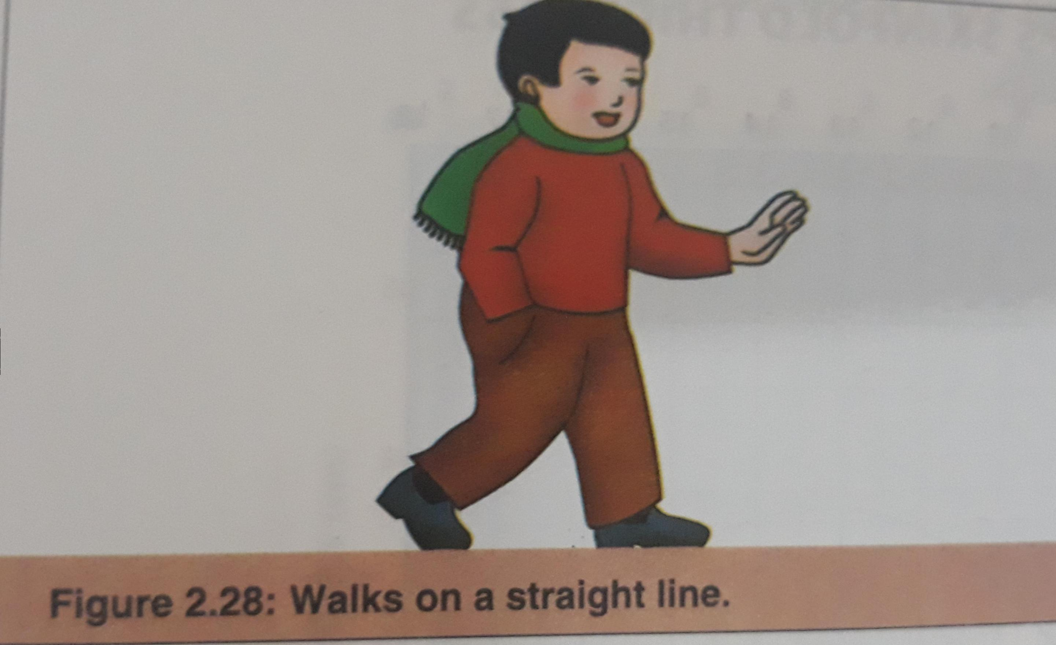
DEVELOPMENT (5YEARS)
GROSS MOTOR
Hops and skip on one foot
Walks on straight line
Runs up and down stairs ,can catch a ball
FINE MOTOR AND VISION
Thread large needle and sew real stitches
Copies square and triangle at 5 years

Slide 46
HEARING AND SPEECH
Gives full name,age birthday
Names 4 colors,loves to listen stories
Defines correct nouns
SOCIAL BEHAVIOR
Dresses and undresses alone
Goes to school unattended
Washes and dries hands and face
Knows right and left hand

