Slide 1
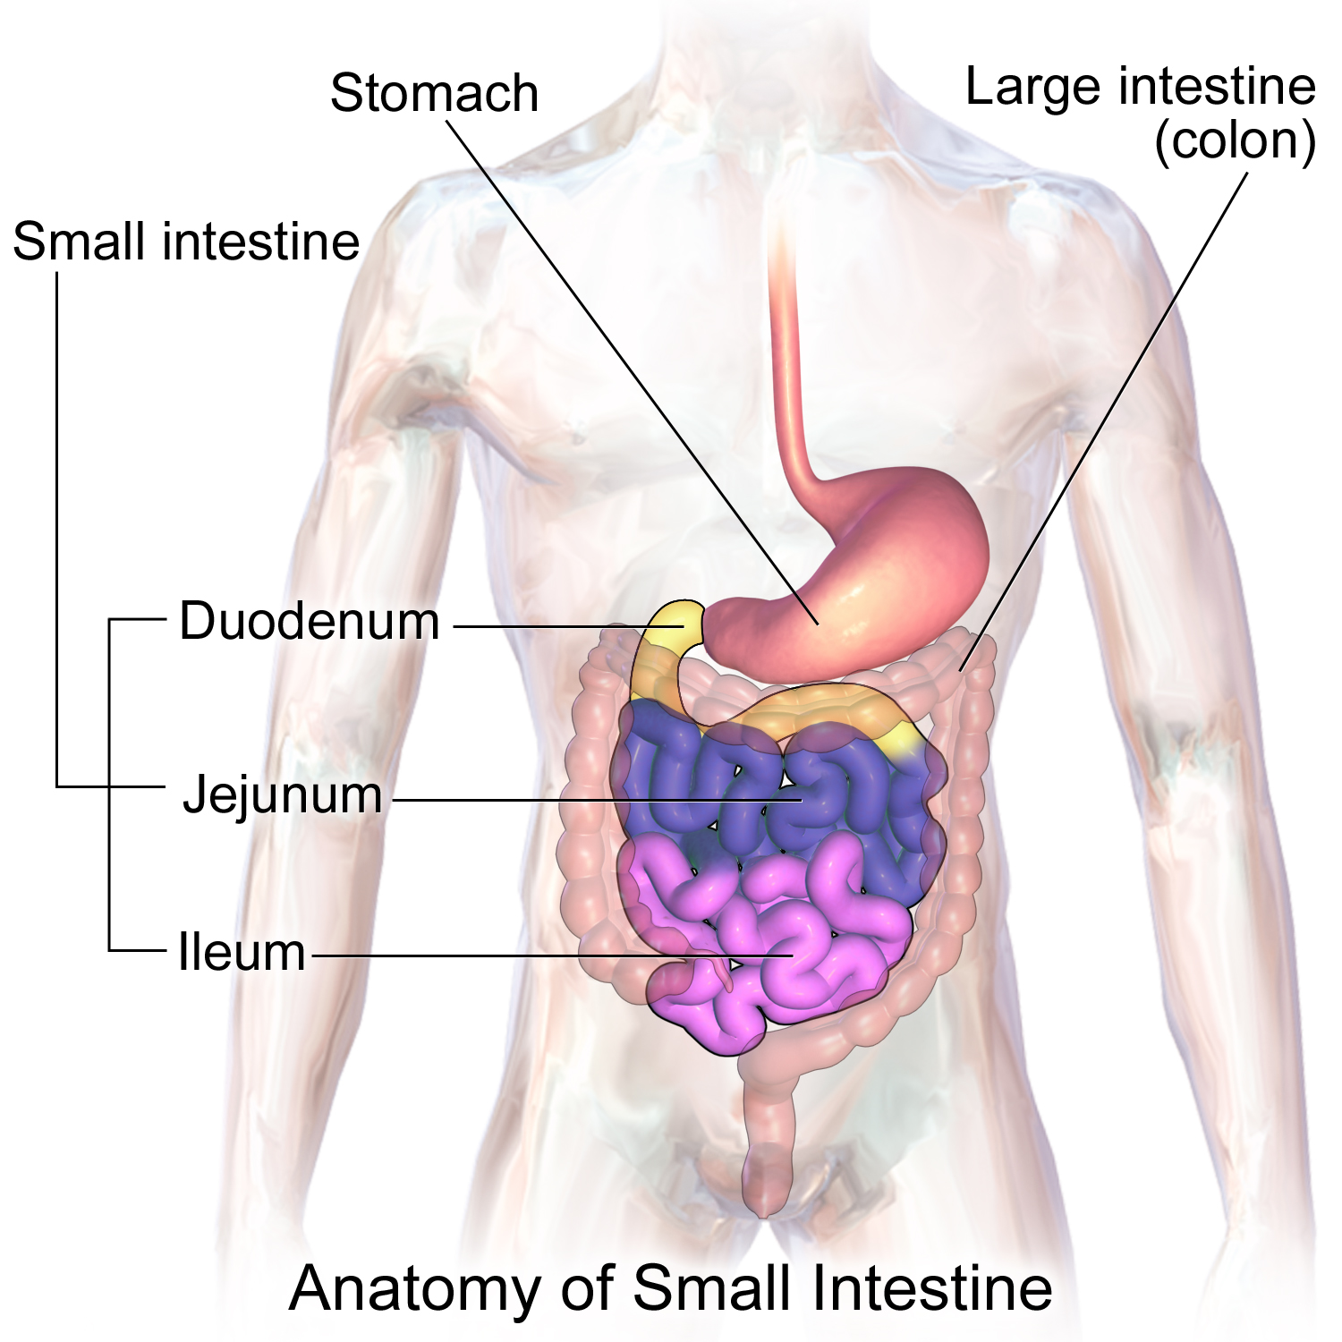

Slide 2
Small Intestine
Is the longest component of the digestive tract
Is divided into three anatomic segments:
duodenum, jejunum, and ileum
Functionally, it is the principal site for the digestion of food & for absorption of the products of digestion

Slide 3
Small Intestine
Mucosa of small intestine has macroscopic and microscopic features.
Plicae circulares: ( valves of kerckering)
Deep circular folds of the mucosa and submucosa are visible to naked eye, most abundant in jejunum and absent in proximal part of duodenum and distal half of ileum.
Villi:
Finger-like projections of the mucosa that extend into the intestinal lumen (epithelium plus lamina propria). Leaf shaped villi in the duodenum and finger like in ileum.

Slide 4
Plicae circularis

Slide 5
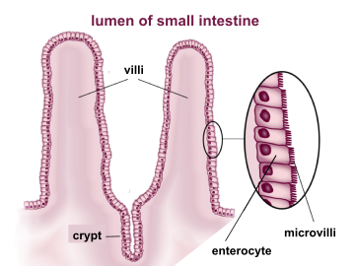
Villi
Finger like projection of mucosa
Contain fenestrated capillaries network a central blind ending lymphatic capillary (lacteal) and few smooth muscle fibers. Are covered by simple columnar epithelium

Slide 7
Intestinal crypts: (Crypts of Lieberkühn)
Deep invaginations of mucosa between the base of the villi, are simple tubular glands.
Microvilli :
The absorptive cells (enterocyte) lining the intestinal villi possess microvilli on their apical surface.
Notes:
numerous projections of apical plasma membranes of absorptive mucosal cells and give the apical region of the cell a striated appearance, called striated border (brush border)

Slide 9
SMALL INTESTINE
Mucosa:
Epithelium : simple columnar
Lamina propria :
Loose connective tissue rich in blood and lymphatic vessels present in the core of the villi and between crypts.
The lamina propria contains lymphocytes and other cells of immune system( plasma cell, macrophages, mast cells and eosinophils).
In the ileum the lymphoid follicles combine to form lymphoid masses called peyer’s patches.
Muscularis mucosae :
Thin layer of smooth muscle located at the base of the crypts

Slide 10
Submucosa :
Consists of loose connective tissue which contains blood vessels, lymphatics and nerve plexus.
Submucosa of duodenum contains branched tubular glands called duodenal or Brunners glands open into the intestinal crypts.
Muscularis externa:
Inner = circular
Outer = longitudinal
(between two layers myenteric ( Auerbach’s) plexus of nerve is present.)

Slide 11
Serosa :
Most of the small intestine is covered by serosa consisting of thin layer of connective tissue .
Posterior surface of duodenum is covered by adventitia.

Slide 12
Epithelium of Small Intestine
Mucosa is lined by simple columnar epithelium that covers the crypts and villi.
Intestinal epithelium contains six types of cell:
Enterocytes
Goblet cells
Enteroendocrine cells
Paneth cells
Stem cells
M cells

Slide 13
Enterocytes
Are absorptive cells ,tall columnar having oval nucleus at base .
Apical surface has closely packed microvilli.
Under LM microvilli show striated appearance to the free border is known as striated border or brush border.

Slide 15
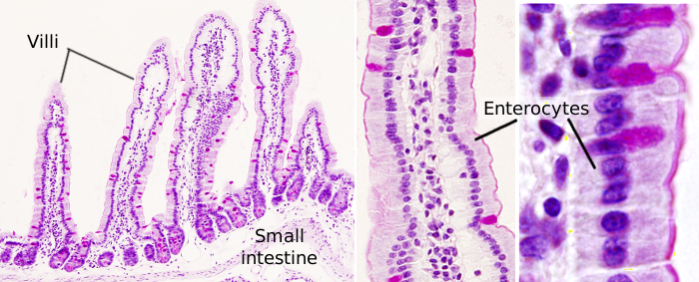

Slide 16
Goblet cells
Mucous secreting ,unicellular glands present in between the enterocyte cells, increase in number from the proximal to the distal part of small intestine.
These cells have typical shape of goblet,apical part which contain mucin granules.
The narrow elongated part contains nucleus and other organelles.
They secrete mucin molecules come in contact with water to form mucus.

Slide 17
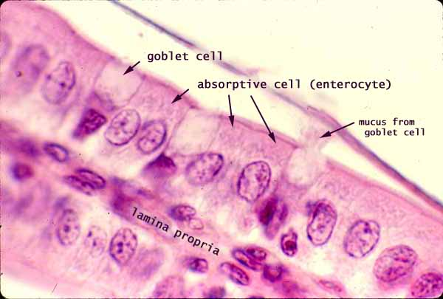
Goblet cells

Slide 18
Epithelium lining the small intestine simple columnar

Slide 20
Enteroendocrine cells
These cells are present in the crypts of liberkuhn of the small intestine.
These cells produce different hormones.
Main hormones include choleccystokinin,gastric inhibitory peptide , secritin and motilin.

Slide 21
Paneth cell
These cells are present only in the bottom of crypts of lieberkuhn.
Paneth cells have basophilic basal cytoplasm and acidophilic granules in the apicalcytoplasm.
The secretory granules contains bactericidal agent lysozyme,defensive proteins called defensins and zinc.

Slide 22
M cells

Slide 23
Enterocytes (absorptive cells)
Goblet cells
Enteroendocrine cells
Paneth cells
M cells

Slide 24
The epithelium of the villus
Enterocytes (absorptive cells)
Goblet cells – unicellular mucin- secreting glands, increase in number from
the proximal to the distal
small intestine
Enteroendocrine cells resemble those described in the stomach

Slide 25
The epithelium of the crypt
Enterocytes (absorptive cells)
Goblet cells
Enteroendocrine cells
Paneth cells – are found in the bases of the glands. They have a basophilic basal cytoplasm & large, intensely acidophilic apical secretory granules. These granules contain: the antibacterial enzyme lysozyme (digests the cell walls of certain groups of bacteria), glycoproteins, an arginine-rich protein & zinc. The antibacterial action & the phagocytosis of certain bacteria & protozoa by Paneth cells suggest that they have a role in regulating the normal bacterial flora of the small intestine.
Undifferentiated cells

Slide 29
Goblet cell

Slide 30
Regional variations in the small intestine
DUODENUM
Presence of Brunner's glands in the submucosa - compound tubuloalveolar branched glands, mixed glands
Presence of chyme in the small intestine induces cells of Brunner's glands to secrete alkaline mucus that neutralizes gastric acid and pepsin and further promotes digestion
No plicae circulares

Slide 33
Regional variations in the small intestine
JEJUNUM
No glands in the submucosa
Longest villi of all three regions
No lymphoid nodules

Slide 36
Regional variations in the small intestine
ILEUM
Permanent aggregated lymphoid nodules in the lamina propria.
Shortest villi
Highest number of goblet cells

