Slide 1
TRACTION
MOHSANA TARIQ
(BSPT, PP.DPT)
LECTURER,
SARDOGHA MEDICAL COLLEGE

Slide 3
TRACTION
“Traction is the application of a mechanical Force to the body in a way that separates, or attempts to separate the joint surfaces and elongate the surrounding soft tissues.”
Traction can be applied manually by the clinician or mechanically by a machine.
Traction can also be applied by the patient using body weight and the force of gravity to exert a force.
Traction can be applied to the spinal or peripheral joints.
Focuses on application of mechanical traction to the cervical and lumber region.

Slide 4
It has been stated that spinal traction can distract joint surfaces
Reduce protrusions of nuclear discal material.
Stretch soft tissue.
Relax muscles, and
Mobilize joints.
Low-force traction, of 10 to 20lb, applied for a long duration, ranging from hours to a few days, can also be used to temporarily immobilize a patient.
All of these effects may reduce the pain associated with spinal dysfunction.
The stimulation of sensory mechanoreceptors that occurs with the application of traction may also gate the transmission of pain along afferent neural pain pathways.

Slide 5
EFFECTS OF SPINAL TRACTION
Joint Distraction
Reduction of Disc Protrusion
Soft Tissue Stretching
Muscle Relaxation
Joint Mobilization
Patient Immobilization

Slide 6
1. Joint distraction
Joint distraction is defined as
“The separation of two articular surfaces perpendicular to the plane of articulation.”
Distraction of the spinal apophyseal joints may prove beneficial for the patient who has signs and symptoms related to loading of these joint compression of the spinal nerve roots as they pass through the intervertebral foramina.
Joint distraction reduces compression on the joint surfaces.
Widens the intervertebral foramina.
Potentially reducing pressure on articular surfaces, intra articular structures or the spinal nerve roots.
Thus joint distraction may reduce pain originating from joint injury or inflammation or from nerve root compression.

Slide 7
The application of a traction force to the spine can cause distraction of spinal apophyseal joints.
For distraction to occur, the force applied must be great enough to cause sufficient elongation of the soft tissues surrounding the joint to allow the joint surfaces to separate.
Smaller amount of force will increase the tension on, elongate soft tissues of the spine with out separating the joint surfaces.
For example. a force equal to 25% of patient's bodyweight has been shown to be sufficient to increase the length of the lumbar spine.
However force equal to 50% of the patient's body weight has been found to be necessary to distract the LUMBER zygapophyseal joints.
T he amount of required to distract the spinal joints also varies with the location and health of the joints.
In general, larger lumbar joints. which have more and tougher surrounding soft tissues, require more force to achieve joint distraction than do the smaller cervical joints.
In contrast to lumber spine,a force equal to approximately 7% of total body weight has been reported to be sufficient to distract the cervical vertebrae.
Same magnitude of force produces greater vertebral separation in healthy spines than in spines with signs of disc degeneration.

Slide 8
2. REDUCTION OF DISC PROTRUSION
According to Cyriax,
“Traction is the treatment of choice for small nuclear protrusions.”
The proposed mechanisms for disc realignment include clicking back of a disc fragment, suction due to decrease intra discal pressure pulling displaced parts of the disc back toward the center or tensing of the posterior longitudinal ligament at the posterior aspect of the disc, thereby pushing any posteriorly displaced discal material anteriorly toward its original position.

Slide 9
Studies using a variety of diagnostic imaging techniques, including discography, epidurography, and (CT), have demonstrated that lumbar traction, using a force of 27 to55 kg (60 to 120lb) can reduce a disc prolapse cause retraction of herniated discal material, and result in clinical improvement in those patients in whom the discal defects are reduced.
These symptomatic improvements may be the result of reducing the discal protrusion or may be due to concurent changes in other associated structures, such as;
Increased size of the neural foramina,
changes in the tension on soft tissues or nerves,
or modification of the tone of the low back muscles.

Slide 10
3. SOFT TISSUES STRECHING
Traction has been reported to elongate the spine and increase the distance between the vertebral bodies and the facet joint surfaces.
Its is proposed that these effects are due to increased length of the soft tissues in the area, including the muscles, tendons, ligaments, and discs.
Soft tissue stretching using a moderate-load, prolonged force, such as that provided by spinal traction, has also been shown to increase the length of tendons and to increase joint mobility.
Increasing the length of the soft tissues of the spine may provide clinical benefits by
contributing to spinal joint distraction
or reduction of disc protrusion,
or by increasing spinal range of motion (ROM) and
Decreasing the pressure on the facet joint surfaces, discs, and inter vertebral nerve roots even when complete joint surface separation is not achieved.

Slide 11
4. MUSCLE RELAXATION
Spinal traction has been reported to facilitate relaxation of the paraspinal muscles.
It has been proposed that this effect may be the result of pain reduction due to
reduced pressure on pain-sensitive structures or
gating of pain transmission by stimulation of mechanoreceptors by the oscillatory movements produced by intermittent traction.
reduction of pain by any means can facilitate muscle relaxation and a reduction of muscle spasms by interrupting the pain-spasm-pain cycle.
It has also been proposed that static traction may cause muscle relaxation as a result of the depression in monosynaptic response caused by stretching the muscles for several seconds and that intermittent traction may cause small changes in muscle tension to produce muscle relaxation by stimulating the Golgi tendon organs (GTOs) to inhibit alpha motor neuron.

Slide 12
5. JOINT MOBILIZATION
Traction has been recommended as a means to mobilize joints in order to increase joint mobility or decrease joint-related pain.
Joint mobility is thought to be increased by high-force traction due to stretching of the surrounding soft tissue structures.
When lower levels of force are applied, the repetitive oscillatory motion of intermittent spinal traction may also move the joints sufficiently to stimulate the mechanoreceptors
and thus decrease joint-related pain by gating the afferent transmission of pain stimuli.
In this manner the effects of spinal traction may be similar to those produced by manual joint mobilization techniques, except that with most traction techniques a number of joints are mobilized at one time, whereas with manual techniques the mobilizing force can be more localized.

Slide 13
6. PATIENT IMMOBILIZATION
Very low load, prolonged static traction, using 4.5 to 9 kg (10 to 20 lb) applied for long periods of hours to days, can be used to temporarily immobilize a symptomatic spinal area and thereby relieve symptoms, that can aggravated by movement.
The benefits of such treatment are thought to be the result of enforced limited mobility and bed rest produced by the belts and harnesses used to apply the traction, rather than being a direct effect of the traction force

Slide 14
CLINICAL INDICATION FOR THE USE OF SPINAL TRACTION
DISC BULGE OR HERNIATION
NERVE ROOT IMPINGEMENT
JOINT HYPOMOBILITY
SUBACUTE JOINT INFLAMMATION
PARASPINAL MUSCLE SPASM

Slide 15
1. DISC BULGE AND HERNIATION
spinal traction relieve symptoms associated with disc bulge or herniated nucleus pulposus.
primary proposed mechanism of this beneficial effect is reduction of the disc bulge or protrusion and thus reduction of compression on the spinal nerve roots.
traction is most likely to improve the patient's outcome if it is applied soon after a discal injury when there is protrusion of soft nuclear discal material.
This is because traction can reduce not only the protrusion but can also reduce the risk of further protrusion.

Slide 16
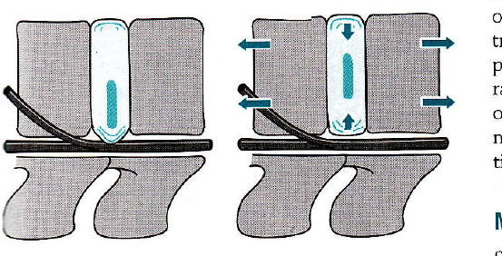

Slide 17
2. NERVE ROOT IMPINGEMENT
Traction has been reported to help alleviate signs and symptoms associated with spinal nerve root impingement, particularly if it is applied shortly after the onset of such symptoms.
Traction is generally recommended as the treatment of choice for patients with neurological deficits from spinal nerve root impingement.
Such impingement may be caused by bulging or herniation of discal material, or by ligament encroachment, narrowing of the intervertebral foramen, osteophyte encroachment, spinal nerve root swelling, or spondylolisthesis
If sufficient traction force is applied, the size of the neural foramen may temporarily be increased, reducing pressure on the spinal nerve root.
F0r example, when cervical lateral flexion and rotation to the same side, which both narrow the intervertebral foramen, a remarkedly limited by arm pain on the same side, indicating impingement of cervical nerve roots, the application of traction may effectively reduce the arm pain by increasing the size of the neural foramen and decreasing pressure on the involved nerve.
Clinically , in general, those patients who report aggravation of symptoms with increased spinal loading and easing o f symptoms with decreased spinal loading are more likely to respond well to treatment with traction.
traction is also recommended to the patients with symptoms of radiating pain or parasthesia that do not improve with trunk movements.

Slide 18
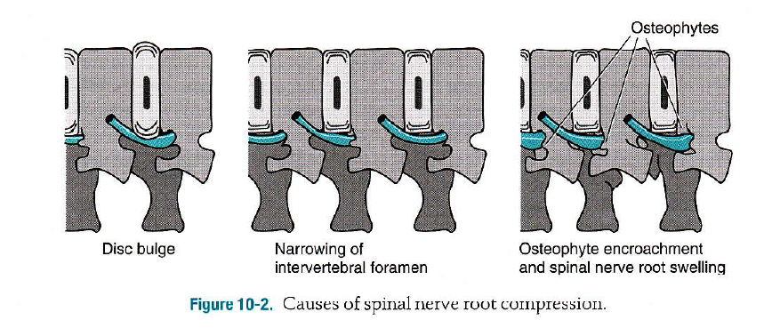

Slide 19
3. JOINT HYPOMOBILITY
Because longitudinal spinal traction can glide and distract the spinal facet joints and stretch the soft tissues surrounding these joints.
spinal traction may prove beneficial in the treatment of symptoms caused by joint hypomobility.
However, spinal traction is not generally the optimal treatment if only individual segments are hypomobile.
because it applied a mobilizing force to multiple rather than single spinal levels.
Such nonspecific mobilization could prove deleterious to the patient with hypomobility of one segment and hypermobility of adjoining segments.

Slide 20
4. SUBACUTE JOINT INFLAMMATION
Traction has been recommended for reducing the pain and limitations of function associated with sub acute joint inflammation.
The force of traction can be used to reduce the pressure on inflamed joint
While the small movements of intermittent may control pain by gating transmission at the cord level.
These movements may also help to train normal fluid exchange in the joints to reduce edema in or around the joints caused by inflammation.
Spinal traction can be used safely the sub acute or chronic stages of joint inflammation.
However ,traction should not be applied after acute injury when the repetitive motion may cause further injury or amplify the inflammatory response.

Slide 21
5. PARASPINAL MUSCLE SPASM
The maintained stretch of static traction or the repititive motion of low-load, intermittent traction help to reduce paraspinal muscle spasm.
This effect may be secondary to reduction in pain and the consequent interruption of pain-spasm-pain cycle
or may be caused by inhibition of alpha motor neuron firing due to depression of the mono synaptic response or stimulation of GTOs.
Higher load spinal traction may also alleviate protective paraspinal muscle spasms by reducing the underlying cause of pain, such as a disc or herniation, or a nerve root impingement, interrupting the pain-spasm-pain cycle.

Slide 22
CONTRA INDICATION AND PRECAUTIONS OF SPINAL TRATION

Slide 23
CONTRAINDICATIONS
Where motion is contraindicated
With an acute injury or inflammation
Joint hypermobility or instability
Peripheralization of symptoms with traction
Uncontrolled hypertension(for inversion traction)

Slide 24
Where motion is contraindicated
Traction should not be used if motion is contraindicated in the area to be affected
for example,
with an unstable fracture,
in cases of cord compression,
Or shrortly after spinal surgery

Slide 25
With an acute injury or inflammation
Acute inflammation may occur immediately after
trauma
or surgery
or as the result of an inflammatory disease such as rheumatoid arthritis
or osteoarthritis.
Static or intermittent traction may
aggravate acute inflammation
or interfere with the healing of an acute injury,
traction should not be applied under these conditions.

Slide 26
To hypermobile or unstable joint
High-force traction should not be used in areas of joint hypermobility or instability because it may further increase the mobility of the area.
Therefore the mobility of joints in the area to which one is considering applying traction should be assessed before the traction is applied.
Joint hypermobility may be the result of a recent fracture, joint dislocation, or surgery,Or it can be due to an old injury, high relaxin levels during pregnancy and lactation, poor posture, or congenital ligament laxity
Joint hypermobility and instability, particularly of the C1-C2 articulations, is also common in patients with rheumatoid arthritis, Down's syndrome, and Marfan's syndrome due to degeneration of the transverse atlantar ligament.
Therefore cervical traction should not be applied to patients with these diagnoses until the integrity of the transverse atlantar ligament and the stability of the C1-C2 articulations have been ascertained.

Slide 27
With peripheralization of symptoms
Traction should be discontinued or modified immediately if it causes peripheralization of symptoms
Because in general progression of spinal symptoms from central area to a more peripheral area is indicative of worsening nerve function and increasing compression.

Slide 28
PRECAUTIONS
Structural disease or conditions affecting the spine( e.g. tumor, infection, or rheumatoid arthritis, osteoporosis, or prolonged systemic steroid use)
When pressure of the belts may be hazardous(e.g. with pregnancy, hiatal hernia, vascular compromise, osteoporosis)
Displacement of annular fragment
Medial disc protrusion
Severe painfully relieved by traction
Claustrophobia
Parients who cannot tolerate the prone or supine posture
Disorientation
Temporomandibular joint (TM) problems
Dentures

Slide 29
1. Structural disease or conditions affecting the spine( e.g. tumor, infection, or rheumatoid arthritis, osteoporosis, or prolonged systemic steroid use)
Traction should be applied with caution when the structural integrity of the spine may be compromised.
Structural compromise most commonly occurs due to a tumor, infection, rheumatoid arthritis, osteoporosis or prolonged systemic steroid use.
In these circumstances, the spine may not be strong enough to sustain the forces of the traction, and therefore injury may result from the application of strong traction forces.
Radiographic reports and other studies that may indicate the nature and severity of the structural compromise should be checked before deciding to apply traction to patients with these conditions.

Slide 30
2. When pressure of the belts may be hazardous(e.g. with pregnancy, hiatal hernia, vascular compromise, osteoporosis)
Pelvic belts used for the application of mechanical lumbar traction may apply excessive abdominal pressure to pregnant patients or to those with hiatal hernia may place excessive pressure on the inguinal region on those with femoral artery compromise.
Compression in the area of the femoral arteries in the inguinal region can be avoided by ensuring that the pelvic belt is positioned with its lower edges superior to femoral triangle and by tightly securing the belt and keeping it in direct contact with the skin to prevent it from slipping down during treatment.
There is also concern that the pelvic or thoracic belts may apply excessive pressure to the pelvis or ribs of patients with osteoporosis.
Because the thoracic belts used for fixation of patient during application of lumbar traction may constrict respiration.
it is also recommended that lumbar traction be applied with caution to patients with cardiac or pulmonary disorders.

Slide 31
3. Displacement of annular fragment
Once a fragment of annulus has become displaced and is no longer connected to the body of the disc,
Traction is not likely to change the position of the disc fragment, and therefore treatment with traction is also not likely to improve the patient's symptoms.

Slide 32
4. Medial disc protrusion
It has been proposed that traction may aggravate symptoms caused by a medial disc protrusion
because, in such circumstances the medial movement of the nerve root caused by a traction force may increase the impingement of the disc on the nerve.

Slide 33
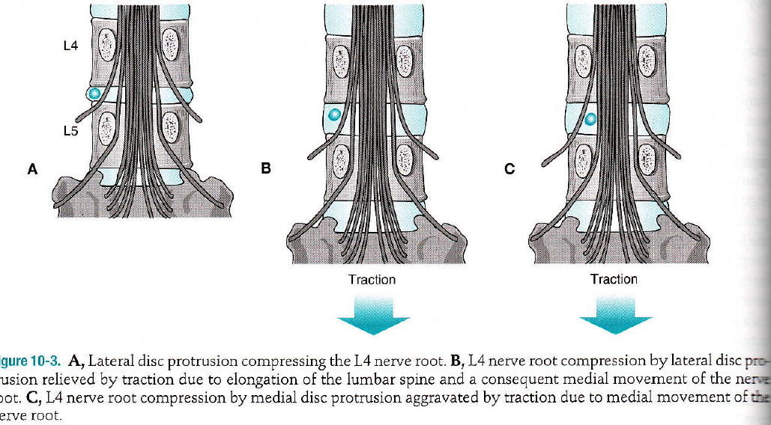

Slide 34
5. Severe pain fully relieved by traction
If severe pain resolves fully with traction,
this may indicate that the traction has increased rather than decreased compression on a nerve root
Causing a complete nerve block

Slide 35
6. Claustrophobia
A number of patients are psychologically averse to the use of traction because this procedure generally involves considerable restriction of movement and loss of control.
In particular, patients with claustrophobia may not tolerate the restriction of movement required for the application of mechanical lumbar traction.
In such cases other forms of traction that do not require immobilization with belts,
such as manual or positional traction, may be better tolerated.

Slide 36
7. Parients who cannot tolerate the prone or supine posture
A number of patients cannot tolerate the prone or supine position for the period of time necessary for the application of traction.
Such limitations may be the result of their spinal condition or other medical problems such as reflux esophagitis.
In such cases the use of supports such as a lumbar roll may allow the patient to tolerate the position.
Cervical traction may be applied in the sitting position.
or for lumbar traction, some of the self-traction techniques may be affective.

Slide 37
8. Disorientation
It is recommended that mechanical traction not be applied to disoriented patients since they may move in the halter or belts, becoming entangled or altering the amount of force they received.
It is recommended that only manual traction techniques be used to treat disoriented patients.

Slide 38
9. Temporomandibular joint (TM) problems
In patients with TMJ problems, or a history of such problems.
It is recommended that a halter that only applies pressure through the occiput be used rather than one that applies pressure through both the mandible and the occiput.
Because the latter may placed pressure on the TMJs and thus aggravate preexisting joint pathology.
Many clinicians use an occipital halter with all patients in order to avoid the possibility of causing TMJ problems in patients who did not have such problems previously.

Slide 39
10. Dentures
The patient who wears dentures should be instructed to keep the dentures in place during treatment with cervical traction because their removal can alter the alignment of the TMJs and may cause problems if pressure is applied to these joints through the mandible.
To protect dentures and the teeth, as well as the TMJs, an occipital halter should be used.

Slide 40
APPLICATION TECHNIQUES

Slide 41
Traction can be applied in a variety of ways.
Treatment with traction at this time includes the use of
Electric and weighted mechanical devices
Self traction
Positional traction.
Manual traction.

Slide 42
MECHANICAL TRACTION
Mechanical traction can be applied to the lumbar cervical spine.
A variety of belts and halters,
A number of different patient treatment positions, can be used to apply traction to different areas of the spine and to focus the effect on different segments or structures.
Electric mechanical traction units can apply static or intermittent traction of varying force.
With static traction same amount of force is applied throughout the treatment.
With intermittent traction the traction force alternates between two set point every few seconds throughout the treatment session.
The force is held at a maximum for a number of seconds, the hold period,
and is then reduced, usually by about50%, for the following relaxation period.
Weighted mechanical traction units apply static traction only, with the amount of force being determined by the amount of weight used.

Slide 44
Methods of Application
Equipment Required
Electrical Mechanical Traction
Traction unit
Thoracic and pelvic belts, cervical halters
Spreader bar
Extension rope
Split traction table (optional)
For Weighted MechanicaI Traction
Traction device (ropes, pulley, weights)
Thoracic and pelvic belts, cervical halters
Spreader bar
Weight bag for water, weights, or sand

Slide 45
Electrical Mechanical Traction Units
These units use a motor to apply traction forces to the Iumbar or cervical spine, statically or intermittently,
and can be used to apply forces of upto 70kg (150 lb).
These units have the advantage of
Being able to apply static or intermittent traction to the lumbar or cervical spine,
They allow fine, accurate control of the forces being applied.
These units allow considerable variation in patient position.
The most significant limitations
of electric mechanical traction devices are their cost and size.

Slide 46
Over-the-Door Cervical Traction Devices
Over the-door cervical traction units can be used for application of static cervical traction only.
They have the additional advantages of being inexpensive, easy to set up, and compact.
The patient should be educated regarding their position, and the amount and duration of force to use prior to using such a device at home.

Slide 48
Procedure
Mechanical Lumbar Traction Procedure
Select he appropriate mechanical traction device
Determine optimal patient position.
try to achieve a comfortable position that allows muscle relaxation.
while maximizing the separation between the involved structures.
The flexed position results in greater separation of the posterior structures, including the facet joints and intervertebral foramina.
the neutral or extended position results in greater separation of anterior structures, including the disc spaces
. Supine positioning is more commonly used
however prone positioning may be advantageous if the patient does not tolerate flexion or being supine.
or if the symptoms are reduced by extension or by being in the prone position

Slide 49
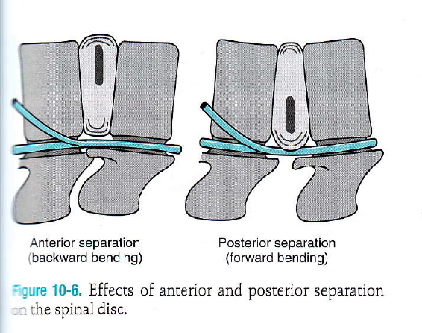

Slide 50
Prone neutral positioning of lumbar spine also localizes the force of the traction to the lower lumbar segments,
Whereas supine flexed positioning localizes the traction force to the upper lumbar and lower thoracic segments.
The patient should lie on a split traction table, with the area of the spine to be distracted positioned over the split.
If supine, with lower extremities are supported on a suitable stool that does not interfere with the motion of the traction rope
3. Apply the appropriate belts or halter
Heavy-duty non-slip thoracic and pelvic belts should be used to secure the patient during the application of mechanical lumbar traction.

Slide 52
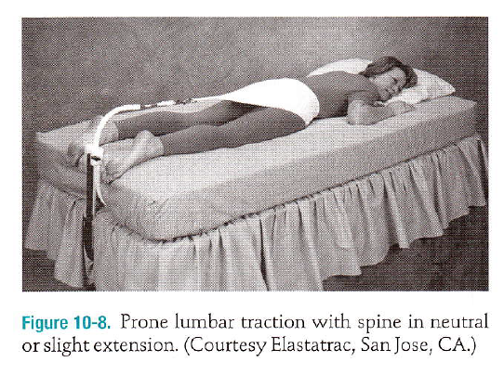

Slide 53
4. Connect the belts or halter to the traction device.
fasten the thoracic belt to the table above the patient's head and connect the pelvic belt to the traction unit using a rope and a spreader bar.
5. Set the appropriate traction parameters
Select static or intermittent traction and then,
for static traction
set the maximum traction force and the total traction duration
for intermittent traction,
set the maximum and minimum traction force,
hold and relax times,
and the total traction duration.

Slide 54
6. Start the traction.
Proper monitering
7. Assess the patient's response
8. Give the patient a means to call you and to stop the traction.
in case of any discomfort, pain etc.
9. Release traction and assess the patient's response.
When the traction time is completed, lock the split sections of the table,
Release the tension on the traction ropes,
and allow the patient to rest briefly
before getting up and recompressing the joints.
Then re examine the patient's signs and symptom

Slide 55
ADVANTAGES
Force and time well-controlled, readily graded, and replicable.
Once applied, does not require the clinician to be with the patient throughout the treatment.
Electrical mechanical traction units allow the application of static or intermittent traction.
Static weighted devices such as over-the-door cervical traction are inexpensive and convenient for independent use by the patient at home.

Slide 56
DISADVANTAGES
Expensive electric mechanical devices.
Time consuming to set up.
Lack of patient control or participation.
Restriction by belts or halter poorly tolerated by some patients.
Mobilizes broad regions of the spine rather than individual spinal segments, potentially inducing hypermobility in normal or hypermobile joints.

Slide 57
MECHANICAL CERVICAL TRACTION PROCEDURE
1. Select the appropriate mechanical traction device.
The choice depends on the region of the body to be treated.
The amount of force to be applied,
Whether static or intermittent traction is desired and the setting in which the treatment will be applied
2. Determine optimal patient position.
comfortable position that allows muscle relaxation
Flexed position results in greater separation of posterior structures including the facet joints,intervertebral foramina,
Whereas neutral or extended position results in greater separation of anterior structures including the discs paces
In most cases asymmetrical central force is used, in which the direction of force is in line with the central sagittal axis of the patient

Slide 58
Traction to the cervical spine may be applied in the supine or the sitting Position
Certain traction devices can only be used in one of positions, while others can be used in either position.
For example. over-the-door cervical traction units must be applied with the patient in sitting
whereas the Saunders occipital cervical traction and halter can only be used with the patient in supine position,
In supine position the Cervical spine is supported and non-weight-bearing, resulting in increased patient comfort and muscle relaxation and greater separation between the cervical segments when the same amount of traction force is with the patient in the sitting position.
3. Apply the appropriate belts or halter.
These are soft fabric halter to maximize patient comfort and avoid excessive pressure on the TMJ during the application of cervical traction.

Slide 59
4. Connect the belts or halter to the traction device
5. Set the appropriate traction parameter
6. Start the traction.
The patient should be observed for the first few cycles of cervical traction to ensure that the halter is staying in place and exerting force through the appropriate areas and to ensure that the patient is comfortable and not experiencing any adverse effects from the treatment.
7. Assess the patient's response.
It is recommended that the clinician assess the patient's initial response to the application of traction within the first 5 minutes of treatment so that any adjustments can be made at that time if needed
8. Give the patient a means to call you and to stop the traction.
9. Release traction and assess the patient's response
When the traction time is completed, lock the split sections of the table, release the tension on the traction ropes, and allow the patient to rest briefly before getting up and recompressing the joints. Then reexamine the patient's signs and symptoms.

Slide 63
ADVANTAGES
Force and time well controlled, readily graded, replicable.
Once applied, does not require the clinician to with the patient throughout the treatment.
Electrical mechanical traction units allow the application of static or intermittent traction.
Static weighted devices such as over-the-door cervical traction are inexpensive and convenient independent use by the patient at home.

Slide 64
DISADVANTAGES
Expensive electric mechanical devices.
Time-consuming to set up.
Lack of patient control or participation.
Restriction by belts or halter poorly tolerated by some patients.
Mobilizes broad regions of the spine rather individual spinal segments, potentially hyper hypermobility in normal or hypermobile joints.

Slide 65
Recommended Parameters for the Application of Spinal Traction
Area of Spine and Goal of Treatment | Force | Hold /Relax Times (seconds) | Total Traction Time (minutes)
Lumber
Initial / Acute phase | 13- 20 kg | Static | 5-10
Joint Distraction | 22.5 Kg; 50% of body weight | 15/15 | 20-30
Decrease Muscle Spasm | 25% of body Weight | 5/5 | 20-30
Disc Problem or Stretch Soft Tissues | 25% of body Weight | 60/20 | 20-30

Slide 66
Cont………
Area of Spine and Goal of Treatment | Force | Hold /Relax Times (seconds) | Total Traction Time (minutes)
Cervical
Initial / Acute phase | 3-4 Kg | Static | 5-10
Joint Distraction | 9-13 Kg; 7% of Body weight | 15/15 | 20-30
Decrease Muscle Spasm | 5-7 Kg | 5/5 | 20-30
Disc Problem or Stretch Soft Tissues | 5-7Kg | 60/20 | 20-30

