Slide 1
Dr. Muhammad Ali-ur-Rasheed
Lecturer , Department of Physiotherapy.
Sargodha Medical College.

Slide 2
REFLEXES Upper and Lower Motor Neuron Syndromes

Slide 3
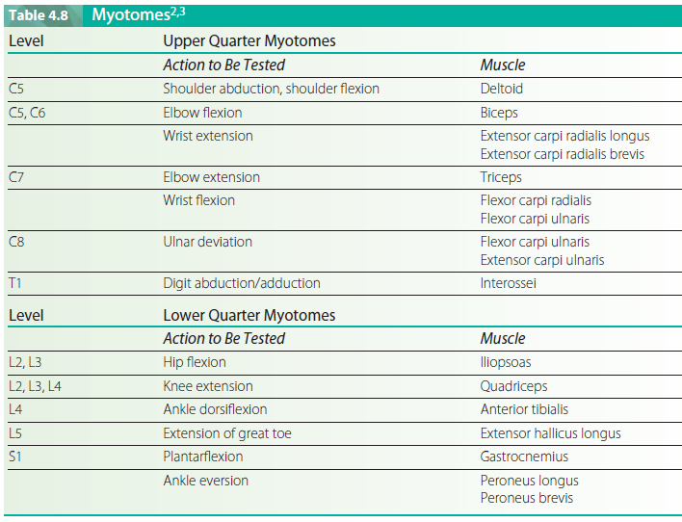

Slide 4
Reflexes (0 , 1+ , 2+ ,3+, 4+)
DTR
Jendrassik maneuver
Superficial reflex
Neonatal reflexes
ATNR
STNR

Slide 5
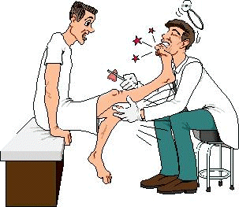
Reflexes
Superficial reflexes
Planter reflex
Abdominal reflex
Deep reflexes
Ankle jerk
Knee jerk
Biceps jerk
Triceps jerk
Brachioradialis jerk
Reinforcement
Upgoing planters
UMNL , hypoglycemia , deep coma ,post epileptic, below age of 1 yr

Slide 8
Difference between UMNL & LMNL
Synergies normal & abnormal
Mass movement
Functional movement
Spastic posture

Slide 12
Proximal muscle weakness
Myopathies
Distal muscle weakness
Neuropathy

Slide 13
How assess upper limb
Bilateral drift
How quickly assess lower limb
Sit to stand
Walk
Walk on toes
Walk on heels
Squat

Slide 14
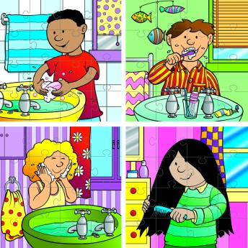
Motor Apraxia:
Partial or complete inability to execute purposeful movements (even with strength or ability) :
Ideomotor inability to remember a command
Ideational : inability to formulate a plan to accomplish a task (scratch nose, brush teeth, draw a clock, comb hair)

Slide 15
Dressing
Constructional

Slide 16
Assessment of motor Apraxia
Ask the patient to perform combing hair….
Imitate the combing and ask the patient to follow …..Lack of imitation
Give comb to patient and ask for combing……
Both have real object and ask the patient to follow

Slide 17
