Slide 1
Levels of Genetic Analysis
How traits are inherited when different strains of organisms are hybridized
The molecular makeup of the genetic material
entire populations of organisms

Slide 2
CLASSICAL GENETICS
The period prior to the discovery of the structure of DNA is often spoken of as the era of classical genetics
Genes are identified by studying the inheritance of trait differences
The trait differences are due to the alternate forms of genes
Studies also on the structure and behavior of chromosomes
These studies emphasize the transmission of genes and chromosomes from one generation to the next so also called transmission genetics
Also studies the nature of the genetic material—how it controls traits and how it mutates
Notes:
Transmission genetics encompasses the general process by which traits controlled by factors (genes) are transmitted through gametes from generation to generation. Its fundamental principles were first put forward by Gregor Mendel in the mid-nineteenth century. Later work by others showed that genes are on chromosomes and that mutant strains can be used to map genes on chromosomes.

Slide 3
MOLECULAR GENETICS
With the discovery of the structure of DNA, genetics entered a new phase
Raised to a new level when it became possible to sequence DNA molecules easily
Also involved Gene Manipulation and Recombinant DNA Technology
Notes:
The recognition that DNA encodes genetic information, the discovery of DNA’s structure, and elucidation of the mechanism of gene expression form the foundation of molecular genetics.
Recombinant DNA technology, which allows scientists to prepare large quantities of specific DNA sequences, has revolutionized genetics, laying the
foundation for new fields—and for endeavors such as the Human Genome Project—that combine genetics with information technology.

Slide 4
POPULATION GENETICS
The members of a population vary in their genetic makeup
Determine the frequencies of specific alleles in a population and then to ascertain if these frequencies change over time
The effort to understand the inheritance of complex traits, such as body size or disease
susceptibility

Slide 5
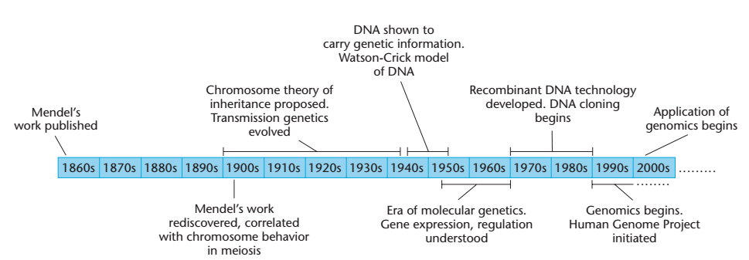
Notes:
A timeline showing the development of genetics from Gregor Mendel’s work on pea plants to the current era of genomics and its many applications in research, medicine, and society

Slide 6
Genetics Has a Rich and Interesting History
Archaeological evidence documents the successful domestication of animals and cultivation of plants thousands of years ago by artificial selection of genetic variants within populations.
Hippocratic School of Medicine (500–400 B.C.) argued that active “humors” in various parts of the male body served as the bearers of hereditary traits.
Aristotle (384–322 B.C.) extended Hippocrates’ thinking and proposed that the generative power of male semen resided in a “vital heat” contained within it that had the capacity to produce offspring of the same “form” (i.e., basic structure and capacities) as the parent.

Slide 7
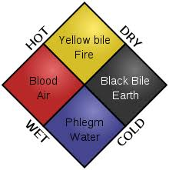
The four humors and their qualities

Slide 8
1600–1850: The Dawn of Modern Biology
William Harvey (1578–1657) credited with the earliest statement of the theory of epigenesis
Around 1830, Matthias Schleiden and Theodor Schwann proposed the cell theory, The idea of spontaneous generation, the creation of living organisms from nonliving components, was disproved by Louis Pasteur
Another influential notion prevalent in the nineteenth century was the fixity of species.
Charles Darwin, who published the book, The Origin of Species, in 1859 convinced him that existing species arose by descent with modification from other ancestral
species.

Slide 9
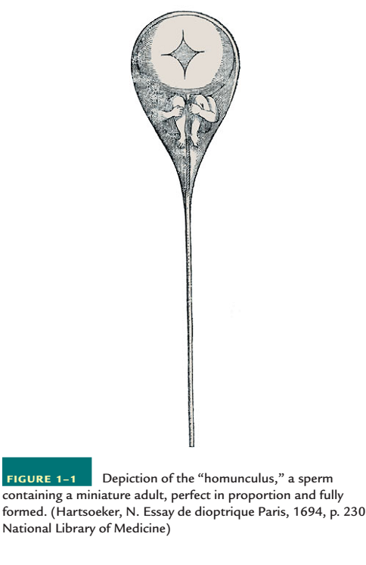

Slide 10
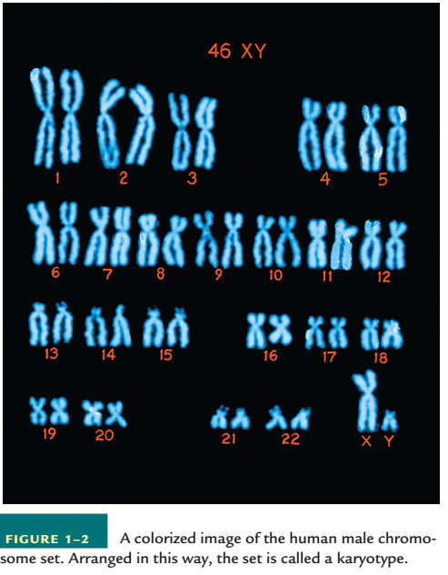

Slide 11
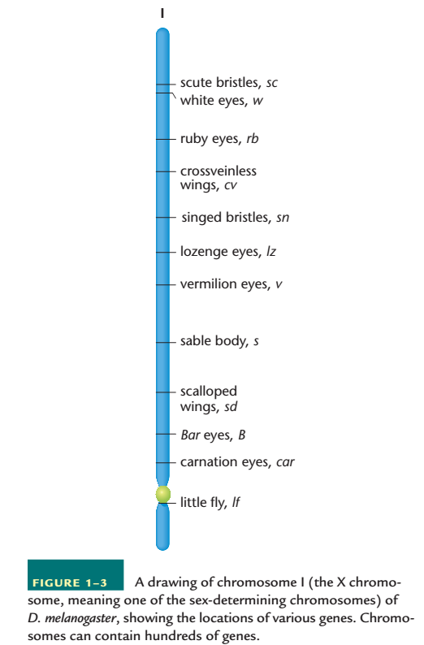

Slide 12
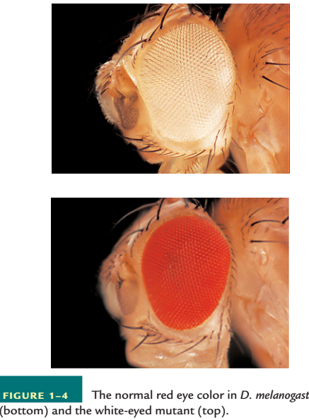

Slide 13
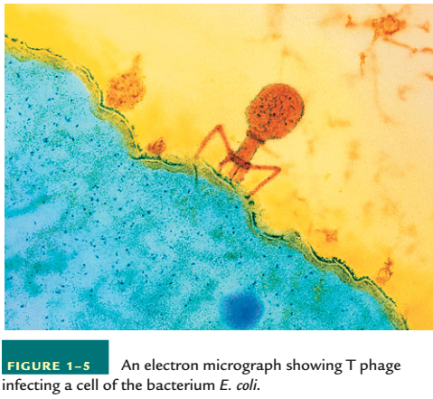

Slide 14
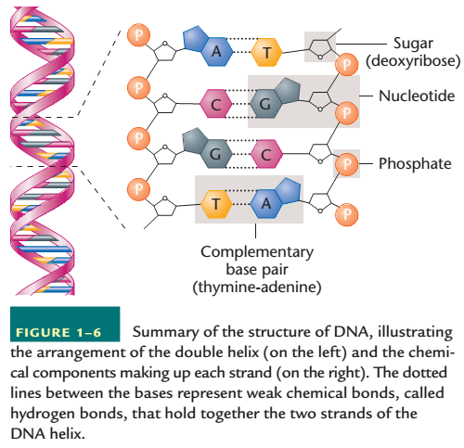

Slide 15
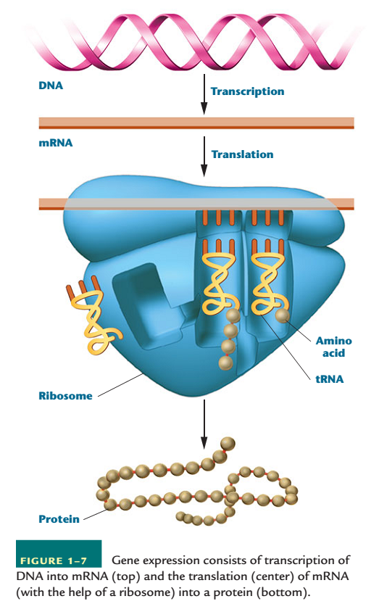

Slide 16
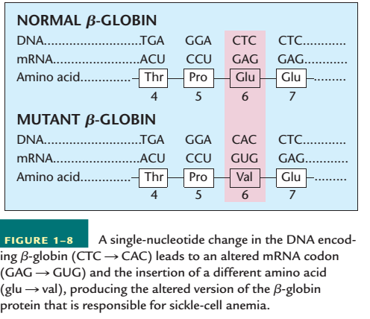

Slide 17
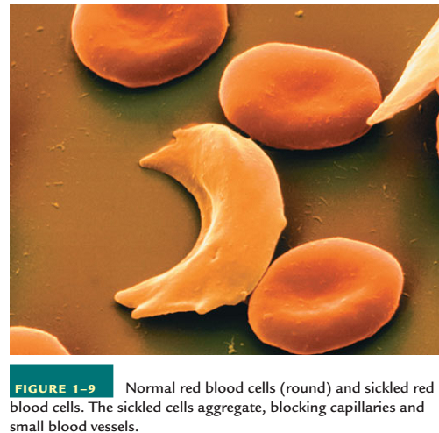

Slide 18
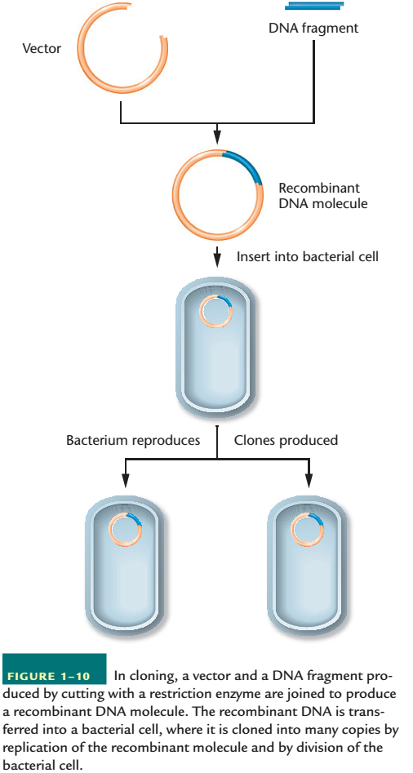

Slide 19
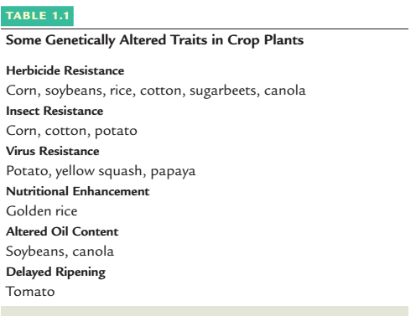

Slide 20
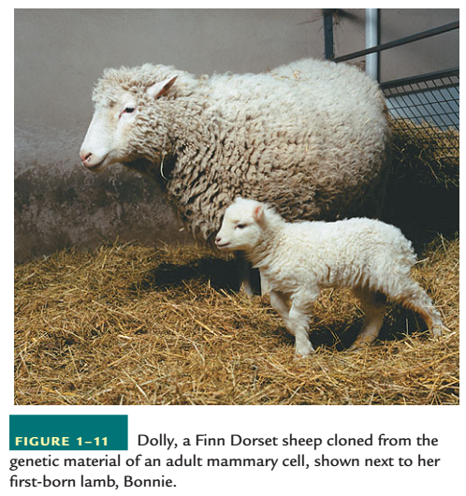

Slide 21
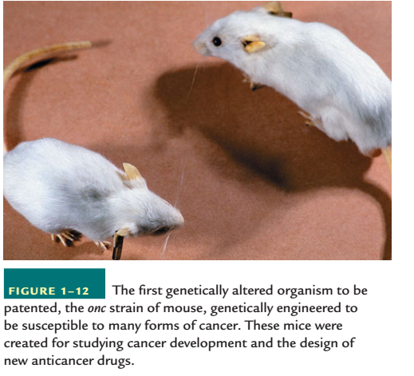

Slide 22
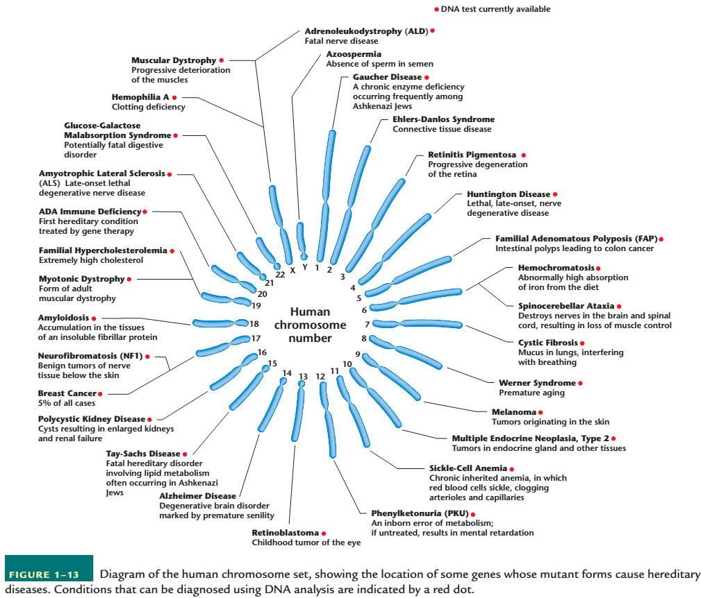

Slide 23
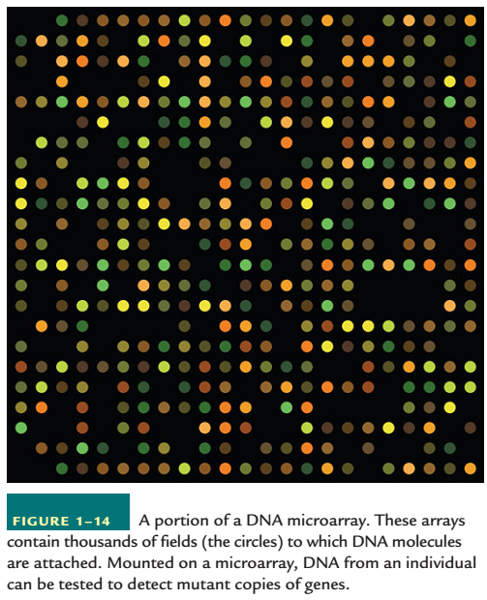

Slide 24
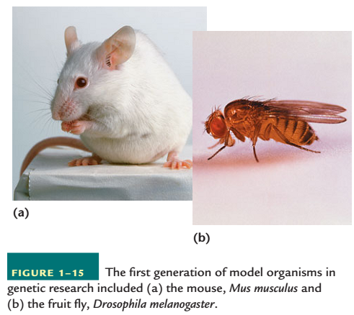

Slide 25
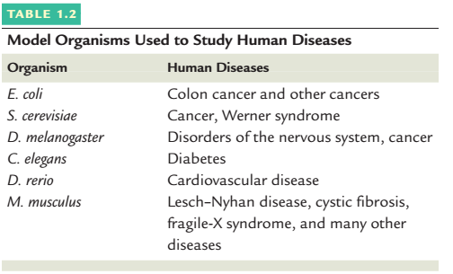

Slide 26
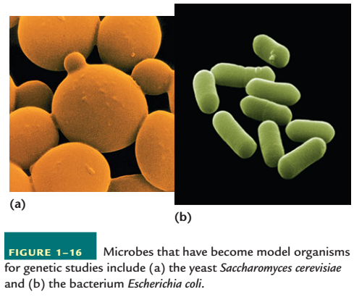

Slide 27
Mendelian Genetics
Elegant Experimental Design and Analysis
Methodology necessary for good experimental biology
Mendel followed seven visible features or characters each represented by two contrasting properties or traits
Several other reasons for Mendel’s success:
a) Restriction of his examination to one or very few pairs of contrasting traits
b) Accurate quantitative records, a necessity in genetic experiments c) Derived certain postulates that have become the principles of transmission genetics
Mendel’s postulates were accepted as the basis for the study of what is known as transmission genetics, how genes are transmitted from parents to offspring.
Notes:
Mendel first reported the results of some simple genetic crosses between certain strains of the garden pea in 1865. Although his was not the first attempt to provide experimental evidence pertaining to inheritance, Mendel’s success where others had failed can be attributed, at least in part, to his elegant experimental design and analysis.
First, he chose an organism that was easy to grow and to hybridize artificially. The pea plant is self-fertilizing in nature, but it is easy to cross-breed experimentally. It reproduces well and grows to maturity in a single season.

Slide 28
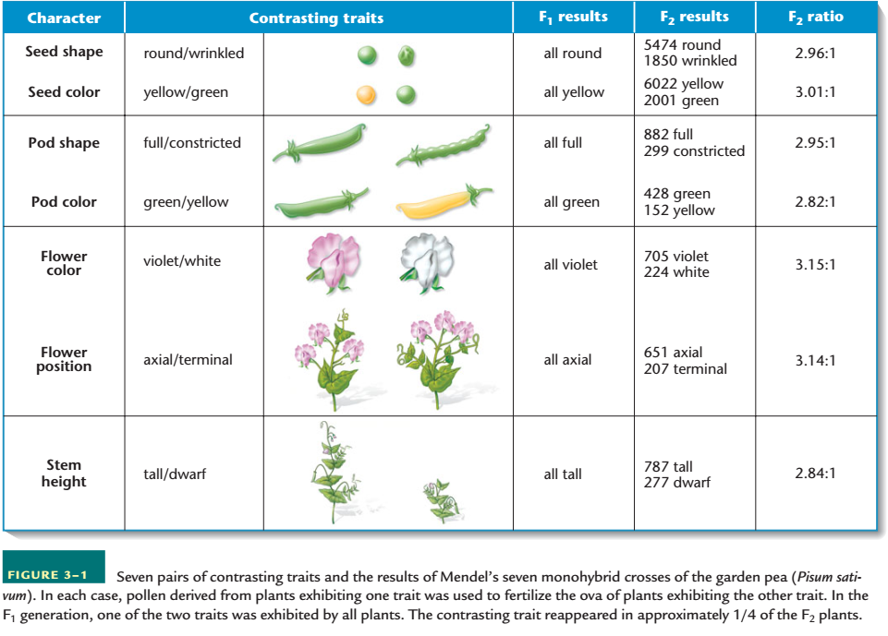

Slide 29
The Monohybrid Cross
Mendel’s simplest crosses involved only one pair of contrasting traits. Each such experiment is called a monohybrid cross
P1, or parental generation
F1, or first filial generation
F2, or second filial generation
Reciprocal crosses
The results of Mendel’s monohybrid crosses were not sex-dependent
To explain these results, Mendel proposed the existence of particulate unit factors for each trait
Notes:
A monohybrid cross is made by mating true-breeding. individuals from two parent strains, each exhibiting one of the two contrasting forms of the character under study. Initially, we examine the first generation of offspring of such a cross, and then we consider the offspring of selfing, that is, of self-fertilization of individuals from this first generation.
We note one further aspect of Mendel’s monohybrid crosses. In each cross, the F1 and F2 patterns of inheritance were similar regardless of which P1 plant served as the source of pollen (sperm) and which served as the source of the ovum (egg). The crosses could be made either way—pollination of dwarf plants by tall plants, or vice versa. Crosses made in both these ways are called reciprocal crosses. Therefore, the results of Mendel’s monohybrid crosses were not sex-dependent

Slide 30
Mendel’s First Three Postulates
UNIT FACTORS IN PAIRS Genetic characters are controlled by unit factors existing in pairs in individual organisms.
DOMINANCE/RECESSIVENESS When two unlike unit factors responsible for a single character are present in a single individual, one unit factor is dominant to the other, which is said to be recessive.
SEGREGATION During the formation of gametes, the paired unit factors separate, or segregate, randomly so that each gamete receives one or the other with equal likelihood.
Notes:
In the monohybrid cross involving tall and dwarf stems, a specific unit factor exists for each trait. Each diploid individual receives one factor from each
parent. Because the factors occur in pairs, three combinations are possible: two factors for tall stems, two factors for dwarf stems, or one of each factor. Every individual possessesone of these three combinations, which determines stem height.
In each monohybrid cross, the trait expressed in the F1 generation is controlled by the dominant unit factor. The trait not expressed is controlled by the recessive unit factor. The terms dominant and recessive are also used to designate traits. In this case, tall stems are said to be dominant over recessive dwarf stems.

Slide 31
Modern Genetic Terminology
The physical expression of a trait is the phenotype of the individual
Mendel’s unit factors represent units of inheritance called genes by modern geneticists
The phenotype is determined by alternative forms of a single gene, called alleles
When alleles are written in pairs to represent the two unit factors present in any individual (DD, Dd, or dd), the resulting symbol is called the genotype
When both alleles are the same (DD or dd), the individual is homozygous for the trait, or a homozygote
When the alleles are different (Dd), we use the terms heterozygous and heterozygote

Slide 32
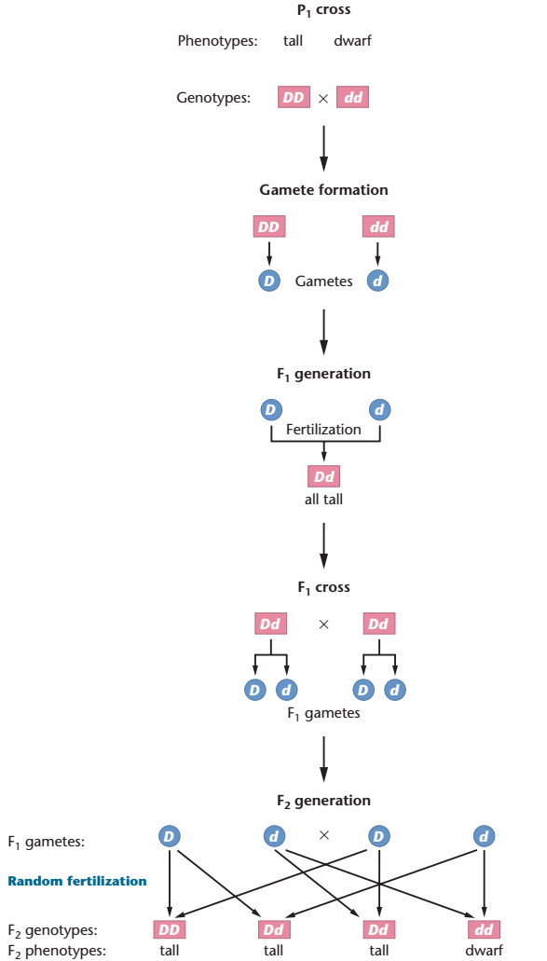

Slide 33
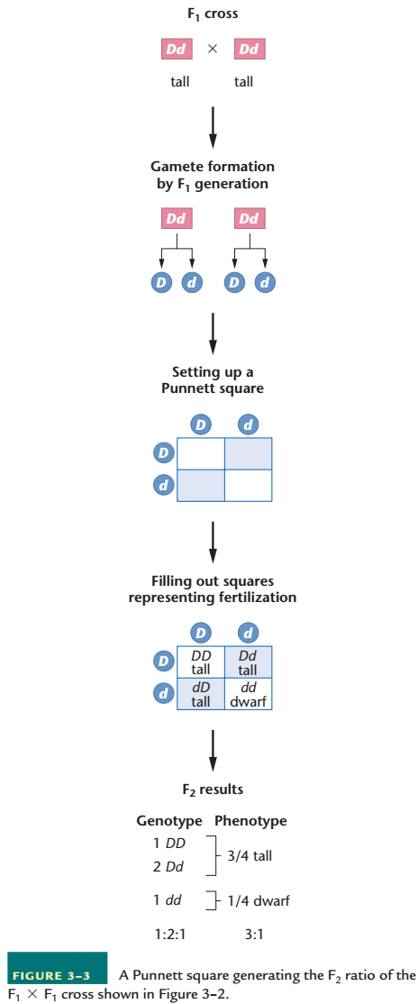

Slide 34
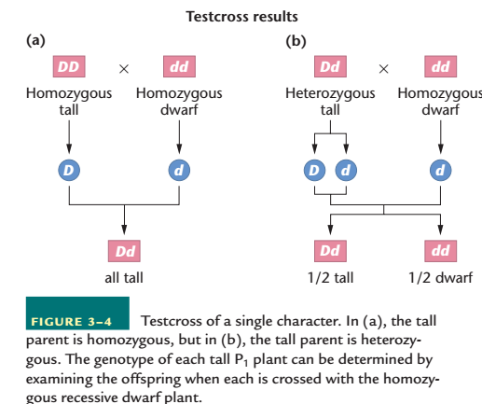

Slide 35
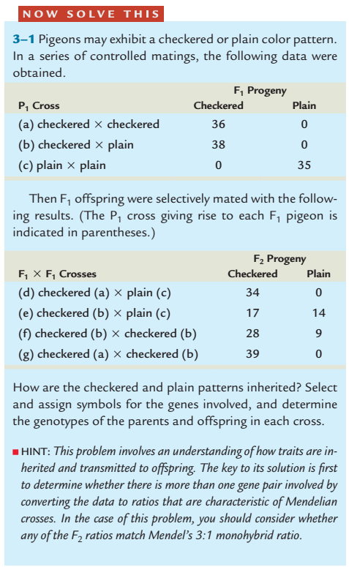

Slide 36
Mendel’s Dihybrid Cross Generated a Unique F2 Ratio

Slide 37
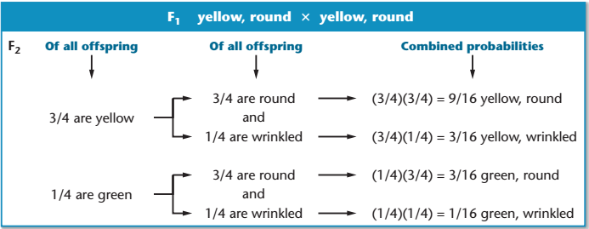
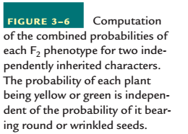

Slide 38
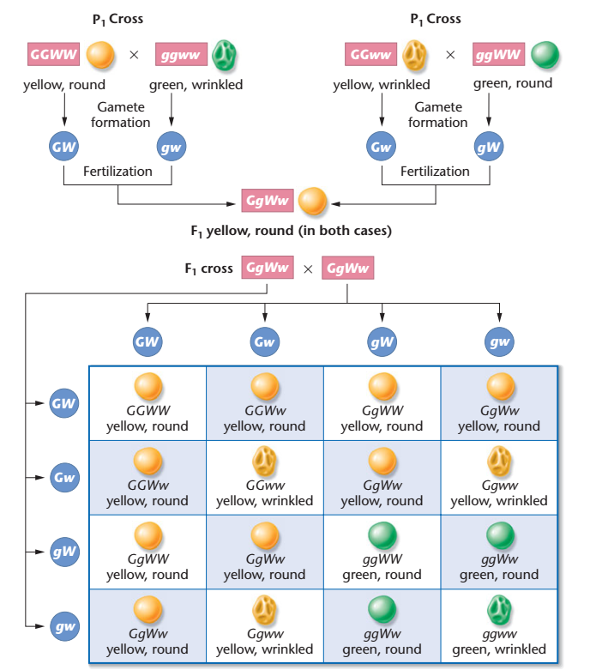

Slide 39
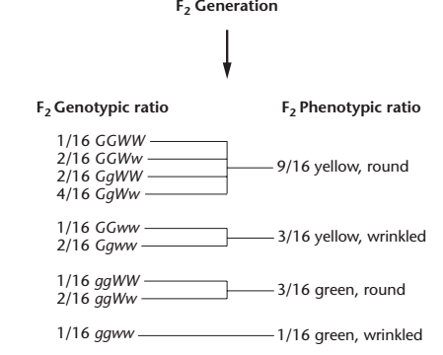

Slide 40
Product law of probabilities: When two independent events occur simultaneously, the probability of the two outcomes occurring in combination is equal to the product of their individual probabilities of occurrence
4. INDEPENDENT ASSORTMENT During gamete formation, segregating pairs of unit factors assort independently of each other.
Notes:
Mendelian postulates prescribe that homologous chromosomes segregate from one another and assort independently with other segregating homologs during gamete formation.

Slide 41
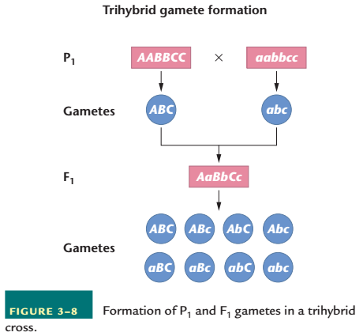

Slide 42
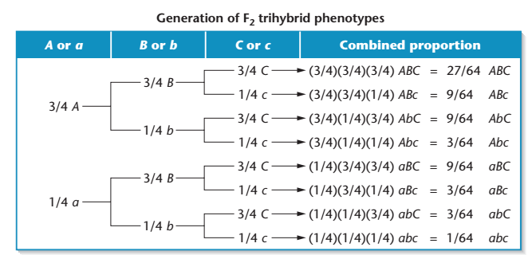
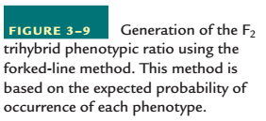

Slide 43
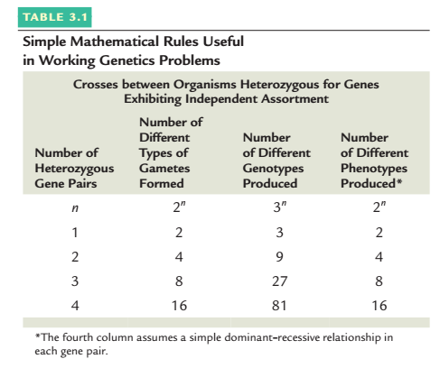

Slide 44
