Slide 1
RENAISSANCE

Slide 2
WHAT IS RENAISSANCE….?
Renaissance means rebirth and Europe was recovering from the dark age.
People had lost there faith and began to put more focus on human
Renaissance supported the spirit of adventure and curiosity
The intellectual movement, Humanism, was at the heart of the Renaissance
Italian Renaissance( rebirth of ancient Greek & Roman worlds)

Slide 3
Characteristics
Secular Urban society (City-states)
Age of Recovery
New view of human ability & worth
Explosion of New Ideas & Learning
Rediscovery of Classical Greek & Roman Culture
Humanism—worth of Individual

Slide 4
ORIGINS OF THE RENAISSANCE
European trade with Asia increased during the 1300s.
Italian merchants organized much of this trade.
Trade cities in Italy grew wealthy.
They competed to create works that would increase the prestige of their cities.
Florence become a center for banking , art , culture, and literature
Cosimo de ‘medici wanted to make Florence the most beautiful city
The renaissance began in Italy and spread throughout Europe.

Slide 5
IMPORTANT CITY-STATES OF THE RENAISSANCE
Florence
Rome
Venice
Genoa
Milan

Slide 6
FLORENCE
The Renaissance started in Florence and spread throughout Europe
Competition between the Italian city-states led to advances in literature, architecture, art, music, science, and education.
Center of art, literature, and culture.
Florence became wealthy from the manufacturing of wool.
Later Florence became the banking center of Italy.
The Medici family were the greatest bankers in Florence.
The Renaissance started in Florence and spread throughout Europe.
Competition between the Italian city-states led to advances in literature, architecture, art, music, science, and education.

Slide 7
ROME
Home of the Catholic Church
Popes commissioned famous artists amid architects to beautify Rome. Michelangelo, Rapheal , and Botticelli all produced major works in Rome.
The popes employed the best artists and architects of the Renaissance to build and decorate the most opulent churches in the world.
Michelangelo designed the finest example of Renaissance architecture in Rome, the Piazza del Campidoglio . He also designed the dome of St . Peter’s Basilica .

Slide 8
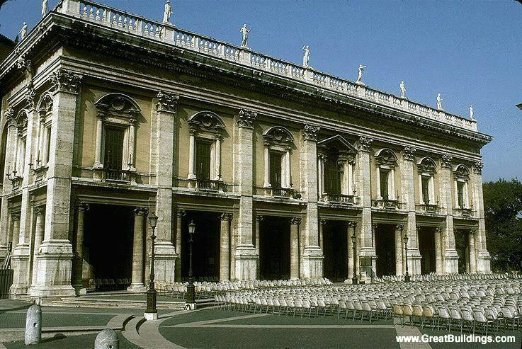
Piazza del Campidoglio
St . Peter’s Basilica

Slide 9
VENICE
Venice was the wealthiest city-state of the Renaissance.
It was a port city on the Mediterranean.
Venice maintained hundreds of merchant ships and warships, and thousands of sailors.
Had a distinct method of brushwork. It's smooth, made for velvety textures.
Venice's geographic isolation, helps a different attitude toward subject matter

Slide 10
ARCHITECTURE
Architecture design returns to the classical style of Rome Greece.
Public buildings , homes and villas are designed using Greek and Roman architectural styles.
Renaissance buildings feature columns, domes , and vaulted ceilings.
Brunelleschi designs the first domed building.
Perspective becomes important in architecture.
Rejection of middle Age Gothic Style
Adopted columns , arches , domes of the Greeks and Romans

Slide 11
CONTRIBUTIONS OF THE RENAISSANCE
Invention of the Gutenberg Press.
The banking industry.
Expansion of trade.
Humanism, individual is the center of the universe.
Reintroduction Greek and Roman Knowledge and philosophy.
Gateway to modern art forms.
Expansion of Greek and Roman architecture and sculpture.
Increased scientific knowledge, and desire to know more.

Slide 12
RENAISSANCE ART
Admired man’s talents
Christ important but new interest emerge
Life on earth important
Body form very life like/natural
Body is seem as beautiful
Artist’s signed works wanted recognition
Perspective.
Light & motion.

Slide 13
Study of human form.
Emotion & drama.
New subject matter > secularism.
Science & mathematics.
Composition & balance.
Changing perspective of man & his role in the world.
Unique vision of each artist.

Slide 14
NEW TECHNIQUES
Renaissance painters developed new techniques for representing both humans and landscapes in a realistic way
Perspective: making distant objects smaller that those close to the viewer
Appeared 3 dimensional
Painters used shading to make objects look round and real
A few women did manage to overcome lack of education & training to become professional painters
Many artists starting using light and shadows in their works to add drama, perspective, and timing to their art

Slide 15
CHANGING ART
Medieval Art
praised God’s greatness
Christianity all important
purpose of life preparing for heaven
didn’t care about subjects, being life like/flat looking
body is the house of sin
artists did not sign works
Renaissance Art
admired man’s talents
Christ important but new interest emerge
life on earth important
body form very life like/natural
body is seen as beautiful
artist’s signed works wanted recognition

Slide 16
PROTO-RENAISSANCE ART (1300-1400)
In fine art, the term "Proto Renaissance" refers to the pre-Renaissance period (c.1300-1400) in Italy, and the activities of progressive painters such as Giotto(1267-1337), who pioneered the new form of figurative "realism“ which was fully developed by artists during the era of Renaissance art proper.
Giotto di Bondone was famous: Architect, sculptor, and painter of the early Renaissance. He broke away from the Byzantine art style and pioneered new ideals of naturalism and creating a sense of pictorial space.

Slide 17
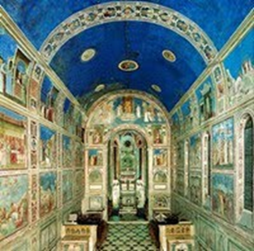
Description
Painting: Scrovegni (Arena) Chapel Frescoes
Date: c.1303-10
Artist: Giotto (1267-1337)
Medium: Fresco painting
Genre: Religious history painting
Movement: Proto-Renaissance
Location: Cappella degli Scrovegni, Padua, Italy.

Slide 18
ARTIST OF PROTO RENAISSANCE
Lorenzetti Ambrogio
Lorenzetti Pietro
Donatello
Hubert van Eyuk

Slide 19
RENAISSANCE SCHOOL

Slide 20
SIENESE SCHOOL OF PAINTING
Platonic and Napoleonic ideas were dominant in Sienese school of painting
metaphysical element - religious factor, their believes,
Elements of beauty suggested by St . Augustine which are: unity, equality, proportion and integrity .“Beauty is that which give you pleasure when seen” .

Slide 21
Influences
Sienese school of painting had great influence of byzantine art .
It had a significant influence on the development of Pre-Renaissance Painting (c.1300-1400).
Themes
Biblical
Didactic
Important personalities like St . Augustine
Effects of good and bad government

Slide 22
LORENZETTI BROTHERS
Pietro and Ambrogio, were brothers, .
Both brothers grouped their figures in a more naturalistic way
Thy made greater use of landscape background.
Pietro Lorenzetti was an Italian painter( 1306 _ 1345)
Together with his younger brother Ambrogio , he introduced naturalism into Sienese art.

Slide 23
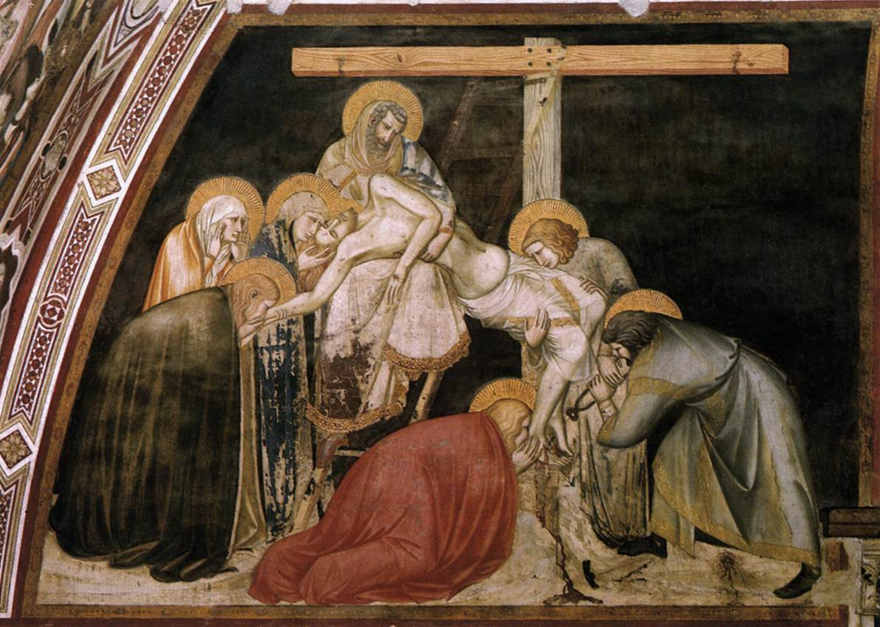
Deposition of Christ from the Cross (c.1320) Fresco by Pietro Lorenzetti

Slide 24
Ambrogio Lorenzetti
Ambrogio Lorenzetti was an Italian painter of the Sienese school. (1317 to 1348.)
Ambrogio created a highly developed Gothicism .
His style is characterized by deep, pure colors, lines, sensitive expressions and spiritual harmony.

Slide 25
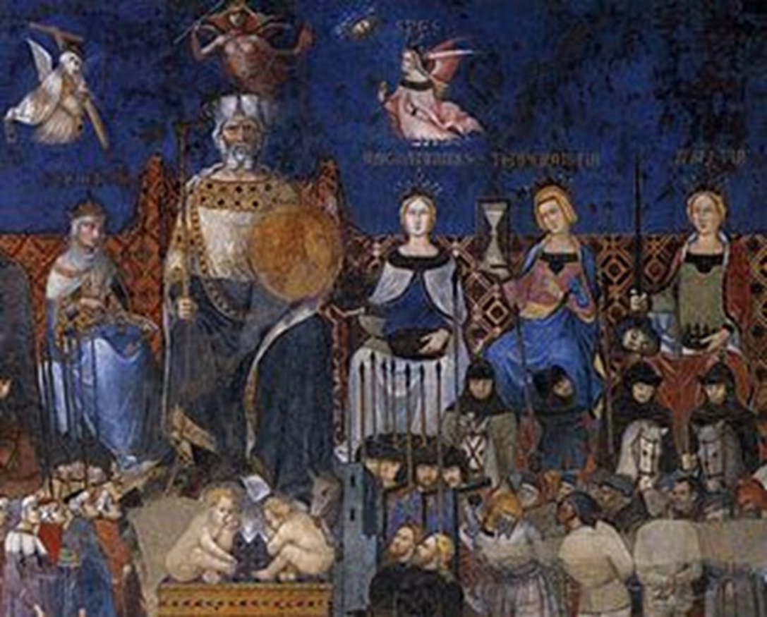
Ambrogio lorenzetti’s best known paintings
the fresco series
Good and Bad Government(1338-9, Siena)

Slide 26
Venetian School
Republic had ceramists, glassworkers, woodworkers, lace makers and sculptors, painters, made satisfactory livings.
Artisan guilds ensure artists and craftsmen were properly rewarded.
The Venetian "School" of painting, not just a descriptive phrase. There were actual scuola" and were highly selective who could or couldn't, guarded the art market, that one did not purchase paintings outside of the schools.

Slide 27
MATERIAL AND STYLE
canvas replaced wood panel and the oil medium, in the 1470s, largely evacuated tempera.
Using egg yolk to bind pigments, tempera dries to a semi-matte state, oil paint retains its flawlessness and produces colors of greater richness
Used pigments previously employed in manuscript illuminations
To add brilliance in paintings, artists mixed pigments with crushed glass.

Slide 28
VENETIAN ATRISTS
Andrea Mantegna
Giorgione
Titian
Tintoretto
Paolo Veronese
A lot of famous artists traveled to Venice, and spent time in the workshops there.

Slide 30
FLORENTINE SCHOOL
A major Italian school of art that flourished between the 13,16 century.
Extending from the early renaissance
Founder of Florentine school was Giotto.
15 century Florentine painting often recalled the late Gothic decorative style.

Slide 31
EARLY RENAISSANCE
The light, color and space techniques, used by ancient Greek and Roman artist.
Artist shifted to the human body and its realistic expressions.
Religious themes, but the saints in the painting wore common people’s clothes and carried on with their everyday activities like eating, dancing.
Architect Filippo Brunelleschi interduce the concept of linear perspective.

Slide 32
MIDDLE RENAISSANCE ART STYLE
Humanism , antiquity
Understanding of figure
Subject matter , allegory
Economics of detail
Single point perspective used to suit own needs
Use of illusion
foreshortening

Slide 33
ARTIST OF MIDDLE RENAISSANCE
Leonardo da Vinci ,the last supper , Milan
Michelangelo, creation of Adam , Vatican
Raphael , School of Athens, Vatican.
Titan, Venus of Urbino, Florence.

Slide 34
HIGH RENAISSANCE
Rome: The Centre of the High Renaissance
Characteristics:
Halos gone
More naturalism
Definite light source(shadows , three-dimensional)
Sense of stability and order (static compositions)
Commissions from private sources increased (no longer as dependent on the Church/royalty)
Raphael, Leonardo and Michelangelo, all of whom created oils and mural painting of startling novelty

Slide 35
THANK
YOU………..

