Slide 1
Data and Computer Communications
Chapter 10 – Circuit Switching and Packet Switching
Eighth Edition
William Stallings
Notes:
Lecture slides prepared by Dr Lawrie Brown (UNSW@ADFA) for “Data and Computer Communications”, 8/e, by William Stallings, Chapter 10 “Circuit Switching and Packet Switching”.

Slide 2
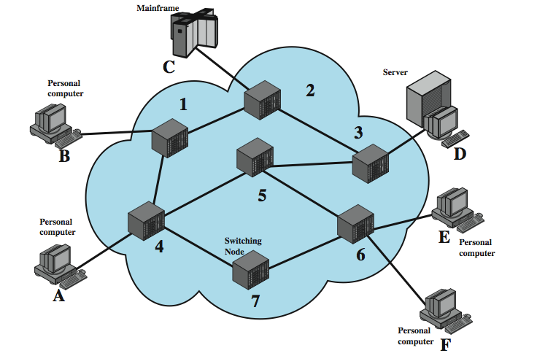
Switched Network

Slide 3
Nodes
a collection of nodes and connections is a communications network
nodes may connect to other nodes only, or to stations and other nodes
network is usually partially connected
some redundant connections are desirable
have two different switching technologies
circuit switching
packet switching

Slide 4
Circuit Switching
uses a dedicated path between two stations
has three phases
establish
transfer
disconnect
inefficient
channel capacity dedicated for duration of connection
if no data, capacity wasted
set up (connection) takes time
once connected, transfer is transparent

Slide 5
Public Circuit Switched Network
A public telecommunications network can be described using four generic architectural components:
Subscribers
The devices that attach to the network, typically telephones, but the percentage of data traffic increases year by year.
Subscriber line
The link between the subscriber and the network, also referred to as the subscriber loop or local loop, mostly using twisted-pair wire.

Slide 6
Public Circuit Switched Network
Exchanges
The switching centers in the network. A switching center that directly supports subscribers is known as an end office.
Trunks
The branches between exchanges. Trunks carry multiple voice-frequency circuits using either FDM or synchronous TDM

Slide 7
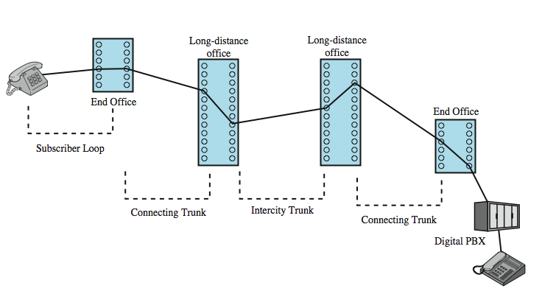
Public Circuit Switched Network

Slide 8
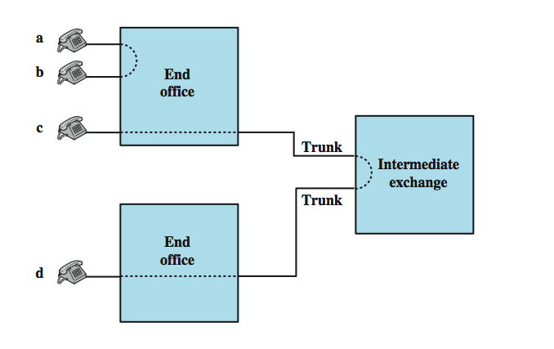
Circuit Establishment

Slide 9
Public Circuit Switched Network
Circuit-switching technology has been driven by those applications that handle voice traffic.
One of the key requirements for voice traffic is that there must be virtually no transmission delay and certainly no variation in delay.
A constant signal transmission rate must be maintained, because transmission and reception occur at the same signal rate.
These requirements are necessary to allow normal human conversation.

Slide 10
Public Circuit Switched Network
Further, the quality of the received signal must be sufficiently high to provide, at a minimum, intelligibility.
Circuit switching achieved its widespread, dominant position because it is well suited to the analog transmission of voice signals. In today's digital world, its inefficiencies are more apparent.
However, despite the inefficiency, circuit switching will remain an attractive choice for both local area and wide area networking.

Slide 11
Circuit Switch Elements
Digital switch
The heart of a modern system
The function of the digital switch is to provide a transparent signal path between any pair of attached devices.
Typically, the connection must allow full-duplex transmission.

Slide 12
Circuit Switch Elements
Network interface
It represents the functions and hardware needed to connect digital devices, such as data processing devices and digital telephones, to the network.
Analog telephones can also be attached if the network interface contains the logic for converting to digital signals.
Trunks to other digital switches carry TDM signals and provide the links for constructing multiple-node networks.

Slide 13
Circuit Switch Elements
Control unit
Performs three general tasks.
First, it establishes connections. This is generally done on demand, that is, at the request of an attached device.
Second, the control unit must maintain the connection. Because the digital switch uses time division principles, this may require ongoing manipulation of the switching elements.
Third, the control unit must tear down the connection, either in response to a request from one of the parties or for its own reasons.

Slide 14
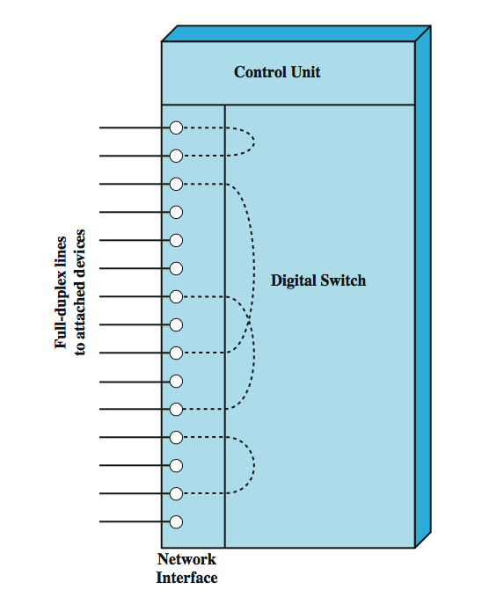
Circuit Switch Elements
Notes:
.

Slide 15
Packet Switching
circuit switching was designed for voice
packet switching was designed for data
transmitted in small packets
packets contains user data and control info
user data may be part of a larger message
control info includes routing (addressing) info
packets are received, stored briefly (buffered) and past on to the next node

Slide 16
Packet Switching
Notes:
Stallings DCC8e Figure 10.8 illustrates how a longer message is broken up into a series of packets, which are transferred over the packet-switched network.

Slide 17
Advantages
line efficiency
single link shared by many packets over time
packets queued and transmitted as fast as possible
data rate conversion
stations connect to local node at own speed
nodes buffer data if required to equalize rates
packets accepted even when network is busy
priorities can be used
Notes:
A packet-switching network has a number of advantages over circuit switching:
• Line efficiency is greater, because a single node-to-node link can be dynamically shared by many packets over time. The packets are queued up and transmitted as rapidly as possible over the link. By contrast, with circuit switching, time on a node-to-node link is preallocated using synchronous time division multiplexing. Much of the time, such a link may be idle because a portion of its time is dedicated to a connection that is idle.
• A packet-switching network can perform data-rate conversion. Two stations of different data rates can exchange packets because each connects to its node at its proper data rate.
• When traffic becomes heavy on a circuit-switching network, some calls are blocked; that is, the network refuses to accept additional connection requests until the load on the network decreases. On a packet-switching network, packets are still accepted, but delivery delay increases.
• Priorities can be used. If a node has a number of packets queued for transmission, it can transmit the higher-priority packets first. These packets will therefore experience less delay than lower-priority packets.

Slide 18
Switching Techniques
station breaks long message into packets
packets sent one at a time to the network
packets can be handled in two ways
datagram
virtual circuit
Notes:
If a station has a message to send through a packet-switching network that is of length greater than the maximum packet size, it breaks the message up into packets and sends these packets, one at a time, to the network. A question arises as to how the network will handle this stream of packets as it attempts to route them through the network and deliver them to the intended destination. Two approaches are used in contemporary networks: datagram and virtual circuit.

Slide 19
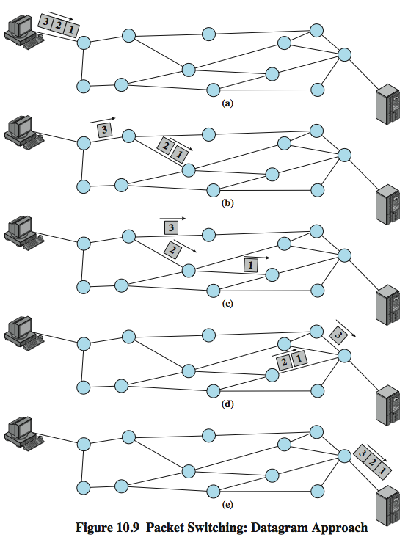
Datagram Diagram
Notes:
In the datagram approach, each packet is treated independently, with no reference to packets that have gone before. This approach is illustrated in Stallings DCC8e Figure 10.9, which shows a time sequence of snapshots of the progress of three packets through the network. Each node chooses the next node on a packet's path, taking into account information received from neighboring nodes on traffic, line failures, and so on. So the packets, each with the same destination address, do not all follow the same route, and they may arrive out of sequence at the exit point. In this example, the exit node restores the packets to their original order before delivering them to the destination. In some datagram networks, it is up to the destination rather than the exit node to do the reordering. Also, it is possible for a packet to be destroyed in the network. For example, if a packet-switching node crashes momentarily, all of its queued packets may be lost. Again, it is up to either the exit node or the destination to detect the loss of a packet and decide how to recover it. In this technique, each packet, treated independently, is referred to as a datagram.

Slide 20
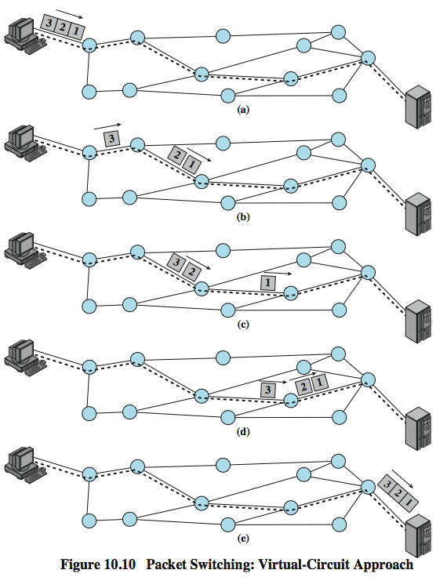
Virtual Circuit Diagram
Notes:
In the virtual circuit approach, a preplanned route is established before any packets are sent. Once the route is established, all the packets between a pair of communicating parties follow this same route through the network. This is illustrated in Stallings DCC8e Figure 10.10. Because the route is fixed for the duration of the logical connection, it is somewhat similar to a circuit in a circuit-switching network and is referred to as a virtual circuit. Each packet contains a virtual circuit identifier as well as data. Each node on the preestablished route knows where to direct such packets; no routing decisions are required. At any time, each station can have more than one virtual circuit to any other station and can have virtual circuits to more than one station.
So the main characteristic of the virtual circuit technique is that a route between stations is set up prior to data transfer. Note that this does not mean that this is a dedicated path, as in circuit switching. A transmitted packet is buffered at each node, and queued for output over a line, while other packets on other virtual circuits may share the use of the line. The difference from the datagram approach is that, with virtual circuits, the node need not make a routing decision for each packet. It is made only once for all packets using that virtual circuit.

Slide 21
Virtual Circuits v Datagram
virtual circuits
network can provide sequencing and error control
packets are forwarded more quickly
less reliable
datagram
no call setup phase
more flexible
more reliable
Notes:
If two stations wish to exchange data over an extended period of time, there are certain advantages to virtual circuits. First, the network may provide services related to the virtual circuit, including sequencing and error control. Sequencing refers to the fact that, because all packets follow the same route, they arrive in the original order. Error control is a service that assures not only that packets arrive in proper sequence, but also that all packets arrive correctly. Another advantage is that packets should transit the network more rapidly with a virtual circuit; it is not necessary to make a routing decision for each packet at each node.
One advantage of the datagram approach is that the call setup phase is avoided. Thus, if a station wishes to send only one or a few packets, datagram delivery will be quicker. Another advantage of the datagram service is that, because it is more primitive, it is more flexible. For example, if congestion develops in one part of the network, incoming datagrams can be routed away from the congestion. With the use of virtual circuits, packets follow a predefined route, and thus it is more difficult for the network to adapt to congestion. A third advantage is that datagram delivery is inherently more reliable. With the use of virtual circuits, if a node fails, all virtual circuits that pass through that node are lost. With datagram delivery, if a node fails, subsequent packets may find an alternate route that bypasses that node. A datagram-style of operation is common in internetworks.

Slide 22
Circuit v Packet Switching
Performance depends on various delays
Propagation delay
The time it takes a signal to propagate from one node to the next. This time is generally negligible. The speed of electromagnetic signals through a wire medium, for example, is typically 2 × 10⁸ m/s.
Transmission time
The time it takes for a transmitter to send out a block of data. For example, it takes 1 s to transmit a 10,000-bit block of data onto a 10-kbps line.

Slide 23
Circuit v Packet Switching
Node delay
The time it takes for a node to perform the necessary processing as it switches data.
range of other characteristics, including:
transparency
amount of overhead

Slide 24
Connection Oriented Networks
X.25
Frame Relay
ATM

Slide 25
Connection Oriented Networks
DoD’s main issue was fault tolerance, not customer billing
So, followed a connectionless approach
But when billing is an issue
A connection oriented approach is followed
Connection Oriented approach:
Caller must dial the calling parties number
Wait for a connection before talking or sending data
All packets follow the same route
If a line or switch in the path goes down, the connection is aborted
DoD didn’t like this …

Slide 26
Connection Oriented Networks
But telephone companies prefer this. Why?
QoS
By setting up connections, resources like buffer space and CPU capacity are reserved
Can provide a better QoS
Billing
Telephone companies are accustomed to charging for connect time

Slide 27
X.25
ITU-T standard for interface between host and packet switched network
defines three levels
Physical
deals with the physical interface between an attached station (computer, terminal) and the link that attaches that station to the packet-switching node
Link
Provides for the reliable transfer of data across the physical link
The link level standard is referred to as LAPB (Link Access Protocol–Balanced) – Subset of HDLC
Packet
provides a virtual circuit service
Notes:
One technical aspect of packet-switching networks remains to be examined: the interface between attached devices and the network. We have seen that a circuit-switching network provides a transparent communications path for attached devices that makes it appear that the two communicating stations have a direct link. However, in the case of packet-switching networks, the attached stations must organize their data into packets for transmission. This requires a certain level of cooperation between the network and the attached stations. This cooperation is embodied in an interface standard. The standard used for traditional packet-switching networks is X.25, which is an ITU-T standard that specifies an interface between a host system and a packet-switching network. The functionality of X.25 is specified on three levels: Physical level, Link level, and Packet level.

Slide 28
Virtual Circuit
External virtual circuit
Logical connection between two stations through the network
Formed by X.25
Internal virtual circuit
This virtual circuit has already been discussed before to refer to a specific preplanned route through the network between two stations
possible to employ X.25 with a datagram-style network

Slide 29
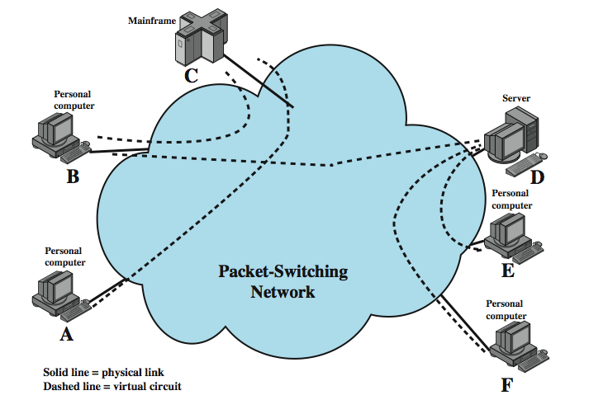
X.25 Use of Virtual Circuits
Notes:
An example of X.25 virtual circuits is shown in Figure 10.13 (compare Figure 10.1). In this example, station A has a virtual circuit connection to C; station B has two virtual circuits established, one to C and one to D; and stations E and F each have a virtual circuit connection to D. As an example of how these external virtual circuits are used, station D keeps track of data packets arriving from three different workstations (B, E, F) on the basis of the virtual circuit number associated with each incoming packet.

Slide 30
User Data and X.25 Protocol Control Information
Notes:
Stallings DCC8e Figure 10.14 illustrates the relationship among the levels of X.25. User data are passed down to X.25 level 3, which appends control information as a header, creating a packet. This control information serves several purposes, including identifying by number a particular virtual circuit with its associated data, and providing sequence numbers that can be used for flow and error control on a virtual circuit basis.
The entire X.25 packet is then passed down to the LAPB entity, which appends control information at the front and back of the packet, forming a LAPB frame (see Stallings DCC8e Figure 7.7). Again, the control information in the frame is needed for the operation of the LAPB protocol.
The operation of the X.25 packet level is similar to that of HDLC as described in Chapter 7. Each X.25 data packet includes send and receive sequence numbers. The send sequence number, P(S), is used to number sequentially all outgoing data packets on a particular virtual circuit. The receive sequence number, P(R), is an acknowledgment of packets received on that virtual circuit.

Slide 31
X.25 Protocol Control Information
User data are passed down to X.25 level 3
appends control information as a header
control information serves several purposes including:
Identifying by number a particular virtual circuit with which this data is to be associated
Providing sequence numbers that can be used for flow and error control on a virtual circuit basis
entire X.25 packet is then passed down to the LAPB entity
appends control information at the front and back of the packet
Operation of LAPB is similar to HDLC

Slide 32
Issues with X.25
key features include:
call control packets, in band signaling
multiplexing of virtual circuits at layer 3
layers 2 and 3 include flow and error control
hence have considerable overhead
not appropriate for modern digital systems with high reliability
Notes:
The traditional approach to packet switching makes use of X.25, which not only determines the user-network interface but also influences the internal design of the network. The following are key features of the X.25 approach:
• Call control packets, used for setting up and clearing virtual circuits, are carried on the same channel and same virtual circuit as data packets.
• Multiplexing of virtual circuits takes place at layer 3.
• Both layer 2 and layer 3 include flow control and error control mechanisms.
The X.25 approach results in considerable overhead. At each hop through the network, the data link control protocol involves the exchange of a data frame and an acknowledgment frame. Furthermore, at each intermediate node, state tables must be maintained for each virtual circuit to deal with the call management and flow control/error control aspects of the X.25 protocol. All of this overhead may be justified when there is a significant probability of error on any of the links in the network. This approach is not suitable for modern digital communication facilities.

Slide 33
Frame Relay
designed to eliminate most X.25 overhead
key differences:
call control carried in separate logical connection
multiplexing and switching at layer 2
no hop by hop error or flow control
hence end to end flow and error control (if used) are done by higher layer
a single user data frame is sent from source to destination and higher layer ACK sent back
Notes:
Today's networks employ reliable digital transmission technology over high-quality, reliable transmission links, many of which are optical fiber. In addition, with the use of optical fiber and digital transmission, high data rates can be achieved. In this environment, the overhead of X.25 is not only unnecessary but degrades the effective utilization of the available high data rates. Frame relay is designed to eliminate much of the overhead that X.25 imposes on end user systems and on the packet-switching network. The standards for frame relay matured earlier than those for say ATM. Accordingly, there is a large installed base of frame relay products. The key differences between frame relay and a conventional X.25 packet-switching service are:
• Call control signaling, which is information needed to set up and manage a connection, is carried on a separate logical connection from user data. Thus, intermediate nodes need not maintain state tables or process messages relating to call control on an individual per-connection basis.
• Multiplexing and switching of logical connections takes place at layer 2 instead of layer 3, eliminating one entire layer of processing.
• There is no hop-by-hop flow control and error control. End-to-end flow control and error control are the responsibility of a higher layer, if they are employed at all.
Thus, with frame relay, a single user data frame is sent from source to destination, and an acknowledgment, generated at a higher layer, may be carried back in a frame. There are no hop-by-hop exchanges of data frames and acknowledgments.

Slide 34
A basic Frame Relay network

Slide 35
Advantages and Disadvantages
lost link by link error and flow control
increased reliability means less an issue
streamlined communications process
lower delay
higher throughput
frame relay can be used for access speeds up to and over 2Mbps
Notes:
The principal potential disadvantage of frame relay, compared to X.25, is that we have lost the ability to do link-by-link flow and error control. Although frame relay does not provide end-to-end flow and error control, this is easily provided at a higher layer. With the increasing reliability of transmission and switching facilities, this is not a major disadvantage.
The advantage of frame relay is that we have streamlined the communications process. The protocol functionality required at the user-network interface is reduced, as is the internal network processing. As a result, lower delay and higher throughput can be expected. Studies indicate an improvement in throughput using frame relay, compared to X.25, of an order of magnitude or more. The ITU-T Recommendation I.233 indicates that frame relay is to be used at access speeds up to 2 Mbps. However, frame relay service at even higher data rates is now available.

Slide 36
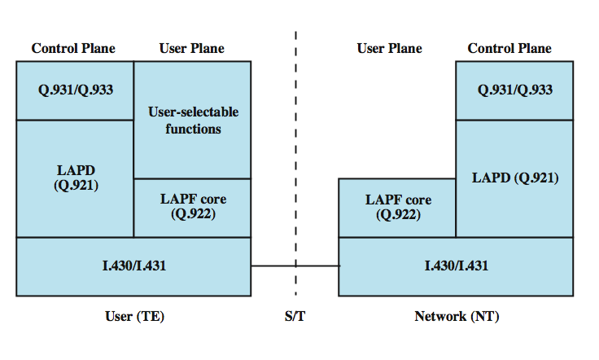
Frame Relay Protocol Architecture
Notes:
Stallings DCC8e Figure 10.15 depicts the protocol architecture to support the frame mode bearer service. We need to consider two separate planes of operation: a control (C) plane, which is involved in the establishment and termination of logical connections, and a user (U) plane, which is responsible for the transfer of user data between subscribers. Thus, C-plane protocols are between a subscriber and the network, while U-plane protocols provide end-to-end functionality.
The control plane for frame mode bearer services is similar to that for common channel signaling for circuit-switching services, in that a separate logical channel is used for control information. At the data link layer, LAPD (Q.921) is used to provide a reliable data link control service, with error control and flow control, between user (TE) and network (NT). This data link service is used for the exchange of Q.933 control signaling messages.
For the actual transfer of information between end users, the user-plane protocol is LAPF (Link Access Procedure for Frame Mode Bearer Services), which is defined in Q.922.

Slide 37
Frame Relay Protocol Architecture
Two separate planes of operation:
Control (C) plane:
User (U) plane

Slide 38
Control Plane
Involved in the establishment and termination of logical connections
C-plane protocols are between a subscriber and the network
Similar to common channel signaling for circuit-switching services
LAPD (Q.921) is used to provide a reliable data link control service, with error control and flow control, between user (TE) and network (NT)
Data link service is used for the exchange of Q.933 control signaling messages

Slide 39
User Plane
Responsible for the transfer of user data between subscribers
U-plane protocols
provide end-to-end functionality
U-plane protocol is LAPF

Slide 40
LAPF Functionality
LAPF (Link Access Procedure for Frame Mode Bearer Services) defined in Q.922
only core functionality used:
frame delimiting, alignment and transparency
frame mux and demux using addressing field
ensure frame is integral number of octets
ensure frame is neither too long nor short
detection of transmission errors
congestion control functions (only in LAPF)
forms sub-layer of data link layer
data transfer between subscribers only
Notes:
Only the core functions of LAPF are used for frame relay:
• Frame delimiting, alignment, and transparency
• Frame multiplexing/demultiplexing using the address field
• Inspection of the frame to ensure that it consists of an integral number of octets prior to zero bit insertion or following zero bit extraction
• Inspection of the frame to ensure that it is neither too long nor too short
• Detection of transmission errors
• Congestion control function (new to LAPF, above are also functions of LAPD)
The core functions of LAPF in the user plane constitute a sublayer of the data link layer. This provides the bare service of transferring data link frames from one subscriber to another, with no flow control or error control. Above this, the user may choose to select additional data link or network-layer end-to-end functions. These are not part of the frame relay service. Based on the core functions, a network offers frame relay as a connection-oriented link layer service with the following properties:
• Preservation of the order of frame transfer from one edge of the network to the other
• A small probability of frame loss

Slide 41
Frame Relay Data Link Connections
logical connection between subscribers
data transferred over them
not protected by flow or error control
uses separate connection for call control
overall results in significantly less work in network
Notes:
As with X.25, frame relay involves the use of logical connections, in this case called data link connections rather than virtual circuits. The frames transmitted over these data link connections are not protected by a data link control pipe with flow and error control. Another difference between X.25 and frame relay is that the latter devotes a separate data link connection to call control. The setting up and tearing down of data link connections is done over this permanent control-oriented data link connection.
The frame relay architecture significantly reduces the amount of work required of the network. User data are transmitted in frames with virtually no processing by the intermediate network nodes, other than to check for errors and to route based on connection number. A frame in error is simply discarded, leaving error recovery to higher layers.

Slide 42
User Data Transfer
only have one frame type which
carries user data
no control frames means
no inband signaling
no sequence numbers
flag and FCS function as in HDLC
address field carries DLCI
DLCI (Data Link Connection Identifier) has local significance only
Same function as VC number in X.25
Allows multiple logical frame relay connections to be multiplexed over a single channel
Notes:
The operation of frame relay for user data transfer is best explained by considering the frame format. This is the format defined for the minimum-function LAPF protocol (known as LAPF core protocol). The format is similar to that of LAPD and LAPB with one obvious omission: There is no Control field, which means there is only one frame type, used for carrying user data. There are no control frames. It is not possible to perform all control on the connection; a logical connection can only carry user data. It is not possible to perform flow control and error control, because there are no sequence numbers.
The Flag and Frame Check Sequence (FCS) fields function as in HDLC. The information field carries higher-layer data.
The address field has a default length of 2 octets and may be extended to 3 or 4 octets. It carries a data link connection identifier (DLCI) of 10, 16, or 23 bits. The DLCI serves the same function as the virtual circuit number in X.25. As in X.25, the connection identifier has only local significance: Each end of the logical connection assigns its own DLCI from the pool of locally unused numbers, and the network must map from one to the other.

Slide 43
LAPF – Core Formats

Slide 44
Summary
circuit verses packet switching network approaches
X.25
frame relay
Notes:
Chapter 10 summary.

Slide 45
Chapter Preparation
Before X.25 (not including X.25)
Thorough reading of slide related material from the book
After X.25
Stick to slide related material
Reading of the book still required

