Slide 1
SYMMETRYOF VIRUSES

Slide 3
CONTENTS
Intro of viruses
Discovery of viruses
Classification of viruses
Classification on the basis of symmetry
Helical viruses
Icosahedral viruses
Complex viruses
Envelope viruses
peplomers

Slide 4
Viruses
Virus: Viruses are acellular obligate intracellular parasites,that consists of nucleic acids either in the form of DNA or RNA. It uses metabolic machinery of host.
Discovery of viruses:
Martinus Willem Beijerinck(1897) coined the Latin name “virus” meaning poison.
Virus Classification:
It is done on the basis of:
Genetic material 4. Type of host
Symmetry 5. Virion range etc
Morphology

Slide 5
Classification on the basis of symmetry
On the basis of symmetry, they are divided into 4 groups
Helical symmetry
Icosahedral symmetry
Complex symmetry
Envelope symmetry

Slide 6
Helical symmetry
Helical Symmetry:
Helical capsids are shaped much like hollow tubes with protein walls.
The tobacco mosaic virus provides a well studied example of helical capsid structure
A single type of protomer associates together in a helical or spiral arrangement to produce a long ,rigid tube, 15 to 18 nm in diameter by 300 nm long

Slide 7
The RNA genetic material is wound in a spiral and positioned toward the inside of the capsid where it lies within the groove formed by protein subunits.
Not all helical capsids are as rigid as the TMV
Influenza virus RNAs are enclosed in thin , flexible helical capsids folded within an envelope
The size of a helical capsid is influenced by both its protomers and the nucleic acid enclosed within the capsid.

Slide 8
The diameter of the capsid is a function of the size, shape, and interactions of the protomers.
The nucleic acid determines helical capsid length because the capsid does not seem to extend much beyond the end of the DNA or RNA

Slide 10
Icosahedral symmetry
Viruses employ the icosahedral shape because it is the most efficient way to enclose a space
A few, genes sometimes only one , can code for proteins that self assemble to form the capsid
In this way, a small number of linear genes can specify a large three-dimensional structure.
Hexagons pack together in plancs and cannot enclose a space , and therefore, pentagons must also be used.

Slide 11
CONTI…
When icosahedral viruses are negatively stained, and viewed in the transmission electron microscope, a complex icosahedral capsid structure is revealed.
The capsids are constructed from ring-or knob shaped units called capsomers,each usually made of five or six protomers
Pentamers have five subunits, hexamers possess six. Pentamers are at the vertices of the icosahedron ,whereas , hexamers form its edges and triangular faces.
Protomers join to form capsomers through non-covalent bonding.

Slide 12
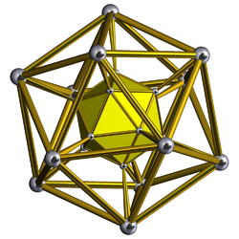
The bonds between proteins within pentamers and hexamers are stronger than those between capsomers

Slide 13
ICOSAHEDRAL SYMMETRY

Slide 14
COMPLEX SYMMETRY
Complex symmetry:
Although most viruses have either icosahedral or helical capsids , many viruses do not fit into either category
The poxviruses and large bacteriophages are two important examples.
The pox viruses are the largest of the animal viruses
They are about 400-200 nm in size

Slide 15
CONTI…
They usually possess an exceptionally complex internal structure with an ovoid to brickshaped exterior.
The double-stranded DNA is associated with proteins and contained in the nucleoid , a central structure shaped like a biconcave disk and surrounded by a membrane
The T2, T4, and T6 phages that infect E.coli have been intensely studied.

Slide 16
CONTI…
Their head resembles an icosahedron elongated by one or two rows of hexamers in the middle and contains the DNA genome.
The tail is composed of a collar joining it to the head , a cental hollow tube , a sheath surrounding the tube, and a complex baseplate.
The sheath is made of 144 copies of the gp18 protein arranged in 24 rings,each containing six copies.

Slide 17
The tail fibers are responsible for virus attachment to the proper site on the bacterial surface
Complex bacterial viruses with both heads and tails are said to have a binal symmetry bIn T-even phages, the baseplate is hexagonal and has a pin and a jointed tail fiber at each corner
Because they possess a combination of icosahedral and helical symmetry

Slide 19
COMPLEX SYMMETRY

Slide 20
ENVELOPED SYMMETRY
Many animal viruses, some plant viruses , and at least one bacterial virus are bounded by an outer membranous layer called an envelope.
Envelope proteins are coded for by virus genes and may even project from the envelope surface as spikes or peplomers
Eg: Influenza virus

Slide 22
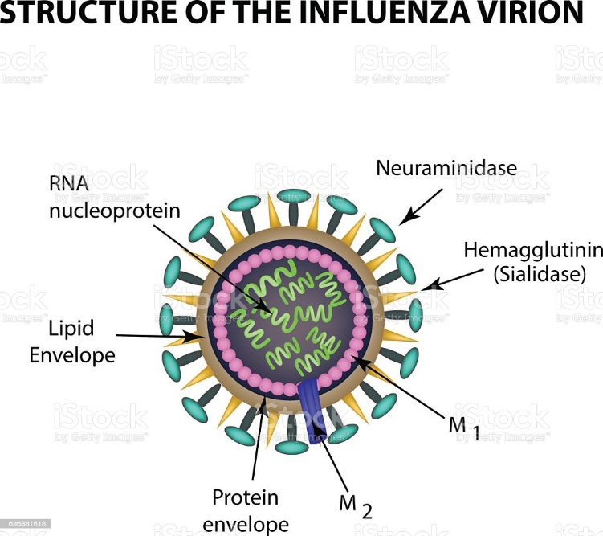
Conti…
These spikes may be involved in virus attachment to the host cell surface
Influenza virus is a well-studied example of an enveloped virus
Spikes project about 10 nm from the surface at 7 to 8 nm intervals.

Slide 23
conti
They protect the genetic material in their life cycle when travelling between host cells
Not all viruses have envelopes.
The envelopes are typically derived from portions of the host cell membranes , but include some viral glycoproteins.
Enveloped viruses enter cells by inducing fusion of viral and cellular membranes , a process catalyzed by a specialized membrane-fusion protein expressed on their surface.

Slide 24
Peplomers:
In mature virus particle, the glycoproteins often appear as projecting spikes on the outer surface of the envelope which are known as peplomers.
A virus may have more than one type of peplomers. Eg: the influenza virus carries two types of peplomers ,one is hemagglutinin and other is neuraminidase

Slide 25
REFERENCES
^ Jump up to: ª ^{b} Lawrence CM, Menon S, Eilers BJ, Bothner B, Khayat R, Douglas T, Young MJ (May 2009). "Structural and functional studies of archaeal viruses". The Journal of Biological Chemistry. 284 (19): 12599–603. d^ Jump up to: ª ^{b} "Virus Taxonomy: 2019 Release". talk.ictvonline.org. International Committee on Taxonomy of Viruses. Retrieved 25 April 202oi:10.1074/jbc.R800078200. PMC 2675988. PMID 19158076.
NOTES BY KOMAL PATIL ,PRIYA KUMARI AND OMILA DEVI
https://www.biologydiscussion.com/
https://premabotany.blogspot.com

