Slide 1
Dr. Muhammad Ali-ur-Rasheed
Lecturer , Department of Physiotherapy.
Sargodha Medical College.

Slide 2
Sociological perspective of profession

Slide 3
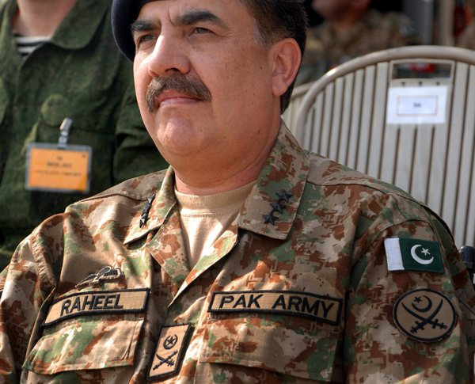
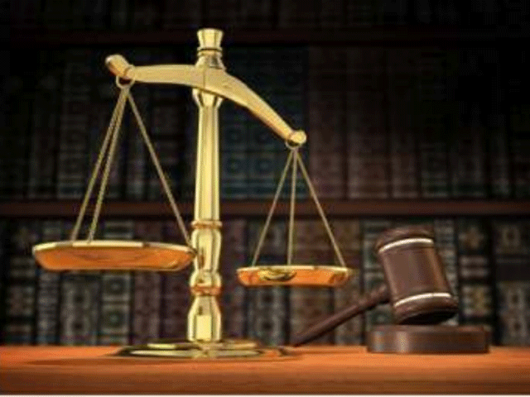
Profession
PRIMARY
SECONDARY
Primary professions include, for example: Judges, top Police Officers, top Military Officers, Professors, higher ranking Lawyers and Bishops
Notes:
Source (http://www.homeoint.org/morrell/misc/professions.htm)

Slide 4
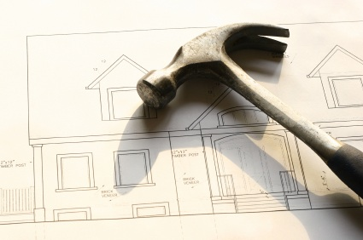
Secondary professions include, for example: Architects, Civil Engineers, Surveyors, Accountants, Lawyers and all other specialised technical occupations
[Scientists, Educators, Nurses, etc]

Slide 5
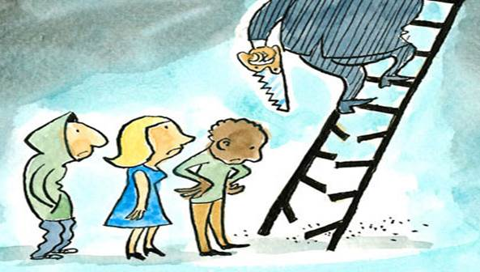
While all professions enjoy high social status, primary professions have the highest status, regard and esteem conferred upon them by society at large
This high esteem arises primarily from the wider, deeper and higher social function of their work as compared with other lower ranking professions.
Their work is regarded as
more vital to society as a whole
and thus of having a special
and very valuable nature.

Slide 6
By contrast, the secondary professions, while also enjoying high standing in society, yet the value of their work is seen as less vital to society and thus they enjoy a correspondingly lower status. All professions involve technical, specialised and highly skilled work. Training for this work involves obtaining degrees and professional qualifications in order to gain entry into the profession, and without which entry to the profession is barred [occupational closure]

Slide 7
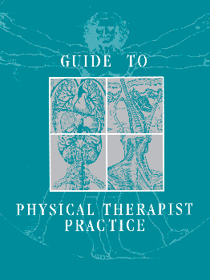
All professions have a high measure of control over their own affairs and therefore tend to be self-regulating or institutionally autonomous. All professions have control over their own knowledge base—epistemological autonomy.
All professions have evolved their own 'codes of practice,'
Thus all professions have overseeing regulatory bodies

Slide 8
Professions have generally arisen and become elevated naturally from lower trades and occupations through a slow process of maturation.
They have established themselves, put down roots, established approved procedures and qualifications, obtained legal and political recognition and so have grown in size, power and sophistication through time, often from modest beginnings.

Slide 9
As is apparent, a profession is not really identified by its specialised technical nature or by its control over its own knowledge base, as is commonly supposed, rather it is better defined by the power and high prestige it has in society as a whole...

Slide 10
Example: power/prestige
Dustmen [waste collectors] have their own knowledge base of sorts, and autonomy over their own affairs, and while regarded as a true specialism, or trade, they are not regarded highly by society as an elite high prestige group...thus, it is the power and prestige or value that society confers upon a profession that more clearly defines its inclusion in this category.
This is why Lawyers, Clerics, Military, Police personnel enjoy this high social status and are regarded as true professions.
Notes:
Prestige : A high standing achieved through success, influence or wealth etc.

Slide 11
Primary profession apparently deal with more compelling and more crucial aspects of social life than the secondary professions or the lesser trades

Slide 12
Many 'secondary professions' also have high status, autonomy, power over their own distinctive knowledge bases, closed entry and high value to society—such as architects, dentists, civil engineers, military officers, land surveyors, etc—but crucially, they do not share the same high professional and social status of doctors, lawyers and clerics and this seems puzzling. It therefore seems that these primary or true professions have a wider remit, a deeper value in society that breeds their higher status and confers upon them an even higher value within society...they apparently deal with more compelling and more crucial aspects of social life than the secondary professions or the lesser trades.

