Slide 1
INTERFERRENTIAL THERAP
MEDIUM FREQUENCY CURRENTS

Slide 2
TYPES OF MFC
REBOX-TYPE CURRENTS ________ 3000Hz
RUSSIAN CURRENTS___________ 2000-10,000Hz
INTERFERENTIAL THERAPY.

Slide 3
INTERFERENTIAL THERAPY
Also called as Nemec’s current after the name of Ho Nemec (an Austrian scientists).
The name Interferential current stems from the concept of two currents interfering with each other.
This becomes readily apparent when one views the four electrodes that are necessary to produce the standard interferential effect in a patient

Slide 4
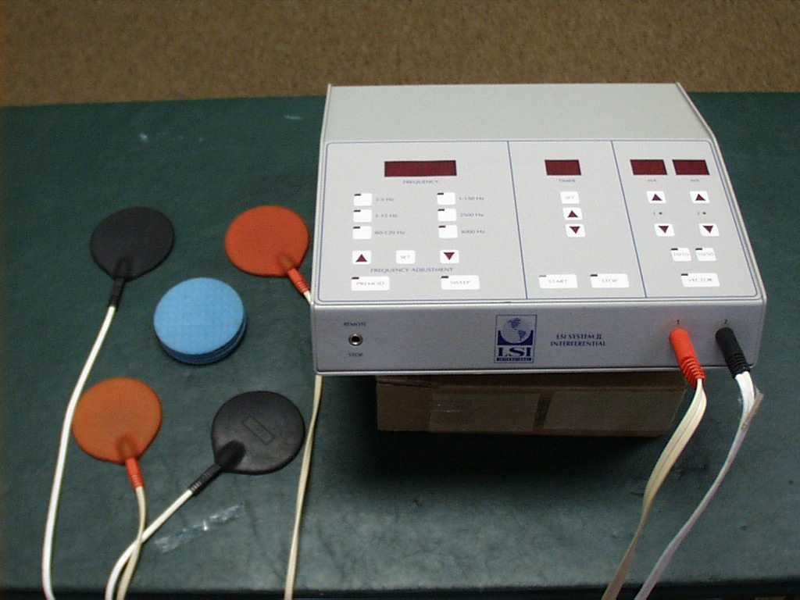
INTERFERENTIAL THERAPY

Slide 5
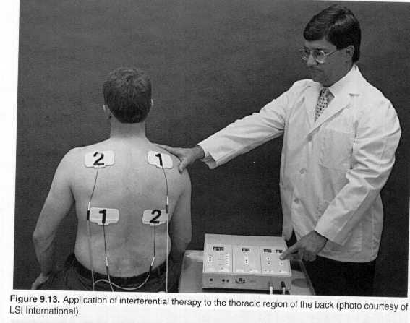

Slide 6
In the interferential current two medium frequency currents are used to produce low frequency current effect.
Since direct application of low frequency faradic current results in pain due to high impedance of tissues, so to have low frequency affect two medium frequency currents are used.
Out of these two medium frequency currents, one current is usually of 4000Hz because there is minimum impedance generated by tissue against this frequency. The other current may be varied accordingly

Slide 7
PRINCIPAL OF INTERFERENTIAL THERAPY
The interferential therapy depends upon the principle of interferential effect of two medium frequency currents crossing in the patients tissues. The interface is produced by two currents in the tissue is called BEAT FREQUENCY.
E.g. let us take the medium frequency currents, current in circuit A=4000 Hz and circuit B=3900. where these two currents are applied to tissues at the point where the current cross over, a new beat frequency is set up whose amplitude is modulated and the frequency of new current is called beat frequency (interferential current) and that is 100 Hz.
By varying the frequency of second channel relative to the constant frequency of first, this possible to produce a wide range of beat frequencies deep in patient tissues, thus it is possible to produce any desired frequency in the range of 1-250Hz by varying the frequency difference of carrier currents.

Slide 9
ADVANTAGES
One of the major advantages of use of IFT is that the affect are produced in the tissue where they are required without un-necessary or uncomfortable skin stimulation.
It can be used as pain relief as well as muscle stimulation.
The main advantages is that , patient can not be given higher doses in low frequency therapy apparatus like FARADIC STIMULATOR.
The skin resistance offered to the 4000cycles/sec is very much less than the resistance offered to low frequency currents such as faradic currents.
The principle of reduction in pain is because of gate control theory and stimulated release of pain reducing substances( endorphine and enkaphalin).

Slide 10
METHODS OF APPLICATION
TWO ELECTRODE BIPOLAR INTERFERENCE
FOUR ELECTRODE CLASSICAL INTERFERENCE (STATIC INTERFERENCE)

Slide 11
TWO ELECTRODE BIPOLAR INTERFERENCE
In this method interferential current is generated inside the equipment and interferential current is delivered to the patient through two electrodes only.
This way of treatment is useful for treating smaller areas like
Ankle
Elbow
Shoulder
Knee etc.

Slide 12
FOUR ELECTRODE CLASSICAL INTERFERENCE
It is applied where the area of application is large.
The amplitude of the current will be equal in both the channels.
In the channel-I frequency will be between 4,000 Hz.
In the channel-II frequency can be varied between 4,001 to 4,250 Hz

Slide 13
METHODS OF TREATMENT
Skin must be clean and clear before the start of treatment.
The part of body to be treated should be washed and if there is skin lesion it should be covered by applying petroleum jelly.
Electrodes should be placed in such a way that the crossing point of two currents lie above or around the affected part.
The suitable frequency current should be given for different conditions.
Select the spectrum mode rectangular, triangular or trapezoidal as needed.
Select the base frequency and upper frequency,, the difference b/t upper and base frequency would give the spectrum.

Slide 14
Increase the power gently and cautiously until the patient starts feeling the current. It can be increased till the patient can tolerate.
The current in the channel-I and channel-II are independently measured.
If there is difference in current in both the channels, this can be equalized by the balance control provided for tis purpose. Usually this difference is caused due to difference in resistance in the body where two currents are passing.
Remember that in case of two electrodes there is current output available only in channel(I) by the superimposition of the two channels internally.
after the treatment, adjust the intensity control to minimum.
Switch ‘OFF’ the mains and disconnect the electrodes.

Slide 15
ADVANTAGES OF INTERFERENTIAL CURRENTS
Do not produce any sensory nerve irritation, not burning sensation.(as other LFC)
Most suitable for treating deep layers of tissues. (high frequency & absence of direct current properties) like muscle, tendons, nerves, bursae and periosteum. IFT is harmless.
Skin resistance is minimum for frequencies in the range of 4,000 Hz, therefor higher doses can be given without any discomfort to skin.
The current can be localized more effectively in specific area. Extensive area can also be covered.
Metal is not the contraindication in treatment with interferential current unlike SWD therefore a number of postoperative pain conditions associated with metal implants can be treated effectively.

Slide 16
PHYSIOLOGICAL EFFECTS OF INTERFERENTIAL THERAPY
The physiological effects of IFT depends upon:
Magnitude of current
Type of mode used__ Rhythmic or constant
The frequency rage used
Accuracy of electrode positioning.
The effects are;

Slide 17
1. RELIEF OF PAIN
An important physiological effect obtained by the use of interferential therapy.
The increase in local blood circulation due to the local pumping effect of the stimulated muscle or the effect on autonomic nerves and thus the blood vessels help removing the chemicals from the local area.
Short duration pulses at a frequency of 100 Hz may stimulate large diameter nerve fibers which will have an effect on the pain gate in the PHC. And inhibit transmission of small diameter nociceptive traffic. Frequency 80-100Hz
15Hz __ activate descending pain suppression__ stimulation of small diameter fibers__ release of endogenous opiates
Physiological blocking of nerve transmission___ C fibers 15Hz , A delta fibers 40 Hz__ frequencies higher than this can block transmission
Placebo effects

Slide 18
2. MOTOR STIMULATION
Normal innervated muscles with IFT at 1-100 Hz
Type of contraction depends on the frequency of stimulation.
Low frequency___ twitching
5-20 Hz ___ partial tetany
30-100Hz ___ titanic contraction rhythmical frequency of 1-100Hz ___ all type of contraction
Little sensory stimulation
Deeply placed muscles treatment like pelvic floor muscle
Rapid return of tone of pelvic floor muscle is due to the stimulation of both voluntary and smooth muscle fibers.(faradism- only voluntary componenet)

Slide 19
3. ABSORBTION OF EXUDATE
Accelerated by frequency of 1-10Hz rhythmic
These two factors help to absorb exudates and reduce swelling.
Rhythmic pumping action of muscle contraction
Effect on autonomic nerves __ affect the diameter of blood vessels___ circulation

Slide 20
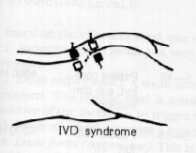

Slide 21
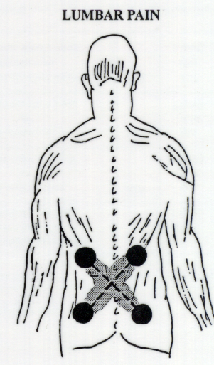

Slide 22
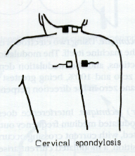

Slide 23
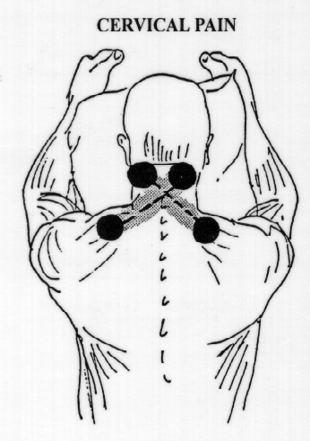

Slide 24
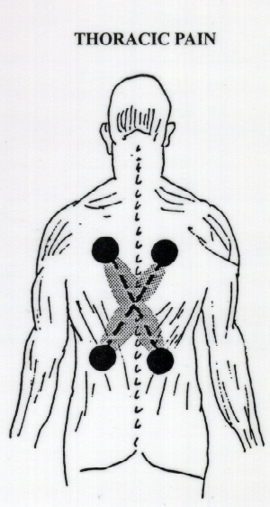

Slide 25
