Slide 1
Plants Ecology
Community concepts

Slide 2
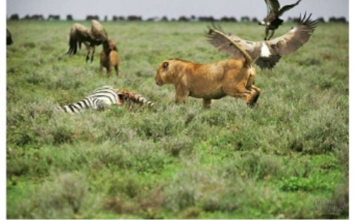
Communities
A group of organisms of different species that live in a particular area

Slide 3
Individualistic Hypothesis:
A community is a chance group of species found in the same area because they have similar biotic requirements.

Slide 4
Interactive hypothesis:
A community is a group of closely linked species locked together in mandatory biotic interactions that cause the community to function as an integrated unit.

Slide 5
Interspecific interactions
Interspecific interactions are those that occur between populations of different species living together in a community.
There are 4 major interspecific interactions:
Predation (parasitism)
Competition
Commensalism
Mutualism

Slide 6
Predation (parasitism)
The interaction is beneficial to one species and detrimental to the other.
Predation:
When a predator eats its prey

Slide 7
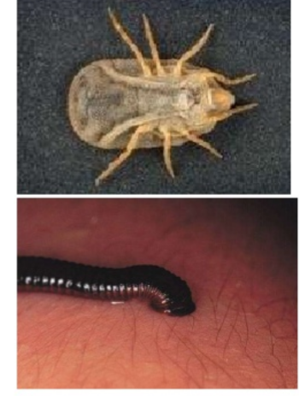
Predation (parasitism)
Parasitism:
Predators that live on or in their hosts, usually feeding
off their body tissues or fluids.
Usually don’t kill their host .

Slide 8
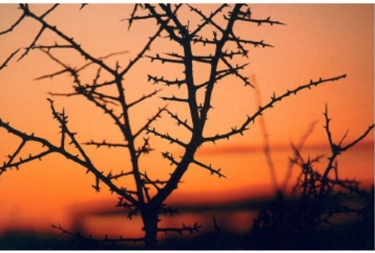
Plant Defenses Against Herbivores
Plants have 2 major mechanisms by which they defend themselves against being eaten
Mechanical defenses
Chemical defenses

Slide 9
Mechanical defenses
Thorns, hooks, etc.

Slide 10
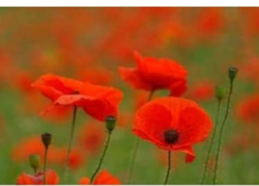
Chemical defenses
Produce chemicals that are distasteful or harmful to an herbivore
Morphine (opium poppy)
Nicotine (tobacco)

Slide 11
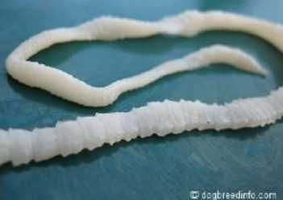
Parasitism
One organism ( the parasite) gets its nourishment from another organism ( host) which is harmed in the process.
Endoparasities:
live within the host ( tapeworms)
Ecto parasities:
feed on external surfaces ( mosquitoes)

Slide 12
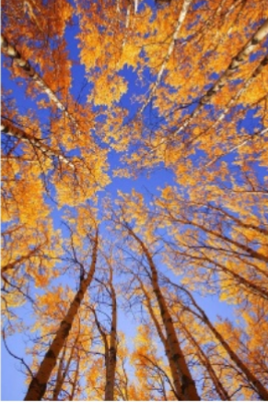
Commensalism:
Relationship in which one organism benefits the other is not harmed
Examples:
cattle and cattle egret ( birds)
sea anemone and clownfish

Slide 13
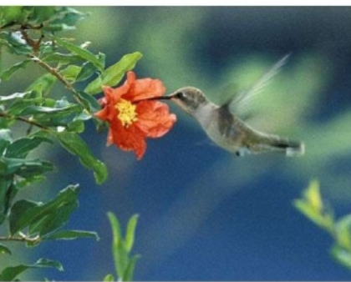
Mutualism:
Relationship in which both partners benefit from the relationship
Examples
Mycorrhizae:
plant gets increased water/ nutrition, fungi gets food
Hummingbirds and flowers:
Hummingbirds get food, flowers can reproduce

Slide 14
Community variables
Physical Appearance
Types Of Species
Number of Species
Ecological Niches

Slide 15
Factors Involved In Community
Species Richness ( number of different species)
Species Evenness ( population size)
Niche Structure ( number of niches)

