Slide 1
Parainfluenza viruses

Slide 2
Parainfluenza viruses
Croup (acute laryngotracheobronchitis)
Laryngitis
Bronchiolitis, otitis media
Pneumonia in children
Common cold in adults
Surface spikes of H, N and F PROTEINS
RESPIRATORY DROPLETS

Slide 3
Parainfluenza viruses
They are of four types 1,2,3 and 4
Types 1 and 2 are the commonest cause of croup.
Croup occurs in children younger than 5 years of age.

Slide 4
Parainfluenza viruses
VIRUS ISOLATION
RISE IN ANTIBODY TITER
PCR

Slide 5
CORONAVIRUSES

Slide 6
CORONA VIRUSES
Its an important cause of common cold
Non segmented, positive polarity and single stranded RNA genome.
Enveloped with helical nucleo-capsid
Electron microscope shows prominent club shaped spikes in the form of corona (halo)
CoV-SARS (severe acute respiratory syndrome)
MERS-CoV (middle east respiratory syndrome)

Slide 7
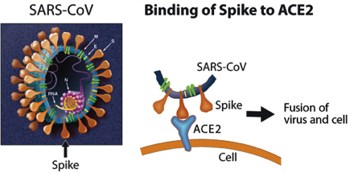

Slide 8
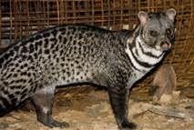
CORONA VIRUSES TRANSMISSION
Air borne droplets
Reservoirs of SARS VIRUS
Civet cat as intermediate hosts
Horseshoe Bats

Slide 9
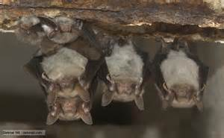
CORONA VIRUSES
Reservoirs of MERS Viruses

Slide 10
CORONA VIRUSES
Immunity following infection is brief
50% infections are asymptomatic
Infection is limited to mucosal cells of respiratory tract.
Pneumonia in case of SARS is caused by binding of virus to ACE-2 on respiratory tract epithelium leading to dys-regulation of fluid balance and edema of alveolar space.
Pneumonia in case of MERS is caused by binding of virus to CD-26 on respiratory tract mucosa

Slide 11
CORONA VIRUSES
COMMON COLD….Mild URTI…Rhinorrhea, scratchy sore- throat and low grade fever
Also cause bronchitis
SARS…..(Severe Acute Respiratory Syndrome)
Incubation period 2-10 days
Severe atypical pneumonia, fever (38℃), nonproductive cough, dyspnea and hypoxia along with rigors, chills and malaise

Slide 12
MERS VIRUS
Transmission …airborne
Reservoirs….bats and camels
People with underlying health conditions, such as heart disease, diabetes, kidney disease, respiratory disease, the immunosuppressed, and the elderly should avoid TRAVELLING TO AREAS WHERE MERS IS ENDEMIC

Slide 13
MERS
MERS-CoV cases have been reported in several countries including e.g.
Saudi Arabia, Malaysia, Jordan, Qatar, Egypt, United Arab Emirates, Kuwait, Oman, the United Kingdom, and the United States.[

Slide 14
Laboratory diagnosis
If SARS and MERS are suspected then PCR based tests are performed
CXR....show “ground glass” interstitial infiltrates.
Leucopenia and thrombocytopenia

Slide 15
Treatment and Prevention
Ribavirin and Steroids can be tried
No treatment and vaccination is available

Slide 16
Rhinoviruses
These viruses are the main cause of common cold

Slide 17
Rhinoviruses
More than 100 serotypes
Best multiply at 33℃ rather than at 37℃ that’s why they affect nose, throat and conjunctiva
They are acid –labile

Slide 18
Rhinoviruses
Two modes of transmission
Direct by respiratory aerosols
Indirect by hands, table tops, fomites etc
Frequency of “colds” is higher in childhood than during adulthood
They are the common cause of common cold
Infection is limited only to upper respiratory tract
Nasal secretory IgA

Slide 19
Rhinoviruses
Clinical findings
Incubation period 2-4 days
Sneezing, nasal discharge, sore throat, cough and headache
Illness lasts about 1 week
(coronaviruses, adenoviruses, influenza C virus and Coxsackie viruses) also cause common cold syndrome

Slide 20
Rhinoviruses
Diagnosis in lab is usually not done
No specific antiviral therapy
Vaccines appear impractical due to large number of serotypes
Prevention…..paper tissues impregnated with citric acid and Na lauryl sulphate , high doses of vit.C or use of lozenges

Slide 21
DNA Nonenveloped Viruses
ADENOVIRUSES
Cause upper and lower respiratory tract diseases as well as other diseases, such as
Pharyngitis
Common cold
Pneumonia
Conjunctivitis (pink eye)
Keratoconjunctivitis
Hemorrhagic cystitis
Gastroenteritis mainly occurs in children <2years of age

Slide 22
ADENO VIRUSES
Approximately 100 serotypes have been recognized, at least 47 of which infect humans
Linear, double-stranded DNA
The virions are nonenveloped icosadeltahedrons
The fiber contains the viral attachment proteins and can act as a hemagglutinin.
Fiber protein is type-specific antigen

Slide 23
Electron micrograph of adenovirus virion with fibers

Slide 24
ADENO VIRUSES
3,4,7,21 serotypes….respiratory disease
8,19 serotypes…..epidemic keratoconjunctivitis
11,21 serotypes….hemorrhagic cystitis
40,41 serotypes….infantile gastroenteritis
Spread mainly is by respiratory, fecal-oral, by fingers, by fomites, by contact from human to human.

Slide 25
Pathogenesis
Capable of causing lytic (e.g., mucoepithelial cells), latent (e.g., lymphoid and adenoid cells, Peyer's patches, and can be reactivated in immunosuppressed patients) and transforming (hamster, not human) infections.
The viral fiber proteins determine the target cell specificity
Infects mucosal epithelium of respiratory tract, GI tract and the conjunctivas

Slide 26
CLINICAL FINDINGS
Causes pharyngitis, which is often accompanied by conjunctivitis (pinkeye) and pharyngoconjunctival fever.
Pharyngitis alone occurs in young children, particularly those younger than 3 years, and may mimic streptococcal infection.
Patients have mild, flulike symptoms (including nasal congestion, malaise, fever, myalgia, and headache).

Slide 27
ACUTE RESPIRATORY DISEASE
A syndrome consisting of fever, cough, pharyngitis and cervical adenitis.
Usually caused by adenovirus serotypes 4 and 7.
OTHER RESPIRATORY TRACT DISEASES:
Cold like symptoms, laryngitis, bronchiolitis, bronchitis and atypical pneumonia .
They can also cause a pertussis-like illness.

Slide 28
CONJUNCTIVITIS AND EPIDEMIC KERATOCONJUNCTIVITIS
Irritation of the eye by a foreign body, dust, debris is a risk factor for the acquisition of this infection.
Cause a follicular conjunctivitis in which the mucosa of the palpebral conjunctiva becomes nodular
Swimming pool conjunctivitis

Slide 29
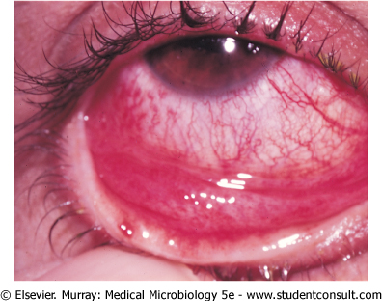

Slide 30
GASTROENTERITIS AND DIARRHEA
Major cause of acute viral gastroenteritis; 15% of the cases of gastroenteritis in hospitalized patients.
Serotypes 40 and 41 appear to be responsible for episodes of diarrhea in infants.

Slide 31
Laboratory Diagnosis
Should be obtained from a site or secretion relevant to the disease symptoms.
Isolation of virus in cell culture and 4-folds rise in antibody titer.
Serologic testing by complement fixation and hemagglutination inhibition.
Fluorescent antibody assays and the polymerase chain reaction can be used to detect type and group the virus.

Slide 32
Treatment, Prevention, and Control
There is no approved treatment for adenovirus infection.
3 Live, oral vaccines have been used to prevent infections, given individually at different occasions, with adenovirus types 4,7 and 21 in military recruits.

Slide 33
TOGA VIRUSES
RUBELLA VIRUS
Rubella(German Measles)
Congenital rubella syndrome

Slide 34
RUBELLA VIRUS
Virus causes….
Member of Togavirus family
Single stranded positive polarity RNA genome
Enveloped, icosahedral symmetry
H spikes are present
Single serotype
Humans are the natural hosts

Slide 35
TRANSMISSION
Air borne droplets
Vertical transmission

Slide 36
RUBELLA VIRUS
Rubella Virus
Nasopharynx
Regional lymph nodes
Internal organs and skin where rash is produced
Antigen antibody mediated rash is developed

Slide 37
RUBELLA
INCUBATION PERIOD
14-21 DAY
Rash is milder and shorter as compared to measles
Fever +malaise
Maculopapular rash (3days)
Posterior auricular lymphadenopathy
Polyarthritis especially in females

Slide 38
Rubella rash

Slide 39
Congenital rubella syndrome include
Cardiac Abnormalities
1.Patent ductus arteriosis
2.Pulmonary artery stenosis
3.Atrio-ventricular septal defects

Slide 40
Congenital rubella syndrome includes:
Neuropathic changes:
1.Microcephaly
2.Mental retardation
3.Meningoencephalitis
4.Cerebral palsy
5.Cerebral calcification

Slide 41
Congenital rubella syndrome include
Ocular defects:
1.Cataract
2.Microphthalmia
3.Retinal changes, retinitis
4.Blindness

Slide 42
Congenital rubella syndrome include
Inner ear problems especially deafness, sensori-neural
Symmetric intrauterine growth retardation.
Other:
1. Purpura
2. Jaundice
3. Hepatosplenomegaly
4. Thrombocytopenia

Slide 43
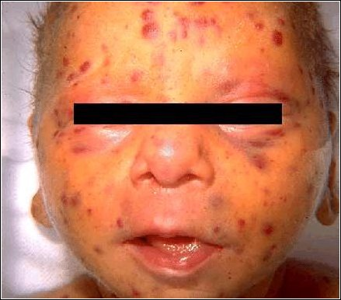

Slide 45
Immunity
Children can shed rubella virus
Should be isolated
Congenitally infected infants have high IgM titers and persistent IgG antibody titer long after maternal antibody has disappeared

Slide 46
LABORATORY DIAGNOSIS
Cell Culture……..Interfere with cytopathic effect of echoviruses ,a phenomenon known as interference
IgM antibody titer in single acute phase serum sample
Fourfold Rise in antibody titer in hemagglutination inhibition test or ELISA
PCR
Amniocentesis

Slide 47
PREVENTION
MMR (live, attenuated vaccine) by s/c route. It can be give to children at age of 15 months and to unimmunized young adult females (should use contraception for 3 months)
Immune serum globulins (IG) to the exposed pregnant females in first trimester and to the ladies when there no option for termination of pregnancy

