Slide 1
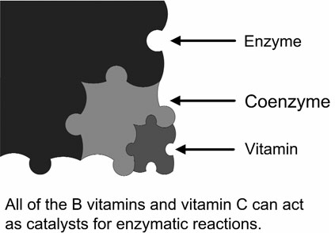
Vitamin C
1 Circulate freely in the blood
in the watery fluids between cells
and in the fluids inside cells.
2 Regulated by the liver and
released through the bile.

Slide 2
Vitamin C
Important to bone health
Blood vessel health
Cell structure and absorption of iron
Deficiency:
Rare
Too much vitamin C
Storage in our bodies is limited.

Slide 3
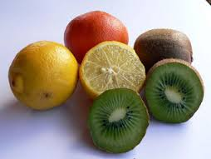
Foods:
Melons Berries Tomatoes
Potatoes Broccoli Fortified juices
Kiwi Mangos Yellow peppers
Citrus fruits

Slide 4
Precaution
Vitamin C can cause intestinal irritation,but only when taken in large amounts and in the acidic form (ascorbic acid).
When taken in an ascorbated or buffered form, Vitamin C is not irritating, even in large doses.

Slide 5
Biosynthesis of Vitamin C
The vast majority of animals synthesize vitamin C.
The few animals that cannot synthesize
vitamin C in their bodies include
Apes humans
guinea pigs, one type of bird
One type of bat and one type of fish.

Slide 6
Process

Slide 7
If humans could synthesize their own vitamin C.
The amount synthesized daily might be between 2800 mg and 20,000 mg.

Slide 8
Collagen and Vitamin C
Supported by vitamin C is also important for veins heart valves intervertebral discs the cornea and lens of the eye.

Slide 9
Lack of vitamin C can cause weak and brittle arteries and raise the risk of cardiovascular disease because of lowered collagen

Slide 10
Collagen and keratin
Responsible for the elasticityof skin.
The degradation of collagen leads to wrinkles that can be caused by aging or smoking.
Injected collagen is used in cosmetic surgery, especially to thicken lips.
Ferrous iron is required as a cofactor for collagen synthesis in the body.

Slide 11
Vitamin C as an Antioxidant
Free radicals are unstable and react quickly with other compounds.
Normally, free radicals
attack the nearest stable molecule, “stealing” its electron,
This attack is known as oxidative stress.

Slide 12
Vitamin C as an Antioxidant

Slide 13
Vitamin C as an Antioxidant

Slide 14
Antioxidant Roles of Vitamin C
Protects Protein and DNA.
Regenerates vitamin E and beta-carotene.
Aids absorption of iron.
Inhibits the formation of nitrosamines.

Slide 15
How Vitamin C May Help with Colds
By reducing damage from phagocyte-released free radicals.
With an antihistamine effect.
By keeping phagocytes and leukocytes“charged” with vitamin C.
By reducing the likelihood of a cold progressingto pneumonia.
More vitamin C is needed during colds.

Slide 16
Vitamin C may lower the risk of:
Coronary heart disease.
Cancer.
High lead levels.

Slide 17
vitamin C is needed in times of stress.

Slide 18
Vitamin C works
Two ways to lower cholesterol.
Vitamin C is needed to change cholesterol into bile in the liver.
Vitamin C helps contract the gallbladder to release bile.

Slide 19
Degradation:
leached by:
cooking water reduced by heat
Light light
Oxygen food processing.

Slide 20
Degradation:

Slide 21
Deficiency of Vitamin C
The newest RDAs for vitamin C are 75 mg for women
90 mg for men, 120 mg
For breastfeeding women
125 mg for male smokers
Five servings of freshfruits and vegetables provide approximately 200 mg of vitamin C.
Optimal amounts for disease prevention of the ascorbated form of vitamin C range from 200 mg to 2 grams daily.

Slide 22
Vitamin C in some common foods.

Slide 23
Recommended daily intake levels for vitamin C.
RDAs for Age Males Females
Vitamin C mg/day mg/day
Infants 0–6 months 40 40
Infants 7–12 months 50 50
Children 1–3 years 15 15
Children 4–8 years 25 25
Children 9–13 years 45 45
Adolescents 14–18 years 75 65
Adults 19 years and older 90 75
Adult smokers 19 years and older 125 110
Pregnancy 18 years & younger — 80
Pregnancy 19 years and older — 85
Breastfeeding 18 years & younger — 115
Breastfeeding 19 years and older — 120

Slide 24
Sucrvy disorder

