Slide 1
GENERAL PARASITOLOGY BY DR. ANAM RASHEED PATHOLOGY DEPARTMENT

Slide 2
PARASITOLOGY is a branch of biology which deals with the phenomenon of dependence of one living organism on another.
MEDICAL PARASITOLOGY deals with parasites which infect man , the disease they produce , the response generated against them and various methods of diagnosis and prevention.

Slide 3
PARASITE
“A parasite is an organism that is entirely dependent on an other organism, referred to as its host ”
Microparasite e.g.. virus, bacteria & protozoa.
Macroparasite e.g.. helminths .

Slide 4
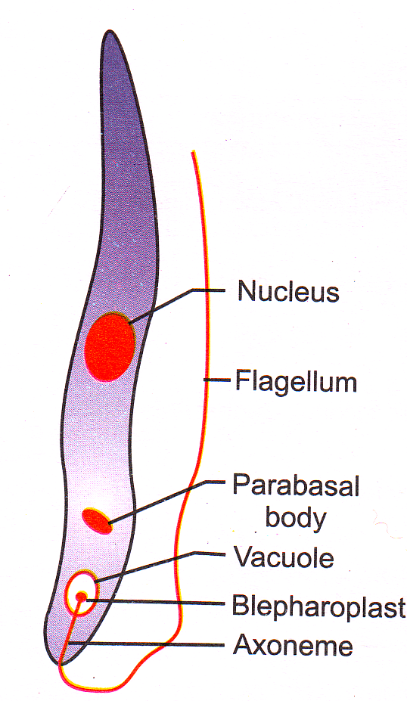
PARASITE (continued)
On the basis of location of parasite they are divided into;
Ecto parasite
Endo parasite

Slide 5
Endo parasites
They are of different types.
1) Obligate parasite
2) Facultative parasites
5) Accidental parasites
4) Aberrant parasites /wandering parasites
3) Free living parasites

Slide 6
Host
It is defined as “an organism which harbours the parasite and provides the nourishment and shelter to the parasite ”.
Definitive host
Intermediate host
Paratenic host
Reservoir host

Slide 7
ZOONOSIS
“This term is used to describe an animal infection that is naturally transmissible to human either directly or indirectly via a vector”.

Slide 8
VECTOR
A vector is an agent that transmits an infection
from one human host to another. .

Slide 9
HOST- PARASITE RELATIONSHIPS
SYMBIOSIS
2. COMMENSALISM
3. PARASITISM

Slide 10
SOURCES OF INFECTION
1. Contaminated Soil & Water
Freshwater fishes
Crab & Crayfishes
Raw or undercooked Pork
Raw or undercooked Beef

Slide 11
SOURCES OF INFECTION
6. Watercress
Blood – sucking insects
Housefly
Dog
Cat
Man
Autoinfection

Slide 13
SCHEME FOLLOWED IN PARASITOLOGICAL STUDIES
Following steps are followed in parasitological studies,
History of discovery of parasite.
Geographical distribution.
Habitat inside the human host.
Morphology & life cycle of parasite.
Mode of infection ;
Reservoir host
Sources of infection
Portal of entry ****
Vehicle of transmission

Slide 14
SCHEME FOLLOWED IN PARASITOLOGICAL STUDIES (continued)
Pathogenicity ;
Parasite may cause damage to its host like this,
Traumatic damage.
Lytic necrosis.
Competition for specific nutrients.
Inflammatory reaction.
Allergic manifestation.
Neoplasia.
Secondary infection.

Slide 15
SCHEME FOLLOWED IN PARASITOLOGICAL STUDIES
Clinical manifestations.
Methods for specific diagnosis.
Approved therapy for eradication of parasitic infection .
Prophylactic measures for prevention of the individual as well as of the community.

Slide 16
METHODS FOR DIAGNOSIS
Demonstration of parasite
Immunodiagnosis
Molecular biological methods

Slide 17
Blood
Stool
Urine
Genital specimen
CSF
Sputum
Tissue biopsy
Culture
Animal inoculation

Slide 18
Immunodiagnosis
Skin test
Serological test

Slide 19
Molecular biological methods
DNA probe
PCR

Slide 20
A HUMAN EMBRYO
OR
FOETUS IS NOT A PARASITE
WHY?

Slide 21
INTRODUCTION TO PROTOZOA

Slide 22
INTRODUCTION TO PROTOZOA
Protozoa are,
Uni- cellular eukaryotic cell.
They may possess pseudopodia , cilia , or flagella as organelles of locomotion.
They have short generation time , high rate of reproduction .
Man harbours > 50 species .
Some are non pathogenic and some cause major diseases.

Slide 23
CLASSIFICATION OF PROTOZOA

Slide 24
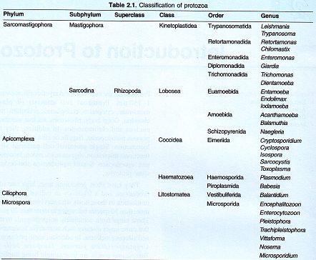

Slide 25
AMOEBA
Sub phylum Sarcodina .
Super class Rhzopoda .
Class – Lobosea .
Order Euamoebida , Amoebida , Schizopyrenida .
Phylum Sarcomastigophora .

Slide 26
AMOEBA (continued)
Six species of amoeba are found in human mouth and intestine .
Entamoeba histolytica (amoebiasis) pathogenic
E. hartmanni .
E. coli . Non pathogenic
E. gingivalis .
Endolimax nana .
Iodamoeba buetschlii .

Slide 27
ENTAMOEBA HISTOLYTICA (parasite causing diarrhoea, dysentry & liver abscess)

Slide 28
Alexander witch was the first who described the infection with E. histolytica.
He injected amoebae in dog by rectal injection and latter on dog died because of ulcers in colon.
Paitent who died from infection showed ulcers in colon on autopsy.

Slide 29
ENTAMOEBA HISTOLYTICA
Geographical Distribution;
It is world wide, but more common in tropical & sub tropical countries .
Habitat ;
Trophozoites of E. histolytica reside in mucosa & sub mucosa of large intestine of man .

Slide 30
ENTAMOEBA HISTOLYTICA
Morphology
The parasite exist in three forms ;
Trophozoite
Precyst
Cyst

Slide 31
TROPHOZOITES AND CYSTS

Slide 32
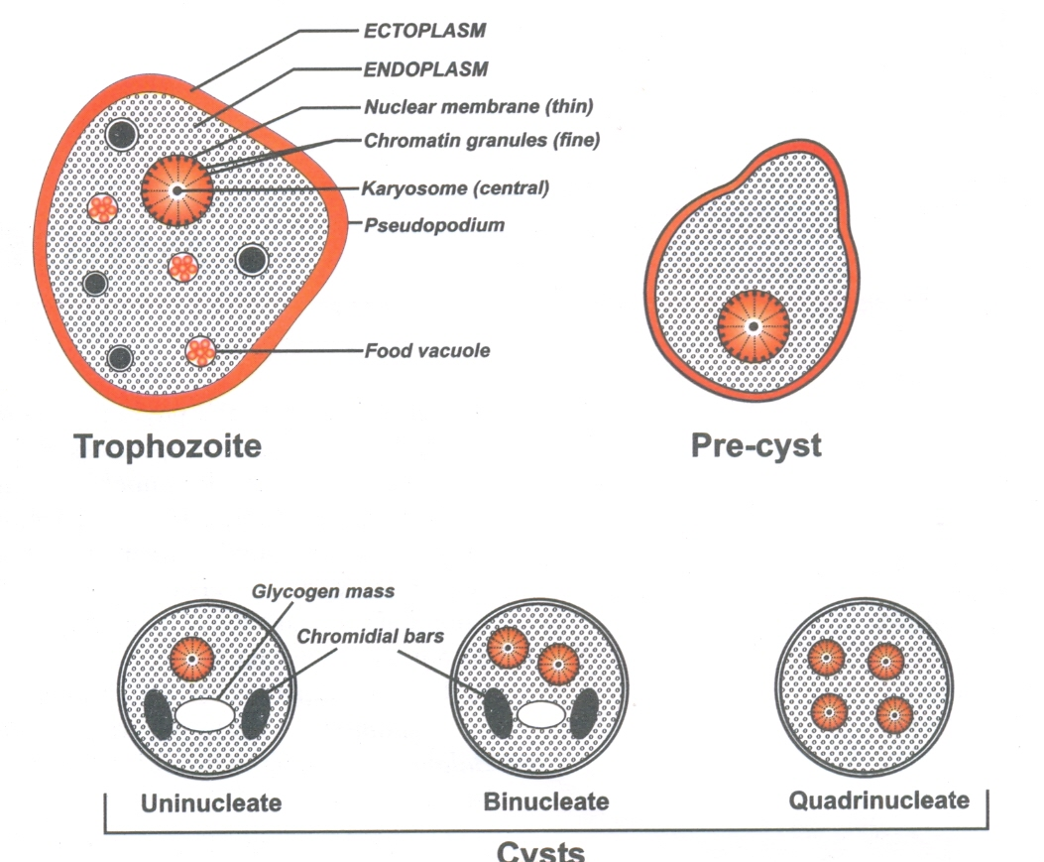
Morphological Forms of E.histolytica

Slide 33
Cyst
It is spherical in shape .
It has thick chitinous wall .
It starts as uni nucleate body but latter divides in 2 and then into 4 nuclei.
Cysts are present only in the lumen of colon & in formed faeces .
Cysts ranging from 3.5_10µm are considered as nonpathogenic (E. hartmanni) .
Stools may contain 1-4 nuclei according to maturation .
Cysts of E. histolytica are not present in tissues .

Slide 34
LIFE CYCLE OF E. HITOLYSTICA
Man is the only host .
Two phases of development are important ;
* one is the trophozoite
*other is the cyst (with a *transitory stage of pre cystic form)

Slide 35
Life Cycle of E.histolytica

Slide 36
Life Cycle of E. histolytica

Slide 37
Reservoirs of infection.
Man is the commonest source of infection.
Modes of infection
Transmission is from man to man .
Faecal contamination of drinking water , vegetables and fruits .
Eating of uncooked vegetables and fruits which have been fertilized with contaminated water.
Infected individuals (cyst-passers , cyst-carriers)also transfer infection .

Slide 38
PATHOGENICITY OF ENTAMOEBA HISTOLYTICA
Incubation period
It is generally of 01 – 04weeks .
Pathological Lesions
They are of two types ;
Primary or Intestinal Lesions.
Secondary or Metastatic Lesions.

Slide 39
Primary or Intestinal Lesions (Intestinal Amoebiasis)
In small intestine cyst wall is lysed by trypsin .
Trophozoites liberated after excystation enter through crypts of liberkhun .
Then penetrate directly through columnar epithelium of mucus membrane by their amoeboid activity .
E . histolytica secretes a proteolytic enzyme that causes destruction & necrosis of tissue .
It causes flask shaped ulcers and bloody diarrhoea (amoebic dysentry) .

Slide 40
Pathogenesis of Intestinal Amoebiasis

Slide 41
Primary or Intestinal Lesions (Intestinal Amoebiasis)
(continued)
Ulcers may be generalized or localized .
Ulcers are discrete with intervening normal mucosa .
Size vary from a pin-head size to >2.5 cm in diameter .
They may be deep or superficial .
Base of deep ulcers is generally formed by muscular coat .
Superficial ulcers don´t extend beyond muscularis mucosae .
E . histolytica may cause cause amoebic appendicitis and amoebomas .

Slide 42
AMOEBOMAS
Amoebomas are pseudotumeral lesions .
It is formed by necrosis ,inflammation & oedema of mucosa and sub mucosa .
Generally it is single or it may be multiple .
The is usually acute with dysentry , abdominal pain and a palpable mass in abdomen .

Slide 43
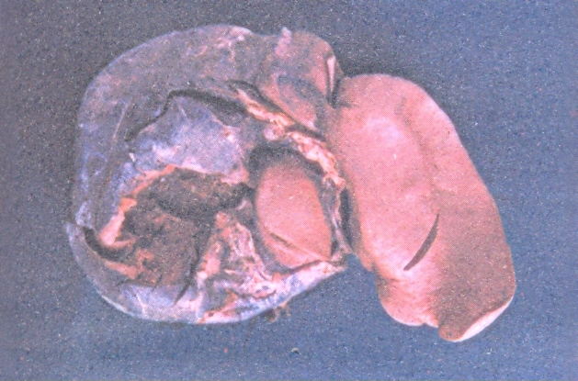
AMOEBIC LIVER ABSCESS

Slide 44
AMOEBIC ULCERS LARGE INTESTINE

Slide 45
AMOEBIC ULCERS LARGE INTESTINE

Slide 46
SECONDARY ⁄ METASTATIC ⁄ EXTRAINTESTINAL LESIONS
5% individuals with intestinal amoebiasis develop hepatic amoebiasis .
The trophozoites of E. histolytica are carried as emboli by radicals of portal vein from base of an amoebic ulcer in the large intestine , usually from caecum and ascending colon .
In capillary system of liver trophozoites are trapped and start multiplying and then start their cytolytic action .
They also cause anaemic necrosis of liver cells .
This primary lesion forms the starting point of liver abscess

Slide 47
AMOEBIC LIVER ABSCESS
An amoebic abscess is differentiated in to 3 zones .
A central necrotic area filled with pus with no amoeba.
An intermediate zone consisting of degenerated liver cells , a few red cells, leucocytes and occasional trophozoites of E. histolytica .
An outer zone of nearly normal tissue .

Slide 48
AMOEBIC LIVER ABSCESS
Pus of liver abscess:
The center of an amoebic liver abscess contains a viscous thick red brown (anchovy sauce appearance) or grey fluid consisting of cytolysed liver cells ,red blood cells and leucocytes .
It contains very few pus cells .

Slide 49
CLINICAL FEATURES OF AMOEBIC LIVER ABSCESS
Located in the postero-superior surface of the right lobe of liver ;
Pain and tenderness .
Fever
Jaundice
General health
On examination

Slide 50
AMOEBIC LIVER ABSCESS

Slide 51
AMOEBIC LIVER ABSCESS

Slide 52
COMPLICATIONS OF AMOEBIC LIVER ABSCESS

Slide 53
METASTATIC LESIONS
Pulmonary amoebiasis
Cerebral amoebiasis
Cutaneous amoebiasis
Splenic abscess

Slide 54
LAB DIAGNOSIS
Intestinal amoebiasis
In acute intestinal amoebiasis ;
Stool examination ; microscopically shows motile trophozoites of E. histolytica .
For demonstration of cysts or dead trophozoites , stained preperation is required .
Blood Examination
Serological Tests; IHA, IFA, ELISA

Slide 55
LAB DIAGNOSIS
HEPATIC AMOEBIASIS
Diagnostic Aspiration
Liver Biopsy
Blood Examination
Stool Examination
Serological Tests; IHA, IFA, ELISA
Molecular Methods; DNA probes & PCR.

Slide 56
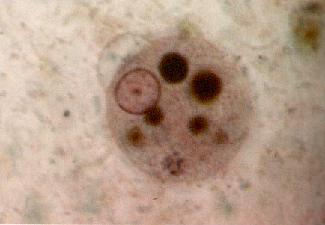
CYST OF ENTAMOEBA HISTOLYTICA IN STOOL

Slide 57
TREATMENT (Antiamoebic drugs)
Amoebicides with luminal action
Diiodohydroxyquin
Diloxanide furoate
Paromomycin
Amoebicides effective in liver, intestineal wall & other tissues
Emetine
Dehydroemetine

Slide 58
TREATMENT (Antiamoebic drugs)
Amoebicides effective only in liver
Chloroquin
Amoebicides effective in both tissues & intestinal lumen
Metronidazole
Nitroimidazole

Slide 59
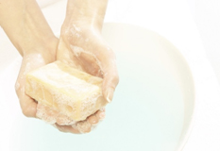
PREVENTION
Avoid faecal contamination of food and water
Asymptomatic cyst carriers must be treated.
Use of human excreta as fertilizer should be condemned.
Prevent house flies
& cockroaches.

Slide 60
E.Coli E. histolytica

Slide 63
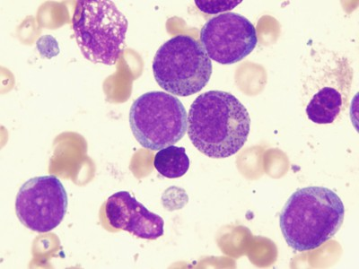
FLAGELLATES

Slide 64
FLAGELLATES
Flagellates are protozoa.
They posses cytoplasmic extensions known as flagella.
Flagella arise from blephroplasts.

Slide 65
CLASSIFICATION OF FLAGELLATES

Slide 66
GIARDIA LAMBLIA (Synonym with G.intestinalis, G. duodenalis)

Slide 67
History
It was discovered by Leeurwenhoek in 1681 in his own stools.

Slide 68
GEOGRAPHICAL DISTRIBUTION
Cosmopolitian in distribution.
More prevelant in children than adults.<IO years
More common in warm climates.

Slide 69
DISEASE
Giardiasis
Most common pathogen in water borne diarrheal illness. Most outbreaks are related to untreated or inadequately purified water.
HABITAT
Duodenum, upper part of the jejunum.

Slide 70
MORPHOLOGY

Slide 71
MODE OF INFECTION
By ingestion of water & food contaminated with cysts
By anal-oral sexual practices

Slide 72
LIFE CYCLE

Slide 74
LIFE CYCLE
With in 30 minutes of ingestion excystation occurs in duodenum.
After multiplication trophozoites colonize in duo. & upper part of jejunum.
Trophozoites are found in frankly diarrhoeic stools.
Encystation occurs in colon.

Slide 75
PATHOGENICITY (AT LEAST 10 CYSTS ARE SUFFICIENT TO CAUSE INFECTION)
Gets attach to mucosal cells of duo & jej. by means of its sucking discs.
Leading to duodenitis & jejunitis.
They don’t invade the tissues.

Slide 76
PATHOGENESIS Following steps lead to malabsorption
First; atrophy of brush border leads to deficiency of disaccharidase.
Second; increased epithelial cell turn over leads to immature enterocytes.
Third; decreased bile salt concentrations, ↓ pancreatic lipase activity→ impaired solubilization of fats.
Fourth; Giardia lamblia infection inhibits trypsin.

Slide 78
Various conditions associated with Giardiasis in compromised people are,
Hypo gammaglobulinemia.
Protein /caloric malnutrition.
Gastric achlorhydria.
Reduced gastric IgA levels in gut.
Patients with HIV have also been found to have giardiasis.

Slide 79
CLINICAL FEATURES
May range from asymptomatic carriers to fulminant diarrhoea.
In acute giardiasis symptoms start after incubation period of 1to 3 weeks with a minimum of 5days.
Dull epi- gastric pain, flatulance, chronic diarrhoea of steatorrhoea type, stool is voluminous foul smelly and contains large amount of mucus and fat but no blood.
Symptoms associated with malabsorption, chronic cholecystis and jaundice.

Slide 80
COMPLICATIONS
Urticaria.
Reactive arthritis.
Biliary tract disease.
Pancreatitis.

Slide 81
LABORATORY DIAGNOSIS
Giardiasis can be diagnosed by;
Identification of cysts in formed stools.
Identification of trophozoites in diarrhoeal stools by normal saline & iodine preperations.
Enterotest.
ELISA test.
Biopsy from multiple duodenal & jejunal sites. (Touch preperations)

Slide 82
Cysts are resistant to chlorination

Slide 84
Stool Examination

Slide 85
Treatment
Metronidazole is very effective.
Tinidazole as a single dose is more effective then metronidazole.
Furazolidone is given in children.

Slide 86
PREVENTION
Improved water supply.
Proper disposal of human excreta.
Improved personal hygiene.
Routine hand washing.
Proper storage of food & water.
Control of insects which may come in contact with stools.
No vaccine is available.

Slide 87
TRICHOMONAS

Slide 88
TRICHOMONAS
Genus Trichomonas contains 3 species;
T. tenax
T. hominis
T. vaginalis

Slide 89
TRICHOMONAS
Important features;
They exist only in trophozoite stage.
Cystic stage is absent.

Slide 90
TRICHOMONAS VAGINALIS
It is a flagelate.
In a wet mount preperation trophozoite has a jerky movement.
It is an obligate parasite.

Slide 91
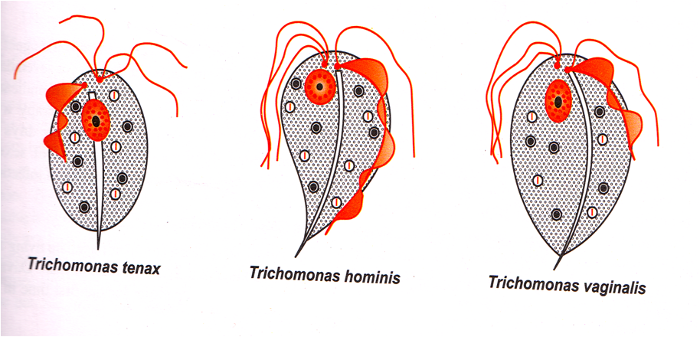
TRICHOMONAS

Slide 92
TRICHOMONAS VAGINALIS
HABITAT
Human vagina, prostate, & urinary tract of both male & female.

Slide 93
TRICHOMONAS VAGINALIS
DISTRIBUTION
World wide in distribution.
Incidence in normal population is 10℅ .
Asymptomatic infections in 50℅ of infected female patients.

Slide 94
MODE OF INFECTION
Sexually transmitted

Slide 95
TRICHOMONAS VAGINALIS
PATHOGENESIS
Exact mechanism is not known.
It depends upon inherent virulence of the parasite & host factors.

Slide 96
TRICHOMONAS VAGINALIS
CLINICAL FEATURES
Mild vaginitis with discharge.
Discharge is liquid , greenish or yellow in color.
Discharge covers the vaginal mucosa down to urethral orifice, vestibular gland & clitoris.
Male patients have mild or asymptomatic infections.
Males develop itching and discomfort during micturation.

Slide 97
TRICHOMONAS VAGINALIS
LABORATORY DIAGNOSIS
In light microscopy;
Motile trophpzoites in wet mount preparation of urine sediments, vaginal secretions or scrapings.
In males it may be found in urine /prostatic secretions.
Fixed smears stained with Papanicolaou, Giemsa, Leishman stain examined under light microscope
Fluorescent microscopy.

Slide 98
TRICHOMONAS VAGINALIS
LABORATORY DIAGNOSIS
Trichomonas vaginalis can be isolated on culture medias e.g. Trussel & Jhonson’s medium, Simplified trypticase serum medium
For best growth in Simplified trypticase serum medium ;
Temperature--35-37 ̊C under anaerobic conditions.
ph---5.5_6.0.
Nucleic acid hybridization.
PCR

Slide 99
TRICHOMONAS VAGINALIS
PREVENTION
Detection & treatment of cases.
Avoidance of sexual contact with infected persons.
Use of condoms.
There is no vaccine available.

Slide 100
TRICHOMONAS VAGINALIS
TREATMENT;
Metronidazole 250mg x TDS X 7 days.
OR
2gm orally X stat.
Metronidazole is C. I in pregnancy. So topical therapy with clotrimazole 100mg X OD X 7 days.
Simultaneous treatment of sexual partner is done to prevent recurrence of infection.

Slide 101
LEISHMANIA

Slide 102
CLASSIFICATION OF LEISMANIA

Slide 103
LEISHMANIA DONOVANI
(OLD WORLD LEISHMANIASIS)

Slide 104
LEISHMANIA DONOVANI
DISEASE
Visceral leishmaniasis & Kala-azar.
Hypertrophy of reticulo endothelial system.

Slide 105
HABITAT
It is an obligate intracellular parasite of reticulo -endothelial cells, predominantly of liver, spleen bone marrow and lymph nodes of man & other vertebrate host (dogs, hamster).
Amastigote

Slide 106
MORPHOLOGY
This parasite exists in 2 forms;
Amastigote – occurs in man.
Promastigote – occurs in gut of insect (sandfly) and culture.

Slide 107
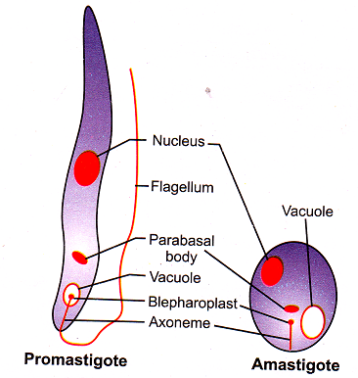
MORPHOLOGY

Slide 108
LIFE CYCLE
Two vertebrate hosts -- Man & dog
Invertebrate host --Female sand fly of genus Phlebotomus.
Important sand fly hosts include;
P. argentipes
P. orientalis
P. martini

Slide 109
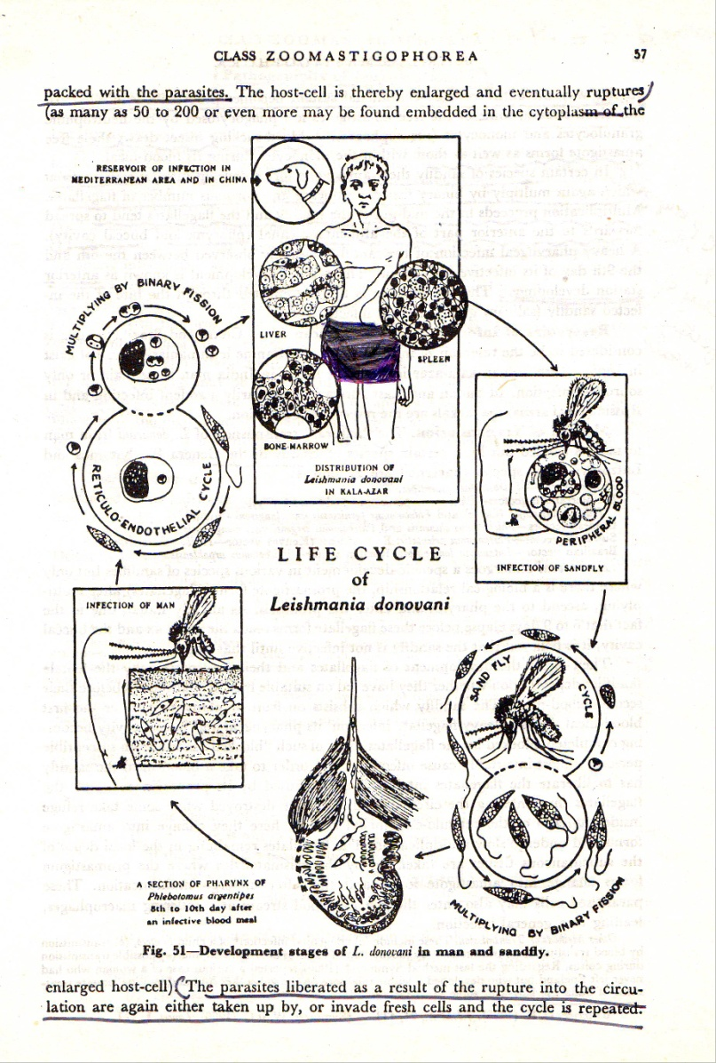

Slide 110
MODE OF TRANSMISSION
By bite of sand fly.

Slide 111
PATHOGENICITY
Disease is reticuloendotheliosis.
Incubation Period- Varies 3-6 months.

Slide 112
PATHOGENICITY
Cellular & humoral proliferation.
Marked proliferation of macrophages .
In bone marrow , spleen, liver, lymph nodes, spleen

Slide 113
CLINICAL FEATURES
Fever
Malaise
Headache
Progressive enlargement of liver, spleen, lymph nodes.
Skin is dry ,rough & pigmented .
Hair.

Slide 114
VISCERAL LEISMANIASIS SHOULD
BE INCLUDED IN THE LIST
OF OPPORTUNISTIC INFECTIONS

Slide 115
LABORATORY DIAGNOSIS
Non-Specific Laboratory Test
Blood count
Haemoglobin Estimation
Estimation of Serum Proteins
Parasitological Diagnosis
Peripheral Blood Film By thick film Method
Needle Biopsy
Culture of blood and FNAC
Animal Inoculation

Slide 116
LABORATORY DIAGNOSIS
Immunological Test
Non-specific Tests
Aldehyde Test, Antimony Test
Specific Tests
DAT, IHA, IFAT, ELISA
Leishmanin or Montenegro Skin Test

Slide 117
POST KALA-AZAR DERMAL DISEASE (PKDL) OR DERMAL LEISHMANOID
It is a common consequence of theraputic cure from visceral Leishmaniasis caused by L. donovani.
Develops 1-2 years after completion of antimonial treatment.

Slide 118
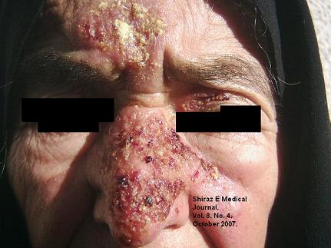
LEISHMANIASIS

Slide 120
LEISHMANIASIS

Slide 121
LEISHMANIA TROPICA
It causes cutaneous leishmaniasis.

Slide 122
HABITAT
Inside reticulo endothelial cells (dermatocytes) of skin.

Slide 123
MORPHOLOGY
Same as that of Leishmania donovani.

Slide 124
LIFE CYCLE
Vertebrate host; man.
Invertebrate host; P. sergenti.
Life cycle as that of Leishmania donovani except that amastigote forms reside in reticulo endothelial cells of skin and not in the viscera.

Slide 125
LIFE CYCLE OF LEISMANIA TROPICA

Slide 126
PATHOGENICITY
Incubation period; A few weeks to six months.
Leishmania tropica causes urban orthoponotic cutaneous leishmaniasis or oriental sore or Delhi boil.
At the site of Inoculation promastigotes are phagocytosed by RE cells of skin and are transformed into amastigotes→ leishmanioma develops → delayed hypersensitivity.

Slide 127
CLINICAL FEATURES
A raised papule is formed, it ulcerates and heals in about six months leaving a depressed scar.
The sores are distributed on the exposed parts of body.
It causes dry lesions.

Slide 128
LABORATORY DIAGNOSIS
Microscopic examination shows amastigote forms of parasites.
Biopsy
Promastigotes may be isolated in NNN culture medium and Hockmeyer’s medium.
Leishmanin skin test is positive.

Slide 129
TREATMENT
Pentavalent antimonials;
Sodium stibogluconate
Meglumine antimoniate
Aromatic diamidines
Pentamidine
Others
Monomycin
Paromomycin
Aminosidine
Amphotericin B
Allopurinol

Slide 130
LEISHMANIA INFANTUM
Main vertebrate host –domestic dog which may develop acute /chronic disease.
Dog carries abundant parasites in the skin.
Infantile visceral leishmaniasis.
Age of child <2 years.
May also infect adults with HIV .

Slide 131
LEISHMANIA AETHIOPICA
Mammalian hosts are rock hyraxes.
Sand fly host is P. longipes.
In man may cause cutaneous leishmaniasis & DCL.
Lesions are more swollen & less necrotic than those of L. tropica.
Gradual scaling / exfoliation of dermis at the center of lesion.
Because of appearance of lesions they resemble lepromatous leprosy.
This condition is difficult to treat and my last for the rest of life .

Slide 132
LEISHMANIA MAJOR
Mammalian host –great gerbil & fat sand rat.
Sand fly vector –P papatasi & P .salehi.
This infection occurs in epidemics in people inhabited in zoonotic focci.
It causes rural zoonotic cutaneous leishmaniasis or oriental sore.
Wet lesions > 100 in number.
Produces delayed type of hypersensitivity response.
Diagnostic methods are same as that of L . tropica.

Slide 133
PROPHYLAXIS
Active case detection & treatment.
Elimination of sand flies by spraying of insecticides.
Insect repellents applied to exposed parts of skin.
Use of fine mesh bed nets.
Sleeping at night on the roof.
Destruction of desert rodents.
Elimination of dogs .
To prevent transmission to other persons cover the lesions /ulcers with gauze pieces.
Avoidance of visit to areas of high risk.

Slide 134
NEW WORLD LEISHMANIASIS
LEISHMANIA BRAZILLIENSIS COMPLEX
LEISHMANIA MEXICANA COMPLEX

Slide 135
HABITAT
Occurs as intracellular parasite (amastigote form) inside macrophages of skin and mucous membranes of nose & buccal cavity.

Slide 136
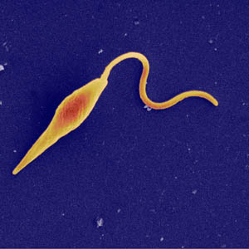
MORPHOLOGY
Same as that of other species.

Slide 137
LIFE CYCLE
It is same as that of other species of Leishmania except that ;
Amastigote form occurs inside macrophages of skin and mucous membranes of nose & buccal cavity.
Vector is sand fly of genus Lutzomyia & Psychodopygus.

Slide 138
PATHOGENICITY
Both cause zoonotic disease.
L .braziliensis complex causes muco cutaneous or espundia ulcers.
Initial lesion enlarges radially forming a weeping ulcer with a clean cut margin.
L .braziliensis sub species form metastatic lesions in nasal , pharyngeal & laryngeal mucosa.
Papulo pustular swellings → cause destructive and mutilating erosions which heal by scarring → producing camel nose.

Slide 139
PATHOGENICITY
In L. mexicana complex parasite provokes an intense reaction at the site of bite.
After 7-10 days a tiny papule appears which produces a crater-like lesion with inflamed borders
Chiclero’s ulcer.
It produces secondary lesions.

Slide 140
PATHOGENICITY
L. braziliensis complex causes espundia ulcers.
Metastatic lesions in nasal, laryngeal and pharangeal mucosae.

Slide 141
LEISHMANIASIS

Slide 142
LABORATORY DIAGNOSIS
Amastigote forms in punctured material from nodule or edge of an ulcer.
NNN culture medias are used.
IFA in 89% - 95% is positive.
ELISA is also positive in 85% cases.
Montenegro skin test is positive.

Slide 143
TREATMENT
Treatment and prophylaxis of new world leishmaniasis is same as that of old world leishmaniasis.

