Slide 1
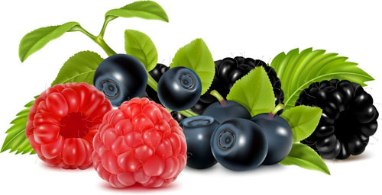
Berries
Fragaria ananassa (Strawberry)
Ribes nigrum (blackcurrants)
Rubus idaeus (raspberries)

Slide 2
Introduction
In botanical terminology, a berry is a fleshy fruit without a stone although many pips or seeds may be present produced from a single flower containing one ovary. It is fleshy throughout, except for the seeds.
In everyday English, "berry" is a term for any small edible fruit. Berries are usually juicy, round, brightly colored, sweet or sour, and do not have a stone or pit, although many pips or seeds may be present.
Mostly berries are edible but some are toxic too therefore it should be kept in mind while eating an unknown Berry fruit.

Slide 3
Example of edible and non edible berries
Edible Berries
Toxic Berries
Strawberry
Blue berry
Black berry
Bilberry
Bear berry
Red berry
Bitter sweet
Baneberry
Holly berry
Mistletoe berry

Slide 4
History
Berries have been valuable as a food source for humans since before the start of agriculture.
Blackberries and Raspberries cultivated since the 17th century, while smooth-skinned blueberries and cranberries cultivated in the United States for over a century. In Japan, between the 10th and 18th centuries, the term "ichibigo" (which later became "ichigo") referred to many berry crops.

Slide 5
Strawberry
Pakistan is producing a limited quantity of strawberries which are either eaten or used in preparing ice-cream, jam, jelly, pickle, cake or milk shake.
There are a number of reasons for restricted production, like the climate, perishability, size and taste.

Slide 6
Climate
Strawberry
Like other berries strawberries also prefer to grow in areas were the winters are very cold followed by mild summers. They need full sun for the highest yields at least 6 (six) hours a day. The soil requirement differs according to variety.

Slide 7
soil
Strawberry
Sandy loam or light clay soils are best. There should be no heavy clay or rock within 300 mm of the surface. On sandy soils, it is difficult to maintain the supply of water and nutrients the plants need. Heavy clay soils stay too wet after rain this may damage the fruit and plant also.

Slide 8
Propagation
Strawberry
Ordinarily, strawberries are propagated from runner plants grown by large commercial growers.
Strawberries grow very well in cool temperate climates, at temperatures below 30°C (86°F)and require at least 6 hours of sunlight per day. They can be grown successfully in a wide variety of soils with pH 5.5 and 6.5.

Slide 9
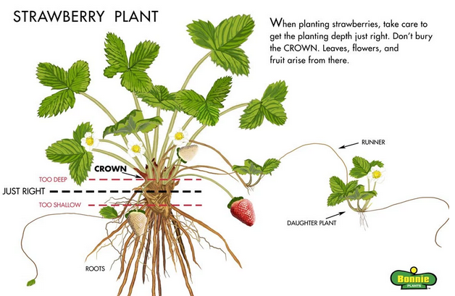
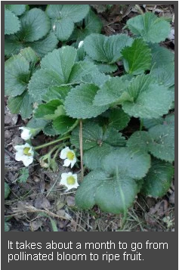

Slide 10
Fertilization
Strawberry
Nitrogen, phosphorus, potassium, and other soil nutrients are required for vigorous crown and runner development. Soil tests will identify the nutrient needs. Generally phosphorus, potassium, and part of the nitrogen should be applied at or before planting.

Slide 11
Varieties
Strawberry
Alba
Alexandria
Allister
Alpine strawberry

Slide 12
Harvest and Storage
Pick strawberries in the morning, when the fruits are cool, and immediately put them in the refrigerator. Wait until just before you eat or cook them to rinse the berries thoroughly with cool water. Extra strawberries can be frozen, dried, or made into jam or preserves.

