Slide 1
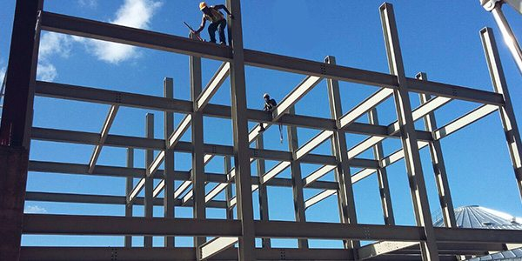
COLLEGE OF ENGINEERING AND TECHNOLOGY UNIVERSITY OF SARGODHA Theory Of Structures (CT-226) (B.S TECHNOLOGY)
LECTURE-1,2&3
INTRODUCTION
Engr. Aqeel Ahmed
Lecturer, CET, UOS, Sargodha
16-Jan-2020

Slide 2
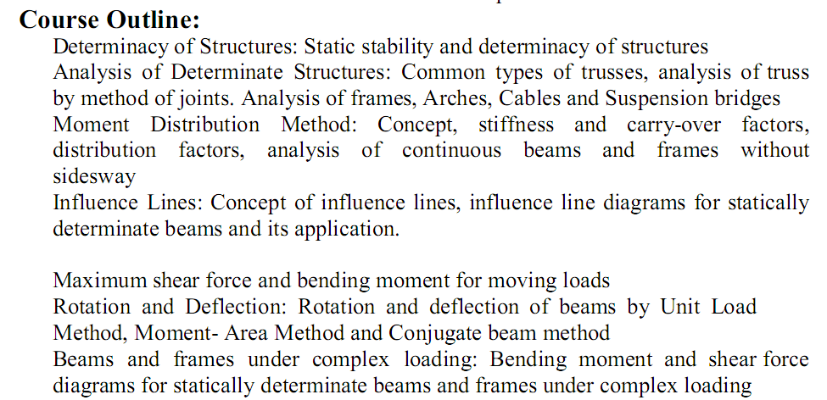
COURSE OUTLINES

Slide 3
RECOMMENDED BOOKS

Slide 4
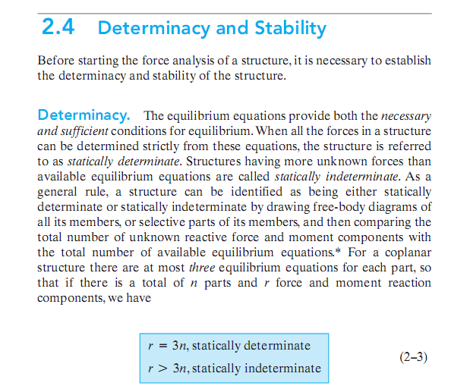

Slide 5
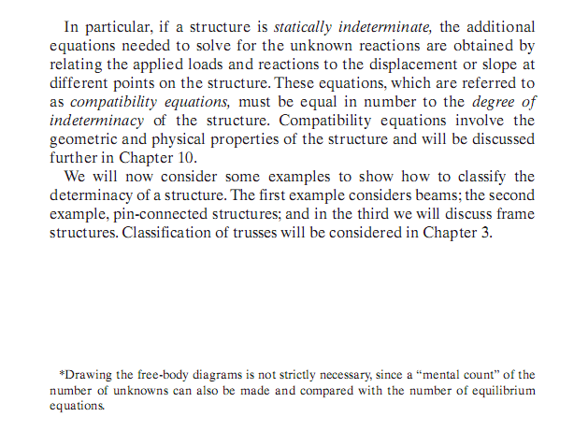

Slide 6
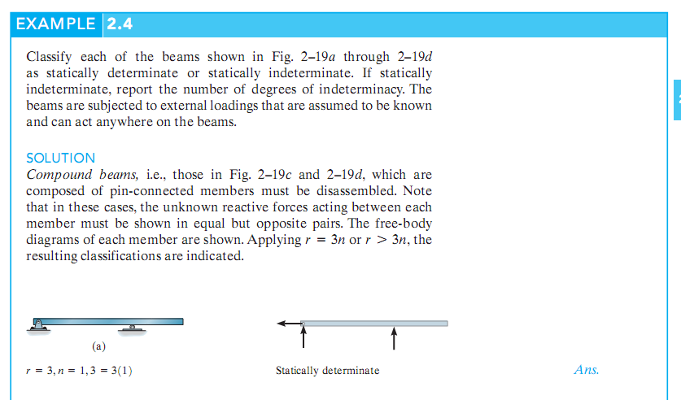

Slide 7
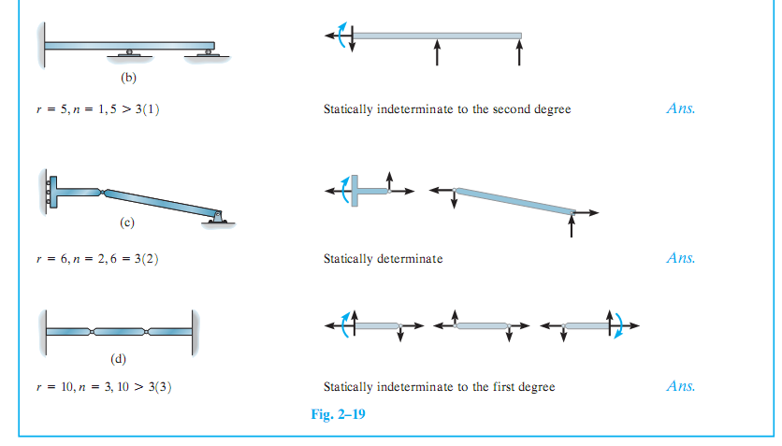

Slide 9
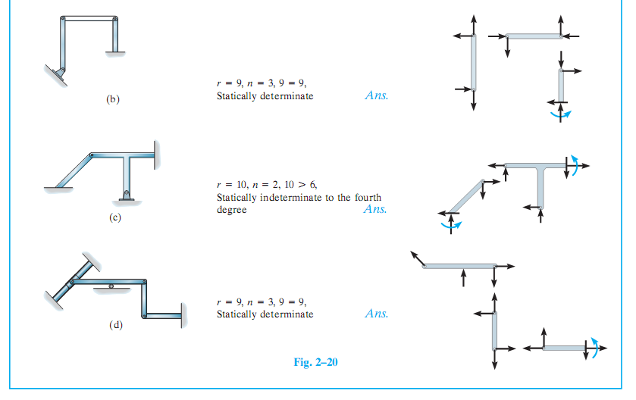

Slide 10
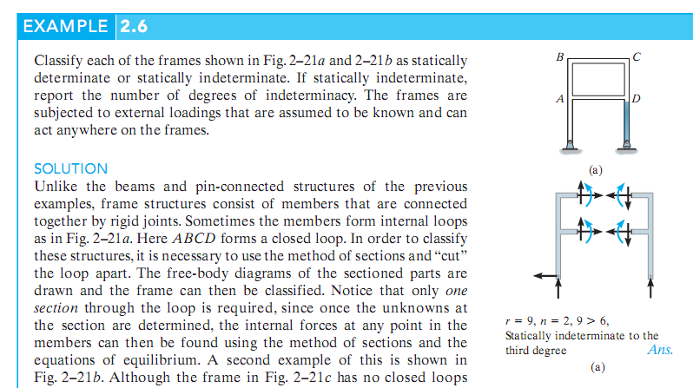

Slide 11
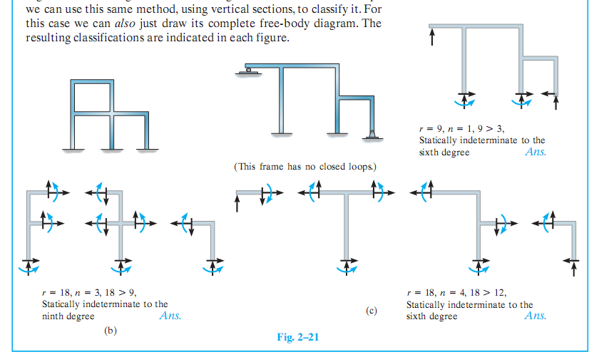

Slide 13
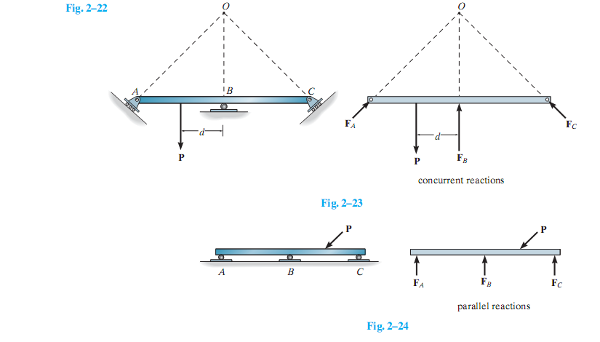

Slide 14
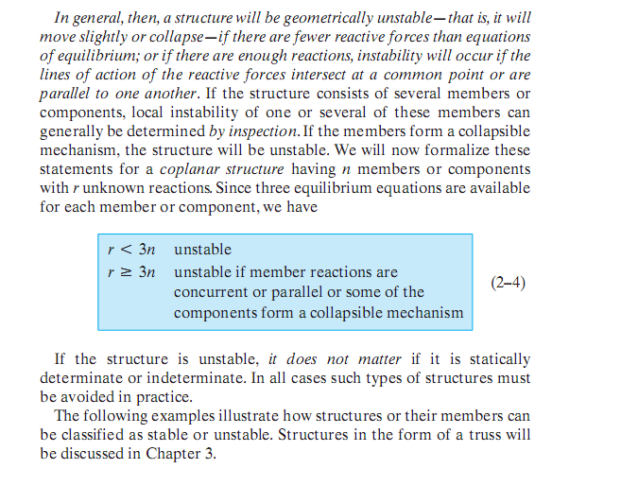

Slide 15
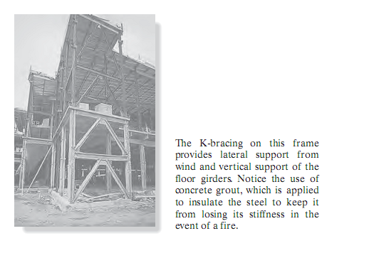

Slide 16
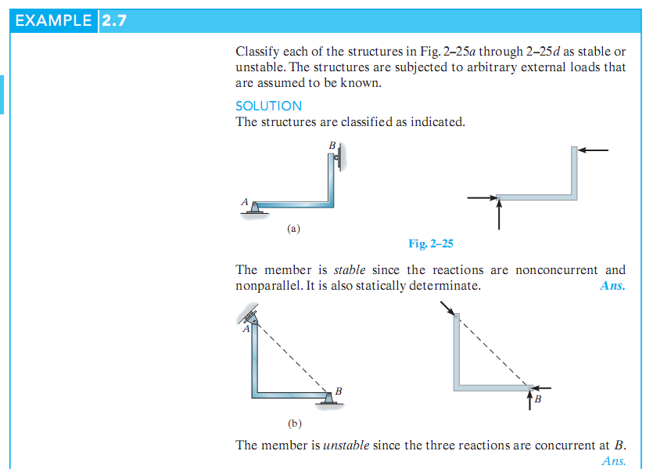

Slide 17
