Slide 2
Professional practice

Slide 3
Direct Access
“Direct access is the ability of a physical therapist to provide evaluation and treatment to patients without the need for a physician referral.” (APTA)

Slide 5
Time , Unnecessary visits to physicians neglect issue

Slide 6
Delay in Care
Notes:
Functional outcomes will be delayed More investment to get outcomes Pt frustrations

Slide 7
Direct access….. & PT’s education , clinical training
Pt’s health
Pt’s safety
Pt’s welfare

Slide 8
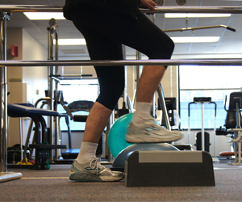
Direct access levels Evaluate and treat vs limited access

Slide 9
Objections to direct access

Slide 10
Durant, Lord, and Domholdt found that 83% of outpatients in Indiana would seek PTs through direct access if they were allowed to do so.

Slide 11
Direct access & limitation on side of PT’s
Prohibitive policies by employer
Reimbursement and physician referral
Personal preference of PTs

Slide 12
APTA’s view point about barrier to Direct access
Medicare Part B
beneficiaries get a physician’s referral for physical therapy to obtain coverage of these services

Slide 13
APTA’s effort of rule elimination
The American Physical Therapy Association (APTA) strongly supports the ability of licensed physical therapists to evaluate, diagnose, and treat beneficiaries requiring outpatient physical therapy services under Part B of the Medicare program, without a physician referral.
The physician referral is unnecessary and limits access to timely and medically necessary physical therapists’ services

