Slide 1
Introduction to Mangers and Management
Chapter 1

Slide 2
Who Are Managers?
A manager is someone who works with and through other people by coordinating their work activities in order to accomplish organizational goals.

Slide 3
Classification of managers
First-line managers are the lowest level of management and manage the work of non-managerial individuals who are involved with the production or creation of the organization's products. They're often called supervisors but may also be called line managers, office managers, or even foremen.
Middle managers include all levels of management between the first-line level and the top level of the organization. These managers manage the work of first-line managers and may have titles such as department head, project leader, plant manager, or division manager.
At or near the top of the organization are the top managers, who are responsible for making organization-wide decisions and establishing the plans and goals that affect the entire organization. These individuals typically have titles such as executive vice president, president, managing director, chief operating officer, chief executive officer, or chairman of the board.

Slide 5
What Is Management?
Management is the process of coordinating work activities so that they are completed efficiently and effectively with and through other people.
The process represents the ongoing functions or primary activities engaged in by managers. These functions are typically labeled planning, organizing, leading, and controlling.
Coordinating the work of others—is what distinguishes a managerial position from a non-managerial one.

Slide 6
Efficiency refers to getting the most output from the least amount of inputs. Because managers deal with scarce inputs—including resources such as people, money, and equipment—they are concerned with the efficient use of those resources. Efficiency is often referred to as "doing things right"—that is, not wasting resources.
However, it's not enough just to be efficient. Management is also concerned with being effective, completing activities so that organizational goals are attained. Effectiveness is often described as "doing the right things"—that is, those work activities that will help the organization reach its goals.
Management is concerned not only with getting activities completed and meeting organizational goals (effectiveness) but also with doing so as efficiently as possible. In successful organizations, high efficiency and high effectiveness typically go hand in hand. Poor management is most often due to both inefficiency and ineffectiveness or to effectiveness achieved through inefficiency.

Slide 7
Efficiency is a mean and effectiveness is an end!

Slide 8
What Do Managers Do?
Management Functions and Process
In the early part of the twentieth century, a French industrialist; Henri Fayol proposed that all managers perform five management functions: planning, organizing, commanding, coordinating, and controlling.
In the mid-1950s, a management textbook first used the functions of planning, organizing, staffing, directing, and controlling as a framework.
Most management textbooks still continue to be organized around the management functions, although they have been condensed down to four basic and very important functions: planning, organizing, leading, and controlling.

Slide 10
The planning function involves the process of defining goals, establishing strategies for achieving those goals, and developing plans to integrate and coordinate activities.
Organizing involves the process of determining what tasks are to be done, who is to do them, how the tasks are to be grouped, who reports to whom, and where decisions are to be made.

Slide 11
Every organization includes people, and management's job is to work with and through people to accomplish organizational goals. This is the leading function. When managers motivate subordinates, influence individuals or teams as they work, select the most effective communication channel, or deal in any way with employee behavior issues, they are leading.
After the goals are set and the plans are formulated (planning), the structural arrangements determined (organizing), and the people hired, trained, and motivated (leading), there has to be some evaluation of whether things are going as planned. To ensure that work is going as it should, managers must monitor and evaluate performance. Actual performance must be compared with the previously set goals. If there are any significant deviations, it's management's job to get work performance back on track. This process of monitoring, comparing, and correcting is what we mean by the controlling function.

Slide 12
Management Process
The management process is the set of ongoing decisions and work activities in which managers engage as they plan, organize, lead, and control. What this means is that as managers manage, their work activities are usually done in a continuous manner—that is, in a process.

Slide 13
Management Roles
Henry Mintzberg, a prominent management researcher, says that what managers do can best be described by looking at the roles they play at work. From his study of actual managers at work, Mintzberg developed a categorization scheme for defining what managers do. He concluded that managers perform 10 different but highly interrelated roles. The term management roles refers to specific categories of managerial behavior.

Slide 14
The interpersonal roles are roles that involve people (subordinates and persons outside the organization) and other duties that are ceremonial and symbolic in nature. The three interpersonal roles include being a figurehead, leader, and liaison. The informational roles involve receiving, collecting, and disseminating information. The three informational roles include a monitor, disseminator, and spokesperson. Finally, the decisional roles revolve around making choices. The four decisional roles include entrepreneur, disturbance handler, resource allocator, and negotiator.

Slide 16
Role | Description | Examples of Identifiable Activities
Interpersonal
Figurehead | Symbolic head; obliged to perform a number of routine duties of a legal or social nature | Greeting visitors; signing legal documents
Leader | Responsible for the motivation of subordinates responsible for staffing, training, and associated duties | Performing virtually all activities that involve subordinates
Liaison | Maintains self-developed network of outside contacts and informers who provide favors and information | Acknowledging mail; doing external board work; performing other activities that involve outsiders

Slide 17
Role | Description | Examples of Identifiable Activities
Informational
Monitor | Seeks and receives wide variety of internal and external information to develop thorough understanding of organization and environment | Reading periodicals and reports; maintaining personal contacts
Disseminator | Transmits information received from outsiders or from subordinates to members of the organization | Holding informational meetings; making phone calls to relay information
Spokesperson | Transmits information to outsiders on organization's plans, policies, actions, results, etc. | Holding board meetings; giving information to the media

Slide 18
Role | Description | Examples of Identifiable Activities
Decisional
Entrepreneur | Searches organization and its environment for opportunities and initiates "improvement projects" to bring about changes | Organizing strategy and review sessions to develop new programs
Disturbance handler | Responsible for corrective action when organization faces important, unexpected disturbances | Organizing strategy and review sessions that involve disturbances and crises
Resource allocator | Responsible for the allocation of organizational resources of all kinds—making or approving all significant organizational decisions | Scheduling; requesting authorization; performing any activity that involves budgeting and the programming of subordinates' work
Negotiator | Responsible for representing the organization at major negotiations | Participating in union contract negotiations

Slide 19
Management Skills
Research by Robert L. Katz found that managers need three essential skills or competencies.
Technical skills include knowledge of and proficiency in a certain specialized field, such as engineering, computers, accounting, or manufacturing. These skills are more important at lower levels of management since these managers are dealing directly with employees doing the organization's work.

Slide 20
Human skills involve the ability to work well with other people both individually and in a group. Because managers deal directly with people, this skill is crucial! Managers with good human skills are able to get the best out of their people. They know how to communicate, motivate, lead, and inspire enthusiasm and trust. These skills are equally important at all levels of management.
Conceptual skills are the skills managers must have to think and to conceptualize about abstract and complex situations. Using these skills, managers must be able to see the organization as a whole, understand the relationships among various subunits, and visualize how the organization fits into its broader environment. These skills are most important at the top management levels.

Slide 21
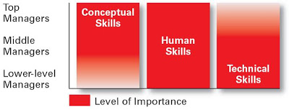

Slide 22
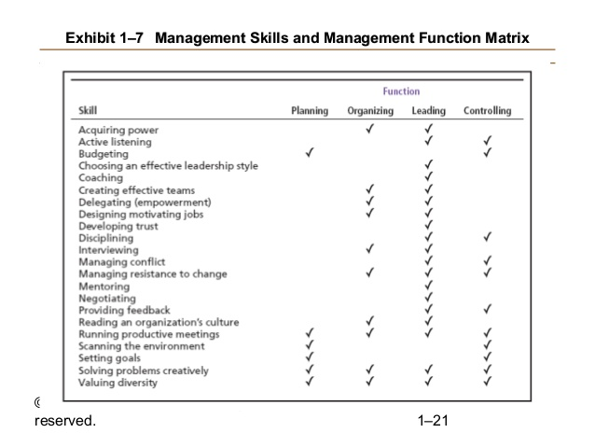

Slide 23
Managing Systems
A system is a set of interrelated and interdependent parts arranged in a manner that produces a unified whole.
The two basic types of systems are closed and open. Closed systems are not influenced by and do not interact with their environment. In contrast, open systems dynamically interact with their environment. Today, when we call organizations systems, we mean open systems, that is, an organization that constantly interacts with its environment.
An organization takes in inputs (resources) from the environment and transforms or processes these resources into outputs that are distributed into the environment. The organization is "open" to its environment and continually interacts with that environment.

Slide 25
What is an Organization?
An organization is a deliberate arrangement of people to accomplish some specific purpose.
Your college or university is an organization; so are government departments, churches, Amazon.com, your neighborhood store, the baseball team, and the Clinic. These are all organizations because they all share three common characteristics; distinct purpose, deliberate structure and people

Slide 26
First, each organization has a distinct purpose. This purpose is typically expressed in terms of a goal or a set of goals that the organization hopes to accomplish.
Second, each organization is composed of people. One person working alone is not an organization, and it takes people to perform the work that's necessary for the organization to achieve its goals.
Third, all organizations develop some deliberate structure so that their members can do their work. That structure may be open and flexible, with no clear and precise delineations of job duties or strict adherence to any explicit job arrangements—in other words, it may be a simple network of loose relationships or the structure may be more traditional with clearly defined rules, regulations, and job descriptions, and some members may be identified as "bosses" who have authority over other members.

