Slide 1
Stereotypes, prejudice and discrimination
Prepared By
Ms. Shahida perveen
Department of psychology
University of sargodha

Slide 4
Stereotypes cont…
Ambivalent sexism
Hostile sexism
Overtly negative evaluation and stereotypes about a gender
Domination, hostility and degradation
“women are less competent then men”
Benevolent sexism
evaluations of gender that may appear subjectively positive, but are actually damaging to people and gender equality more broadly
Attitude of idealization, affection and protection
“Women should be treated delicately”
“Women should be rescued before men in emergency”

Slide 5
Stereotypes cont…

Slide 6
Stereotype cont…

Slide 7
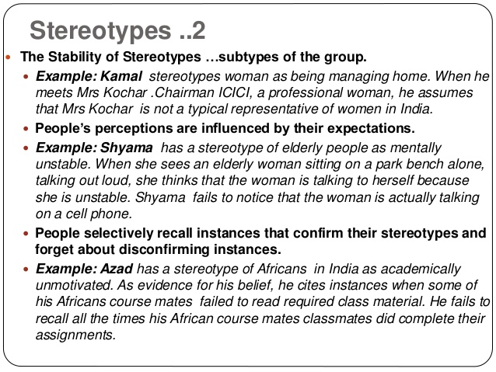

Slide 11
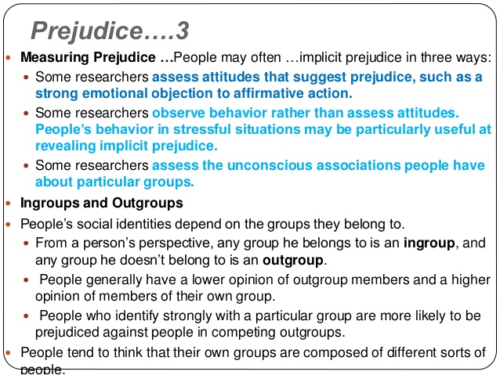

Slide 13
REDUCING PREJUDICE
1. learning not to hate
Strongly identify with their parents, participating in institutions and having peers that justify discrimination
2. contact hypothesis
Increased contact with outgroup help people to see diversity among group members and hence reduce prejudice.
3. Recategorization: changing the boundaries
Shifting the boundaries of a group reduce “ingroup” and “outgroup” conceptualization
4. by using social influence
If people can be induced to belief that their prejudiced believes are out of line with those of most other people (especially those they respect) they may well change those views towards less prejudiced

Slide 14
Discrimination
Definition:
Discrimination is the behavior or actions, usually negative, towards an individual or group of people, especially on the basis of sex/race/social class, etc.
For example:
Racial discrimination: Apartheid (literally "separateness") was a system of racial segregation that was enforced in South Africa from 1948 to 1994. Non-white people where prevented from voting and lived in separate communities.
Gender discrimination: For instance after a divorce women receive primary custody of the children far more often than men. Women on average earn less pay than men for doing the same job.

Slide 15
Types of discrimination
Racial and ethnic discrimination.
On basis of nationality.
Gender discrimination.
Religious discrimination.
On basis of disability.
On basis of employment.

Slide 16
END OF CHAPTER

