Slide 1
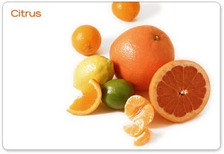
Citrus

Slide 2
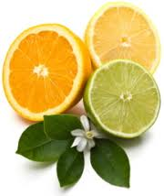
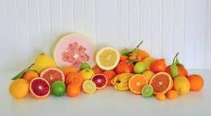
Introduction
Origin: South East Asia
Family: Rutaceae
A prized fruit of Pakistan
Ranks 1st among all fruits
Shares 34% in total fruit production
Shares one-third of total value of fruit’s exports
95 % kinnow Produced in Punjab

Slide 3
Classification
Swingle (1943) divided the genus citrus into 3 independent genera:
Citrus included 16 species
Poncirus include 1 species
Fortunella include 4 species
Hodgson (1961) divided citrus into 36 species.
Mostly Swingle classification is followed with some modifications suggested by Hodgson.

Slide 4
Family: Rutaceae
Sub Family: Aurantioideae
Sub family consists of 2 tribes:
Clausenae and Citreae
Citreae has 33 genera including
Citrus (Sweet orange, mandarin, grapefruit, lime and lemons)
Poncirus (kumquat)
Fortunella (trifoliate orange)

Slide 5
Distinguishing features of 3 genera
Genus Citrus:
Unifoliate
Ovary has 8 or more cells
Evergreen trees and shrubs
Spiny with thick, leathery leaves and winged petioles
Flowers are white or in some species pink on the outside, Pentamerous, axillary and scented.
They have small calyxes, hard sepals and thick petals with densely spaced oil cells.
The stamens are numerous (15-60) and the ovary superior with 8-15 carpels containing few to several ovules
Fruit has thick leathery rind, botanically it is a special type of berry called a hesperidium.
Fruit is globose, sub-globose or elliptical filled with juice sacs or vesicles.
Fruit contain few to many white or light green seeds, which are generally polyembryonic.

Slide 6
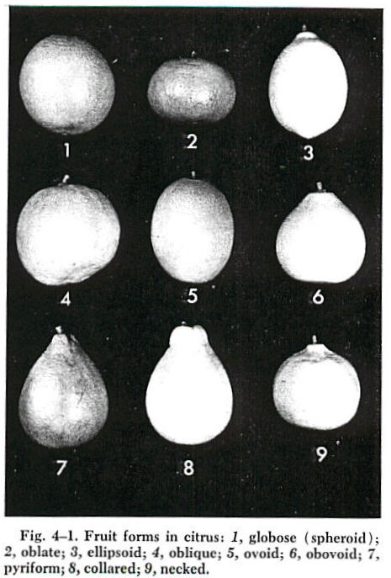

Slide 7
Distinguishing features of 3 genera
Genus Citrus: is divided into two sub-genera
Eucitrus: all edible citrus species
Papeda: contain acrid oil droplets in the juice vesicles and are inedible

Slide 8
Distinguishing features of 3 genera
Few important commercial citrus species are:
Citrus sinensis (L) Osbeck----Sweet Orange
Citrus reticulate Blance----Mandarin
Citrus paradisi Macf. Grapefruit----(Pomelo)
Citrus grandis (L) Osbeck Chakotra---(Pummelo)
Citrus limettioides Tan.----Sweet lime
Citrus aurantifolia Swing----Kaghzi Lime
Citrus limonia (L)----Lemon
Citrus medica (L)----Citron
Citrus aurantium (L)----Sour orange
Citrus jambheri Lush----Rough Lemon

Slide 9
Distinguishing features of 3 genera
Genus Poncirus:
It has only one species P. trifoliate Raf.,
Compound leaves with three leaflets
Deciduous
Tree is small and spiny
Flowers are sessile, and borne on previous-year wood in the axils of spines. They open wide and flat and are creamy white.
The inedible, pubescent fruit has 6-8 segments, is filled with smooth seeds and is orange-yellow at maturity.
Poncirus is generally used as a rootstock in colder regions and for growing dwarf trees.

Slide 10
Distinguishing features of 3 genera
Genus Fortunella:
It has four species, of which the commercially important ones are F. margarita Swing. (oval kumquat) and F. japonica Swing. (round kumquat).
The trees are small with small green leaves paler on the other side.
The flowers are white and smaller than those of citrus
Fruit is small, orange colored, 3-6 celled, acidic and juicy but with a sweet and edible rind. The other species are F. crassifolia Swing and F. hindsii Swing.

Slide 11
Hybrids
Hybrids | Parents
Citranges | Poncirus × sweet orange
Citrangesquats | Citranges× fortunella
Tangelos | Mandarins × grapefruit
Limequats | Lime × fortunella
Citrumellos | Poncirus × grapefruit
Citrandrins | Poncirus × mandarins
Kinnow | Nobilis ×deliciosa

Slide 12
Soil
Deep sandy loam, loam and clay loam
pH: 5.5-8.5
Subsoil should be free from hard pan, sticky clay and water logged conditions
Poor soils with high pH are not suitable
Soil requirements depend upon the type of rootstock used for various species and varieties.
Rough lemon is a good rootstock for dry, sandy loam soils of Punjab, whereas sour orange performs better on the moist and heavy soil of NWFP.

Slide 13
Climate
Tropical and Sub Tropical
Up to 450-750m elevation
Temperature is an important factor. In cool regions, vegetative growth is less, fruit growth is slow, ripening is delayed and fruit is acidic. In colder regions, pigmented cultivars like Red Blood sweet orange develop excellent quality.
Temperature range: 13-40°C
Can endure 0-2°C without injury, depending on the cultivar and duration of cold period.
Grapefruit is the high temperature resistant citrus sp.
Extreme cold and frost can burn flowers and young twigs.

Slide 14
Climate
Species appear to resist frost in the following descending manner
Mandarin, sour orange, sweet orange, chakotra, grape fruit, sweet lime, lemon, kaghzi lime and citron.
In hotter regions, trees produce more growth and fruit grows faster and ripens earlier but fruit may suffer from sunburn
In Pakistan, the central divisions of Punjab– Sargodha, Faisalabad, Lahore and Multan---produce excellent citrus.
In NWFP, Peshawar, D.I. Khan and Dir are important citrus producing areas.

Slide 15
Temperature Requirement
Seed Germination:
15-30°C
Vegetative Growth:
Optimum shoot growth: 25-31°C
Optimum root growth: 25-26 °C

Slide 16
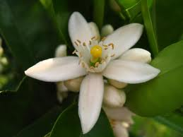
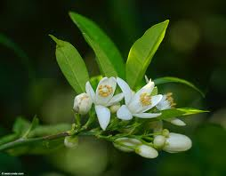
Flowering
Season:
February- March
Lemon:
Throughout year, when growing in coastal regions with mild winter
Spring, when growing in dry areas with hot summer and cold winter

Slide 17
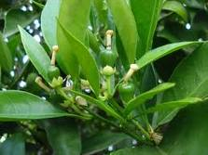
Fruit Set
Optimum Temperature for pollen viability:
15-20°C
Pollen tube growth is temperature dependent
High temperature causes poor fruit set

Slide 18
Propagation
Sexual:
Seeds
Asexual:
Budding
Layering
Grafting

Slide 19
Planting Seasons
Spring
February- March
Autumn
September-October

Slide 20
Citrus Nursery
Extraction of seeds
August- September
Storage of seeds
Preparation of seed bed
Length 5-6 ft
Width 3 ft
Height 6-9 inch
Distance from seed to seed 4-6 inch
Use fungicides and depth of seed should be 1 cm

Slide 21
Transplantation of seedling:
Seedling should be transplanted after 6-12 month
Plant to plant distance 6-9 inch
Row to row distance same as plant to plant distance
Please left some space empty after four lines
Care of seedlings
Budding and grafting of seedlings
Selection of scion wood, preparation of rootstock
Aftercare of budded/grafted plants

Slide 22
Recommended Propagation Techniques
Fruits | Recommended Methods
Sweet Orange, Mandarin | T-Budding, T-Grafting
Grapefruit and Eureka Lemon | T-Budding
Sweet Lime | Stem cutting
Khaghzi Lime | Layering

Slide 23
Time of Fertilizer Application
Nutrients and Doses | Time of Application
FYM | Dec-January
1/3 N + P + K (full dose) | Before flowering (Feb)
1/3 N | At pea stage
1/3 N | In August
Micronutrients | Foliar application in Feb

Slide 24
Planting Geometry
Square System
Planting distance: 22´ to 25´
64-90 plants/acre
High Density Plantation
R×R: 10 ft
P×P: 10 ft

Slide 25
Intercropping
From 1-6 yrs of age: short stature crops with shallow root system are allowed to grow
Mung, Mash, Masoor, Peas
Exhaustive crops with deep root system are not allowed to grow
Sugarcane, Cotton, Wheat
Afterwards clean cultivation is recommended
No hoeing or cultivation except once in a year to kill the weeds.

Slide 26
Irrigation
Over irrigation is more injurious than under irrigation in citrus
Surface irrigation
Basin system
Modified basin system
Flood irrigation
Sprinkler irrigation
Drip irrigation

Slide 27
Irrigation Schedule
Season/Month | Irrigation Frequency
Spring (Feb-March) | Once a month
Summer (April-July) | Twice a month
Monsoon (August) | Subject to rainfall
Autumn (Sept-Oct) | No irrigation
Winter (Nov-Jan) | Once a month

Slide 28
Precautions in Applying Irrigation
Irrigation water may not be allowed to touch directly to the stem of citrus tree
Field and water channels should be precisely leveled
Stop irrigation at flowering time
Stop irrigation two weeks before harvesting
Restrict irrigation in Oct-Nov
Light irrigation during frosty nights

Slide 29
Determination of irrigation
Fruit growth
Wilting symptoms
Tensiometer

Slide 30
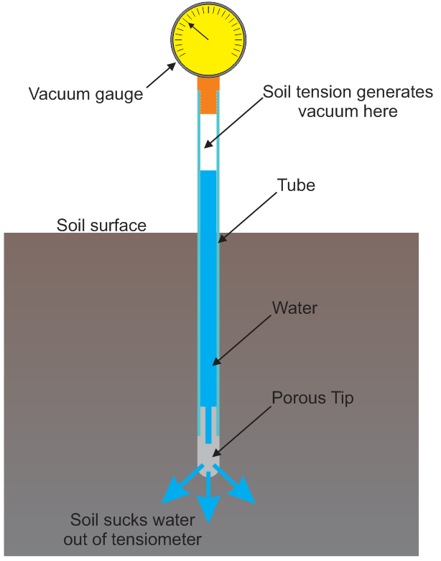
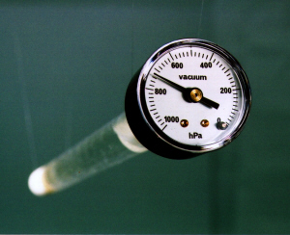
Tensiometer

Slide 31
Pruning
For establishment of strong well balanced framework
Facilitate management practices like spraying, picking etc.
To ensure balance between vegetative vigor and fruitfulness
To improve penetration and increase the set of inferior fruit
Increase soluble solids and improve rind color
To produce new and productive wood
Tree age 70-100 years California due to pruning

Slide 32
Physiological Disorders
Alternate Bearing
Unfruitfulness
Fruit Drop
Granulation

Slide 33
For disease there is some specific causal organism and which can be corrected
It is very hard and difficult to correct/control the physiological disorder

Slide 34
Alternate Bearing
Heavy crop: on year
No or less crop: off year
Nutritional imbalance
Varietal character
Mandarin Kinnow , Wilking
Sweet orange V. Late, W. Navel
Grape fruit Marsh seedless,
Heavy manuring during off year
Fruit thinning during on year
Delayed harvesting during off year
Early harvesting during on year

Slide 35
Unfruitfulness
Physiological or genetic causes
Involve hormonal or nutritional imbalances
Climatic factors
Genetic or physiological
Incompatibility
Heterostyly
Ovule abortion

Slide 36
Involvement of hormonal or nutritional imbalances
General weakness may be removed by an appropriate fertilizer program
While excessive vegetative growth
Withholding nutrition
Root pruning or ringing of main branches
Climatic factors
Certain varieties refused to produce in particular environments e.g Washington navel

Slide 37
Fruit Drop
Start from blooming and continue up to harvest
1- Flower drop
Bloom heavily---- thousand of flowers
Usually 95% drop and 5% set fruit
Fruit set % range form 1-4%
Reasons:
Climatic conditions
Weak plant, deficiency of nutrients
Mutual flower competition
Heavy winds, or rain fall

Slide 38
Fruit Drop
2- Initial fruit drop
Fruit drop after fruit set
Due to nutritional imbalance
Weak trees
3- June drop
Occurs in month of May and June
Natural load sharing
Drop of poorly developing fruits
Around 96% young fruit drop occurs in Pineapple orange
Around 75% drop ----- in Kinnow

Slide 39
Fruit Drop
4- Pre-harvest drop
This drop is at mature stage
It is a commercial loss to the grower
Failure in auxins synthesis due to abscission layer
Attack of insects and disease
Controlled with application of hormones
GA and 2,4-D, NAA etc
Ethylene inhibitors

Slide 40
Granulation/Raciness
The condition is characterised by large, hardened and apparently dry juice vesicles
The stem end of fruit is more effected as compared to styler end
Some time one half, one third or under extreme cases whole fruit is affected
It cannot be identified externally, because there is no external abnormality
The cell wall of granulated vesicles are thick
Sugar contents are reduced then normal
Mineral content are increased then the normal

Slide 41
Granulation/Raciness
Due to thick walls of fruit vesicles more minerals, less sugar content it seems to be dry
Granulation increase of harvesting is delayed
Frequent irrigation or water standing in the root zone for longer period of time may also increase the incidence of granulation
Corrective measure
Spot picking of larger fruits at earlier stage
Large interval of irrigation
Spraying of growth regulators

Slide 42
Granulation/Raciness

Slide 43
Major Diseases
Phytophthora Gummosis or Foot rot
Trunk Gummosis
Damping off/ Root rot
Wither tip
Citrus Canker
Citrus Greening
Citrus Quick Decline
Citrus Slow Decline

Slide 44
Citrus Canker
1- Citrus Canker (Xanthomonas compestris)
Bacterial disease
Appear on leaves, branches, fruit
a- Symptoms
Small yellow spots are formed on upper epidermis, then on lower epidermis
Later, spots become bigger, brown, raised
Diseased area die and leaving hole
Spots also appear on twigs and fruit drop
Example: K lime, Lemon, Grapefruit, Sweet lime, Sweet orange
b- Corrective measure
Selection of healthy nursery plants
Prune the affected part and spray with bacteriaside

Slide 45
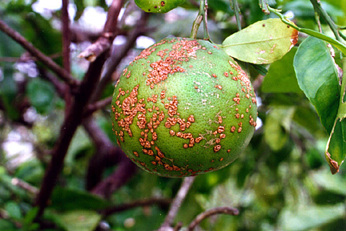
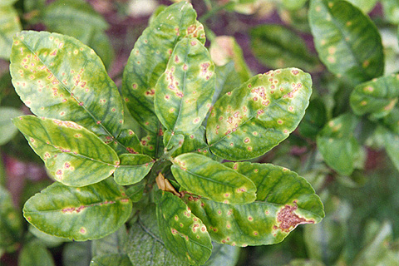
Citrus Canker
Citrus Canker on leaves
Citrus Canker on fruit

Slide 46
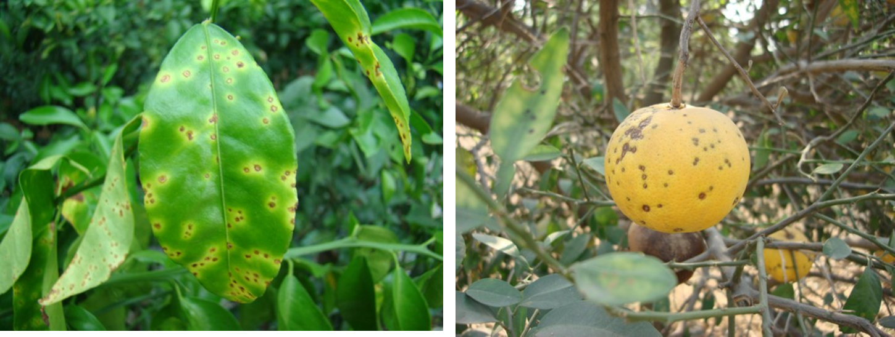

Slide 47
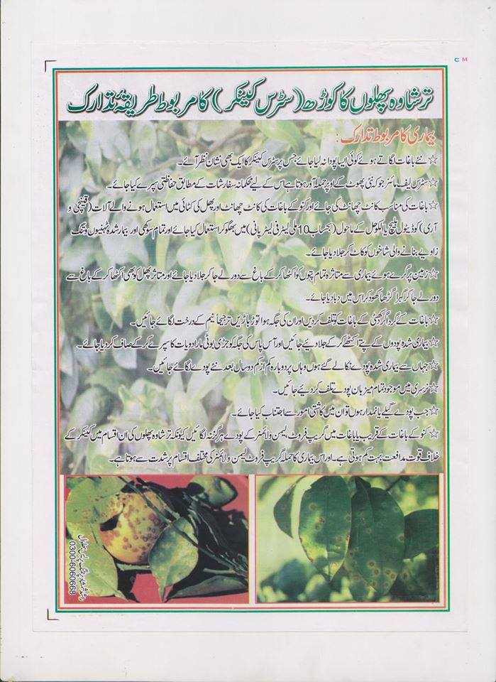

Slide 48
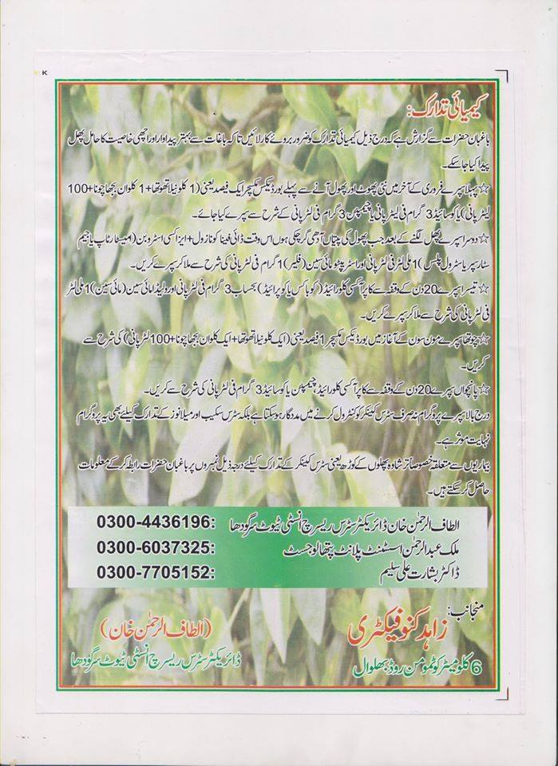

Slide 49
Citrus Withertip
2- Citrus wither tip (Colletotricum gloeosporioids)
Fungal disease
a- Symptoms
All aerial part, leaves, braches and fruit are affected
Wilting from braches from top to bottom
Branches looks silvery grey leafless
Leaf fall is common
Pathogen kill the plant
b- Corrective measure
Improve growing conditions of the orchard
Spraying with copper based fungicides

Slide 50
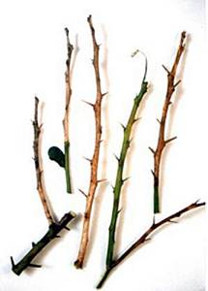
Citrus Withertip
Citrus withertip

Slide 51
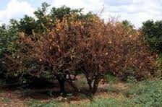

Slide 52
Insect Pests of Citrus
Citrus psylla
Citrus leaf miner
Citrus fruit fly
Lemon butterfly
Citrus mealy bug
Citrus thrips

Slide 53
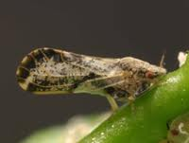
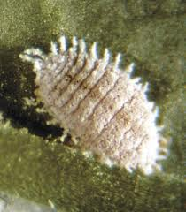
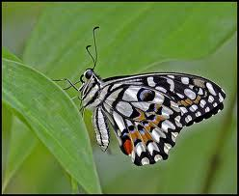
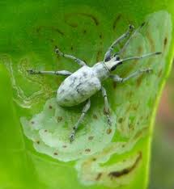
Citrus Psylla
Leaf Miner
Mealy Bug
Lemon Butterfly
Weevil citrus leaf miner

Slide 54
Citrus Psylla
1- Citrus Psylla
Sucking types insect,
Adult are brown in colour, black antena,
Insect attack at the time of blooming
Attacked the fresh growth, which is important for fruiting in citrus
Corrective measure
Pre-bloom prophylactic spray of insecticides during January and February

Slide 55
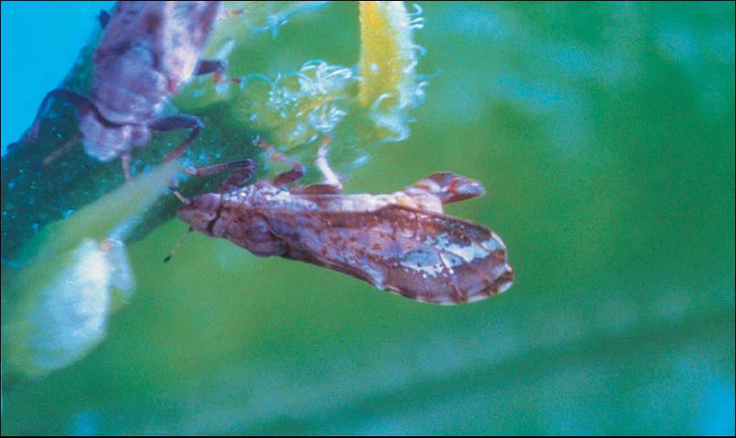
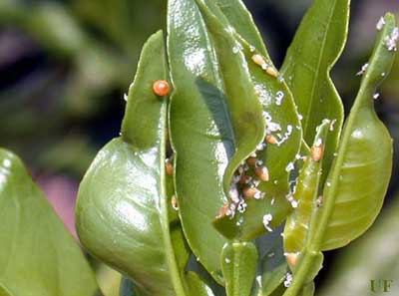
Adult; Citrus Psylla
Nymph; Citrus Psylla

Slide 56
Citrus Leaf Miner
1- Citrus leaf miner
Chewing types insect,
Small silvery white insect with black eyes and wings fringed with hairs,
It make the tunnels in the leaves, which looks silvery white, Attack on young nursery plants more
Corrective measure
Spray with insecticides during leaf emerging
Avoid using citrus hedges around citrus orchards or nurseries

Slide 57
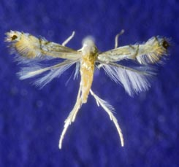
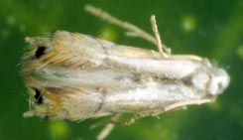
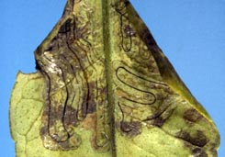
Citrus leaf miner
Damage caused by citrus leaf miner

Slide 58
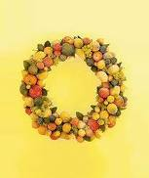
Thanks

