Slide 1
Sleep disorders

Slide 10
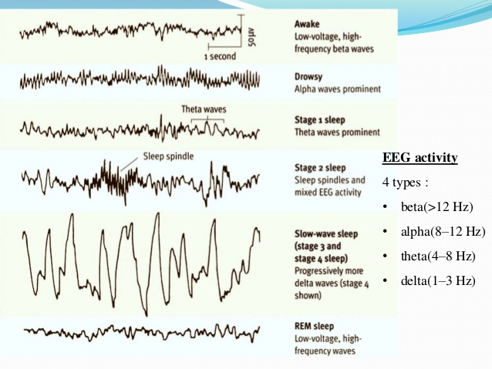

Slide 11
Sleep cycle
Usually sleepers pass through four stages: 1, 2, 3, and REM (rapid eye movement) sleep. These stages progress cyclically from 1 through REM then begin again with stage 1.
A complete sleep cycle takes an average of 90 to 110 minutes, with each stage lasting between 5 to 15 minutes

Slide 13
There are two main types of sleep:
Non-rapid eye movement (NREM) - also known as quiet sleep
Rapid eye movement (REM) - also known as active sleep or paradoxical sleep

Slide 14
The experts divided sleep into five different stages. Fairly recently, however, stages 3 and 4 were combined so that there are now three NREM stages and a REM stage of sleep.

Slide 15
NREM Stage 1
Stage 1 is the beginning of the sleep cycle and is a relatively light stage of sleep. Stage 1 can be considered a transition period between wakefulness and sleep.
In Stage 1, the brain produces high amplitude theta waves, which are very slow brain waves. This period of sleep lasts only a brief time (around five to 10 minutes).5﻿ If you awaken someone during this stage, they might report that they were not really asleep

Slide 16
NREM Stage 2
During stage 2 sleep:
People become less aware of their surroundings
Body temperature drops
Breathing and heart rate become more regular
Stage 2 is the second stage of sleep and lasts for approximately 20 minutes. The brain begins to produce bursts of rapid, rhythmic brain wave activity known as sleep spindles. Body temperature starts to decrease and heart rate begins to slow. According to the American Sleep Foundation, people spend approximately 50% of their total sleep in this stage

Slide 17
NREM Stage 3
During stage 3 sleep:
Muscles relax
Blood pressure and breathing rate drop
Deepest sleep occurs
This stage was previously divided into stages 3 and 4. Deep, slow brain waves known as delta waves begin to emerge during stage 3 sleep. This stage is also sometimes referred to as delta sleep.

Slide 18
During this stage, people become less responsive and noises and activity in the environment may fail to generate a response. It also acts as a transitional period between light sleep and a very deep sleep.
Older studies suggested that bed-wetting was most likely to occur during this deep stage of sleep, but some more recent evidence suggests that such bed-wetting can also occur at other stages. Sleepwalking also tends to occur most often during the deep sleep of this stage.

Slide 19
Rem sleep
REM Sleep
During REM sleep:
The brain becomes more active
Body becomes relaxed and immobilized
Dreams occur
Eyes move rapidly

Slide 26
