Slide 1
Presented By:
Iqra Mumtaz(101)
Iqra Iqbal (127)
Abdullah (118)

Slide 2
Chapter 6 Content:
Environmental Awareness
Types of pollution
Causes Of Pollution
Environmental Education

Slide 3
Environmental Awareness

Slide 4
What is Environmental Awareness
Environmental awareness is to understand the fragility of our environment and the importance of its protection

Slide 5
Types of Pollution
The term "pollution" refers to any substance that negatively impacts the environment or organisms that live within the affected environment. The five major types of pollution include: air pollution, water pollution, soil pollution, light pollution, and noise pollution.

Slide 6
Air Pollution
Burning of fossil fuels is a major source of air pollution. A major source of air pollution results from the burning of fossil fuels. Vehicle and factory emissions are common sources of this type of air pollution. The burning of fossil fuels contributes to the formation of smog, a dense layer of particulate matter that hangs like a cloud over many major cities and industrial zones. Air pollution contributes to respiratory problems such as asthma, lung cancer, chronic bronchitis, and other lung ailments. Nitrogen and sulfur oxides in the air contribute to acid rain, which is a form of precipitation with a lower (more acidic) pH than normal. Acid rain harms forests, species that live in water bodies, and degrades outdoor statues, monuments, and buildings.

Slide 7
Water Pollution
Trash pollutes water. A major source of water pollution is runoff from agricultural fields, industrial sites, or urban areas. Runoff disrupts the water body's natural balance. For example, agricultural runoff typically includes fertilizer or toxic chemicals. Fertilizer can cause algal blooms (an explosive growth of algae), choking out other plants and decreasing the amount of available oxygen necessary for the survival of other species. Raw sewage is another type of water pollutant. When sewage gets into the drinking water supply, serious stomach and digestive issues may result, including the spread of diseases such as typhoid or dysentery. A third source of water pollution is trash. Improperly disposed of items, such as plastic bags, fishing line, and other materials may accumulate in the water and lead to the premature death of animals that get tangled within the garbage.

Slide 8
Soil Pollution
Abandoned industrial zones are often polluted. Soil can become polluted by industrial sources or the improper disposal of toxic chemical substances. Common sources of soil pollution include asbestos, lead, PCBs, and overuse of pesticides/herbicides. In the United States, the Environmental Protection Agency (EPA) is in charge of cleaning up uncontrolled hazardous waste sites, which are referred to as "Superfund" sites. Many of these sites are abandoned or improperly-managed industrial zones.

Slide 9
Light Pollution
Light pollution keeps people from seeing the night sky.
Light pollution refers to the large amount of light produced by most urban and other heavily-populated areas. Light pollution prevents citizens from seeing features of the night sky and has also been shown to impede the migration patterns of birds and the activities of nocturnal animals.

Slide 10
Noise Pollution
Noise pollution disrupts human and animal life.
Noise pollution typically refers to human-made noises that are either very loud or disruptive in manner. This type of pollution has been shown to impact the movement of sea mammals, such as dolphins and whales and also impacts the nesting success of birds.

Slide 11
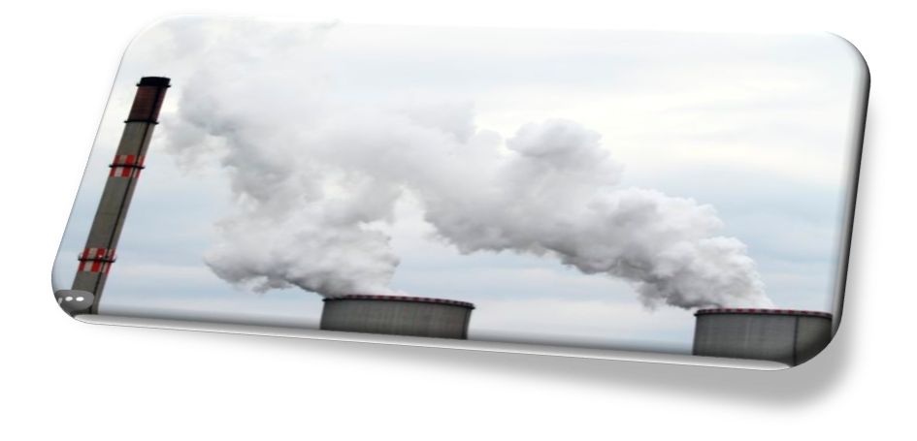
Causes of pollution
Causes Of Air Pollution
There are two types of air pollutants
Primary
Secondary

Slide 12
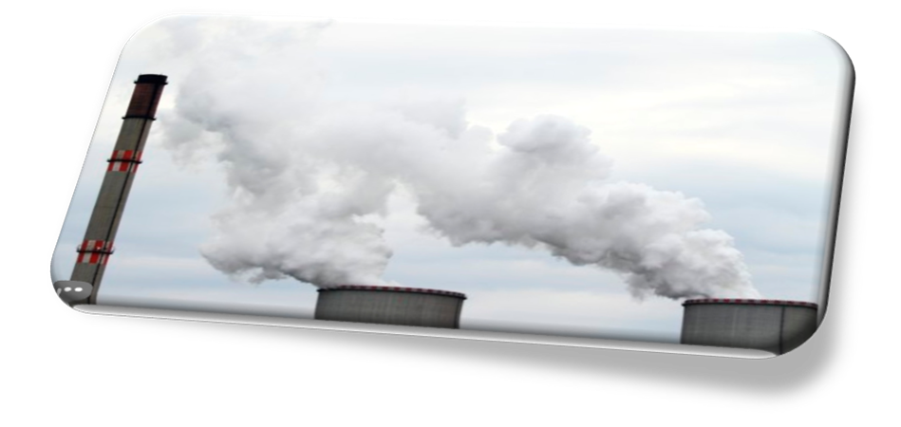
Air pollution
Burning of fossil fuels
fumes from car
Ammonia
Agricultural air pollutants

Slide 13
According to the earth institute
The heavy use of fertilizer for agriculture is a major contributor of fine-particulate air pollution, with most of Europe, Russia, China, and the United States being affected. The level of pollution caused by agricultural activities is thought to outweigh all other sources of fine-particulate air pollution in these countries.

Slide 14
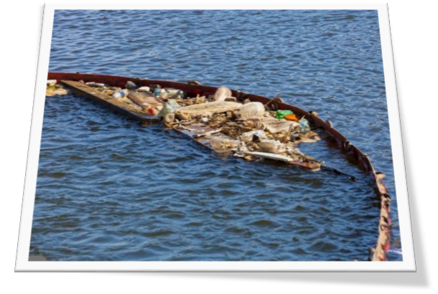
Causes water pollution
Sewage
wastewater
fertilizers
Pesticides and herbicides
Industrial waste

Slide 15
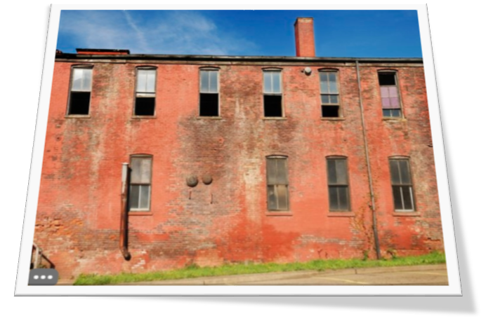
Causes of land and soil pollution
Human s’ activities and misuses of land
Excessive usage of chemicals
Underground leakage
Rain and flooding
Over-farming and over-grazing

Slide 16
Causes of noise pollution
Household sources
social events
Commercial and industrial activities
Transportation.

Slide 17
Causes of light pollution
Artificial lights
Vehicles lights at night
electronic billboards
night sports grounds
street and car lights
city parks
public places
Air ports

Slide 18
ENVIRONMENTAL EDUCATION

Slide 24
To create awareness among the students about the environment and its problems.
To enable the students to understand the environment and its inter relationship with man.
To enable the students to acquire basic knowledge about the environment.
To identify the social values which are in harmony with the environmental quality.
To create positive attitude among the students towards environment.
To develop skills among the students for evaluating environmental measures and educational programs.
To develop skills among the students with a view to solve environmental problems.

