Slide 1
Theories of learning
Azhar Pervaiz

Slide 2
Broad Goals
1. Operationally define terms relevant to theories of learning.
2. Examine learning theories that are currently important.

Slide 3
Definitions: Learning is:
1. “a persisting change in human performance or performance potential . . . (brought) about as a result of the learner’s interaction with the environment” (Driscoll, 1994, pp. 8-9).
2. “the relatively permanent change in a person’s knowledge or behavior due to experience” (Mayer, 1982, p. 1040).
3. “an enduring change in behavior, or in the capacity to behave in a given fashion, which results from practice or other forms of experience” (Shuell, 1986, p. 412).

Slide 4
Learning Theory
Q: How do people learn?
A: Nobody really knows.
But there are 6 main theories:
Behaviorism
Cognitivism
Social Learning Theory
Social Constructivism
Multiple Intelligences
Brain-Based Learning

Slide 5
Behaviorism
Confined to observable and measurable behavior
Classical Conditioning - Pavlov
Operant Conditioning - Skinner

Slide 6
Behaviorism
Classical Conditioning - Pavlov
A stimulus is presented
in order to get a response:
S R

Slide 7
Behaviorism
Classical Conditioning - Pavlov
S US
UR
CS US
CR
Notes:
First Order Classical Conditioning:
S = Stimulus (bell)
US = Unconditioned Stimulus (food)
UR = Unconditioned Response (saliva)
CS = Conditioned Stimulus (bell)
CR = Conditioned Reponse (saliva)

Slide 8
Behaviorism
Operant Conditioning - Skinner
The response is made first,
then reinforcement follows.

Slide 9
Behaviorism
Learning is defined by the outward expression of new behaviors
Focuses solely on observable behaviors
A biological basis for learning
Learning is context-independent
Classical & Operant Conditioning
Reflexes (Pavlov’s Dogs)
Feedback/Reinforcement (Skinner’s Pigeon Box)
Notes:
Biological basis for learning – you have it or you don’t…it’s a thing you inherit

Slide 10
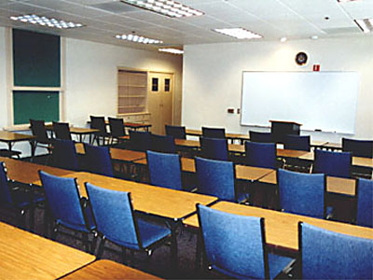
Behaviorism in the Classroom
Rewards and punishments
Responsibility for student learning rests squarely with the teacher
Lecture-based, highly structured

Slide 11
Critiques of Behaviorism
Does not account for processes taking place in the mind that cannot be observed
Advocates for passive student learning in a teacher-centric environment
One size fits all
Knowledge itself is given and absolute
Programmed instruction & teacher-proofing

Slide 12
Learning Theory
Behaviorism
Cognitive Learning Theory
Social Learning Theory

Slide 13
Cognitivism
Grew in response to Behaviorism
Knowledge is stored cognitively as symbols
Learning is the process of connecting symbols in a meaningful & memorable way
Studies focused on the mental processes that facilitate symbol connection
Notes:
Grew in response to Behaviorism in an effort to better understand the mental processes behind learning

Slide 14
Cognitive Learning Theory
Discovery Learning - Jerome Bruner
Meaningful Verbal Learning - David Ausubel

Slide 15
Cognitive Learning Theory
Discovery Learning
1. Bruner said anybody can learn anything at any age, provided it is stated in terms they can understand.

Slide 16
Cognitive Learning Theory
Discovery Learning
a. Transfer to many different situations
b. Only possible through Discovery Learning
c. Confront the learner with problems and help them find solutions. Do not present sequenced materials.
2. Powerful Concepts (not isolated facts)
Notes:
An example of a powerful concept is addition. Instead of drilling facts
1 + 1 = 2
1 + 2 = 3
into people’s heads, teach them the CONCEPT of addition.

Slide 17
Cognitive Learning Theory
Meaningful Verbal Learning
Advance Organizers:
New material is presented in a systematic way, and is connected to existing cognitive structures in a meaningful way.
Notes:
New material is related to something they already know!

Slide 18
Cognitive Learning Theory
Meaningful Verbal Learning
When learners have difficulty with new material, go back to the concrete anchors (Advance Organizers). Provide a Discovery approach, and they’ll learn.
Notes:
.

Slide 19
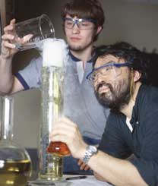
Cognitivism in the Classroom
Inquiry-oriented projects
Opportunities for the testing of hypotheses
Curiosity encouraged
Staged scaffolding
Notes:
Staged scaffolding: not based on ability or experience…based on developmental stage (age most predominantly)

Slide 20
Critiques of Cognitivism
Like Behaviorism, knowledge itself is given and absolute
Input – Process – Output model is mechanistic and deterministic
Does not account enough for individuality
Little emphasis on affective characteristics
Notes:
Does not account enough for individuality and differences in staged development
Little emphasis on affective characteristics, especially motivation

Slide 21
Learning Theory
Behaviorism
Social Learning Theory
Cognitive Learning Theory

Slide 22
Social Learning Theory (SLT)
Grew out of Cognitivism
A. Bandura (1973)
Learning takes place through observation and sensorial experiences
Imitation is the sincerest form of flattery
SLT is the basis of the movement against violence in media & video games
Notes:
Imitation: Individuals adopt the modeled behavior more readily and completely if the person they are observing is admired by the observer
We more readily model behavior if it results in outcomes we value or approve of

Slide 23
Social Learning Theory
Learning From Models -
Albert Bandura
1. Attend to pertinent clues
2. Code for memory (store a visual image)
3. Retain in memory
4. Accurately reproduce the observed activity
5. Possess sufficient motivation to apply new learning

Slide 24
Social Learning Theory
Research indicates that the following factors influence the strength of learning from models:
1. How much power the model seems to have
2. How capable the model seems to be
3. How nurturing (caring) the model seems to be
4. How similar the learner perceives self and model
5. How many models the learner observes

Slide 25
Social Learning Theory
Four interrelated processes establish and strengthen identification with the model:
1. Children want to be like the model
2. Children believe they are like the model
3. Children experience emotions like those the model is feeling.
4. Children act like the model.

Slide 26
Social Learning Theory
Through identification, children come to believe they have the same characteristics as the model.
When they identify with a nurturant and competent model, children feel pleased and proud.
When they identify with an inadequate model, children feel unhappy and insecure.

Slide 27
SLT in the Classroom
Collaborative learning and group work
Modeling responses and expectations
Opportunities to observe experts in action

Slide 28
Critiques of Social Learning Theory
Does not take into account individuality, context, and experience as mediating factors
Suggests students learn best as passive receivers of sensory stimuli, as opposed to being active learners
Emotions and motivation not considered important or connected to learning
Notes:
Think of a laboratory environment, for instance. What’s more effective in your estimation…watching the faculty member conduct the lab, or you doing it yourself?

Slide 29
Social Constructivism
Grew out of and in response to Cognitivism, framed around metacognition
Knowledge is actively constructed
Learning is…
A search for meaning by the learner
Contextualized
An inherently social activity
Dialogic and recursive
The responsibility of the learner
Lev Vygotsky
Social Learning
Zone of Proximal Development
Notes:
Knowledge is actively constructed by individuals in light of and in relation to our past experiences, the context of learning, personal motivation, and our beliefs/attitudes/prior knowledge
Think of the lab…instead of just watching it being done, the student acts as the active agent conducting the lab, with expert support leading them to the edge of their knowledge and beyond.
Dialogic: central focus is on written & spoken dialogue
Recursive: new learning is built upon prior learning…scaffolding

Slide 30
Social Constructivism in the Classroom
Journaling
Experiential activities
Personal focus
Collaborative & cooperative learning

Slide 31
Critiques of Social Constructivism
Suggests that knowledge is neither given nor absolute
Often seen as less rigorous than traditional approaches to instruction
Does not fit well with traditional age grouping and rigid terms/semesters
Notes:
Suggests that knowledge is neither given nor absolute, but is rather an individual construct
Does not fit well with traditional age grouping and rigid terms/semesters that do not provide a flexible timeframe for learning

Slide 32
Multiple Intelligences (MI)
Grew out of Constructivism, framed around metacognition
H. Gardner (1983 to present)
All people are born with eight intelligences:
Enables students to leverage their strengths and purposefully target and develop their weaknesses
1. Verbal-Linguistic | 5. Musical
2. Visual-Spatial | 6. Naturalist
3. Logical-Mathematical | 7. Interpersonal
4. Kinesthetic | 8. Intrapersonal
Notes:
Metacognition – simply put is learning about learning, but more realistically, it’s about kn owing who you are as a learner, and developing the capacity to leverage your strengths to your advantage while purposefully addressing your weaknesses

Slide 33
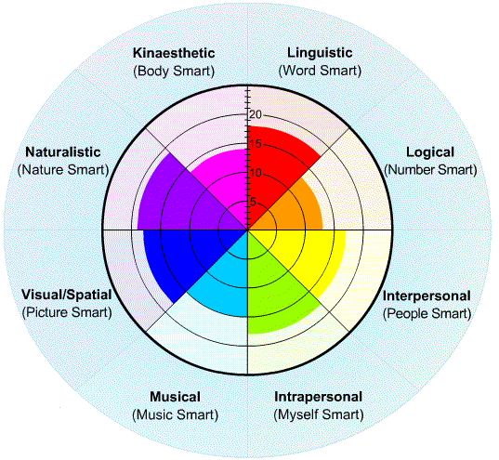
MI in the Classroom
Delivery of instruction via multiple mediums
Student-centered classroom
Authentic Assessment
Self-directed learning

Slide 34
Critiques of MI
Lack of quantifiable evidence that MI exist
Lack of evidence that use of MI as a curricular and methodological approach has any discernable impact on learning
Suggestive of a departure from core curricula and standards

Slide 35
Brain-Based Learning (BBL)
Grew out of Neuroscience & Constructivism
D. Souza, N. Caine & G. Caine, E. Jensen (1980’s to present)
12 governing principles
1. Brain is a parallel processor | 7. Focused attention & peripheral perception
2. Whole body learning | 8. Conscious & unconscious processes
3. A search for meaning | 9. Several types of memory
4. Patterning | 10. Embedded learning sticks
5. Emotions are critical | 11. Challenge & threat
6. Processing of parts and wholes | 12. Every brain is unique

Slide 36
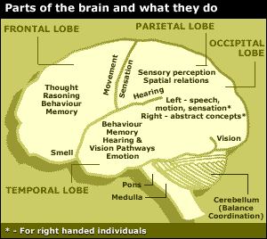
BBL in the Classroom
Opportunities for group learning
Regular environmental changes
A multi-sensory environment
Opportunities for self-expression and making personal connections to content
Community-based learning

Slide 37
Critiques of BBL
Research conducted by neuroscientists, not teachers & educational researchers
Lack of understanding of the brain itself makes “brain-based” learning questionable
Individual principles have been scientifically questioned
Notes:
Individual principles have been scientifically questioned (left/right brain laterality)

Slide 38
Other Learning Theories of Note
Andragogy (M. Knowles)
Flow (M. Czikszentmihalyi)
Situated Learning (J. Lave)
Subsumption Theory (D. Ausubel)
Conditions of Learning (R. Gagne)

Slide 39
Humanist
All students are intrinsically motivated to self actualize or learn
Learning is dependent upon meeting a hierarchy of needs (physiological, psychological and intellectual)
Learning should be reinforced.

Slide 40
Sources:
facultyweb.anderson.edu/~jhaukerman/Learning%20Theory.ppt
Matthew D. Laliberte www.nercomp.org/data/media/A%20Brief%20History%20of%20Learning%20Theory.ppt
Michael A. Lorber, Ph.D. www.learningtechnologies.ac.uk/.../PROJECT/resources/Learning%20Theory/Resources/learning%20theories.ppt
www.dcs.bbk.ac.uk/selene/reports/SeLeNe1.2.ppt

