Slide 2
Field Drainage

Slide 3
Introduction
Drainage means the removal of excess water from a given place.
Two types of drainage can be identified:
Land Drainage
Field Drainage

Slide 4
Land Drainage
This is large scale drainage where the objective is to drain surplus water from a large area by such means as excavating large open drains, erecting dykes and levees and pumping.
Such schemes are necessary in low lying areas and are mainly Civil Engineering work.

Slide 5
Field Drainage
This is the drainage that concerns us in agriculture. It is the removal of excess water from the root zone of crops.

Slide 6
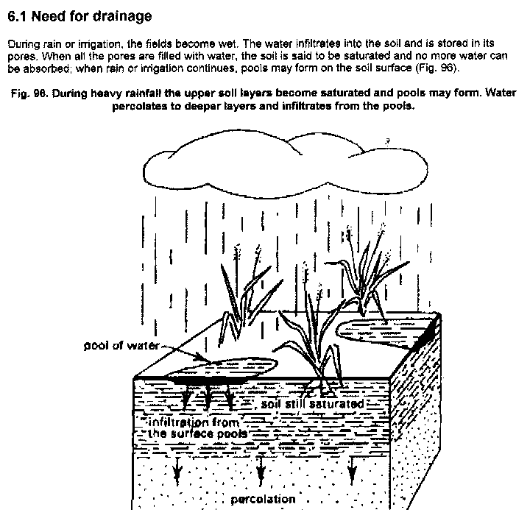

Slide 7
The Main Aims of Field Drainage Include:
To bring soil moisture down from saturation to field capacity. At field capacity, air is available to the soil and most soils are mesophites i.e. like to grow at moisture less than saturation.
Drainage helps improve hydraulic conductivity: Soil structure can collapse under very wet conditions and so also engineering structures.

Slide 8
Cont…
In some areas with salt disposition, especially in arid regions, drainage is used to leach excess salt.
In irrigated areas, drainage is needed due to poor application efficiency which means that a lot of water is applied.

Slide 9
Conti…
Drainage can shorten the number of occasions when cultivation is held up waiting for soil to dry out.

Slide 10
The excess water, if not drained causes serious damages to the soil as well as crops .The harmful effect may be categorized as under:

Slide 11
Harmful effects on plants
Under wet condition the transport of gases in the soil become slow or stopped totally as the gas filled in the pore spaces are replaced by water .
This decreases oxygen contents and increases CO₂ contents .
The anaerobic condition ,thus created ,adversely affects physiological processes of plant like transpiration, ion and water absorption ,respiration, photosynthesis etc

Slide 12
Conti…
The oxygen deficiency in soils leads to conversion of minerals into reduced form as in case of Fe , Mn ,S and other products which become toxic to plants .
Besides the availability of several plant nutrients e.g. C , O ,N , S ,Cu and others are reduced due to their conversion in reduced state.

Slide 13
Harmful effects of excess water on microbial health
The oxygen deficiency in the soil results in the production of several toxic substances.
Nutrient are made unavailable due to leaching. Toxic elements will be formed under anaerobic condition.
Decomposition of organic matter under anaerobic condition result in production of organic acid like butyric acid which is toxic to plant.

Slide 14
Replacement of soil air,which is the main source of oxygen for the roots as well as soil microbes.
Due to high amount of CO₂ in soil air, high CO₂ concentration under water logged condition will kill plant roots.

Slide 15
Methods of Drainage
Surface Drainage
Sub surface Drainage

Slide 16
Surface Drainage
This is designed primarily to remove excess water from the surface of soil profile.
This is done by removing low spots where water accumulates by land forming or by excavating ditches or a combination of the two.

Slide 17
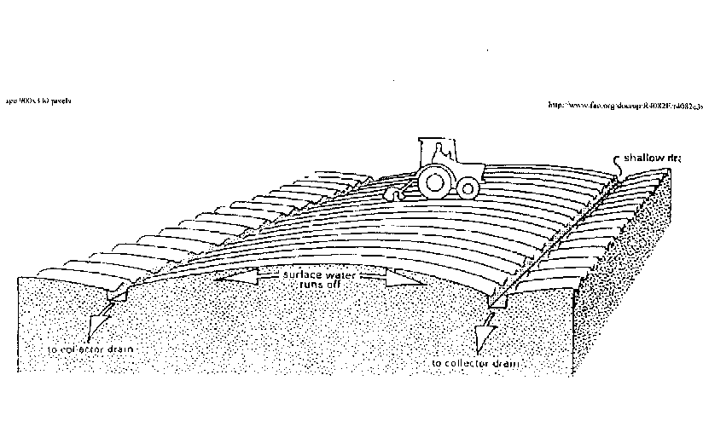

Slide 18
Conti…
Land forming is mechanically changing the land surface to drain surface water.
This is done by smoothing, grading, bedding or leveling.
Land smoothing is the shaping of the land to a smooth surface in order to eliminate minor differences in elevation and this is accomplished by filling shallow depressions.
There is no change in land contour. Smoothing is done using land levelers or planes

Slide 19
Conti…
Land grading is shaping the land for drainage done by cutting, filling and smoothening to planned continuous surface grade e.g. using bulldozers or scrapers.

Slide 20
Disadvantages
Valuable cropland is used for drainage purpose.
Open ditches may cause the hindrance to the use of implements and intercultural operations.
Animal and rodents may damage the surface drains.

Slide 21
Surface drainage can be further classified as:
Lift Drainage
Gravity Drainage
Field surface Drainage
Ditch Drainage

Slide 22
Lift Drainage
To drain from low lying areas or areas having water due to embankment, lift drainage is used.
Water to be drained is lifted normally by open devices, By pumping or by mechanical means.
This method is costly and time consuming.

Slide 23
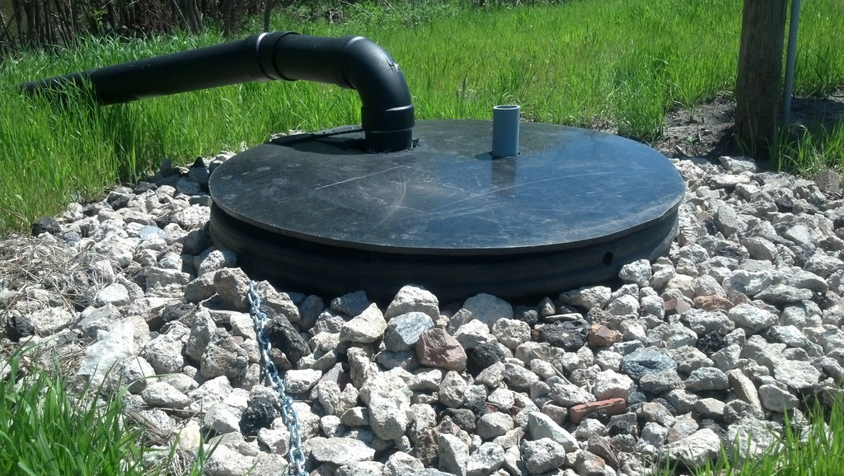

Slide 24
Gravity Drainage
Water is allowed to drain from the area under higher elevation to lower reaches through regulated gravity flow through the outlet.
This system is practiced in wetland rice with gentle to moderate slope.
This method is less costly, easy and effective.

Slide 25
Field surface Drainage
The excess water received from the rain or irrigation is drained through this method.
This drainage method is cheap and effective but there is possibility of soil erosion and distribution of weed seed along the flow of drainage water.

Slide 26
Ditch Drainage
This method is adopted in nurseries, seed beds and rainfed crops.
This is an effective and efficient method but requires smoothening of surface and construction of ditches.
This involves cost and wastage of crop lands.

Slide 27
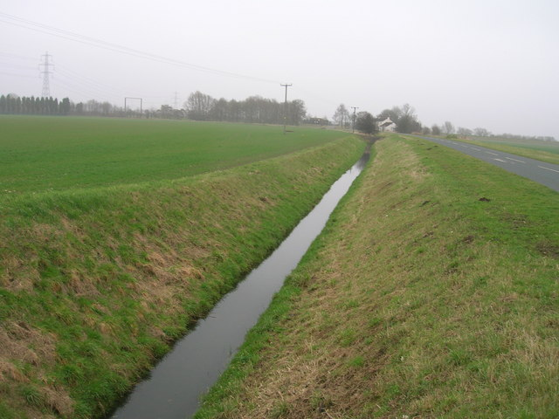

Slide 28
Subsurface drainage
These drains are made in underground area at an appropriate depth ranging from 1 m to 2 m depending upon situation.
It aims at increasing the rate at which water will drain from the soil, and so lowering the water table, thus increasing the depth of drier soil above the water table.
Sub-surface drainage can be done by open ditches or buried drains.

Slide 29
Sub-Surface Drainage Using Ditches
Ditches have lower initial cost than buried drains;
There is ease of inspection and ditches are applicable in some organic soils where drains are unsuitable.
Ditches, however, reduce the land available for cropping and require more maintenance that drains due to weed growth and erosion.

Slide 30
Sub-Surface Drainage Using Ditches

Slide 31
Sub-Surface Drainage Using Buried Drains
Buried drains refer to any type of buried conduits having open joints or perforations, which collect and convey drainage water.
They can be fabricated from clay, concrete, corrugated plastic tubes or any other suitable material.

Slide 32
Sub-Surface Drains Using Buried Drains

Slide 33
Sub-Surface drainage can be further classified as:
Tile Drainage
Mole Drainage
Vertical Drainage
Drainage Wells

Slide 34
Tile drainage
This consist of a continuous line of tiles laid at specific depth and grade so that excess water enter through the tiles and flow out by gravity.
Tiles should be strong enough to withstand the pressure and also resist to erosive action of chemicals in soil water.

Slide 35
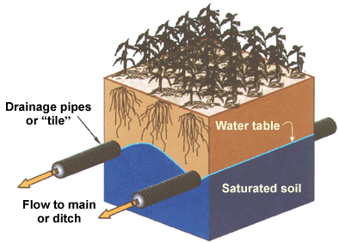

Slide 36
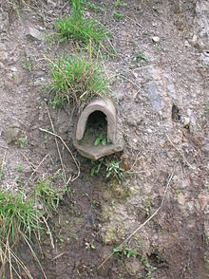
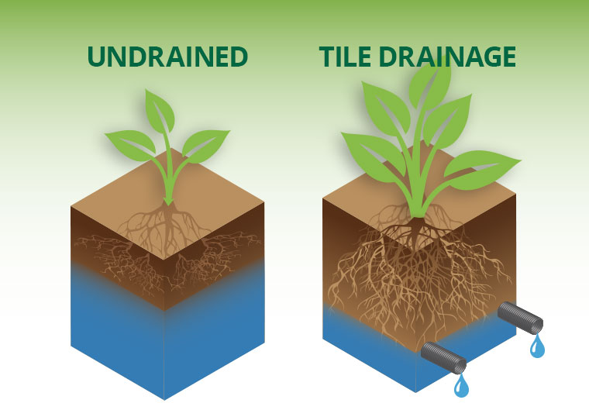

Slide 37
Mole drainage
This drain is common in European countries having deep soils rich in organic matter (peat and muck soils).
Mole drains are unlined circular earthen channels formed within a soil by a mole plough.

Slide 38
Mole drains are used in heavy soils where a clay subsoil near moling depth (400 to 600 cm) prevents downward movement of ground water.
Mole drains do not drain groundwater but removes water as it enters from the ground surface.

Slide 39
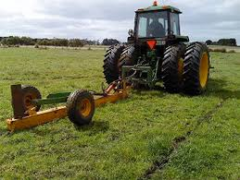

Slide 40
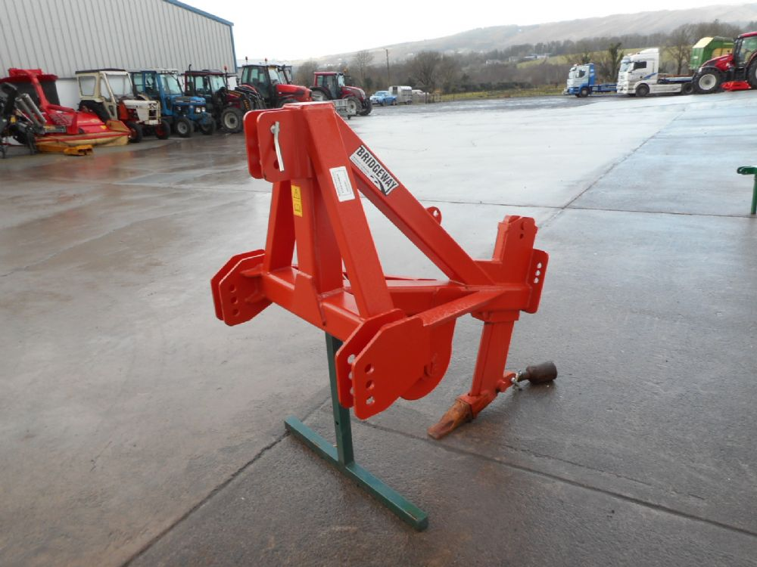

Slide 41
Vertical Drainage
It is the disposal of drainage water through well into porous layers of earth.
Such a layer must be a capable of taking large volume of water rapidly.
Such layers are found in river beds.

Slide 42
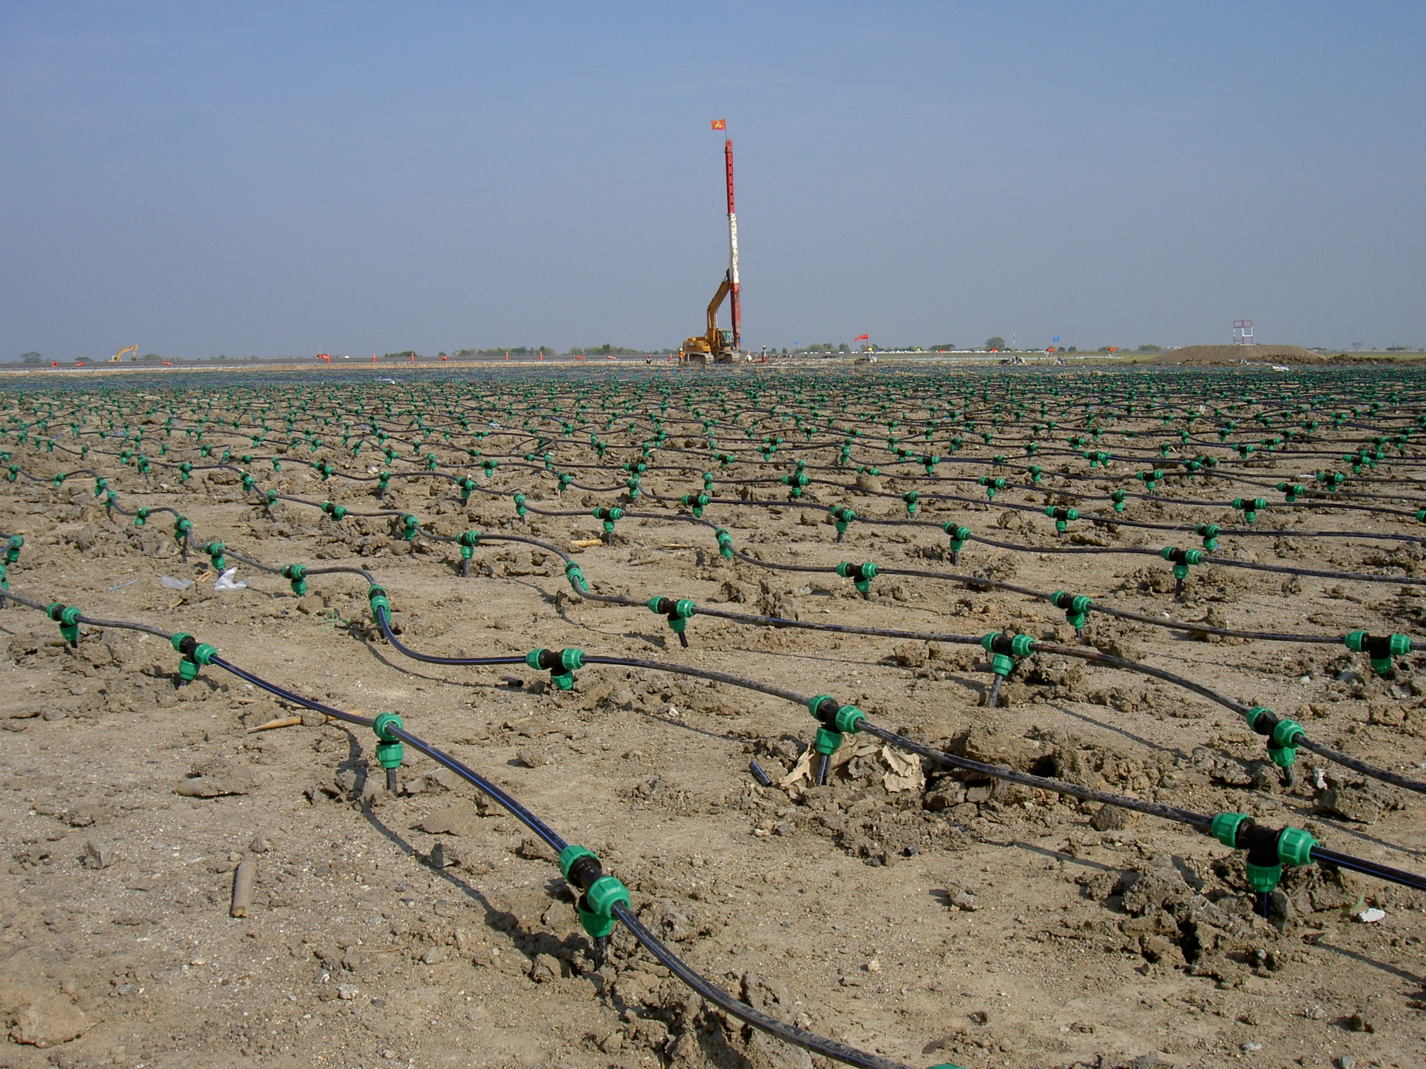

Slide 43
Drainage Wells
In places of high water table, shallow wells are dug which collect water through seepage in infiltration.
The wells are used for the drainage of agricultural lands especially in irrigated areas.

Slide 44
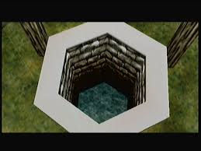

Slide 45
Advantages
There is no loss of cultivable land.
No interference for field operation.
Effectively drains sub soil and creates better soil environments.

Slide 46
Disadvantages
Initial cost is high.
It requires constant attention.
It is effective for soils having low permeability.

