Slide 1
Critical thinking vs creative thinking Sports psychology
Anam Yousaf

Slide 2
Need of critical thinking
On a daily basis, we face problems and situations that should be evaluated and solved, and we are challenged to understand different perspectives to think about these situations. Most of us are building our cognitive thinking based on previous similar situations or experiences. However, this may not guarantee a better solution for a problem, as our decision may be affected by emotions, non-prioritized facts, or other external influences that reflect on the final decision. Therefore, critical thinking tends to build a rational, open-mined process that depends on information and empirical evidence

Slide 3
Critical Thinking
The National Council for Excellence in Critical Thinking defines critical thinking as an “intellectually disciplined process of actively and skillfully conceptualizing, applying, analyzing, synthesizing, and/or evaluating information gathered from, or generated by, observation, experience, reflection, reasoning, or communication, as a guide to belief and action.”

Slide 4
Ability to think clearly, understanding the logical connection between ideas
Objective analysis and evaluation of issue/problem in order to form a judgment
Analysis of facts to form a judgment

Slide 5
Continue
The more clearly we are aware of ourselves, strengths, weaknesses, then critical thinking will be productive

Slide 6
The critical thinking process prevents our minds from jumping directly to conclusions. Instead, it guides the mind through logical steps that tend to widen the range of perspectives, accept findings, put aside personal biases, and consider reasonable possibilities.

Slide 7
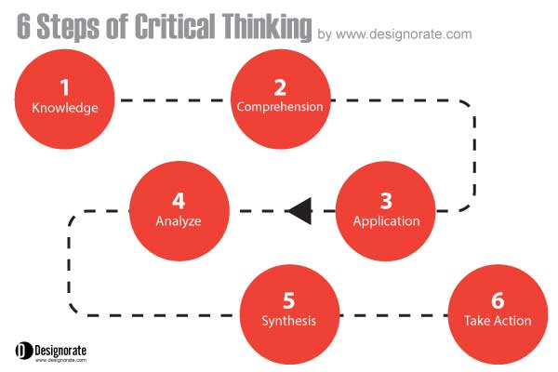

Slide 8
knowledge
For every problem, clear vision puts us on the right path to solve it. This step identifies the argument or the problem that needs to be solved. Questions should be asked to acquire a deep understanding about the problem. In some cases, there is no actual problem, thus no need to move forward with other steps in the critical thinking model. The questions in this stage should be open-ended to allow the chance to discuss and explore main reasons. At this stage, two main questions need to be addressed: What is the problem? And why do we need to solve it?

Slide 9
Comprehension
Once the problem is identified, the next step is to understand the situation and the facts aligned with it. The data is collected about the problem using any of the research methods that can be adopted depending on the problem, the type of the data available, and the deadline required to solve it.

Slide 10
Application
This step continues the previous one to complete the understanding of different facts and resources required to solve the problem by building a linkage between the information and resources. Mind maps can be used to analyze the situation, build a relation between it and the core problem, and determine the best way to move forward.

Slide 11
Analyze
Once the information is collected and linkages are built between it the main problems, the situation is analyzed in order to identify the situation, the strong points, the weak points, and the challenges faced while solving the problem. The priorities are set for the main causes and determine how they can be addressed in the solution. One of the commonly used tools that can be deployed to analyze the problem and the circumstances around it is the cause effect diagram, which divides the problem from its causes and aims to identify the different causes and categorize them based on their type and impact on the problem.

Slide 12
Synthesis
In this stage, once the problem is fully analyzed and all the related information is considered, a decision should be formed about how to solve the problem and the initial routes to follow to take this decision into action. If there are number of solutions, they should be evaluated and prioritized in order to find the most advantageous solution. One of the tools that contribute choosing the problem solution is the SWOT analysis that tends to identify the solution’s strength, weakness, opportunity, and threats.

Slide 13
SWOT analysis

Slide 14
Strengths
What are the advantages of the new product or service?
What are the product advantages over similar competitors in market?
What strength points do people see in the product or service?
What are the product’s unique selling factors?

Slide 15
Weaknesses
What weakness could be improved in the design?
What issues should be avoided?
What are the factors that reduce your sales?
Does the production process have limited resources?

Slide 16
Opportunities
What are the opportunities for the new product?
What are the trends to take advantage of?
How can we turn strengths into opportunities?
Are there any changes in the market or government which can lead to opportunities?

Slide 17
Threats
Who are the existing or potential competitors?
What are the factors that can put business into risk?
What issues can threaten the product on the market?
Will there be any shifts in consumer behavior, government or market that can affect the product success?

Slide 18
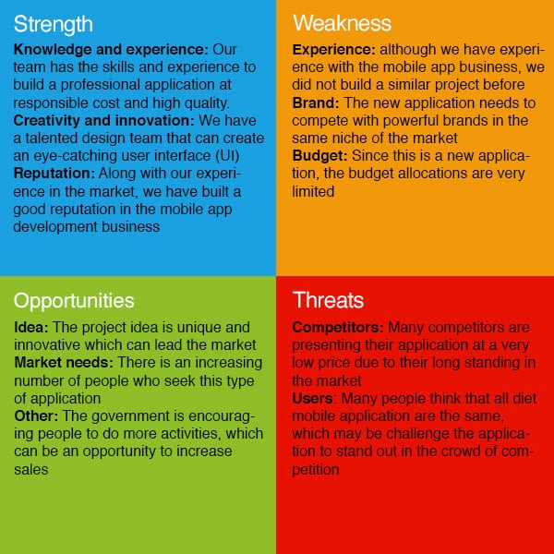

Slide 19
Take Action
The final step is to build an evaluation about the problem that can be put into action. The result of critical thinking should be transferred into action steps. If the decision involves a specific project or team, a plan of action could be implemented to ensure that the solution is adopted and executed as planned.

Slide 20
Creative Thinking

Slide 21
define
Creative thinking is a skill which lets you consider things from a fresh perspective and different angles. It's an inventive thought process which results in surprising conclusions and new ways of doing things. Creative thinking can be aided by brainstorming or lateral thinking to generate ideas.

Slide 22
Lateral thinking
Lateral thinking is a manner of solving problems using an indirect and creative approach via reasoning that is not immediately obvious. It involves ideas that may not be obtainable using only traditional step-by-step logic

