Slide 1
History of Statistics
Latin word | Italian word | German word | French word
Status | Statistica | Statistick | Statistique

Slide 2
What is Statistics?
Collection of DATA
Summarization of DATA
Analysis of DATA
Presentation of DATA
Interpretation of DATA

Slide 3
Uses and Application
Information to general public.
Facilitates comparison.
Simplifies the message.
Helpful in testing and formulating hypothesis.
Helps in prediction.
Association and relationship between factors.

Slide 4
Importance of Statistics
Statistics in Planning
Statistics in Research work

Slide 5
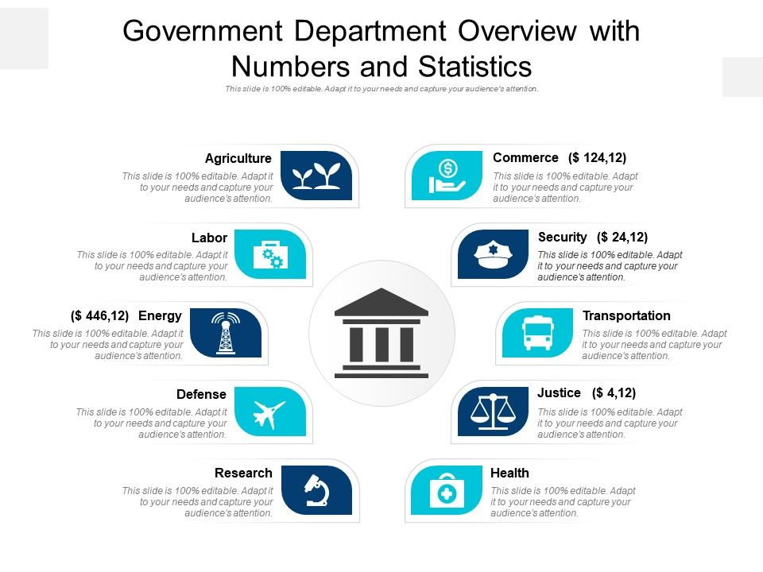
Importance of Statistics
Statistics in Government
Statistics in Health Industry

