Slide 1
Sources of salinity

Slide 2
SOIL SALINITY
Soil salinity is defined as high concentration of solute salts including Na+, Ca2+, and Mg2+ in soils, causing more than 4 dS/m for soil electric conductivity (Rengasamy, 2002)

Slide 3
Sources of Salt in Soil
There can be many causes of salts in soils; the most common sources are listed below:
Inherent soil salinity (weathering of rocks, parent material)
Brackish and saline irrigation water
Sea water intrusion into coastal lands as well as into the aquifer due to over extraction and overuse of fresh water
Restricted drainage and a rising water-table
Surface evaporation and plant transpiration

Slide 4
Sources of Salt in Soil
Sea water sprays, condensed vapors which fall onto the soil as rainfall
Wind borne salts yielding saline fields
Overuse of fertilizers (chemical and farm manures)
Use of soil amendments (lime and gypsum)
Use of sewage sludge and/or treated sewage effluent
Dumping of industrial brine onto the soil

Slide 5
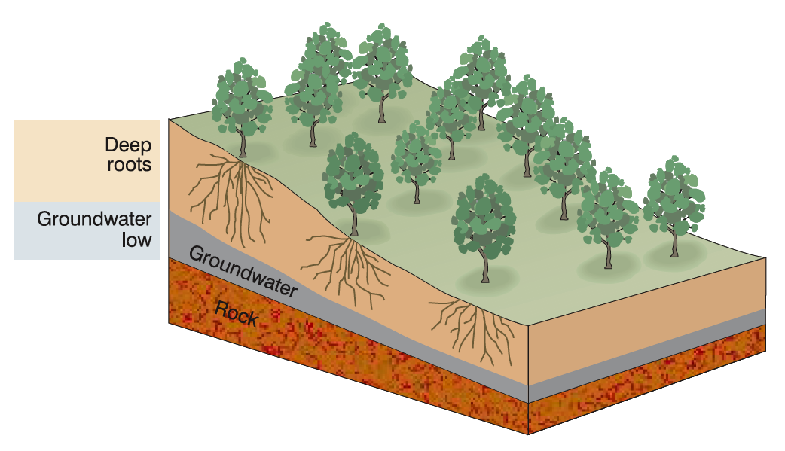
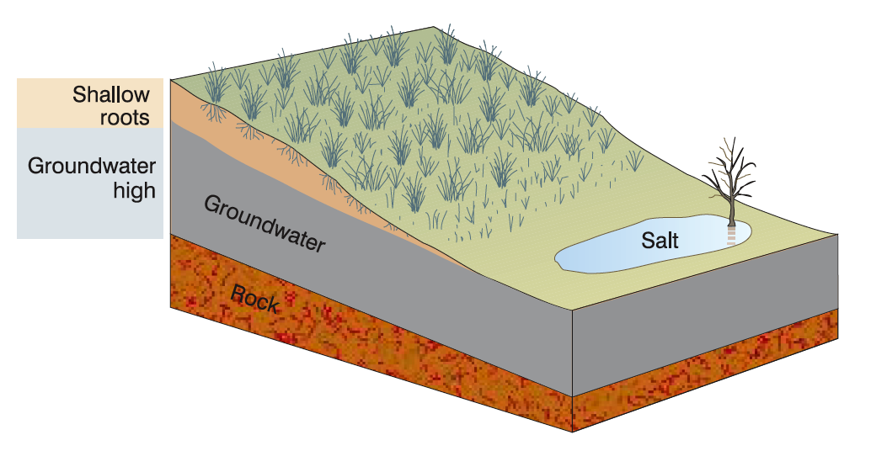
Classification of Sources
Naturally occurring (primary) processes
Human-induced (secondary) processes
Native woody vegetation
Crops and pastures
(Source: CSIRO Land and Water, 1999)

Slide 6
Soil salinity development in agriculture and coastal fields.
(a) Salinity in a furrow irrigated barley field, (b) Salinity in a sprinkler irrigated grass field, (c) Salinity due to sea water intrusion in coastal land

Slide 7
Dryland Soil Salinity (Primary Salinity)
Salinity in dryland soils develops through a rising water table and the subsequent evaporation of the soil water.
There are many causes of the rising water table, e.g.
Restricted drainage due to an impermeable layer and when deep-rooted trees are replaced with shallow-rooted annual crops
Groundwater dissolves salts embedded in rocks in the soil, with the salty water eventually reaching the soil surface and evaporating to cause salinity
Dryland salinity can also occur in un-irrigated landscapes
Weathering of rocks

Slide 8
Secondary Salinity
In contrast to dryland salinity, secondary salinity refers to the salinization of soil due to human activities such as irrigated agriculture.
Secondary salinization may take place mainly in the following situations:
Accumulation of salts from irrigation water of poor quality.
Increase in the level of groundwater
The salt content of the groundwater accumulates in the affected layers
the rising groundwater transports the salts from the deeper soil layers to the surface or surface layers, or
the rising water table limits natural drainage and hinders the leaching of salts.

Slide 9
SALT AFFECTED OR THUR SOILS
The soils in which concentration of salt is very high are called salt affected soil or thur soil. Salt effected is a collective term which includes saline, sodic and saline sodic soil.
It occur commonly in arid and semiarid regions, as well as humid and sub humid regions.
Salt affected soil has: sodium, calcium, potassium, carbonates and bicarbonates.

Slide 10
Types of salt affected soils
Primary salt affected soil
Secondary salt affected soil
1)Primary salt affected soil:
The soil that develops as a result of natural causes (imperfect drainage of surface and ground water is called primary salt affected soil.

Slide 11
2) Secondary salt affected soil
The soil that develops due to accumulation of salt as a result of rise in ground water table are under faulty system of irrigation is called secondary salt effected soil.

Slide 12
Damages Caused by Soil Salinity
Loss of biodiversity and ecosystem disruption
Declines in crop yields
Abandonment or desertification of previously productive farm land
Increasing numbers of dead and dying plants
Increased risk of soil erosion due to loss of vegetation
Contamination of drinking water
Roads and building foundations are weakened by an accumulation of salts within the natural soil structure
Lower soil biological activity due to rising saline water table

Slide 13
Socioeconomic Impacts of Salinity
Reduced crop productivity on saline land leads to poverty due to income loss
In worst case scenario, farmers abandon their land and migrate out of rural areas into urban areas which leads to unemployment
High costs for soil reclamation, when feasible
Loss of good quality soil (organic matter and nutrients) requires more inputs, such as fertilizer – financial pressure on farmer
Compromised biosaline agriculture system that may give lower cash returns, relative to conventional crop production systems

Slide 14
Environmental Impacts of Salinity
Ecosystem fragmentation
Poor vegetative growth and cover lead to enhanced soil degradation (erosion)
Dust with high salt levels causes environmental issues
Sand encroaches into productive areas
Storage capacity of water reservoirs is reduced due to eroded soil material
Contamination of groundwater with high levels of salts occurs

Slide 15
Effects on Plant Growth
Osmotic effect :Increase in osmotic pressure so plants required additional energy to absorb water(Only halophytes are adapted to such soils)
Specific ion effect: uptake of specific ion at the expense of other ions (Results in accumulation of toxic amount of sodium and other ions)
Salt tolerance of crops: Salinity effects salt tolerance of crops (ability of crop to survive and produce economic yield on saline soil)

Slide 16
MITIGATION OF SOIL SALINITY (Primary Salinity)
The potential technologies to mitigate dryland salinity include:
Pumping of saline groundwater and its safe disposal or use
Development of alternate crop plant production systems to maximize saline groundwater use such as deep-rooted trees
Such a deep-rooted trees system utilizes groundwater and lowers water table, the process called biodrainage (or biological drainage)

Slide 17
MITIGATION OF SOIL SALINITY (Secondary Salinity)
Common ways of managing secondary salinity in irrigated agriculture are:
Laser land leveling which facilitates uniform water distribution
Leaching excess salts from surface soil into the subsoil
Lowering shallow water tables with safe use or disposal of pumped saline water
Tillage practices, seed bed preparation and seeding
Adaption of salt tolerant plants
Cycling the use of fresh and saline water
Blending of fresh water with saline water
Minimize evaporation and buildup of salts on surface soil through conservation agriculture practices such as mulching, addition of animal manure and crop residues, etc.

