Slide 2
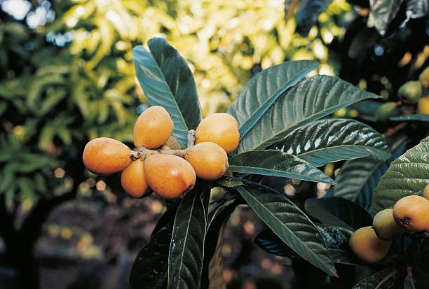
Common name:
Loquat
Scientific name:
Eriobotrya Japonica
Family:
Rosaceae

Slide 3
Plant description:
• Loquat tree can grow 5.5-9 metres, but it is often
smaller 4-5 metres.
• Leaves are longe 4-10 in inches, dark green in colour,
• Flowers are white in colour, flowers have 5 sepal, 5
petals, 5 carpels each with 2 ovules and 20 stamens.
• Fruits are pale yellow, each contain 1-10 ovule.
• In fruits 2-3 seeds are present and seed size is
4-5cm.

Slide 4
Origin and distribution:
• it is native to cooler hill region of china to south-
central china
• it is also known as Japanese plum and China
plum
• in Pakistan, it is found in sub-mountanious district
of punjab like as Labor, Gujranwala, Jhelum,
Rawalpindi and mardan district in NWFP
• commercially, it is grown in Australia, S-africa, USA,
Japan, China and india

Slide 5
Climate:
• Loquat tree perform well in mild climate of sub-
tropical region where the average rain fall is 50 to
100 mm.
• where climte and temperture are to cool and
excessively warm and moist the loquat tree is
grown as ornamentals
• Loquat tree require mild climate and bright
sunshine for proper development of size,
sweetness and flavor.

Slide 6
Soil:
• Loquat is successfully grown on wide range of soil
from light sandy loam to heavy soil
• The ideal soil for loquat is well-drained light loam
• sub-soil containing gravel and high percentage of
calcium is unfit for loquat production.
Irrigation:
• Loquat trees are drought tolerant, but it will
produce a high quality of fruits when we apply the
regular and deep watering.

Slide 7
Irrigation:
• The trees should be watered at the time of swelling
of bloom
• About 2-3 watering should be given during the time
of harvesting.
Fertilizers requirements:
• To get good crop 50kg of well-rotted FYM mixed
with 2kg of bone meal and 5kg of wood ash can be
added every year
• chemical fertilizer N:P:K ratio of 750:300:750 grams/plant should
be applied.

Slide 8
Propagation:
• propagated by both sexual and Asexual method
Sexual propagation:
• propagation by seed is used only for ornamental
purpose
• Asexual propagation:
• propagated by cutting, layering, grafting and
budding( shield budding)
• shield budding is easy and their success is high.
• plant is transplanted with Hight of 6-7 inches.

Slide 9
Fruits maturity and harvesting:
• fruit mature when they turn golden pale or orange
yellow.
• Loquat tree bearing start after the plantation of
3rd year and give maximum yield.
• Lquat tree take two months after fruit setting.
• Usually, fruits in a cluster mature uniformly so
whole cluster may be cut by sharp scature.
• If fruits in cluster do not mature uniformly are
harvested by clipping.

Slide 10
Yield:
• average yield is 15-20 kg/tree.
• it is available when citrus is finished and mango is
reached about to ripe.
Storage:
• Loquat can be stored 3-4 weeks at 0c° and 2 weeks
at 10c°.
• uses of polythene bags retard weight loss and
minimizes decrease in organic acid.

Slide 11
Varieties:
• Loquat varieties are not common but few varieties
depending upon the time of fruit maturity.
• Early season varieties: golden yellow, pale yellow
and large round.
• Mid season varieties: Fire ball, sufeda and
mammoth.
• Late season varieties: California advance and
Tanaka.
• seedless variety: Kibou.

Slide 12
Packing and grading:
• The fruits are graded by their size and colour.
• Graded fruits are packed in wooden boxes and card
board.
• well size and good fruits are are packed in A grade.
• small size and good fruits are packed in B grade.
• The remaining fruits are packed separately.

Slide 13
Training and pruning:
• prune the loquat of tree every couple of month
during its 1st two years.
• cutting off the growing tips of all of its branches to
keep them shorter than 3 feet.
• cutt off dead branches, twigs and leaves as soon as
You notice them.

Slide 14
Medicinal value:
• the loquat fruits and leaves have pectin, iron,
potatium, vitamin A, vitamin C and fibers.
• it is very effective for boosting the overall human
health.
• Some other medical uses lower blood pressure, lower
cancer risk, prevent diabaties, control cholestrol level,
Strengthen bone, soothes respiratry system, boost
immunity, Aids in digestion and regulate the
circulatory system.

Slide 15
Insect pest:
• Bark eating caterpillar: it causes the huge damage
the loquat tree.
• They fed on bark and and tunnel in trunk.
• Due to tunneling, girdling is caused, which may kill
the plant.
Fruit fly: At fruit maturity,fruits are attacked by fruit fly.
• on hatching, maggots bore into fruits and feed on
the pulp.
• The infested fruit become unfit for human health and
reduce the yield Economic value.

Slide 16
Diseases:
• collar rot: the disease is caused by Diplodia
natelensis.
• Fungous attack on the bark of collar region, which
turn brown, then craks or sometime peals off.
• The whole tree may be killed.

