Slide 1
Closing A Project
By: Saba Ashraf
Noon Business School, University of Sargodha

Slide 2
What is Project Closing
Project Closing is the process of finalizing all activities for the project, phase, or contract.
The entire project management closure process requires meetings and communication with your team and stakeholders, a handful of project documents, and analysis skills.
When the project closure phase is completed properly, your project documents will be finalized, your clients and stakeholders will have any final reports that they require, and your team will have had the chance to reflect upon and adjust their processes.
This stage is equally important as the other stages of the project. Even a minor oversight can cause drastic outcomes.

Slide 3
Activities involved in the Closing Stage
Handing over the deliverables
Confirming project completion
Releasing resources
Procurement and other contracts closure
Indexing the project files
Lesson learned documentation

Slide 4
Handing Over The Deliverables
Deliverables are first tested by the Project Management team for its completeness. The deliverables once tested are called validated deliverables.
Then you deliver these deliverables to your client.
The process doesn’t end until the client gives it a formal sign-off
Let’s say the customer receives the deliverables and indicates the work isn’t up to par, and you need to do some rework—that will incur more cost. Another serious problem would be to have to regroup the project team again. Therefore, formal sign-off is essential for closing projects.
You can move to the next step when the customers declares the deliverable as accepted.

Slide 5
Confirming Project Completion
Next, confirm the project is complete. It’s not enough to declare a project done yourself. Each person involved needs to agree on the project’s completion before you can formally close it out and move on.
If you skip this step, you may continue to receive (and be charged for) change requests by the client.
To confirm the project’s completion, you will need to obtain approvals for the project deliverables (i.e., all stakeholders must agree that you delivered on all parts of the project plan) with official sign-offs from the project stakeholders.
Be sure to document this step so you have proof that the project close was formally signed off.

Slide 6
Releasing Resources
After delivering the deliverables and receiving formal sign-off from the customer, the project manager must hand over the resources to their respective departments so that they can be sourced for other projects.
Formally release resources from the project, including suppliers, contractors, team members, and any other partners. Notify them of the end of the project, confirm any final payments or obligations, and officially release them so they are free to work on other projects.
Be sure to follow the correct policies of your performing organization while releasing the resources.

Slide 7
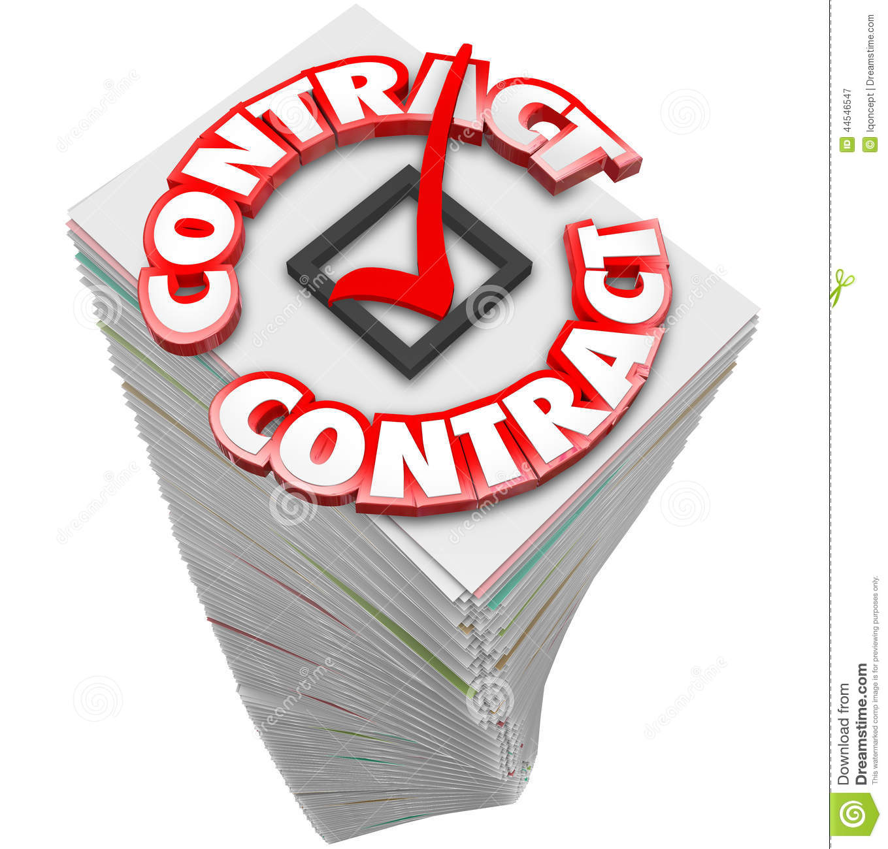
Procurement and Other Contracts Closure
If a third-party vendor or any subcontractors have been working on the project, those contracts need to be closed.
Once they have produced deliverables, and you have delivered them to your end customer, the contracts should be closed; those contracts have no meaning after the deliverables have been accepted.

Slide 8
Indexing the Project’s Files
Once the project is over, the deliverables have been handed over to the customer, and the customer signs off, you should compile the project files and convey them to your entire list of key stakeholders.
The archived files could be used in the future

Slide 9
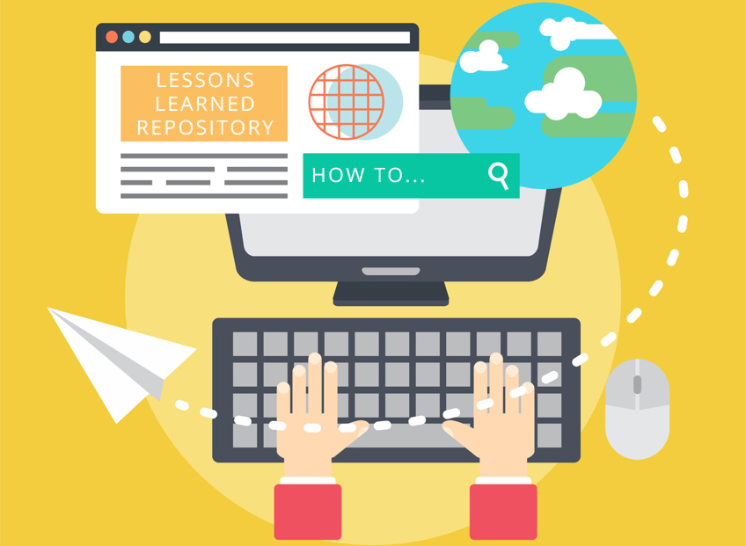
Lesson Learned Documents
Once you’ve received the formal sign-off from your customer, you should work on documenting the lessons learned from this project which can be used as a reference for future projects.
Such documentation could be reused; then you won’t need to work on that documentation again and again.
Circumstances for change requests that were accepted or rejected, history of the schedule control, and cost control could be assessed with the lessons learned.
It serves as an important document in case of project closure. You should involve all of your stakeholders during that process.

Slide 10
Project Closure Deliverables
Wrap-up closure activities
Facilities
Report
Performance Evaluation
Team Evaluation
Individual Evaluation
Project Audit
Report
Lesson Learned
Customers
Vendors
Retrospective

Slide 11
Wrap-up Closure Activities
The major wrap-up task is to ensure the project is approved and accepted by the customer.
Other wrap-up activities include closing accounts, paying bills, reassigning equipment and personnel.
Checklists are used extensively to ensure tasks are not overlooked.
The final report writing is assigned to one project staff member, who assembles input from all the stakeholders.

Slide 12
Performance Evaluation
Evaluation includes team, individual team members, and project manager performance.
Vendors and customers may provide external output.
Evaluation of major players provides important information for the future.

Slide 13
Project Audit
Audits are post project reviews of how successful the project was.
They include casual analysis and thorough retrospective which identify lesson learned.
These post-project reviews should be held with the team members and key stakeholders to catch the missing issues or gaps.

Slide 14
Types of Project Closure
Normal
The most common circumstances for project closure is simply a completed project
The end involves handing off the final design.
Premature
For a few projects, the project may be completed early with some parts of the project eliminated
For example, in a new development projects, a marketing manager may insist o production model before testing.
Perpetual
Some projects never seem to end
The major characteristic of this kind is constant add-ons.
Failed Project
Failed projects are usually easy to identify and easy for review group to close down.
Many projects will fail because of the circumstances beyond the control of the project team.

Slide 15
Examples of Project Closing Oversight

Slide 16
