Slide 1
Development of Immortalized Cell line

Slide 2
What are immortalized cells?
Strategies for generating immortalized cells
An overview of the immortalized workflow
Cell line quality control consideration

Slide 3
What are Immortalized Cells?
We are probably used cells that are taken directly from living tissue, called primary cells
The difficulty with primary cells is that their telomeres shorten after every cell division, causing the cells to enter senescence and stop dividing after only a few cell cycles
This means that if we are working on a long term project, we’ll frequently need to keep harvesting and re-establishing new batches of primary cells.
In addition, every batch of cells is different due to different harvesting conditions, making reproducibility a headache!

Slide 4
Immortalized cells (also called continuous cells or cell lines) are primary cells whose telomeres and/or tumor suppressor genes have been altered
Tumor suppressor genes (e.g. p53 and Rb) are important for signaling the cell to stop dividing when the likelihood of DNA damage is higher (i.e. after multiple cell cycles)
In the case of immortalized cells, these genes have been knocked down or their function inhibited so that the cell is able to keep dividing indefinitely.

Slide 6
Ideal immortalized cells have genotypes and phenotypes similar to their parental tissues
Some labs use the same immortalized cells for decades, and consequently, their cell lines are well characterized and provide a consistent baseline for their long term projects
The oldest and most commonly used human cell line is the HeLa cell line, established from cervical cancer cells in the 1950s!

Slide 7
Primary Cells
Advantages
Similar chromosome number as parent tissue
Have specialized biochemical properties as parent tissue (growth factor and hormone secretion)
Best experimental models for in vivo situations

Slide 8
Disadvantages
Finite lifespan/limited number of cell divisions
Considerable variation in population and between preparations
Difficult to maintain in culture (very “finicky”) – also more susceptible to contamination
Difficult to obtain (donor availability)

Slide 9
Immortalized Cells
Advantages
Have a tendency to grow more quickly and can grow up to higher cell density compared to primary cells
Uniform cell type (mostly clonal)
Same donor source therefore less batch-to-batch variation
Most cellular characteristics are maintained from parent cell
Saves money and time for long term projects
Good for in vitro experiments

Slide 10
Disadvantages
Cells may differentiate over time in culture
Cell behavior in vitro may not represent in vivo situation
Potential alteration in phenotype or cell functions

Slide 11
Cell immortalization strategies
So, how do we engineer an immortalized cell line?
There are two major methods:
Method A:
Telomerase Reverse Transcriptase protein (TERT) expression
Method B:
Viral oncogenes

Slide 12
Method A:
Telomerase Reverse Transcriptase protein (TERT) expression
The TERT protein is the catalytic subunit of the telomerase enzyme, and is normally inactive in most somatic cells
In this method, we can insert cDNA coding for the human telomerase reverse transcriptase (hTERT) protein into your primary cells of interest
When hTERT is exogenously expressed, the cell is able to maintain sufficient telomere length to avoid senescence. This is the most recently developed approach for cell immortalization

Slide 13
Advantages
Works well for immortalization of cells that are most affected by telomere length (e.g. human cells)
Least likely to cause cancer-like phenotypes
Cell lines generated using this method have stable genotypes and retain critical phenotypic markers

Slide 14
Disadvantages
May not obtain high success immortalization rate as compared to Method B for certain cell types
Over expression of hTERT can even induce cell death in some cell types (e.g. epithelial cells)
This method, alone, may not be enough for successful immortalization

Slide 15
Method B:
Viral oncogenes
Viral oncogenes such as the large T antigen from the SV40 virus or the E6/E7 oncogenes from HPV can achieve immortalization by suppressing tumor suppressor genes (e.g. p53 and Rb)
This method takes effect quicker than Method A but may change some of the cells’ characteristics

Slide 16
Advantages
Quickest route to immortalization
Useful for difficult-to-immortalize primary cells (e.g. epithelial cells)
Disadvantages
May change the cell’s characteristics (e.g. loss of contact inhibition, genomic instability, disruptions of cell cycle checkpoints)
This method, alone, may not be enough for successful immortalization

Slide 17
In many cases, method A and B alone may not be enough for a successful immortalization
Recent studies have found that co-expressing hTERT with viral oncogenes have a higher success rate and result in more authentic and normal cell models with well-defined genetic backgrounds

Slide 18
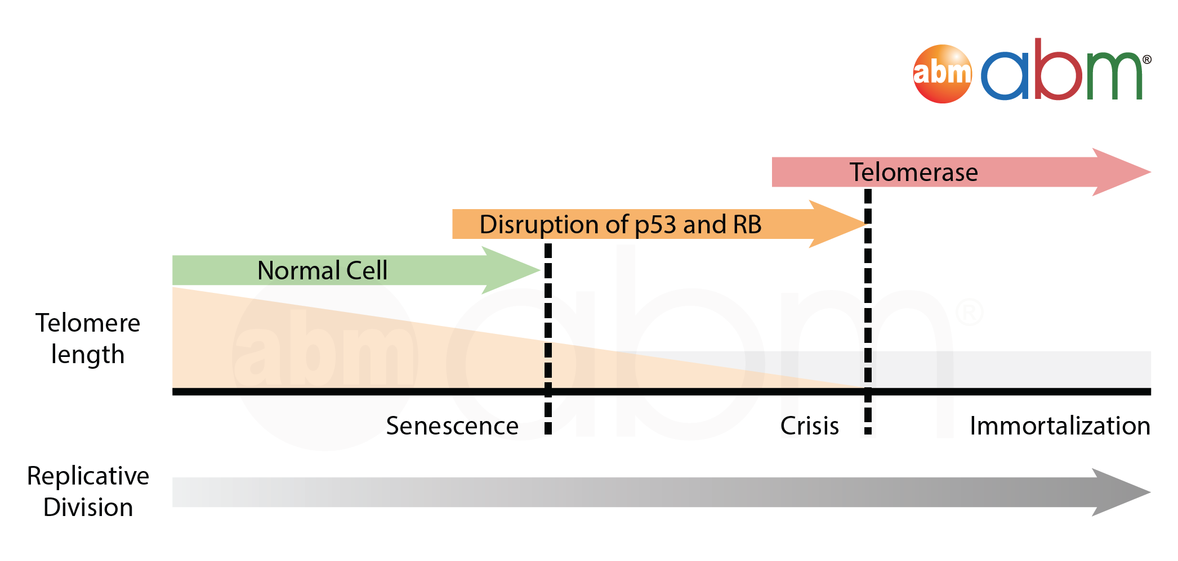

Slide 19
The immortalization workflow
There are two methods of performing the immortalization itself:
Method A:
Plasmid transfection
Method B:
Viral transduction

Slide 20
Method A:
Plasmid transfection
One way to introduce the immortalizing agent (i.e. hTERT, SV40T antigen) into the cells is DNA transfection
DNA transfection methods include electroporation, lipofection,
Primary cells are less susceptible to DNA transfections and as such, many use the viral transduction method

Slide 21
Method B:
Viral transduction
Primary cells are known to be difficult-to-transfection but receptive to recombinant viral transduction, especially adenoviral and lentiviral particles.
The lentiviral transduction method, in particular, results in the stable integration of your gene of interest into the host genome for long term gene expression

Slide 22
Basic workflow steps to help for understand of the cell immortalization
Step 1:
Seed the cells so that they are 50-60% confluent. Incubate overnight.
Step 2:
Infect the cells with a variety of cell immortalization reagents (e.g. lentiviruses). Combinations can be tried if necessary.
Step 3:
Remove virus from the cells and replace with fresh growth medium.

Slide 23
Step 4:
Monitor the cell's growth rate and morphology. Grow infected cells in parallel with control cells to assess the proliferation rate.
Step 5:
Use qRT-PCR to test for transgene expression.

Slide 25
Cell line quality control considerations
There are few important quality control checks for to ensure cell line is in perfect condition
Characterization of Your Cell Line
Passaging and Transgene Expression Test
STR Profiling
Mycoplasma and Pathogen Detection

Slide 26
Characterization of Your Cell Line
After every immortalization, always check cells for the proper markers, as well as the cell’s functionality to make sure it represents the primary cells that worked with. This step is especially important when we are studying cellular pathways because we would not want the immortalization step to have altered the specific pathway, function, or phenotype of the cells
For example, if have plan to use cells for a cytotoxicity assay, it is a good idea to perform a cytotoxicity assay with immortalized cells alongside the primary cells to ensure newly immortalized cells respond to stimuli in a manner comparable to their primary cell of origin

Slide 27
Passaging and Transgene Expression Test
Passage cells a minimum of 30 times to prove that the transgene has been stably expressed and to observe that growth rate has improved and density capability has increased

Slide 28
STR Profiling
It is of crucial importance that you verify the identity of your cell line as issues of cross-contamination or population mixing can occur. For example, according to a paper published in Science, the famous HeLa cells which are widely used in labs worldwide have been found to have contaminated many cell lines, including the Hep-2 and INT407 cell lines.
The gold standard for identifying cell lines is Short Tandem Repeat (STR) profiling. STR analysis is a method where short tandem DNA repeats at specific loci are compared to a standard reference profile. A cell line’s STR Profile can be used to confirm its identity and it is a good idea to do regular STR profile checks to ensure cell line has not been contaminated over time

Slide 29
Mycoplasma and Pathogen Detection
Finally, it is always a good idea to test for microbial contaminants such as fungus, bacteria and mycoplasma.
Mycoplasma, in particular, is one of the most common contaminants in cell culture laboratories. It is often difficult to detect Mycoplasma through the typical visual inspection under the microscope. However, this bacteria can affect the cell’s proliferation, change its gene expression profile, and other effects that can skew experimental results. There are many kits available PCR Mycoplasma Detection and Elimination kits, that can easily detect and remove over 50 types of Mycoplasma from cells.

Slide 30
References
Ahmed N, Maines-Bandiera S, Quinn MA, Unger WG, Dedhar S, Auersperg N. Molecular pathways regulating EGF-induced epithelio-mesenchymal transition in human ovarian surface epithelium. Am J Physiol Cell Physiol. 2006 Jun;290(6): C1532-42. Epub 2006 Jan 4.
Ben-Porath I, Weinberg RA. The signals and pathways activating cellular senescence. Int J Biochem Cell Biol. 2005 May;37(5):961-76. Epub 2004 Dec 30.
Ben-Porath I, Weinberg RA. When cells get stressed: an integrative view of cellular senescence. J Clin Invest. 2004 Jan;113(1):8-13. Review.
Lundberg AS, Hahn WC, Gupta P, Weinberg RA. Genes involved in senescence and immortalization. Curr Opin Cell Biol. 2000 Dec;12(6):705-9. Review.
Matsumura T, Takesue M, Westerman KA, Okitsu T, Sakaguchi M, Fukazawa T, Totsugawa T, Noguchi H, Yamamoto S, Stolz DB, Tanaka N, Leboulch P, Kobayashi N. Establishment of an immortalized human-liver endothelial cell line with SV40T and hTERT. Transplantation. 2004 May 15;77(9):1357-65.
Rosalie Sears, Faison Nuckolls, Eric Haura, Yoichi Taya, Katsuyuki Tamai, and Joseph R. Nevins. Multiple Ras-dependent phosphorylation pathways regulate Myc protein stability. Genes & Dev. 2000 14: 2501-2514.

Slide 31
Dimri G, Band H, Band V. Mammary epithelial cell transformation: insights from cell culture and mouse models. Breast Cancer Res. 2005;7(4):171-9. Epub 2005 Jun 3. Review.
Fridman AL, Tainsky MA. Critical pathways in cellular senescence and immortalization revealed by gene expression profiling. Oncogene. 2008 Aug 18.
Kirchhoff C, Araki Y, Huhtaniemi I, Matusik RJ, Osterhoff C, Poutanen M, Samalecos A, Sipilä P, Suzuki K, Orgebin-Crist MC. Immortalization by large T-antigen of the adult epididymal duct epithelium. Mol Cell Endocrinol. 2004 Mar 15;216(1-2):83-94. Review.
Stewart SA, Weinberg RA. Senescence: does it all happen at the ends? Oncogene. 2002 Jan 21;21(4):627-30. Review. Stewart SA, Weinberg RA. Telomeres: cancer to human aging. Annu Rev Cell Dev Biol. 2006;22:531-57. Review.
Thibodeaux CA, Liu X, Disbrow GL, Zhang Y, Rone JD, Haddad BR, Schlegel R. Immortalization and transformation of human mammary epithelial cells by a tumor-derived Myc mutant. Breast Cancer Res Treat. 2008 Jul 20.

Slide 32
Jha KK, Banga S, Palejwala V, Ozer HL. SV40-Mediated immortalization. Exp Cell Res. 1998 Nov 25;245(1):1-7. Review.
Yang G, Rosen DG, Colacino JA, Mercado-Uribe I, Liu J. Disruption of the retinoblastoma pathway by small interfering RNA and ectopic expression of the catalytic subunit of telomerase lead to immortalization of human ovarian surface epithelial cells. Oncogene. 2007 Mar 1;26(10):1492-8. Epub 2006 Sep 4.
Yang G, Rosen DG, Mercado-Uribe I, Colacino JA, Mills GB, Bast RC Jr, Zhou C, Liu J. Knockdown of p53 combined with expression of the catalytic subunit of telomerase is sufficient to immortalize primary human ovarian surface epithelial cells. Carcinogenesis. 2007 Jan;28(1):174- 82. Epub 2006 Jul 8.

Slide 33
THANK YOU

