Slide 1
CONTENTS:
Etymology
Definition of photosynthesis
General view of photosynthesis
Diagram
Light reaction
Mechanism
Conclusion

Slide 2
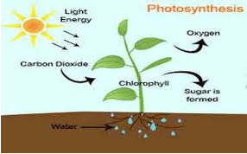
PHOTOSYNTHESIS:
Etymology:
Photo synthesis is basically a greek word; photo means light and synthesis means to put something together so photsynthesis gives meaning as to put something together in prescence of light
DEFINITION:
“carbohydrates formation from carbon dioxide and a source of hydrogen (such as water) in the chlorophyll-containing cells (as of green plants) exposed to light”
OR
“the complex process in which CO2, H2O, and certain inorganic salts are converted into carbohydrates by plants, algae, and certain bacteria, by the action of sunlight caused by chlorophyll”

Slide 3
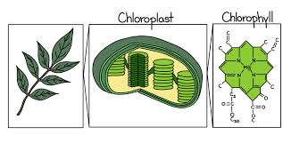
GENRAL EQUATION FOR PHOTOSYNTHES:
CO2(carbon
dioxide) + 2H2Owater + photon (sunlight energy) → [CH2O]carbohydrate + O2(oxygen) + H2O(water)n
In photosynthetic bacteria protein gathering light for the process of photosynthesis are embedded in cell membranes of bacteria. The membrane may be folded tightly into cylindrical sheets called as thylakoids ,or pilled up into vesicles called as intracytoplasmic membranes. Those thylakoids and intra cytoplasmic membranes can fill almost cell’s interior , increasing the surface area of the cell and increasing the absorbed amount of light
Chloroplast: As photosynthesis takes place in chloroplasts, so generally a plant cell contain about 10 to 100 chloroplasts in plants. The chlorophyll is enclosed by inner and outer membrane which contain intermembrane space between them. membrane is formed of phospholipids(both inner and outer) . there is aqueous fluid present inside the inner membrane called as stroma.

Slide 4
Stages of photosynthesis:
• Light dependent reactions
• Light independent reactions

Slide 5
LIGHT DEPENDENT REACTION
Light reactiontakes place in presence of light ,its also called as photochemical reaction or Hill reaction . in this light reaction light is being absorbed by chlorophyll and rich energy compounds ATP and NADPH formed.
There are three steps of light dependent reaction these are:
• Electron transport and phosphorylation
• Phototysis of water
• Reduction of NADP to form NADPH2

Slide 6
1. Electron transport and photophosphorylation:
Basically electron transport chain is series of complexes and photosystem I & II which transfer electron from splition of water to various complexes and in the end result in production of ATP & NADPH
“Formation of ATP , as a result of special processes is known as Phosphorylation.”
Thr pathway to which phosphorylation occur is electron transport chain. light reaction occur in chloroplast’s thylakoid membrane where chlorophyll present to capture sunlight. Basically two systems are involved in the electron transport hain , these are photosystem I and photosystem II. Various protien complexes are also pesent in electron transport chain such as plastoquinone, cytochrome, plastocyanin, ferredoxin,NADP reductase .

Slide 7
Non-cyclic phosphorylation:
In non-cyclicphosphorylation , the process in which electron that is excited by photon from reaction center doesnot return to its original position. This noncyclic phosphorylation completed out dueto collaboration of both photosystems in non cyclic phosphorylation end product is both ATP & NADPH. Water supply is necessary for this reaction. Major steps are:
i. chlorophyll b of the reaction centre absorb light of 680nm and get activated, releasing an electron. Electron get excited to the energy level of high state . this excited electron is then transferred to primary electron acceptor that is phaelophtin.
ii. From the primary electron acceptor electron is being sent to protein complex, Plastoquinone(PQ) and this complex is associated withFe ions.
iii. Then plastoquinone convey this electron to another complex which is cytochrome complex. (cytochrome F and cytochrome b6.).
iv. From cytochrome complex electron is being conveyed to another protein complex, plastocyanin. Plastocyanin is a reduced protein and is present in lumen, it is associated with copper.
v. From cytochrome F to b6 ATP formation occurs
vi. Plastocyanin conveys electron to PS I , here chlorophyll a present in reaction center, which absorb light at 700nm.
viii. Then electron is sent to Ferredoxin reducing substrate, its primary acceptor of this system
ix. From prmary acceptor electron is delivered to Ferredoxin . it is iron containing protein.
x. From ferredoxin electron is conveyed to NADP where NADP reductase reduces NADP to NADPH.
AS a result ATP & NADPH are final products formed in this non cyclic

Slide 8
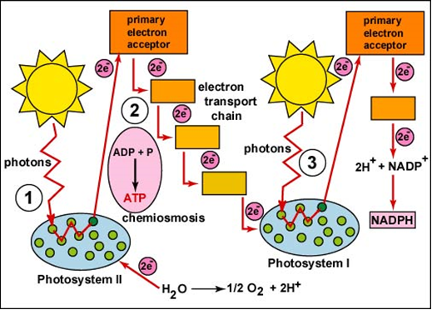

Slide 9
Cyclic-phosphorylation:
“In some cases electrons do come back to their original position when get excited by photons and combination with various complexes”
It is regarded as formation of ATP solely by photosystem I. this system can be found in photosynthetic bacteria. This type of photophosphorylation occurs on the stroma lamella. In cyclic photophosphorylation, from P700 of PS1 high energy electrons comes down in a cyclic pathway. In cyclic electron flow, the electron excited in a pigment complex called photosystem I, passes from the primary acceptor that is ferredoxin reducing substrate, to ferredoxin and then to plastoquinone, then flows to cytochrome b6f , and then flows to plastocyanin before returning back to Photosystem-1. This electron transport chain motivates a proton-motive force, that pumps H+ ions across the membrane; producing a concentration gradient used to power ATP synthase during chemiosmosis. This pattern is called as cyclic photophosphorylation, and it doesnot form O2 and NADPH. In cyclic photophosphorylation, NADP+ does not accept the electrons; they move back to cytochrome.This single photosystem is used by bacteria for photosynthesis, and therefore perform cyclic photophosphorylation. It is favorable during anaerobic condition.

Slide 10
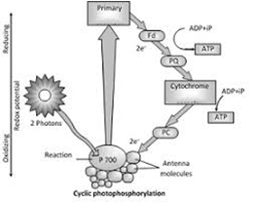

Slide 11
Photolysis of water:
The photolysis of water (H2O) in the ligh dependent reactions of photosynthesis is splitting of water which produced electron used to fill up the space, formed as a result of excitation of photosystem II in chloroplasts. Following equation describes splitting of water:
H2O → 2H+ + 2e- + 1/2O2
Oxygen is flowed out from plant to outer atmosphere as a waste product in light reaction.
Electrons are going to replace those place where photoexcitation from chlorophyll a in the reaction center of photosystem II occurs, and electrons excited from chlorophyll help in formation of ATP and reduction of NADP to NADPH

Slide 12
Reduction of NADP compound:
What is NADPH ?
NADP+ Produce NADPH . Ferredoxin NADP reductase present after photosystem I, That become the major source of NADPH in plants algae and cyanobacteria etc. basically it appears in last stage o f ETC of light reaction in photosynthesis. It may be used as reducing power in calvin cycle for assimilation of carbon dioxide into glucose . it has ability to accept electron in other non photosynthetic pathways as well i.e it is needed in reduction of nitrate into ammonia that is necessary for plant and to maintain nitrogen cycle.
Reduction of NADP into NADPH:
When splitting of water occurs
, electrons, hydrogen ions and oxygen form. The hydrogen which gets seprated from water combines with a compound NADP to form NADPH . SO this way reduction take places. Hydrogen that is being attached with NADP, remain attached for a short period till it perform its function in dark reaction to form carbohydrates.
NADP + H2 → NADPH2
NADP + 2H → NADPH + H

