Slide 1
Simpson’s rule

Slide 2
Simpson’s 1/3rd rule
Trapezoidal rule was based on approximating the integrand by a first order polynomial, and then integrating the polynomial in the interval of integration. Simpson’s 1/3rd rule is an extension of Trapezoidal rule where the integrand is approximated by a second order polynomial.

Slide 3
Simpson’s 1/3rd Rule

Slide 4
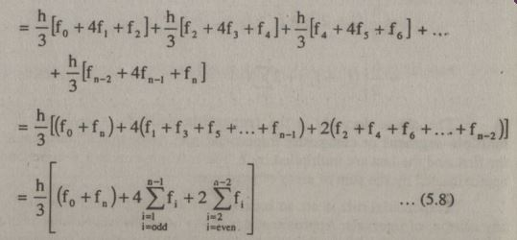
Simpson’s 1/3rd Rule
If n intervals are even in number than Simpson’s 1/3rd rule will be

Slide 5
Simpson’s 1/3rd Rule

Slide 6
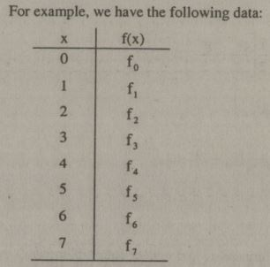
Combination of Trapezoidal and Simpson’s 1/3rd Rule

Slide 7
Combination of Trapezoidal and Simpson’s 1/3rd Rule
Notes:
I=IS+IT

Slide 8
Simpson’s 3/8th Rule

Slide 9
Simpson’s 3/8th Rule

Slide 10
Example

Slide 11
Example

Slide 12
Example

Slide 13
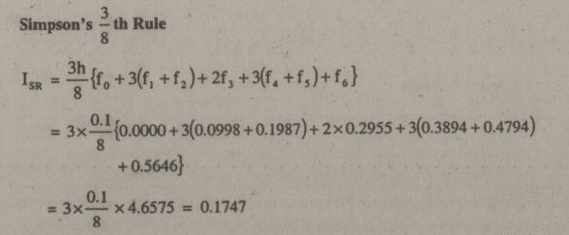
Example
Notes:
=3h/8{(f0+3(f1+f2)+f3)+(f3+3(f4+f5)+f6)}
=3h/8{f0+3(f1+f2)+2f3+3(f4+f5)+f6}

Slide 14
Example # 2
When function is given and n is known and h is not known
Then
n=8, h=?
h=(b-a)/n a=0 and b=2
h=(2-0)/8=0.25

Slide 15
Example # 2

Slide 16
Example # 2

