Slide 1
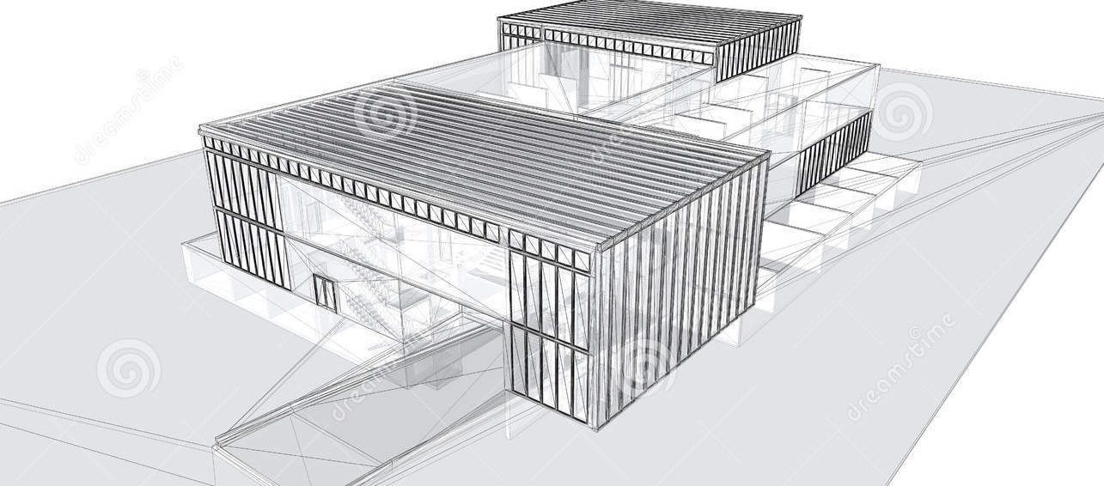
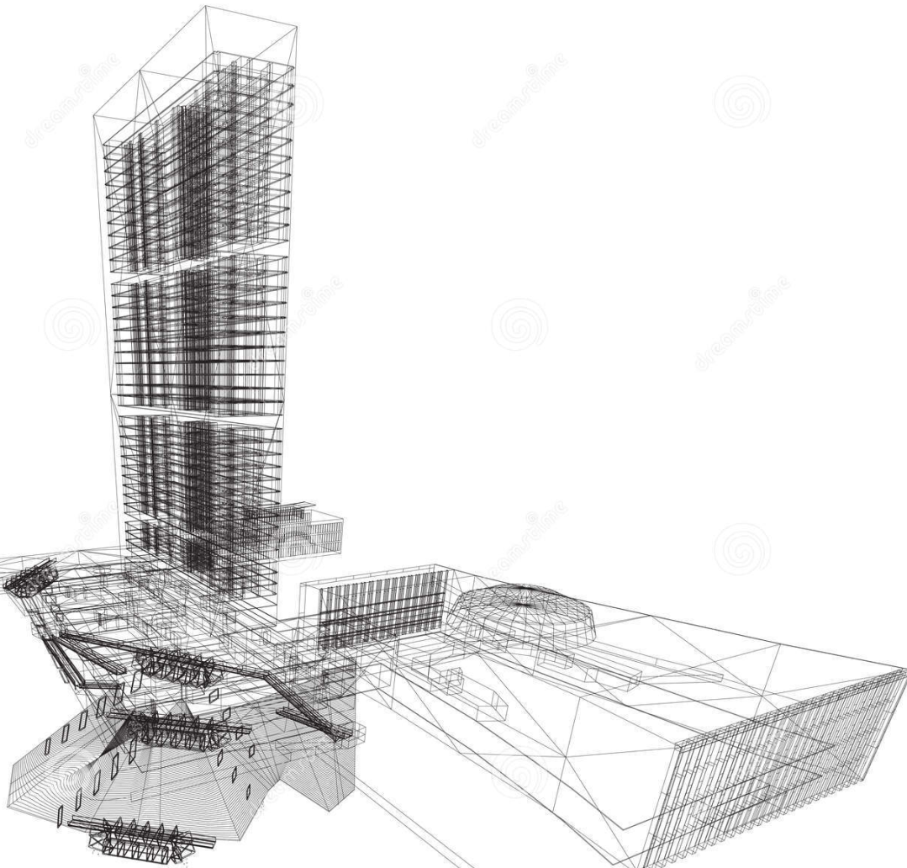
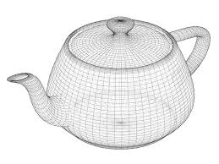
Computer Graphics Software and Data Base Wireframe vs Solid Modelling
A Wireframe Model is a skeletal description of a 3D object.
There are no surfaces in a wireframe model; it consists only of points, lines, and curves that describe the edges of the object.
You can create wireframe models by positioning 2D (planar) objects anywhere in 3D space. Some 3D wireframe objects may also be constructed.
This type of modeling can be the most time-consuming.

Slide 2
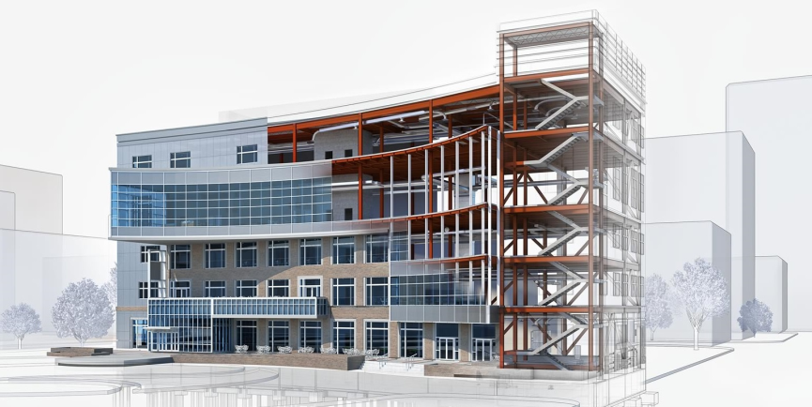
Computer Graphics Software and Data Base Wireframe vs Solid Modelling
Solid Modeling is the easiest type of 3D modeling to use.
With the solid modeler, you can make 3D objects by creating basic 3D shapes: boxes, cones, cylinders, spheres, wedges, and tori (donuts). You can then combine these shapes to create more complex solids by joining or subtracting them or finding their intersecting (overlapping) volume.
You can also create solids by sweeping a 2D object along a path or revolving it about an axis. With Autodesk Mechanical Desktop, you can also define solids parametrically and maintain associativity between 3D models and the 2D views that you generate from them.

