Slide 1
transpiration

Slide 3
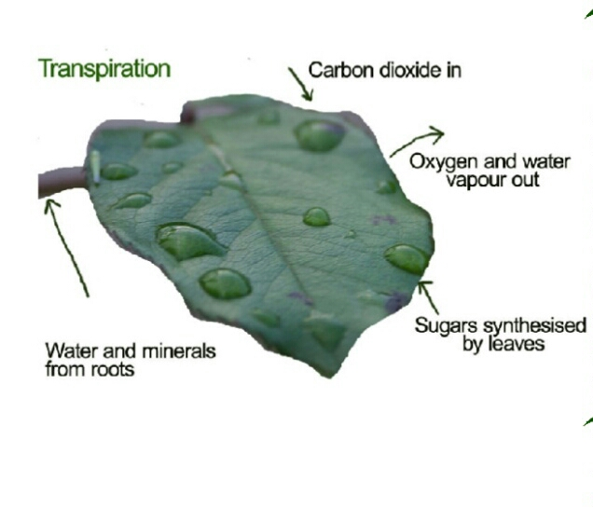

Slide 7
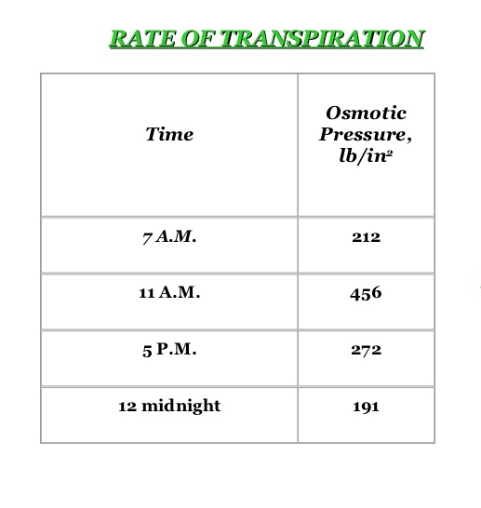

Slide 9
Types of transpiration
There are three types of transpiration.
Cuticular transpiration.
Lenticular transpiration.
Stomatal transpiration.

Slide 10
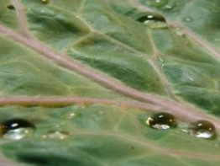
Cuticular transpiration:
The loss of water in the form of water vapours through the cuticle is called cuticular transpiration.

Slide 11
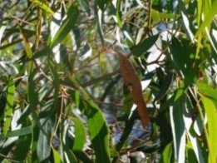
Lenticular transpiration:
Loss of water in the form of vapors taking place through the lenticels present in the woody stem and fruits is called lenticular transpiration.
It amounts 1-5 percent of the total water loss by the plant.

Slide 12
Stomatal transpiration:
Stomata are minute pores confined to epidermis of green shoot and leaves.
Opening and closing of stomata are controlled by guard cells.
Maximum loss (80-90% of the total water loss) of water from the plant tissues takes place through the stomatal openings.

Slide 13
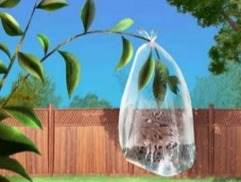
How much water do plants transpire?
During a growing season, a leaf will transpire many times more water than its own weight.
An acre of corn gives off about 3,000-4,000 gallons (11,400-15,100 liters) of water each day, and a large oak tree can transpire 40,000 gallons (151,000 liters) per year.

Slide 19
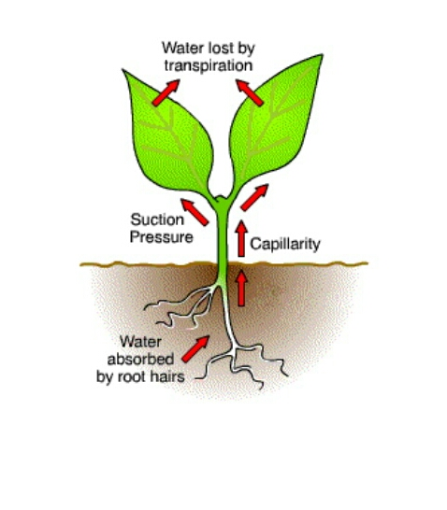

Slide 20
Antitranspirant:
Antitranspirants are the compounds applied to leaves of plants to reduce transpiration.
They are used on Christmas trees, on cut flowers, on newly transplanted shrubs, and in other applications to preserve and protect plants from drying out too quickly.
They have also been used to protect leaves from salt burn and fungal diseases.

Slide 21
Antitranspirants:

Slide 22
