Slide 1
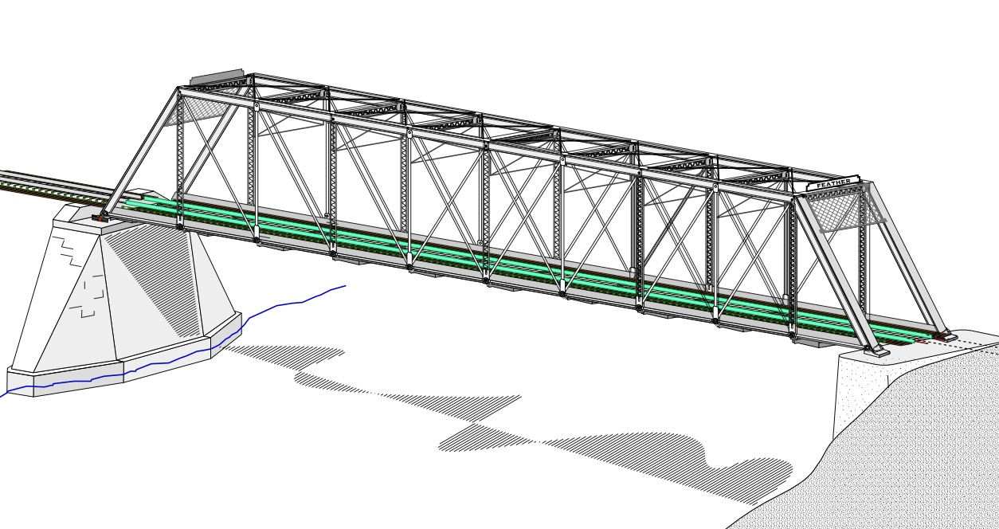
COLLEGE OF ENGINEERING AND TECHNOLOGY UNIVERSITY OF SARGODHA STEEL STRUCTURES (CT-313) (B.S TECHNOLOGY)
LECTURE-16, 17 & 18
DESIGN OF TENSION MEMBERS
Engineer Aqeel Ahmed
Lecturer, CET, UOS, Sargodha
20-Nov-2020

Slide 2
TENSION MEMBERS
DESIGN OF A TENSION MEMBER
The deign of a tension member involves finding of a member with adequate gross and net areas.
If the member has a bolted connection, the selection of a suitable cross section requires an accounting for the area lost because of holes.
For a member with rectangular cross section, the calculations are relatively straight forward. If the rolled section is to be used, the area to be reduced can not be predicted in advance because the members thickness at the location of the holes is not known.
A secondary consideration in the design of the tension members is slenderness ratio.

Slide 3
TENSION MEMBERS
DESIGN OF A TENSION MEMBER…………..
If a structural member has a small cross section in relation to its length. Its said to be slender.
A more precise measure is the slenderness ratio, L/r, where L is the length of the member and r is the minimum radius of gyration of the cross-sectional area.
The minimum radius of gyration is the one corresponding to the minor principal axis of the cross section. This value is tabulated for rolled shapes in the properties table in part 1 of the manual.

Slide 4
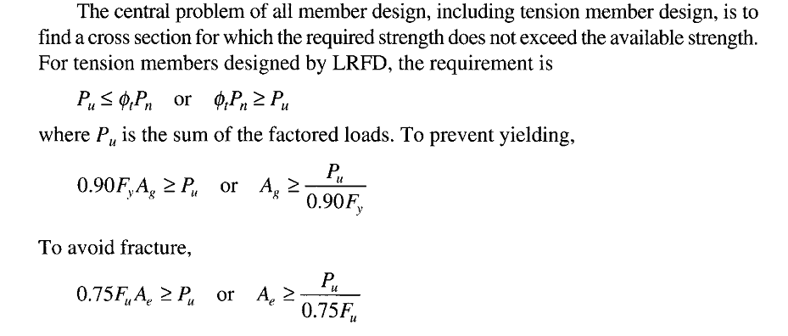
TENSION MEMBERS
DESIGN OF A TENSION MEMBER…………..

Slide 5
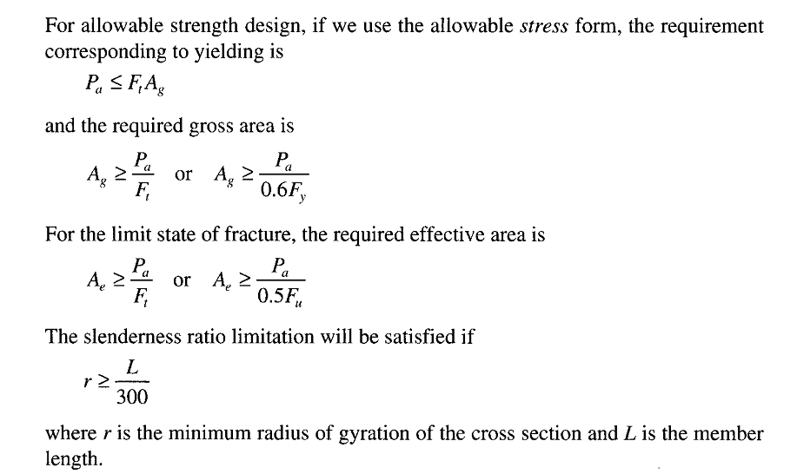
TENSION MEMBERS
DESIGN OF A TENSION MEMBER…………..

Slide 6
TENSION MEMBERS

Slide 7
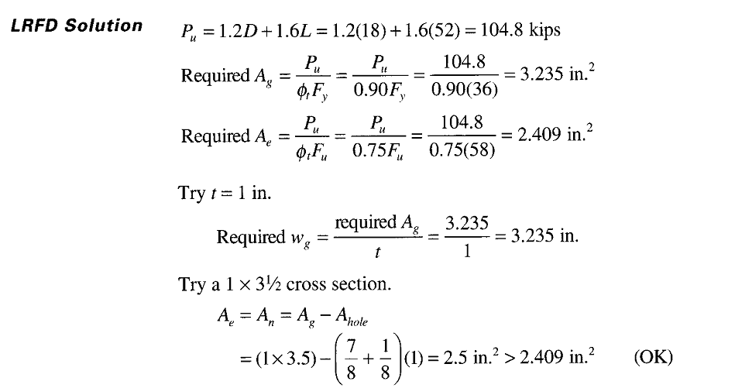
TENSION MEMBERS

Slide 8
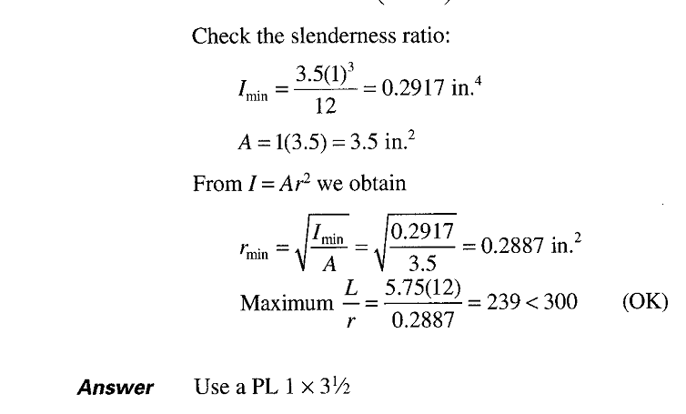
TENSION MEMBERS

Slide 9
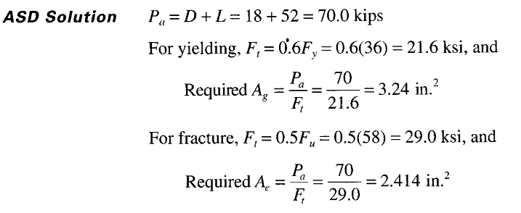
TENSION MEMBERS

Slide 10
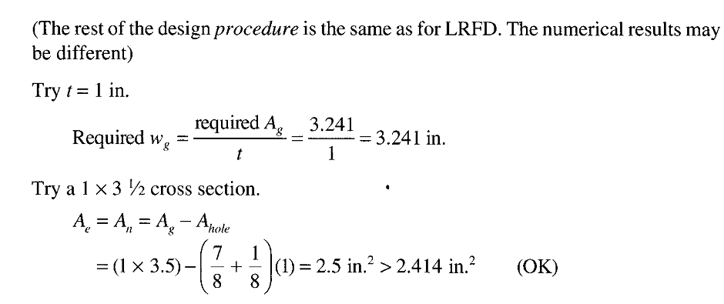
TENSION MEMBERS

Slide 11
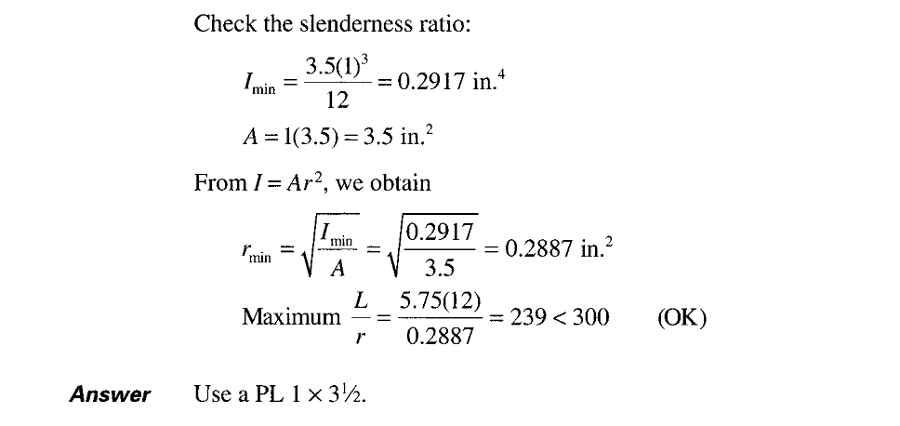
TENSION MEMBERS

Slide 12
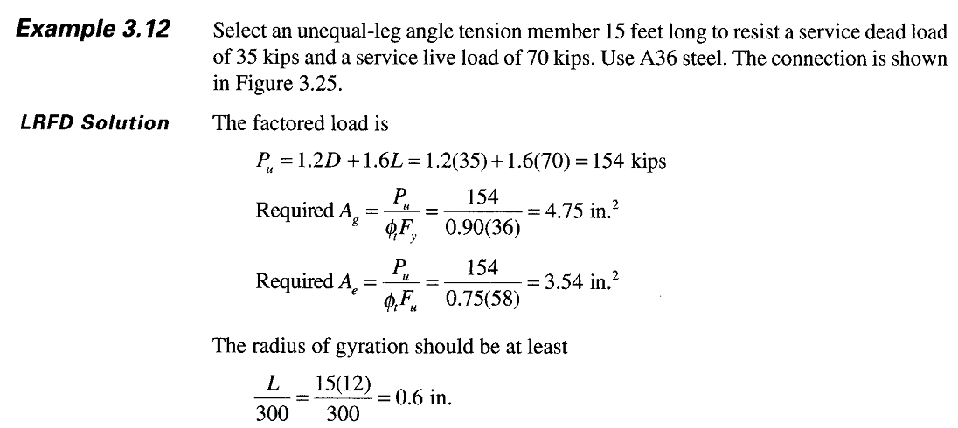
TENSION MEMBERS

Slide 13
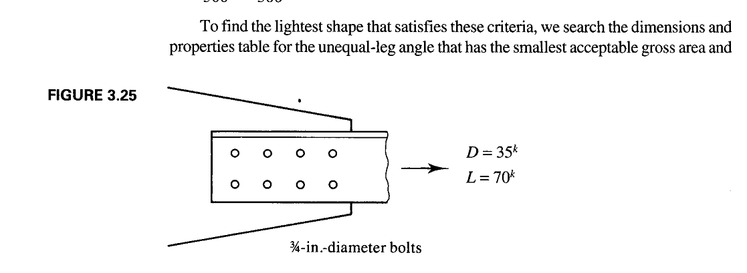
TENSION MEMBERS

Slide 14
TENSION MEMBERS
DESIGN OF A TENSION MEMBER…………..
If an angle shape is used as a tension member and the connection is made by bolting, there must be enough room for the bolts.
Space will be a problem only when there are two lines of bolts in a leg.
The usual fabrication practice is to punch or drill holes in standard locations in angle legs, these hole locations are given in a table in part 1 of the manual.
This table is located at the end of the dimensions and properties table for angles.
Figure 3.24 presents this same information.
Gage distance g applies when there is one line of bolts and g₁ and g₂ apply when there are two lines.
Figure 3.24 shows that an angle leg must be at least 5 inches long to accommodate two lines of bolts.

Slide 15
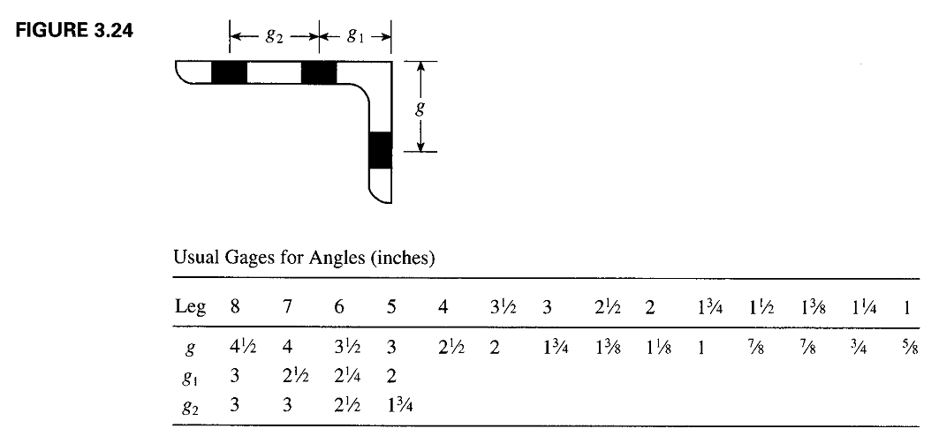
TENSION MEMBERS

Slide 16
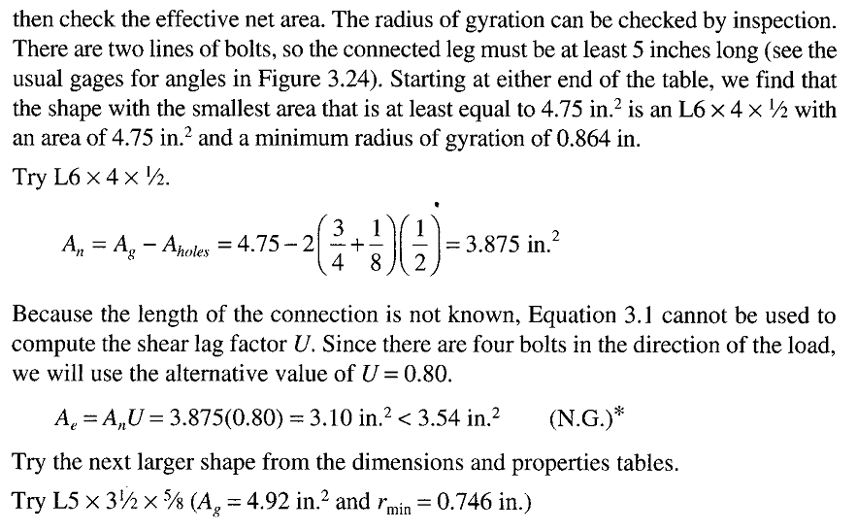
TENSION MEMBERS

Slide 17
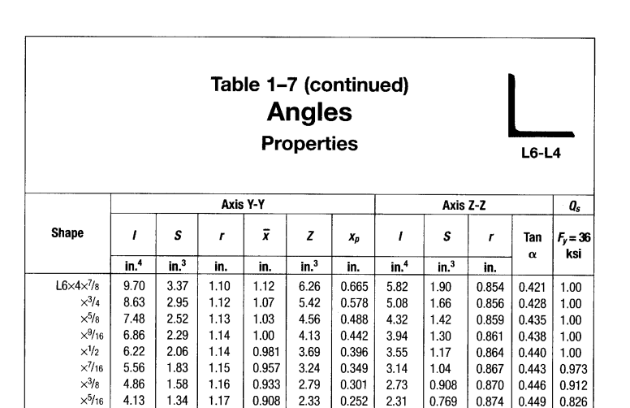
TENSION MEMBERS

Slide 18
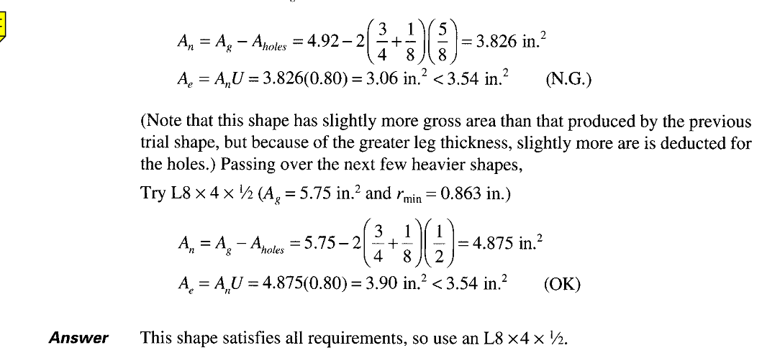
TENSION MEMBERS

Slide 19
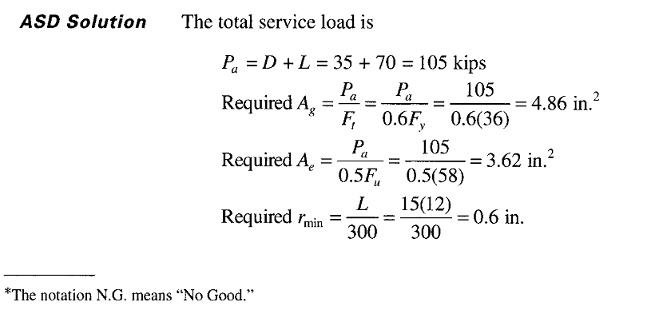
TENSION MEMBERS

Slide 20
TENSION MEMBERS

Slide 21
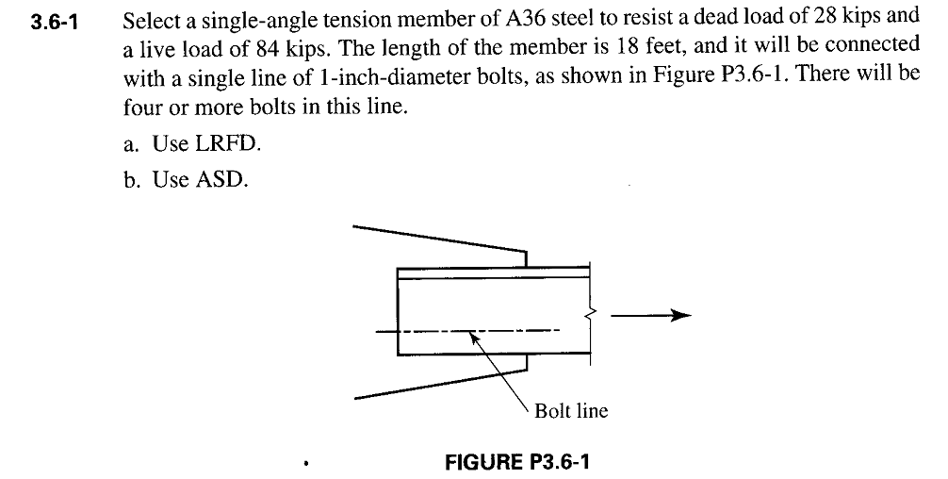
TENSION MEMBERS

Slide 22
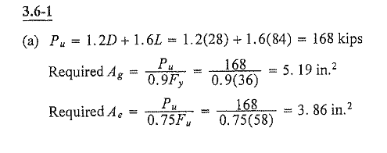
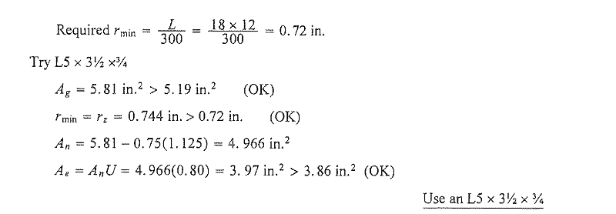
TENSION MEMBERS

Slide 23
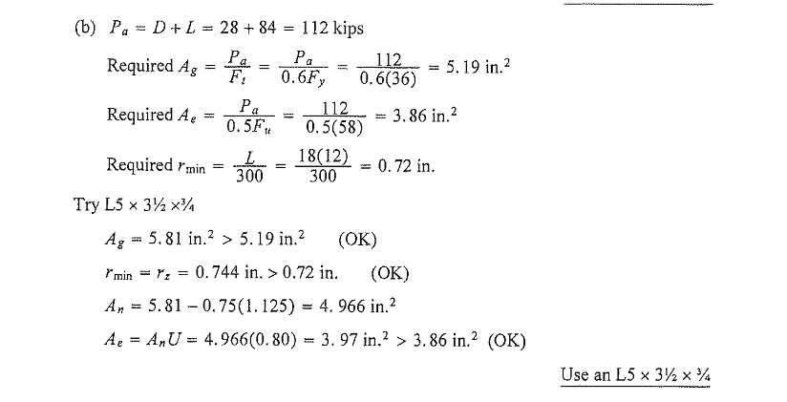
TENSION MEMBERS

Slide 24
TENSION MEMBERS

Slide 25
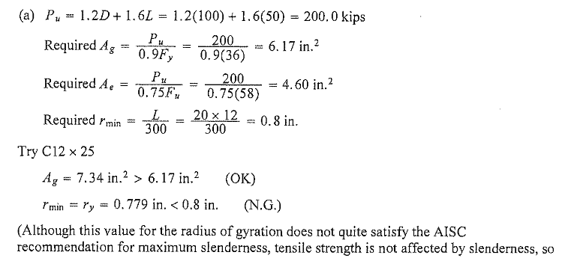
TENSION MEMBERS

Slide 26
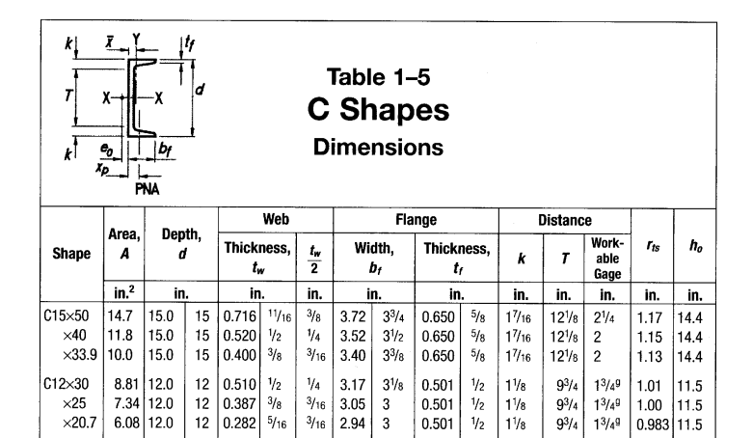
TENSION MEMBERS

Slide 27
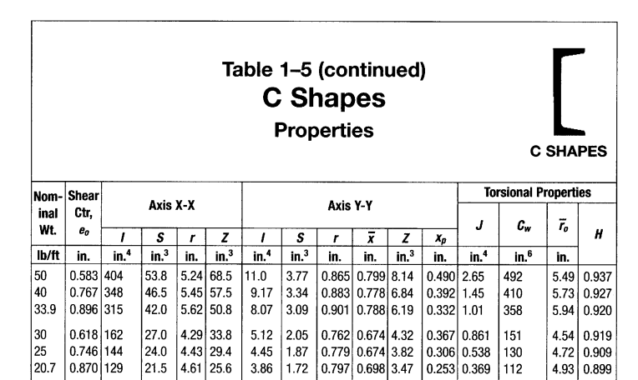
TENSION MEMBERS

Slide 28
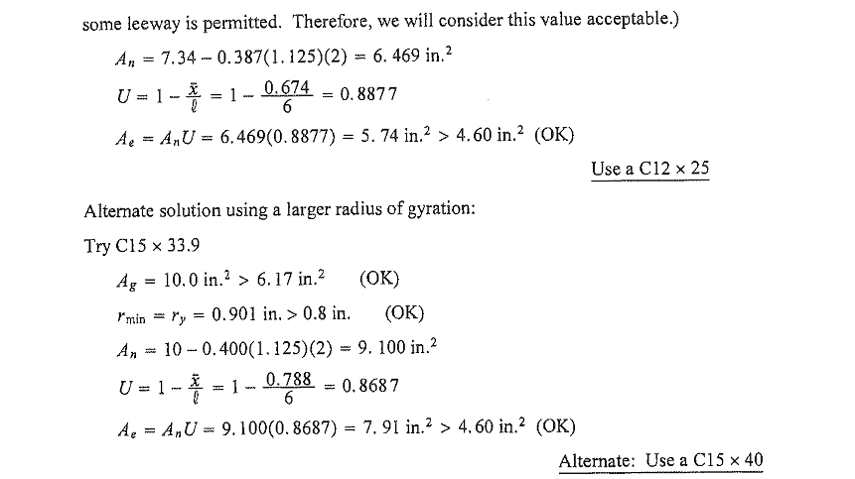
TENSION MEMBERS

Slide 29
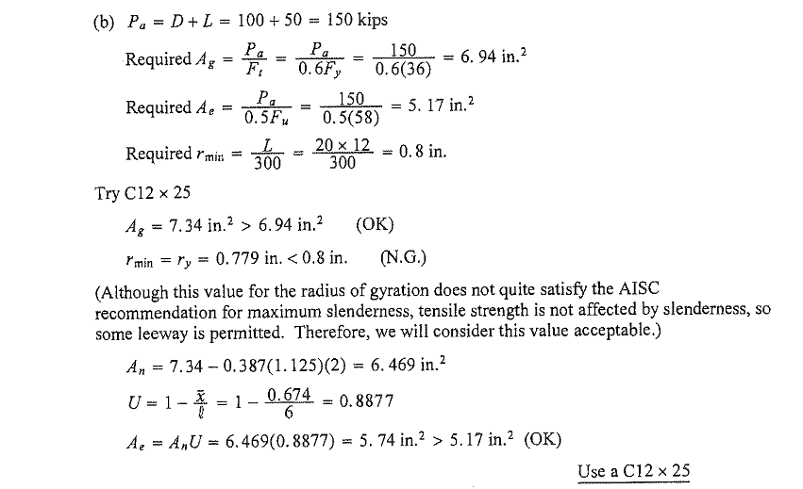
TENSION MEMBERS

Slide 30
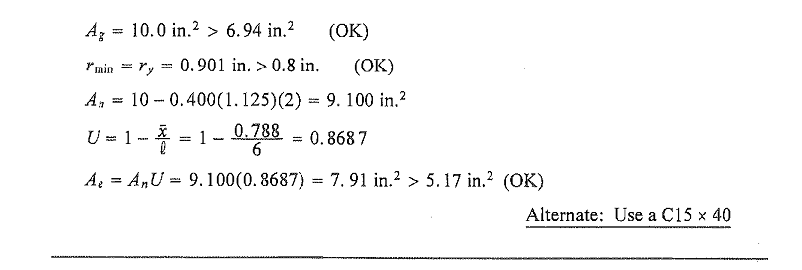
TENSION MEMBERS

