Slide 1
Histology of Large Intestine

Slide 2
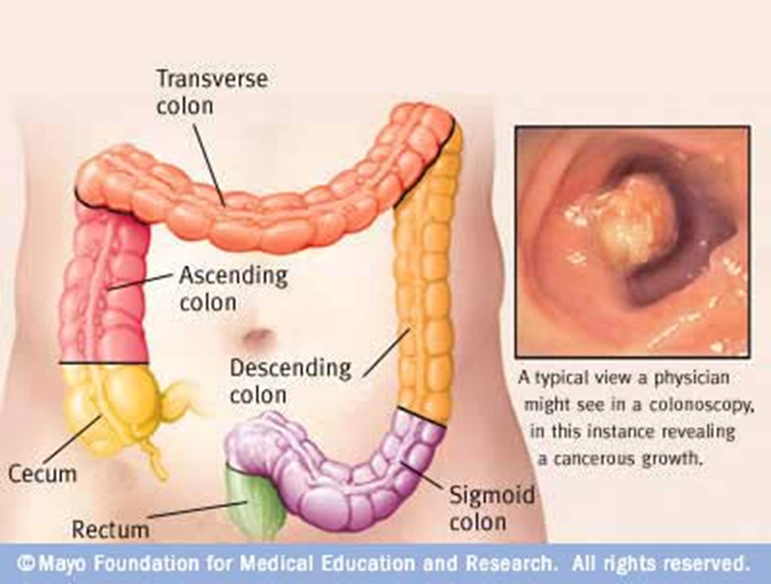
Large Intestine
Caecum
Colon
Rectum
Anal canal
Main functions
Absorption of water
Formation of faecal mass
Production of mucus

Slide 3
Histology of Large intestine
Mucosa
Submucosa
Muscularis
Serosa

Slide 4
Common features
Mucosa
Epithelial lining, lamina propria of loose connective tissues rich in blood, lymph vessels and smooth muscle cells and muscularis mucosae.
Submucosa
Dense connective tissues with many blood and lymph vessels.
Muscularis
Contains smooth muscle cells, divide into 2 layers; internal (circular); external (longitudinal)
Serosa
Thin layer of loose connective tissue rich in blood and lymph vessels and adipose and single squamous covering epithelium (mesothelium)

Slide 5
Colon
No plicae circularis
No villi
Typical four layers
Mucosa
Submucosa
Muscularis externa
Serosa

Slide 6
Large intestine (Colon)
Mucosa:
The epithelium formed of simple columnar ciliated epithelium.
The epithelium is folded and formed straight glands
Two types of cells are present
Mucus cells for secretion of mucus
Brush cells for absorption of water
The mucus cells increase and the brush cells decrease toward the anal canal.

Slide 7
The crypts of lieberkhun is lined by colonocyte and goblet cells.
The lower 2/3 of these glands are lined by mainly goblet cells and some enteroendocrine and stem cells also present
Paneth cells are entirely absent.
Lamina propria:
Rich in lymphatic tissue, blood vessels, lymphocytes, plasma cells, collagen
Muscularis mucosa:
A thin layer of smooth muscle (inner circular and outer longitudinal)

Slide 8
Submucosa:
Consist of dense connective tissue ,blood vessls,lymphatics and meissner’s plexus of nerves.
Muscularis externa:
Inner circular layer of smooth muscle
Outer longitudinal layer of smooth muscle
Teniae Coli:
Are three separate longitudinal ribbons or bands (taeniae meaning ribbon in latin) of smooth muscle on the outside of the ascending, transverse, descending and sigmoid colons

Slide 9
Serosa /Adventitia:
Transverse colon and sigmoid colon is completely surrounded by serosa.
Anterior surface of ascending and descending colon is covered by serosa while their posterior surface is covered by adventitia.

Slide 10
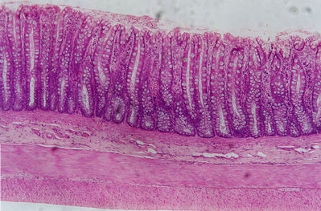
Large Intestine

Slide 11
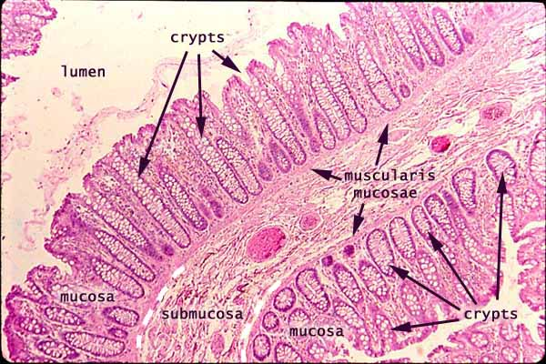
Large intestine

Slide 12
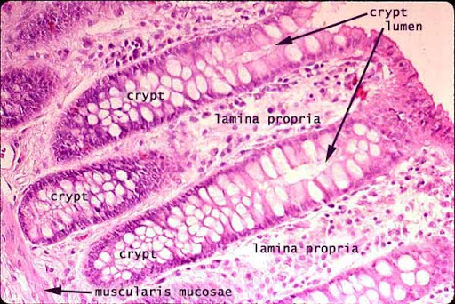

Slide 13
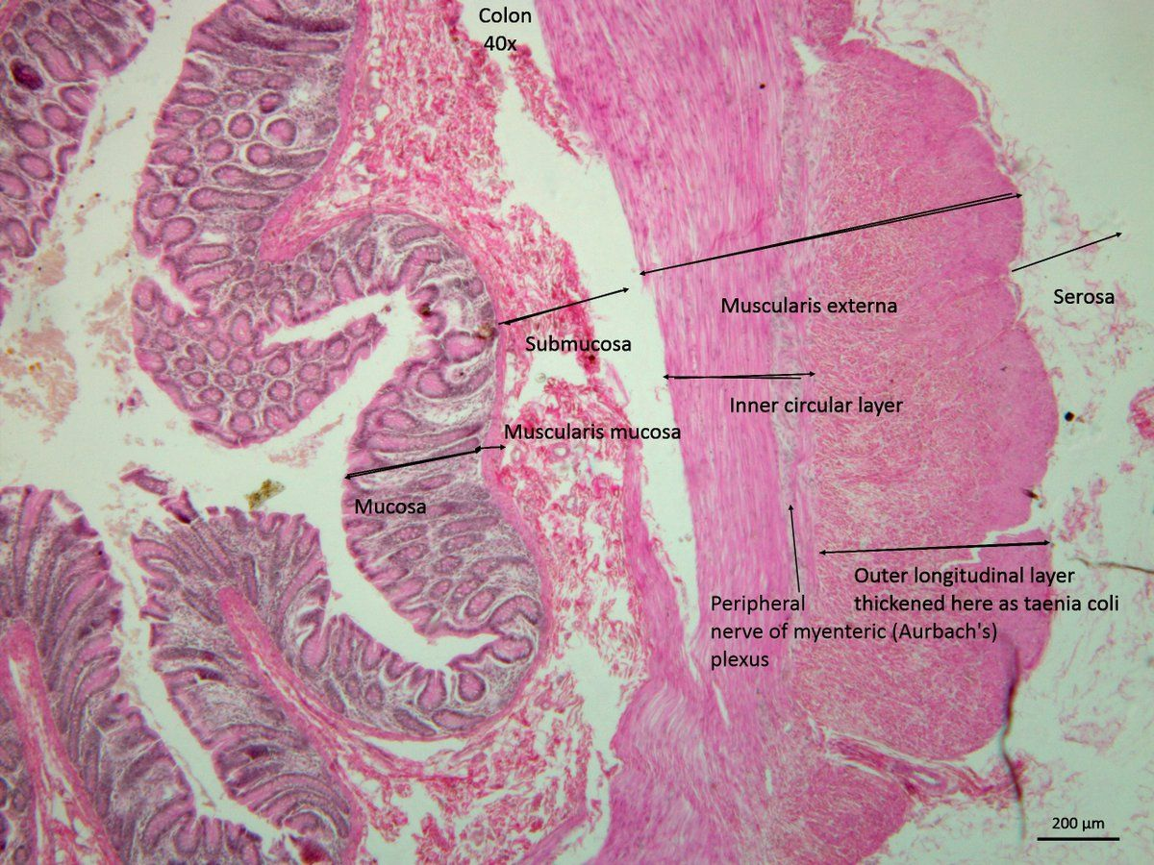

Slide 14
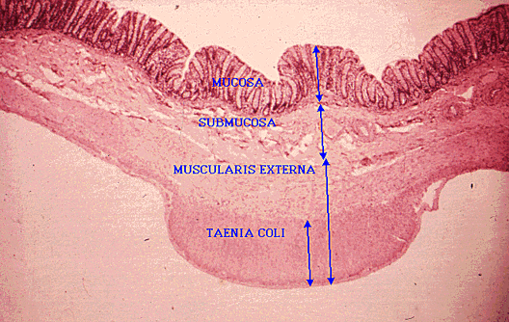

Slide 15
Appendix
A worm like structure present below the ileocecal orifice.
Intestinal villi are absent
Few goblet cell
Intestinal glands are also fewer.
Structurally the wall consists of
Mucosa
Submucosa
Muscularis externa
Serosa

Slide 16
Mucosa:
Consist of simple columnar epithelium.
The epithelial cells are absorptive in nature with few goblet cells.
Lamina propria:
Is a connective tissue layer containing lymphatic nodules that extend into the submucosa.
Mucularis Mucosa is not well developed

Slide 17
Submucosa:
Is a connective tissue layer containing numerous fat cells.
Muscularis externa:
Forms a complete outer longitudinal and inner circular layer of smooth muscle.
Serosa:
The appendix is covered by serosa.

Slide 18
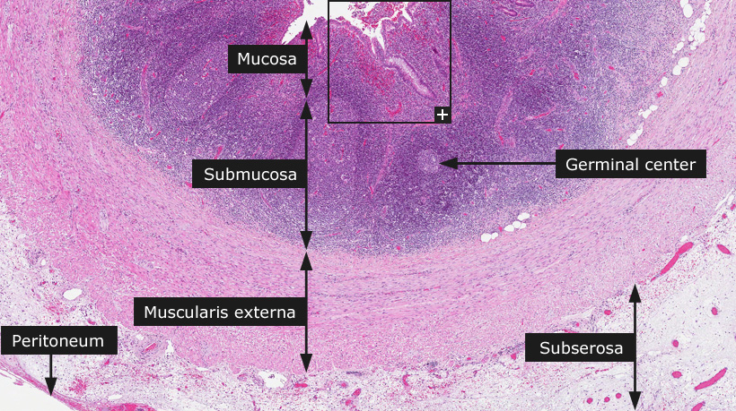

Slide 19
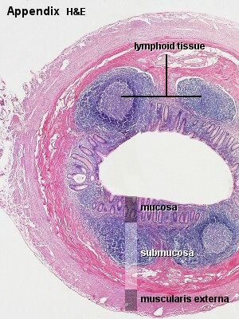

Slide 20
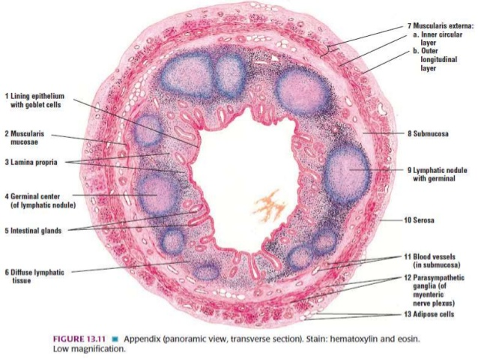
Appendix

Slide 21
Rectum
Mucosa:
Consist of simple columnar epithelium.
goblet cells are numerous.
Lamina propria:
Is a layer of connective tissue containing crypts which are lined almost by goblet cells.
Mucularis Mucosa:
Consist of inner circular and outer longitudinal.

Slide 22
Submucosa:
Is a connective tissue layer containing blood vessels .
Muscularis externa:
Forms a complete outer longitudinal and inner circular layer of smooth muscle.
adventitia:
Rectum is covered by adventitia .

Slide 23
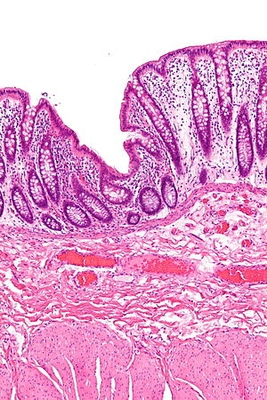
Rectum

Slide 24
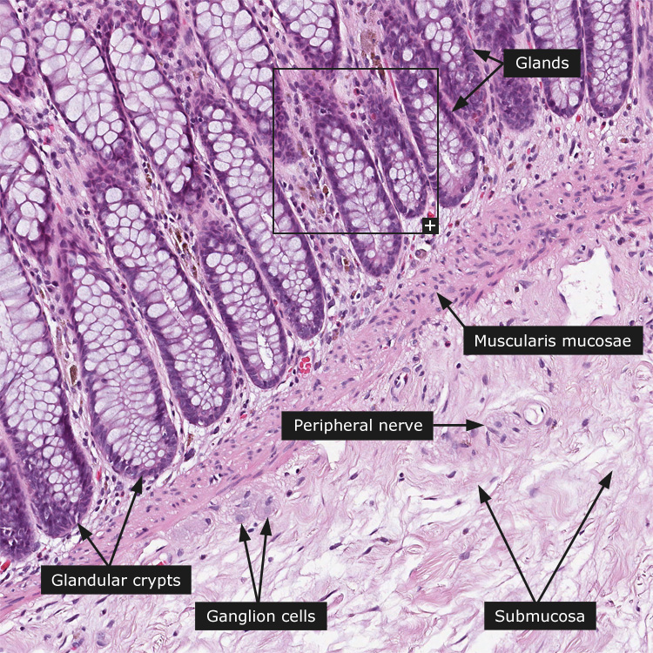
Rectum

Slide 26
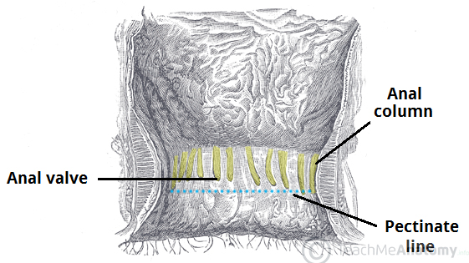
Anal canal
Is the terminal part of alimentary tract.
Anal canal shows longitudinal folds of mucosa called anal columns.
The depression between anal columns are called anal sinuses.
The anal valves are small valve-like folds at the lower ends of the anal sinuses in the rectum.

Slide 27
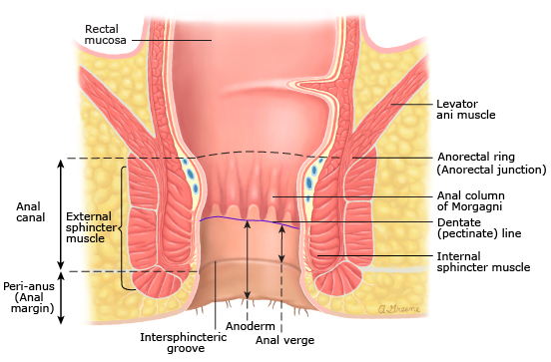

Slide 28
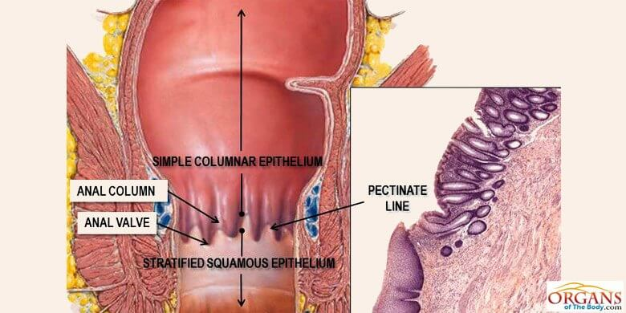

Slide 29
Anal canal
Mucosa:
Above the anal valve the mucosa is lined by simple columnar epithelium consisting of absorptive cells and goblet cells.
Below the anal valve the epithelium is stratified squamous non keratinized.
Lamina propria:
Dense connective tissue and contains crypts of lieberkhun above the anal valves but completely absent below it.
Muscularis mucosa
Consist of inner circular and outer longitudinal layers of smooth muscle above the anal valves.

Slide 34
Appendix
Star shaped lumen
Mucosa: Simple columnar epithelium with many goblet cells, Lamina Propria, Muscularis Mucosae
Submucosa: Contain blood vessels and nerves Muscularis Externa: Inner circular and outer longitudinal muscles. No taenia coli
Serosa: Visceral layer of peritoneum

Slide 35
Appendix

Slide 36
The anal canal
Definition: it is the lower part of the large intestine
It is function to give passage for the feces out side the body

Slide 37
The histological structure of the anal canal
The mucosa: the upper part of the anal canal lined by simple columnar while the middle part lined by stratified squamus non keratinized epithelium and the lower part lined by skin
The mucosa fold and formed the anal columns
The lamina proporia: formed of collagen fibers support the mucosa
The sub mucosa: it is formed of loose tissue contain blood vessel, nerve fibers and lymphatic

Slide 38
The musculosa
It is formed of inner circular layer which is thick at the lower part and outer longitudinal layer. There is skeletal muscles cover the outer longitudinal layer
The serosa: formed of connective tissue to support the anal canal with the surrounded tissue

Slide 39
Anal canal

