Slide 1
Industrial uses OF PLANT & CELL TISSUE CULTURE

Slide 2
INTRODUCTION :
Tissue culture
This term used for “the process of growing cells artificially in the laboratory”
Plant tissue culture
Technique of growing plant cells, tissues, and organs in an artificially prepared nutrient medium under aseptic condition.

Slide 3
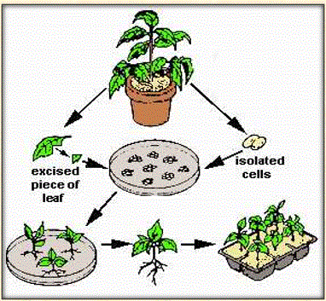
REQUIREMENT OF TISSUE CULTURE:
Appropriate tissue (explant)
Growth regulators
Aseptic (sterile) conditions
Frequent sub culturing
A suitable growth medium

Slide 4
SHORT HISTORY :
Gottlieb Haberlandt (1902) (father of plant tissue culture)
Cultured isolated single palisade cells from leaves in Knop's salt solution enriched with sucrose
Morel & Martin (1952)
Meristem-tip culture for disease elimination They recovered for the first time, virus- free Dahlia plants
Morel 1960 & Wimber 1963
Disease eradication & in vitro production of orchids
Murashige and Skoog(1962)
Developed a universally used high salt medium containing mineral salts, vitamins, an energy source and growth hormone (MS medium)

Slide 5
USES OF PLANT & CELL TISSUE CULTURE:
Micro propagation
Germplasm preservation
Embryo rescue production
Artificial seed production
Production of Virus free plants
In vitro hybridization – protoplast fusion
Dihaploid production
Cell suspension cultures
Soma clonal variation

Slide 6
MICRO-PROPAGATION :
Large scale production of genetically identical clones in vitro is called Micro-propagation
Millions of shoot tips from a small piece of plant tissue in a short period of time and space
Maintain Genetically uniform progeny
Can produce exact copies of plants required that have desirable traits
Supplies plant throughout the year irrespective of seasonal variation
Micro propagation of Orchids demonstrated profit all over the world

Slide 7
CONTI……….
Many crops like banana, papaya, potato, gerbera, carnation, Anthodium, apple, pear, cherry etc have been grown through micro propagation are commercially exploited
Development of disease resistant crops .Some valuable clones recovered from virus are
Tobacco- TMV, Sugarcane-Mosaic virus ect.
Somatic embryogenesis with synthetic seed production or artificial seed technology is very promising

Slide 8
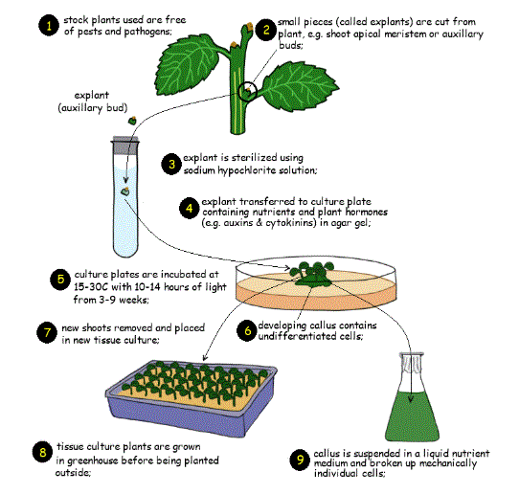

Slide 9
GERMPLASM CONSERVATION:
Plants vulnerable to pathogen, insects and various climatic hazards and plants with early embryo degeneration that are difficult to maintain
Plant species which are endangered, rare threatened with extinction are needed to be conserved by ex-citu method of germplasm conservation
Provides cost effective alternative to growing plants under field condition , nurseries or green houses
Cryopreservation of germplasm is really effective in conservation biotechnology

Slide 10
EMBRYO CULTURE:
To raise the rare hybrids by rescuing embryo from incompatible crosses is the most popular application
The production of embryos from somatic or “non-germ” cells
Seed dormancy can be overcome
Circumvent post zygotic barriers

Slide 11
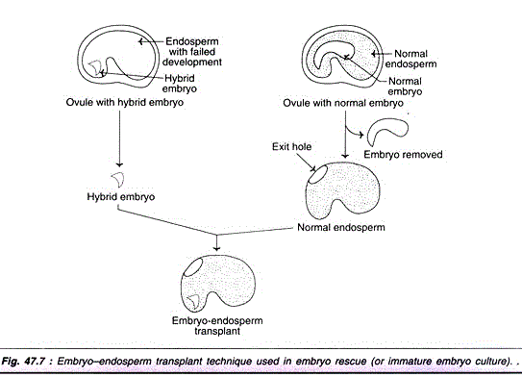

Slide 12
ARTIFICIAL SEED PRODUCTION:
Synthetic or artificial seeds (living seed-like structure)
Totipotent cells (somatic embryos or meristem tips etc.)
Artificially encapsulated by chemicals (hydrogels)
Behave like true seeds if grown in soil
Substitutes of true seeds

Slide 13
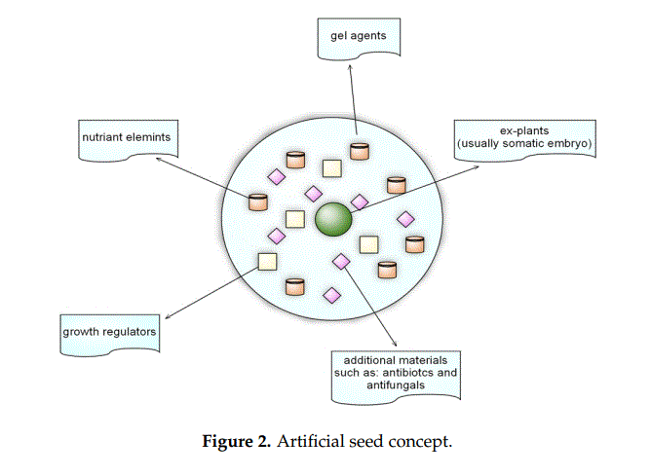

Slide 14
PRODUCTION OF VIRUS FREE PLANTS:
Plants maybe infected with one or more pathogens
There is no commercially available treatment to cure the plant
Micro propagation provides a rapid method for production of plants
Apical meristems are utilized for the production of virus free plants

Slide 15
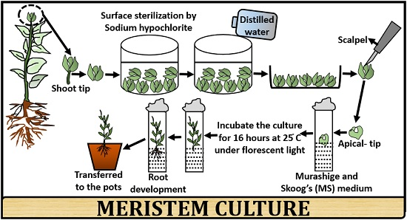

Slide 16
APPLICATIONS:
To conserve genetic variation and save industrially important species
To facilitate micro propagation techniques to produce large number of these virus free plants
R & D
Production of virus free plant for safe germplasm transfer

Slide 17
CONT…………
Plantlets derived from shoot-tip or meristem cultures are easily accepted by authorities for international exchange contributing to better efficacy of crop improvement programs between different countries of the world.

Slide 18
Protoplast fusion and generation of novel hybrid production:
Protoplast fusion
is a type of genetic modification in plants by which two distinct species of plants are fused together to form a new hybrid plant with the characteristics of both.
Why is it important?

Slide 19
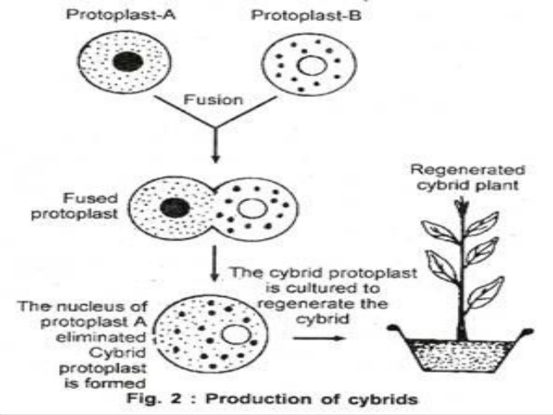

Slide 20
PROTOPLAST FUSION APPLICATION:
Transfer genes for a desired quality and quantity of production such as higher bio product productivity, improved protein quality, heat and cold resistance etc.
Novel hybrid plant production
Regeneration of entire plant or plant improvement through protoplast culture
Single cell cloning can be easily performed using protoplast culture.
Foreign DNA insertion

Slide 21
SOMACLONAL VARIATION:
The “soma” means the somatic cell and “clones” means the generation
According to larkin and scowcroft “soma clonal” variation is the genetic variation which is regenerated during tissue culture.
Calliclone (clones of callus),mericlone(clone of meristem),and protoclone(clone of protoplast) are produced
Variation in number and structure of chromosomes are commonly observed

Slide 22
CAUSES OF SOMACLONAL VARIATION:
Physiological cause
Exposure of culture to growth regulators.
Culture condition.
Genetic cause
Change in chromosomes number
Chang in chromosome structure
Gene mutation
Change in DNA sequence

Slide 23
CONT…
Biochemical cause
Lack of photosynthetic ability due to alteration in carbon metabolism
Nitrogen metabolism
Antibiotic resistance

Slide 24
APPLICATIONS OF SOMACLONAL VARIATION:
Production of ergonomically useful plants:
Several novel variants of existing crops have been developed, pure thorn-less blackberries
List of crops with useful and improved morphological characters are
Rice, wheat, maize, sugarcane, potato, carrot ect.
Resistance to diseases:
Largely contributed towards the development of disease resistance in many crops like rice, wheat, maize, sugarcane, tobacco, apple, tomato

Slide 25
3. RESISTANCE TO ABIOTIC STRESSES:
It has been possible to develop biochemical mutants with abiotic stress resistance.
Freezing tolerance e.g. wheat.
Salt tolerance e.g., rice, maize, tobacco.
Aluminum tolerance e.g., carrot, sorghum, tomato

Slide 26
4) RESISTANCE TO HERBICIDES:
Tobacco resistant to glyphosate, sulfonylurea and picloram
Carrot resistant to glyphosate
Lotus resistant to 2, 4-dichlorophenoxy acetic acid (2, 2-D).
5) IMPROVED SEED QUALITY:
A new variety of Lathyrus sativa seeds (Lathyrus Bio L 212) with a low content of neurotoxin has been developed through somaclonal variations.

Slide 27
HAPLOID&DIHAPLOID PRODUCTION:
Anther or Ovary/ovule culture
Dihaploidy is the state in which the nucleus contains two copies of the same haploid genome.
A cell showing dihaploidy is called a dihaploid
Development of homozygous lines
Fixation of heterosis
Mutation studies and easy to induce mutation
Production of biotic and abiotic stress resistant plants

Slide 28
CONT……….
Cytogenetical research
Induction of genetic variability at haploid level
Double haploids in genome mapping
Evolutionary studies
QTL analysis

Slide 29
Different methods to induce double haploid
In-vitro method
In-vivo method
Haploids from male gametes
Anther culture
Pollen/Microspore culture
Haploids from female gametes
Ovary slice culture
Ovule culture
Chromosome elimination
Bulbosome method
Parthenogenesis
Pseudogamy
Semigamy
apogamy
Inducer based approach

Slide 30
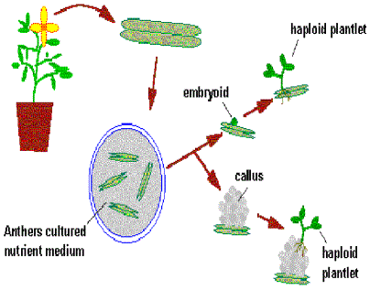

Slide 31
CELL SUSPENSION CULTURES :
Cell suspension cultures is a culture in which ingle cells or small aggregates of cells mul­tiply while suspended in agitated liquid medium
Cell suspension culture uses
Understanding of biosynthetic pathway
Mutant selection
Secondary metabolite production
Use of suspension cultures in plant propagation

Slide 32
METHODE :

Slide 33
ADVANTAGES OF PLANT TISSUE CULTURE:
A single explant can be multiplied into several thousand plants in less than a year - this allows fast commercial propagation of new cultivars. Very useful solution for the prevention of starvation in third world countries since the process is highly efficient i.e. by using only one plant it is possible to produce more than one thousand copies of the same plant with higher productivity if its genome is changed.
Taking an explant does not usually destroy the mother plant, so rare and endangered plants can be cloned safely
Once established, a plant tissue culture line can give a continuous supply of young plants throughout the year

Slide 34
CONTI……..
The production of clones of plants that produce particularly good flowers, fruits, or have other desirable traits
The production of multiples of plants in the absence of seeds or necessary pollinators to produce seeds
Allows production of plants from seeds that otherwise have very low chances of germinating and growing, i.e. Orchids and Nepenthes
The regeneration of whole plants from plant cells that have been genetically modified
To clean particular plants of viral and other infections and to quickly multiply these plants as 'cleaned stock' for horticulture and agriculture

