Slide 1
Lecture # 11
Rise and Fall Method

Slide 2
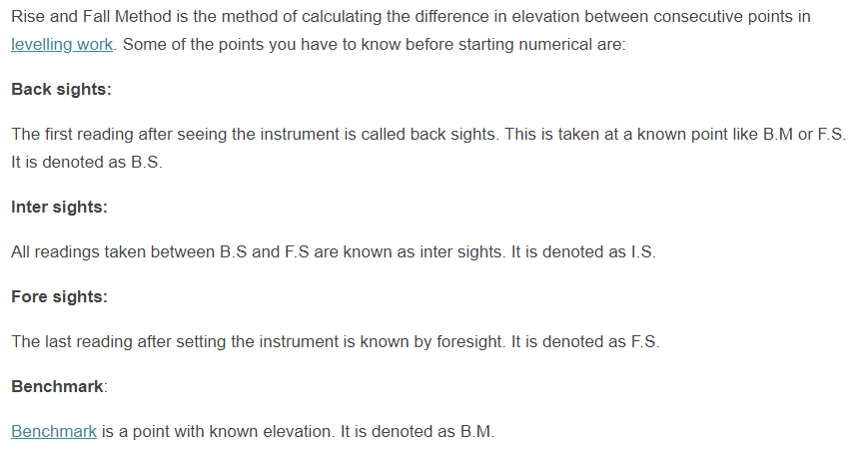
Introduction

Slide 3
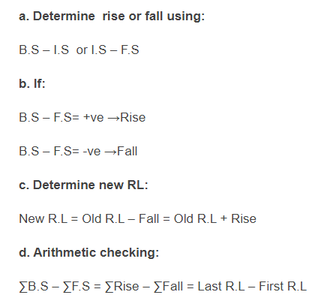
Steps in Numerical calculation

Slide 4
Numerical Problems

Slide 5
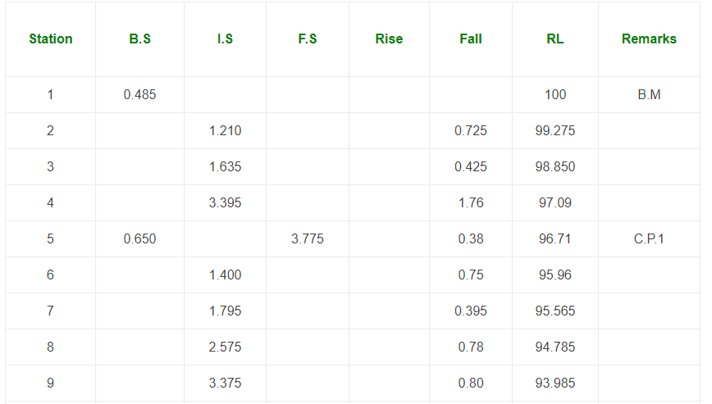

Slide 6
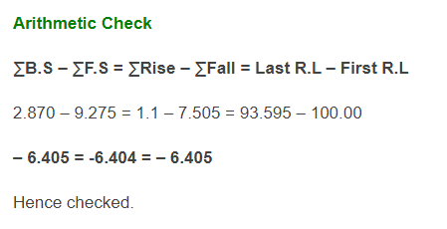
Numerical Problems

Slide 7
Numerical Problems

Slide 8
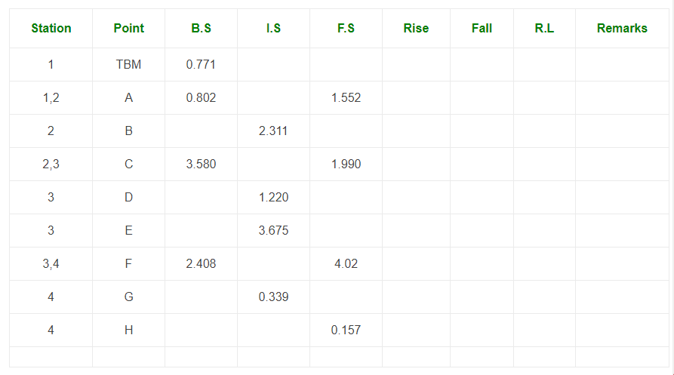
Numerical Problems

Slide 9
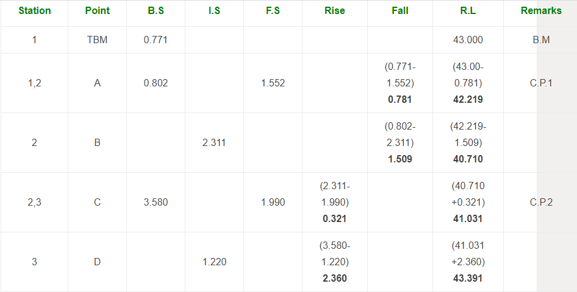
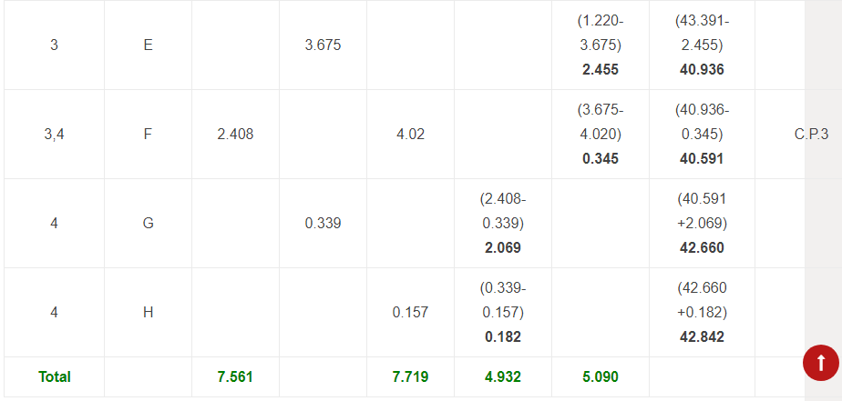

Slide 10
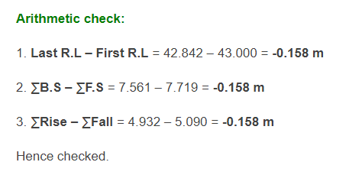
Numerical Problems

Slide 11
Numerical Problems

Slide 12
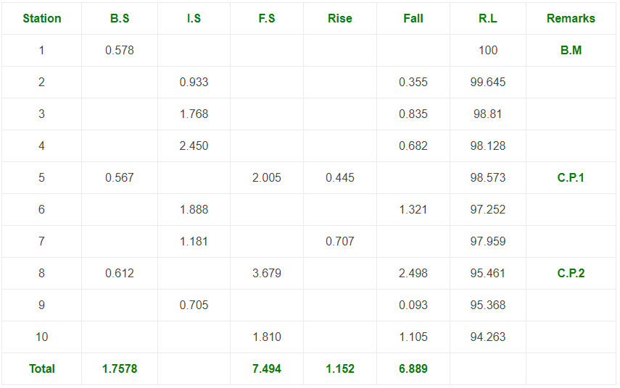
Numerical Problems

Slide 13
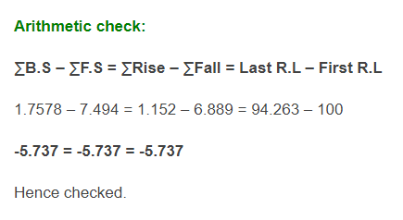
Numerical Problems

Slide 14
Numerical Problems

Slide 15
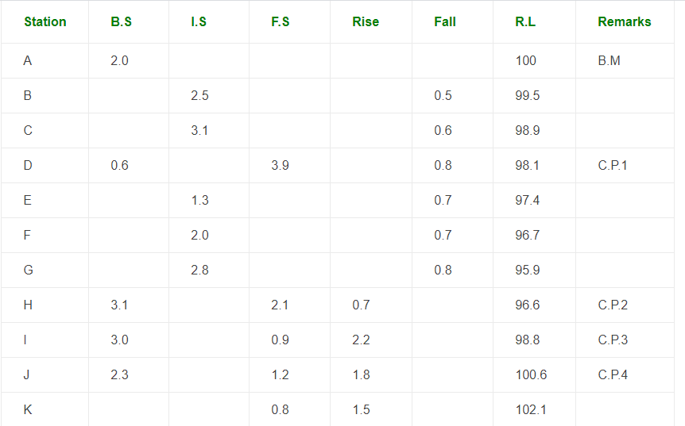

Slide 16
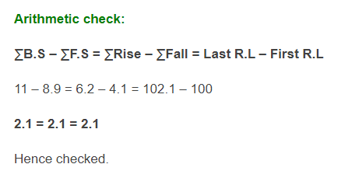
Numerical Problems

Slide 17
Thanks

